Slide 1
Predicting US earnings based on census data data)
Slobodan Radosavljevic, Senior Data Scientist

Slide 2



Agenda
01
The problem and initial data analysis
02
Feature engineering and early modelling
03
Reflections and potential next steps

Slide 3
The problem
"Given information on a range of socio-economic factors about a US individual, can we predict whether or not they earn more than $50,000 per year?"

Slide 4


1
Accuracy
We want to have confidence in our predictions – how good (or bad) are they?
Two key measures of success
2
Explainability
We need to be able to identify the main factors driving the predictions

Slide 5
The data
Available data
Example information in the data
300k records of US census data
200k records to be used for training (and validation)
100k for testing (holdout)
40 pieces of information for each record
7 numerical
33 categorical
Age
Gender
Residence details (duration at address, main householder/child, etc.)
Level of education
Tax information (filing status, capital gains/losses)
Employment status & industry codes
>

Slide 6
Exploratory data analysis
Key initial questions
Answers
1
What sort of class imbalance do we have in our "target variable"?
Only about 6.2% of data is in the "positive" (earnings over $50k) class
2
How much duplication/correlation is there between factors?
Of around 500 exploded (OHE) categorical columns, there is only about 20 columns' worth of information*
3
Can we quickly establish a set of candidate factors?
Comparing per-class feature distributions certainly gives an early indication of what could be promising
4
Within these, are some categories more useful to us than others?
Comparing per-class feature distributions here also implies "yes"
Discussed on next slides
*Based on eigenvalues of Principal Components

Slide 7
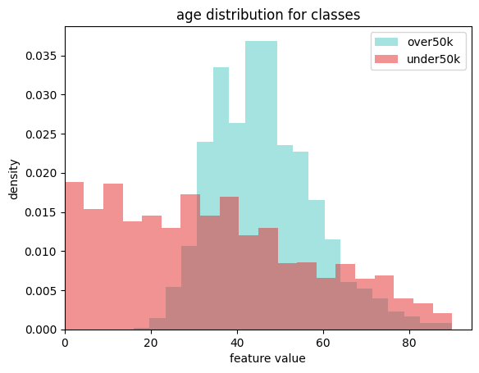
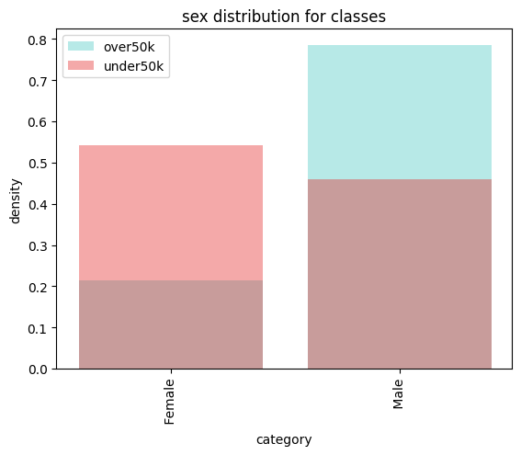
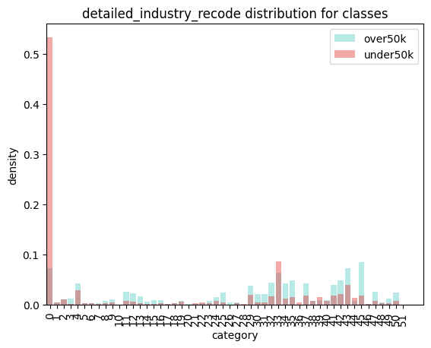
Exploratory data analysis – curated results
0 = agriculture
Age
Minors will always be in the negative class (below $50k)
Much more likely to find positive instances among the working age population
Gender
Female individuals much less likely to be in positive class
Worker industry code
Agricultural workers overwhelmingly in the negative class

Slide 8
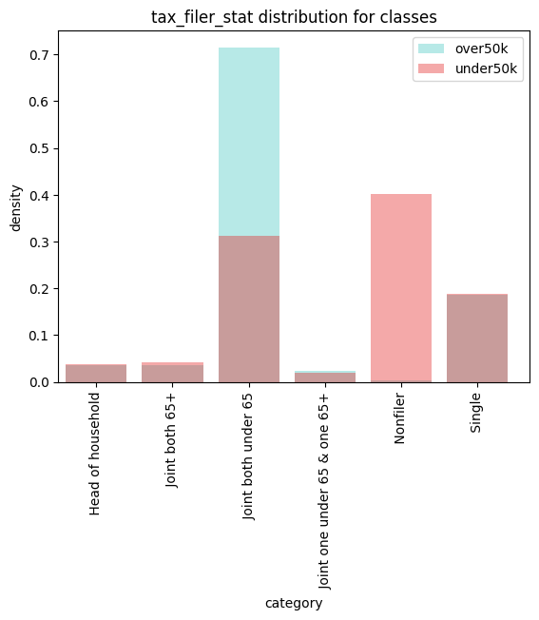
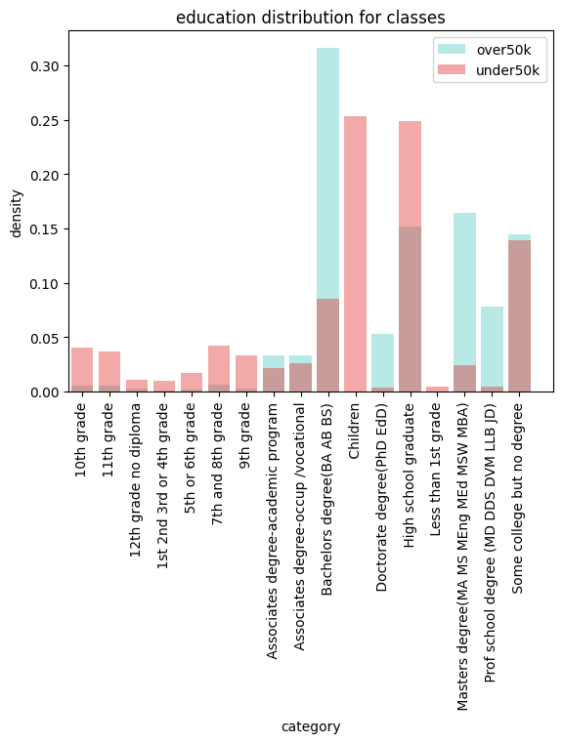
Exploratory data analysis – curated results
Tax filer status
Non-filers almost certainly in the negative class
Joint-both-under-65 disproportionately favours positive class
Education
Those with higher education much more likely to be in positive class

Slide 9


First iteration of feature engineering
Column name | Processing | Intention
class_of_worker | (binary) | Flag workers that were hard to classify
detailed_industry_recode |  | Identify workers in the agriculture industry
education |  | Pick out individuals with (at least) a university degree
enroll_in_edu_inst_last_wk |  | Identify individuals still studying (minors and college students)
marital_stat | (ordinal – ternary) | Marital status can be impacted by earnings – utilise this
major_industry_code |  | Identify minors – possibly (in effect) a duplicate
sex |  | To target the strong class imbalance between male and female
full_or_part_time_employment_stat |  | Showed strong ternary inclination, with armed forces vs full time
tax_filer_stat |  | Split dataset between non-filers, other, and joint-under-65s
detailed_household_summary_in_household |  | Utilise the strong class imbalances in householder status
country_of_birth_mother |  | Flag individuals with maternal Mexican or Puerto Rican heritage
All numerical features were also used for initial training (age, wage_per_hour, capital_gains, capital_losses, dividends_from_stocks, num_persons_worked_for_employer, weeks_worked_in_year)

Slide 10
Modelling approach and results
Approach
Results
Types of model
5 different model (specifically, binary classifier) types were evaluated
All models trained with class weight applied to counteract the class imbalance
Quick basic baselining and HP adjustments
Rough overfitting sanity check – AUC on train vs validation
Metrics
Main metric used was Area-under-Curve (AUC)*
F1 score and precision on the positive class also considered
Chosen with the class imbalance in mind
Model | Logistic Regressor | Random Forest Classifier | Gradient Boosting Classifier | XGBoost Classifier | XGBoost RF
AUC | 0.905 | 0.941 | 0.945 | 0.945 | 0.939
Positive class precision | 0.20 | 0.30 | 0.28 | 0.29 | 0.27
Positive class F1 | 0.33 | 0.45 | 0.42 | 0.43 | 0.41
>
*AUC measures the area under the Receiver Operating Characteristic curve – detail in appendix

Slide 11
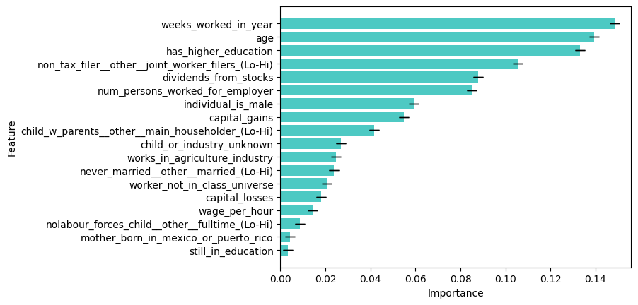
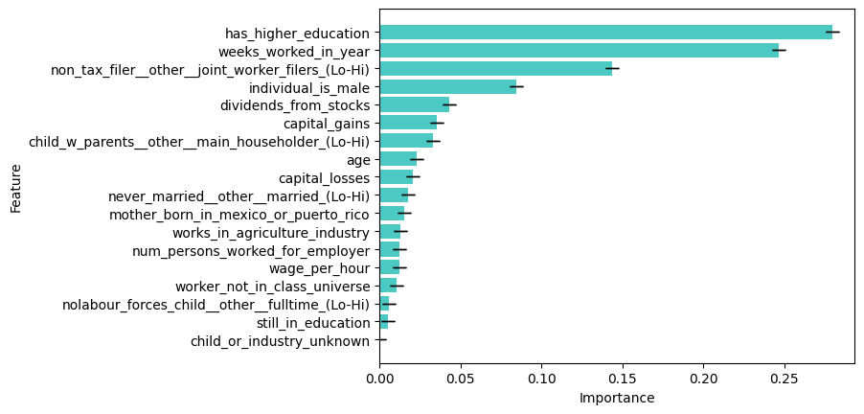
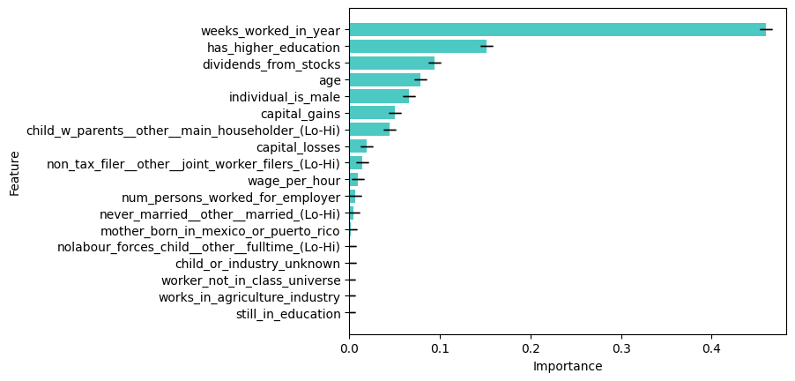
Feature importance (trends)
Random Forest Classifier
XGBoost Classifier
Gradient Boosting Classifier
XGBoost RF

Slide 12
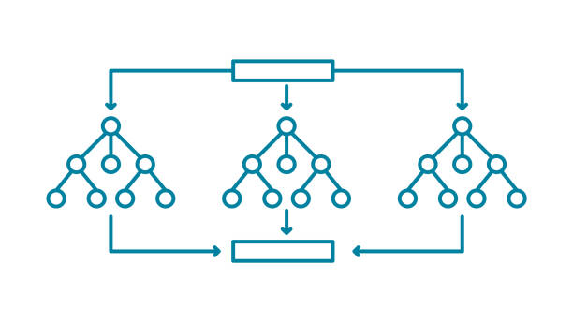
Initial recommendation
Random Forest Classifier
Not the top AUC, but…
Is still competitive by this measure, while being the winner in positive-class specific metrics, where all tested models struggled most
Has the smoothest roll-off for feature importances – more balanced, less over-reliant on any single feature → potentially less prone to error on outliers
Most compatible with additional leading model-analysis tools such as Shap → potentially more headroom to identify model weaknesses and correct them

Slide 13
Potential further
work
01
More careful feature curation – eliminating highly correlated features
02
More attention on numerical features – these have only been used unprocessed, despite some very long-tailed distributions (take a logarithm?)
03
Running sequential feature selection before training
04
More closely inspecting misclassified examples (our positive precision is not great) to get a better sense of what are the biggest drivers – and potentially doing a more targeted round of feature engineering
05
Gridsearch on hyperparameters
Notes:
Results so far can only be considered a PoC – it’s all about how one deals with features from here Another BIG one – pipeline improvements (but hey, that’s what DSS is for!)

Slide 14
Questions?

Slide 15
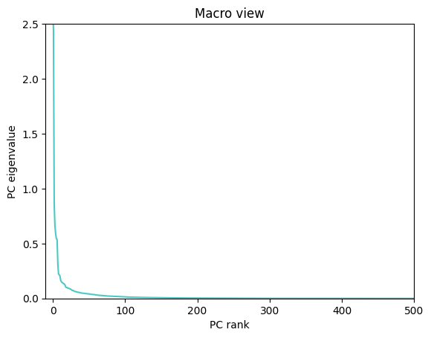
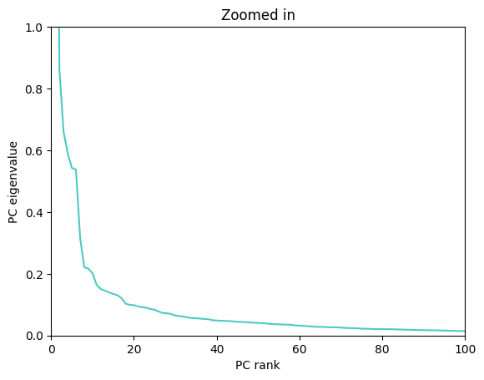
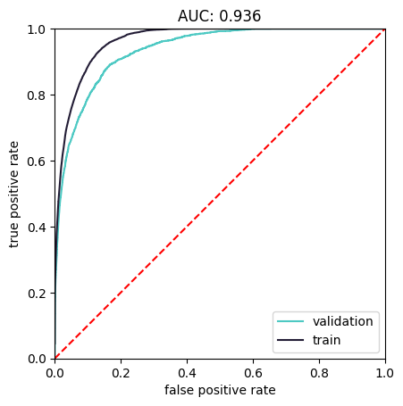
Appendix
PCA/Scree plot
AUC curve

