Slide 1
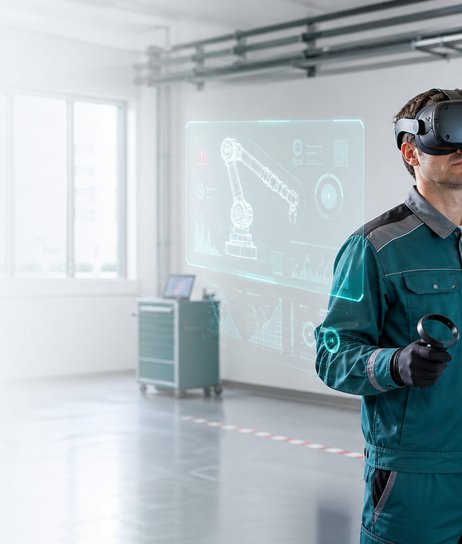
INVESTMENT PRESENTATION
Safety Sim builds measurable VR training
The initial focus is high-risk industrial procedures where practice, records, and certification are business requirements.
Safety Sim
01

Slide 2
Training is moving from attendance to provable readiness
Companies increasingly need training that can be repeated, measured, and documented. VR creates a safe environment for procedures that are costly or risky to practice in real life.
Safe
Repeat
Record
Dangerous situations are practiced without exposing people or equipment.
The same scenario can train many workers, sites, and shifts.
Results and certificates become part of the company record.
Safety Sim
02

Slide 3
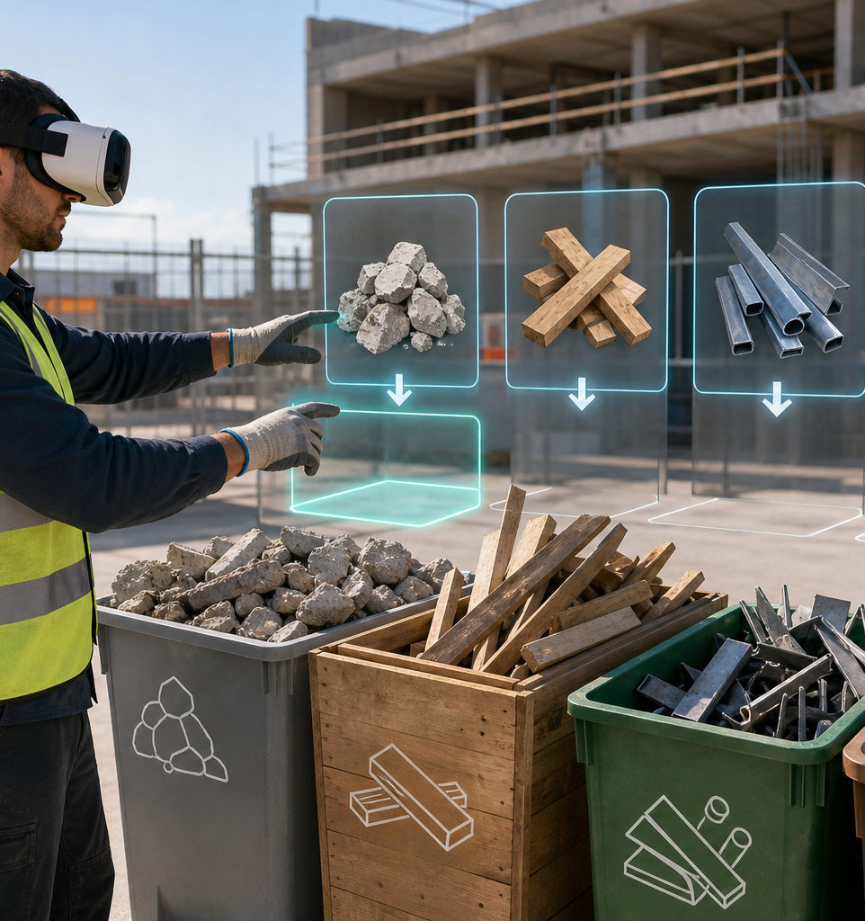
VR training fits where practice is expensive
PwC reports that VR can speed up training, increase focus, and become cost-effective at scale. Recent research also shows applications in industrial hazards and evacuation protocols.
Scenario-based learning
VR supports practice in context, not only memorization of procedures.
Scalable content
Once created, a scenario can be sold per worker, per company, and per vertical.
Industrial wedge
Safety, hazardous materials, and waste handling have a clear need for documented training.
Safety Sim
03

Slide 4
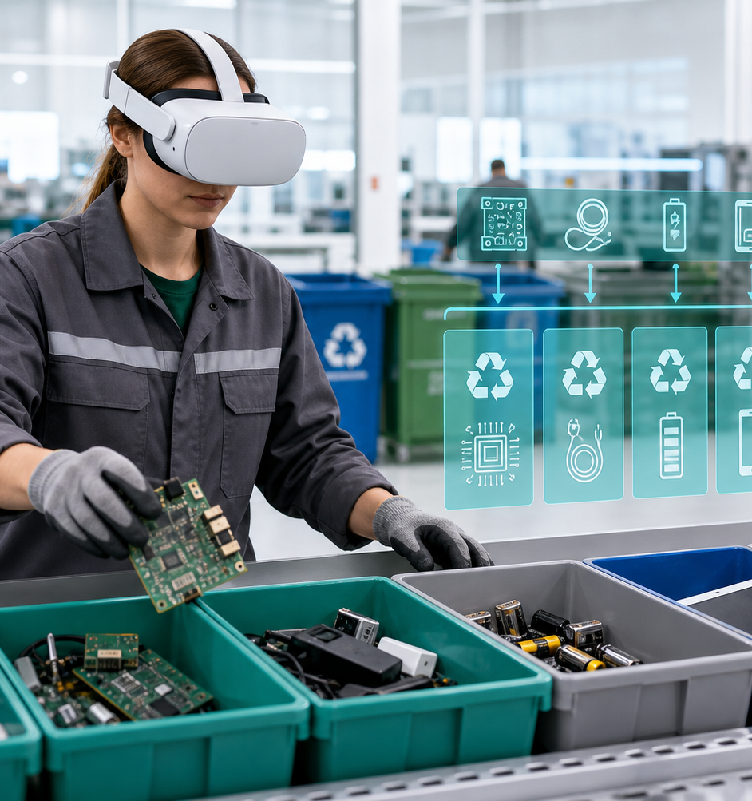
The product is already shaped as a SaaS platform, not a one-off demo
The backend is multi-tenant, users belong to companies, and worker and certificate data stay within each tenant.
Scenario catalog
Six areas are ready for presentation and further modeling.
Tenant logic
Companies, users, workers, enrollments, and certificates are separated by organization.
Deployment path
Frontend and backend run on Hugging Face, with Azure SQL Free tier for the demo database.
Safety Sim
04

Slide 5
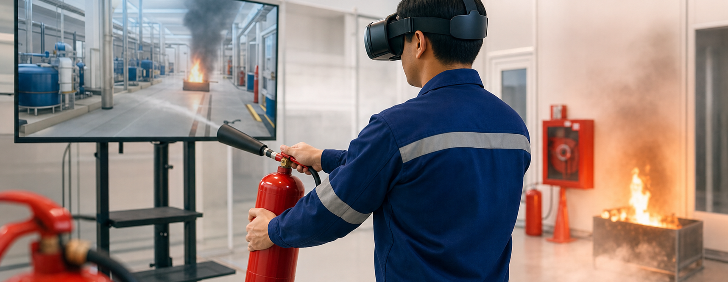

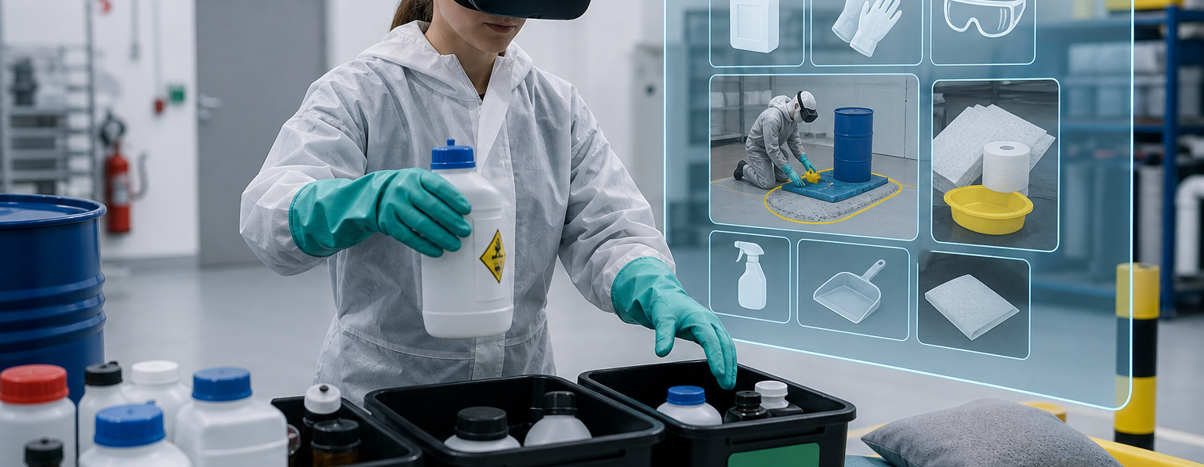
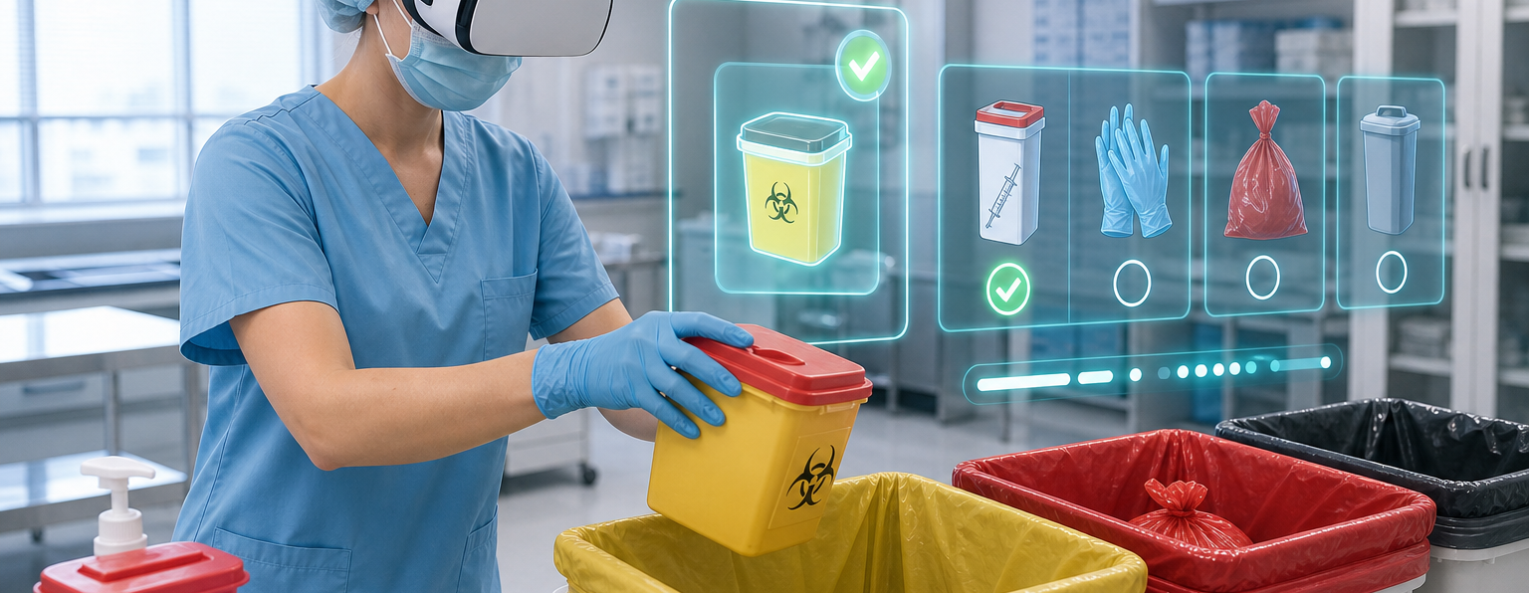
The initial catalog covers high-risk and regulated processes
Fire protection
Radioactive materials
Chemical waste
Construction waste
Electronic waste
Biomedical waste
Safety Sim
05

Slide 6
Pricing is simple enough for a fast buying decision
Small companies
Mid-size companies
Large companies
up to 10 workers
up to 100 workers
100+ workers
up to EUR 10 monthly
up to EUR 100 monthly
EUR 1 x number of workers
up to EUR 100 yearly
up to EUR 1,000 yearly
EUR 10 x number of workers
Base model: EUR 1 per worker per month or EUR 10 per worker per year.
Safety Sim
06

Slide 7
Go-to-market starts with narrow pilots, then expands through the catalog
01
02
03
04
05
Pilot
Proof
Expand
Partner
Platform
One company, one topic, one small worker group.
Completed training, certificates, and instructor feedback.
Add sites, languages, and scenarios.
Sell through HSE consultants and training centers.
Scenario library as recurring revenue.
Safety Sim
07

Slide 8
The roadmap increases value per customer and lowers sales cost
The most important next steps are validation with first customers and stronger product depth around analytics and content.
Short term
Stabilize the Azure SQL production database, onboarding, and basic reports.
Mid term
Add mistake analytics, certificate templates, and new languages.
Long term
AI feedback, LMS/HR integrations, and a scenario marketplace.
Safety Sim
08

Slide 9
The investment story needs capital or partnership to validate the market
1. Complete 2-3 paid pilots in industrial safety.
2. Turn the most requested procedures into repeatable VR modules.
3. Build a sales channel through HSE and training partners.
Goal: repeatable SaaS model
Safety Sim
09

