Slide 1
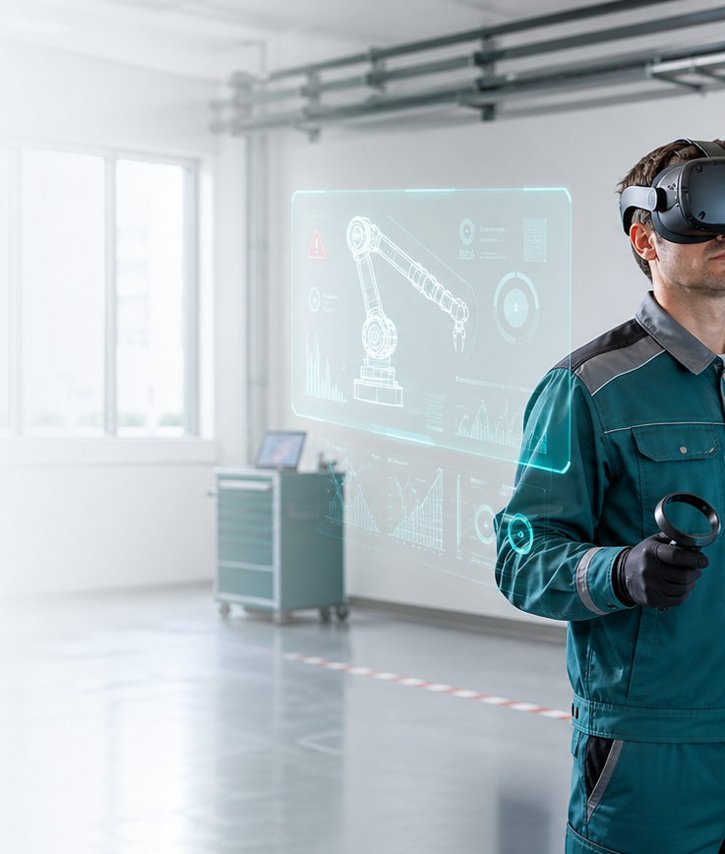
SALES PRESENTATION
VR training for industrial safety
Safety Sim helps companies rehearse risky procedures before a real incident happens.
Safety Sim
01

Slide 2
Traditional training rarely prepares people for the pressure of a real incident
Paper tests and classroom sessions can prove attendance, but not whether a worker can spot the risk, select equipment, and react in the right order.
Risk
Standard
Proof
Dangerous situations cannot be practiced often enough in the real environment.
Different instructors and sites often create an inconsistent learning experience.
The company needs records showing who completed training, results, and certificates.
Safety Sim
02

Slide 3
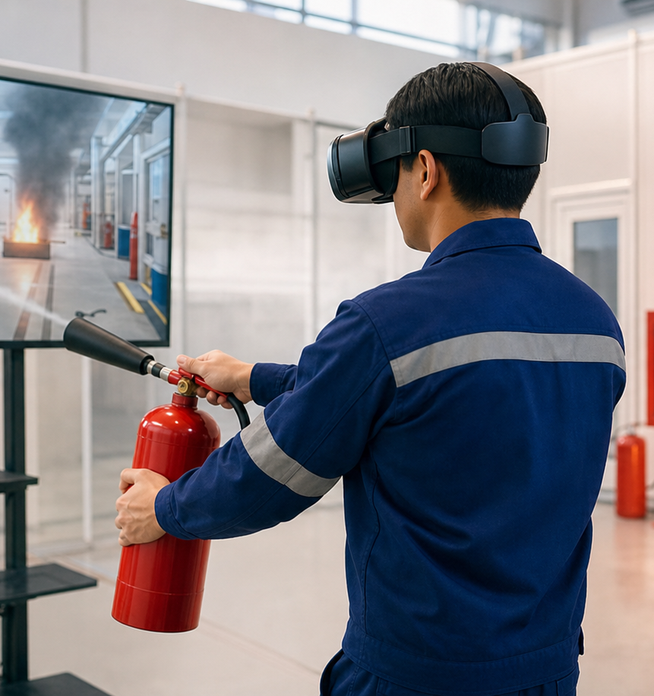
Safety Sim turns training into controlled practice
The platform combines VR scenarios, worker records, and certificates for completed training.
Realistic scenario
Workers make decisions, use equipment, see mistakes, and learn consequences in a safe setting.
Measurable result
The system records score, duration, status, and certificate issuance.
Multilingual rollout
Serbian and English are already supported, with room to add more languages.
Safety Sim
03

Slide 4
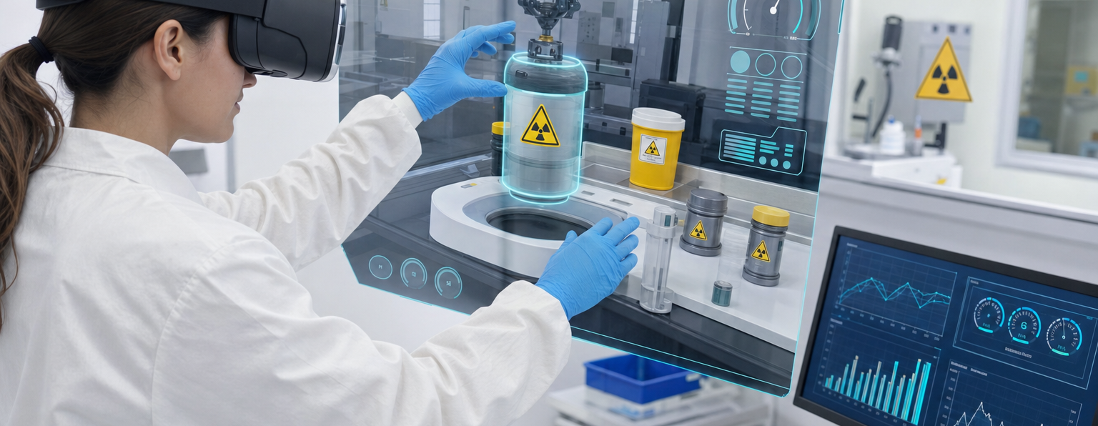
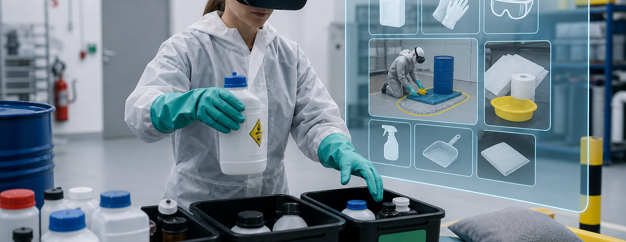
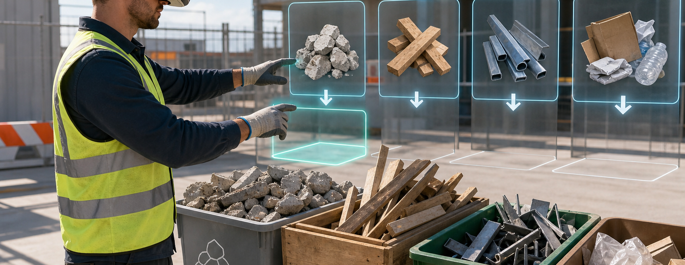
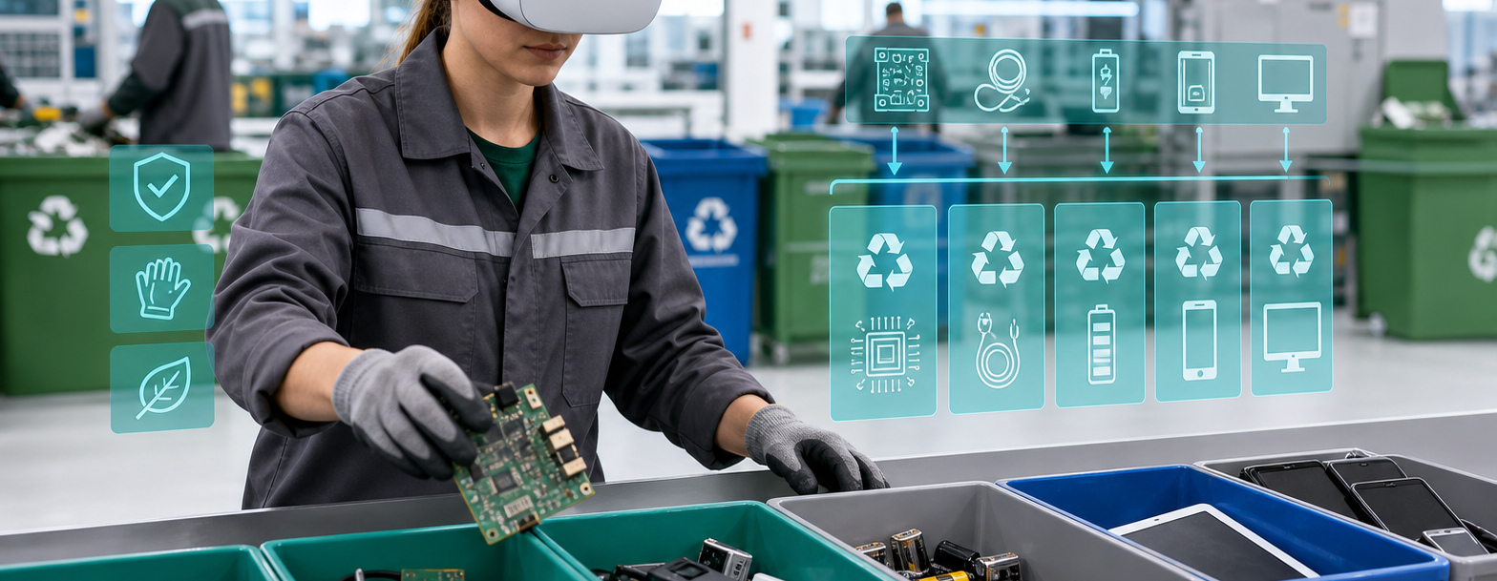
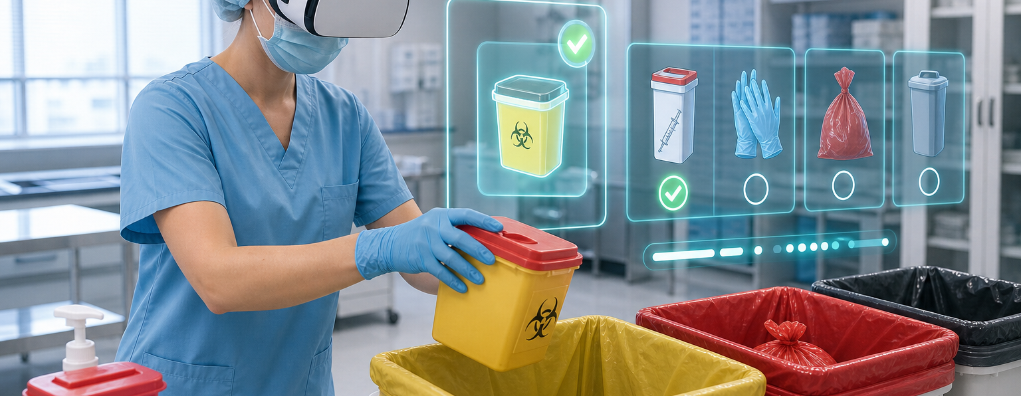
The initial catalog covers high-risk and regulated processes
Fire protection
Radioactive materials
Chemical waste
Construction waste
Electronic waste
Biomedical waste
Safety Sim
04

Slide 5
The workflow supports companies, instructors, and workers
01
02
03
04
05
Company
Workers
Courses
Certificate
Verify
Tenant and company user registration.
Worker and department management.
Scenario assignment and status tracking.
Automatic record of completed courses.
Public certificate number verification.
Safety Sim
05

Slide 6
For buyers, the value is lower risk and better records
Safety Sim is not sold as a game. It is a tool for standardizing safety training.
Safe practice before real risk
Workers can make mistakes in simulation, not in a facility, laboratory, or production area.
One standard across sites
The same scenario, criteria, and instructions can be used for every team.
Management evidence
The company can see workers, enrollments, results, certificates, and expiry dates.
Safety Sim
06

Slide 7
Pricing is simple enough for a fast buying decision
Small companies
Mid-size companies
Large companies
up to 10 workers
up to 100 workers
100+ workers
up to EUR 10 monthly
up to EUR 100 monthly
EUR 1 x number of workers
up to EUR 100 yearly
up to EUR 1,000 yearly
EUR 10 x number of workers
Base model: EUR 1 per worker per month or EUR 10 per worker per year.
Safety Sim
07

Slide 8
A pilot can start with one scenario and one worker group
The fastest sales path is a concrete demo for a training area the buyer already needs to cover.
Choose the scenario
Fire protection, radioactive materials, or one of the waste handling scenarios.
Add workers
A small pilot group makes it easy to test the workflow and reporting.
Evaluate after the pilot
Success is measured through completed training, certificates, and instructor feedback.
Safety Sim
08

Slide 9
The next conversation should choose the pilot scenario
1. Select the training area and number of workers.
2. Agree on the company account and participant list.
3. Show the demo and confirm the commercial package.
Contact: office@nswebdevelopment.com
Safety Sim
09

