Slide 1
Asian garment shop
By Sara Qureshi

Slide 2
Why did I choose the shopkeeping brief?
Having own shop could choose something visually appealing such as dresses and have fun with it
Can make very visually appealing

Slide 3
Planning

Slide 4
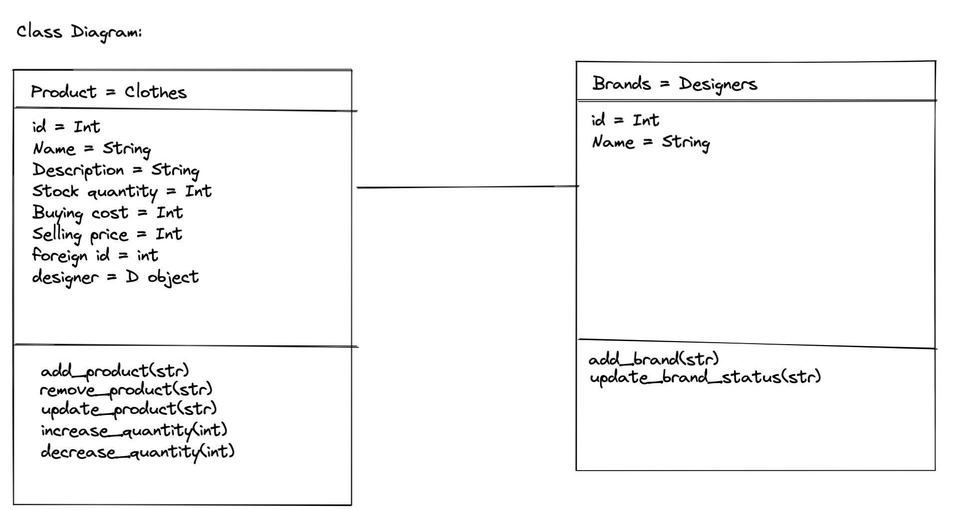
Class Diagram

Slide 5
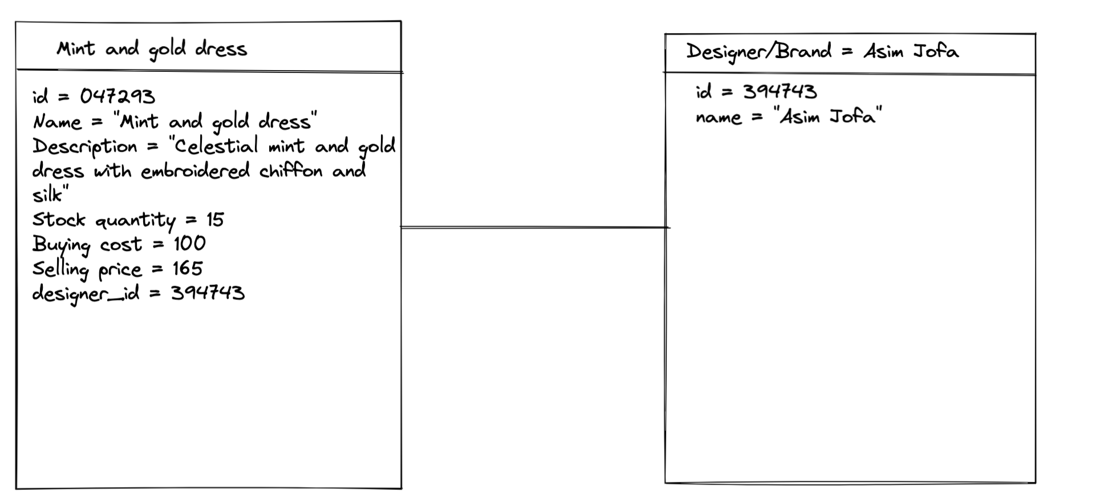
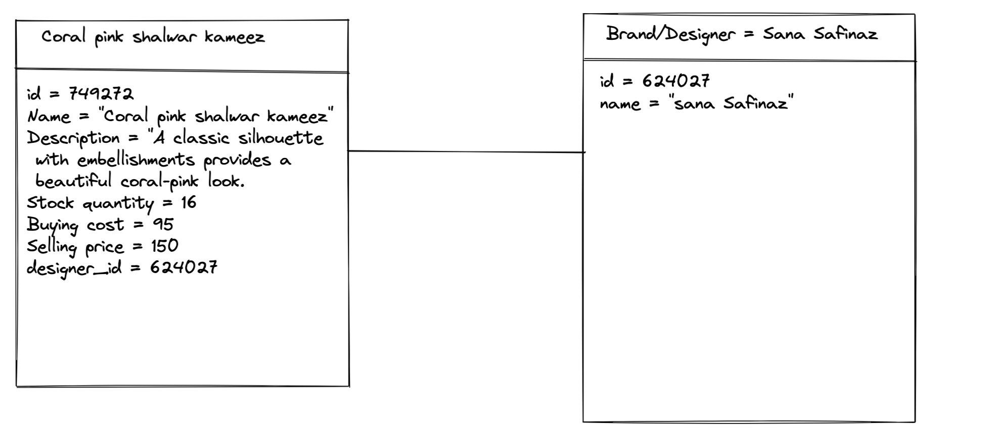
Object diagrams

Slide 6
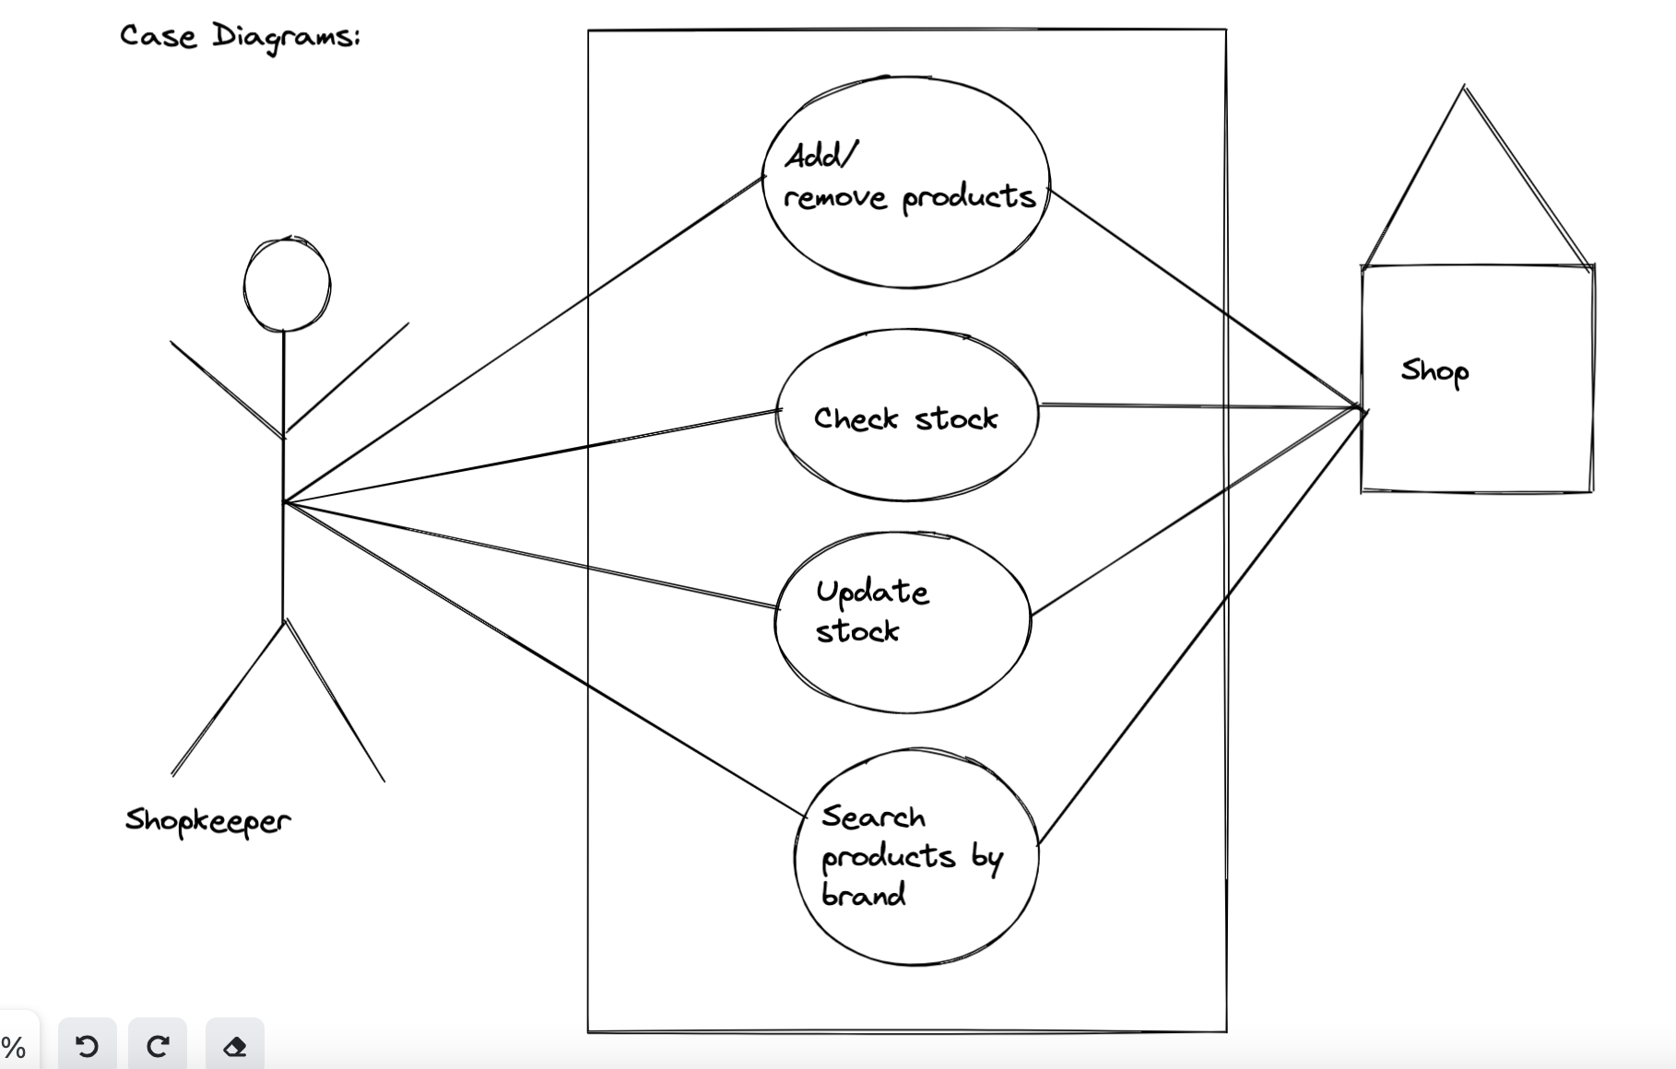
Case diagram

Slide 7
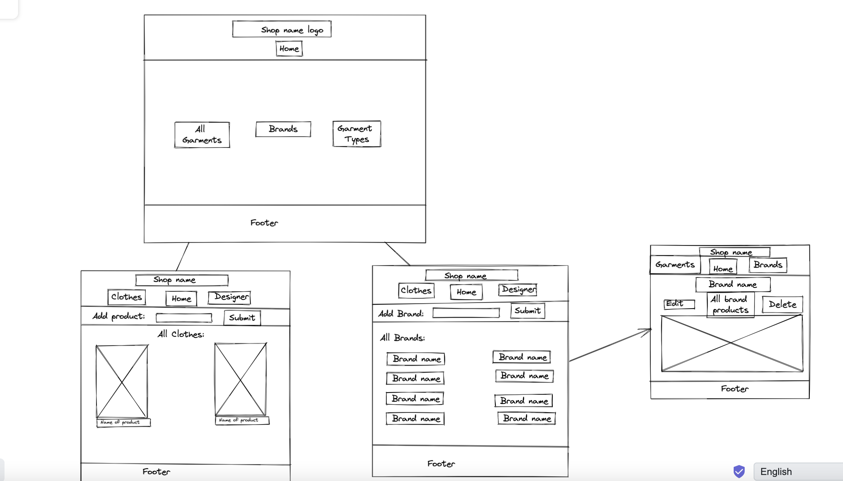
Wireframe

Slide 8
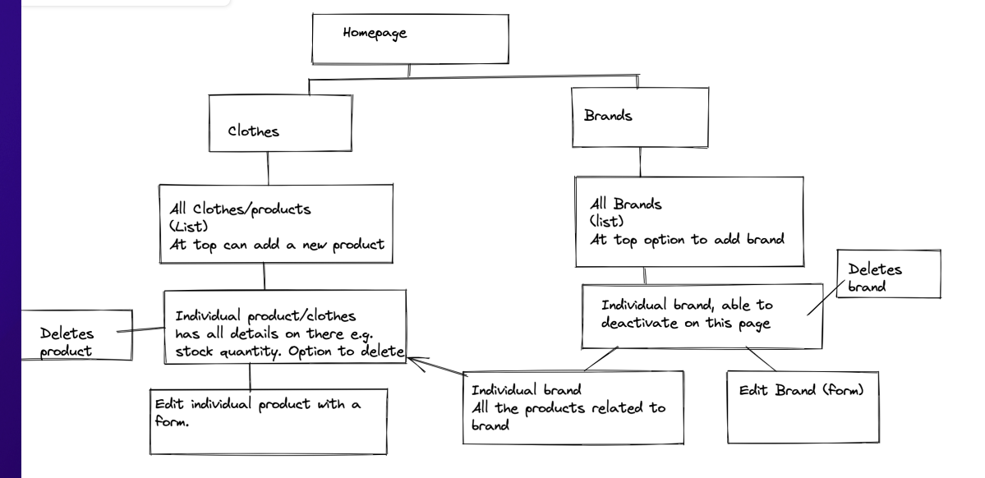
Rough starting sitemap

Slide 9
Code proud of:

Slide 10
Main learning points:

