Slide 1
EXPLAINABLE AI · CHRONIC DISEASE PROGRESSION
Cognitive Decline Prediction
An Explainable AI Platform for Prediction, Simulation, and Clinical Decision Support
Presented by : Sredha Gopan
Innovation Labs
July 2026

Slide 2
MOTIVATION
02
The Problem
● Chronic-disease patients show highly variable cognitive progression across patients.
● Early identification of high-risk patients is difficult.
● Prediction alone is insufficient. Clinicians need patient-specific explanations.
● Gap this project addresses:
– Predict the next-visit cognitive score
– Explain *why* - per patient, not just globally
– Enable interactive exploration through an AI assistant
WHY IT'S HARD
● Longitudinal healthcare data with irregular visit intervals.
● Multiple interacting clinical, demographic, and lifestyle factors.
● Healthcare requires explainable models rather than black-box predictions.
● Explanations must avoid clinical overreach.
Cognitive Decline Prediction — Explainable AI Pipeline

Slide 3
APPROACH
03
System Architecture
Raw Longitudinal
Data
500 patients × 6 visits
XGBoost
Prediction
Next-visit cognitive score
SHAP
Explainability
Global + per-patient drivers
Phenotype
Clustering
Domain-based patient groups
Grounded LLM
Chatbot
Context-injected, local LLM
OFFLINE (run once)
LIVE (interactive)
● xgboost_and_shap.py — train model + compute SHAP
● generate_shap_phenotype.py — cluster patients, build knowledge base
● llm_chatbot.py — patient Q&A + what-if simulation, grounded on the outputs above
Cognitive Decline Prediction — Explainable AI Pipeline

Slide 4
DATA
04
Dataset
500
6
78
2,500
Patients
Visits / Patient
Model Features
Modeled Rows
after next-visit target shift
DISEASE COHORTS (test set, N=526 visits)
FEATURE ENGINEERING
Disease | N | MAE
Alzheimer's | 224 | 4.51
Diabetes | 193 | 4.22
Parkinson's | 109 | 4.00
● Time features: visit gap, log-gap, days since first visit, visit index
● 8 key biomarkers: previous value, delta, 3-visit rolling mean, baseline deviation
● Target: CognitiveScore shifted forward one visit
● Split: GroupShuffleSplit — no patient appears in both train & test
Cognitive Decline Prediction — Explainable AI Pipeline

Slide 5
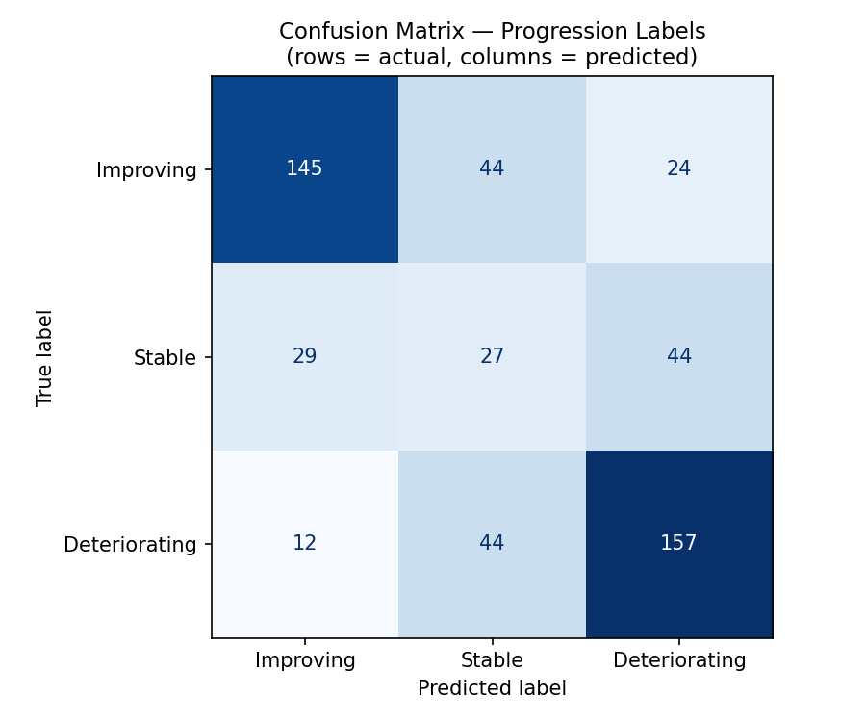
RESULTS
05
Model Performance
4.29
6.48
+2.19
0.147
62.5%
Model MAE
Naive Baseline MAE
Improvement
R²
Label Agreement
ERROR CALCULATION
Metric | Value
MAE | 4.472 ± 0.189
RMSE | 5.429 ± 0.195
SUBGROUP MAE BY OUTCOME LABEL
Actual Label | N | MAE | Agreement
Deteriorating | 213 | 4.21 | 73.7%
Improving | 213 | 4.35 | 68.1%
Stable | 100 | 4.37 | 27.0%
Cognitive Decline Prediction — Explainable AI Pipeline

Slide 6
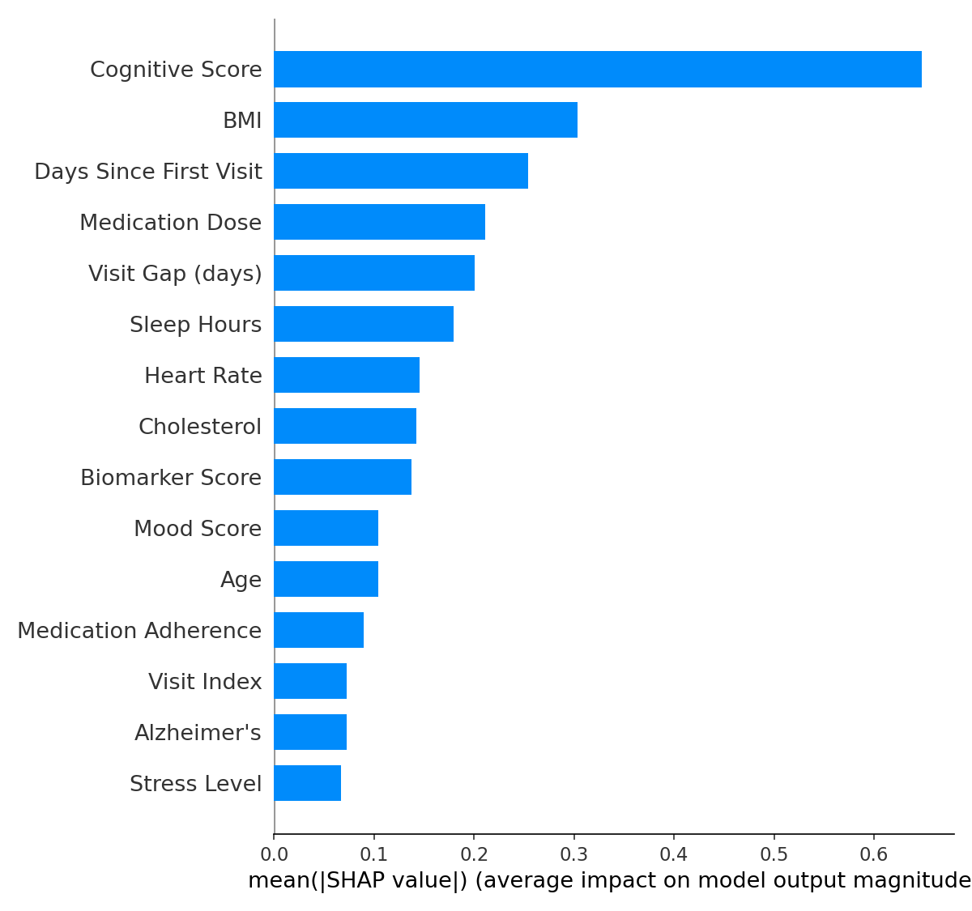
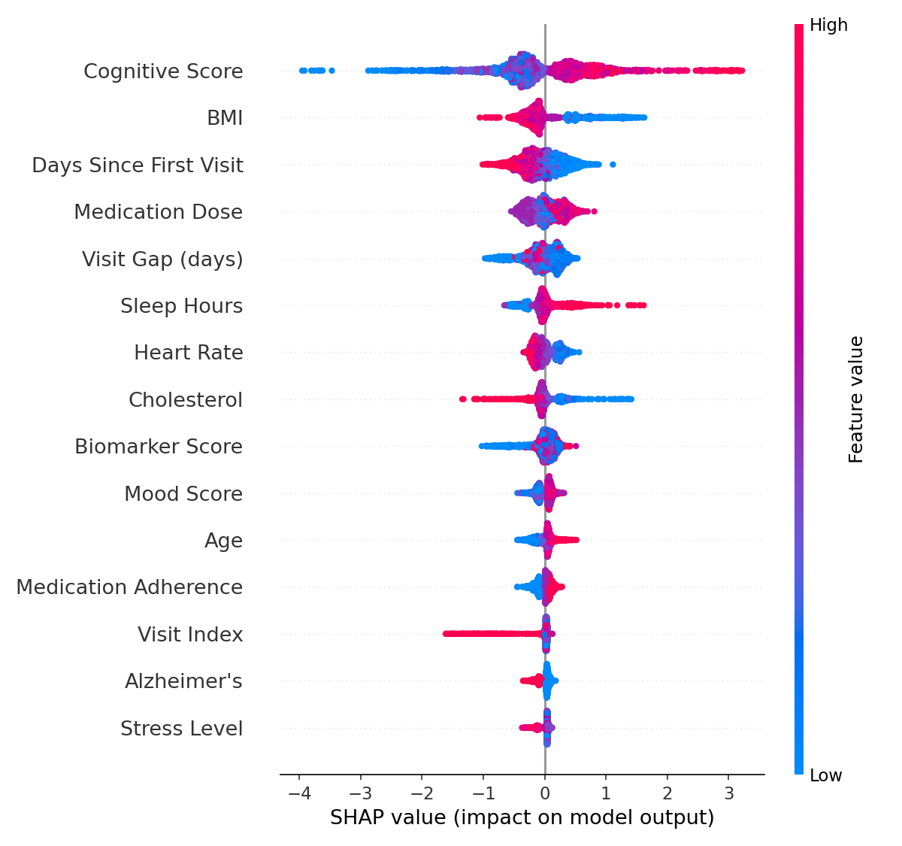
EXPLAINABILITY
06
SHAP — What Drives Each Prediction
TOP DRIVERS
● Cognitive Score
● BMI
● Days since first visit
● Medication Dose
Every prediction is accompanied by patient-specific explanations rather than just a risk score.
Cognitive Decline Prediction — Explainable AI Pipeline

Slide 7
SEGMENTATION
07
Patient Phenotyping
Patients are clustered by which clinical domain dominates their SHAP profile — not by raw biomarkers.
Phenotype | N | % of Cohort | Improving | Stable | Deteriorating
Cardiometabolic / BMI Dominant | 261 | 52.2% | 42.1% | 24.1% | 33.7%
Cardiometabolic / Cholesterol Dominant | 103 | 20.6% | 42.7% | 18.4% | 38.8%
Cardiometabolic / Heart Rate Dominant | 70 | 14.0% | 37.1% | 17.1% | 45.7%
Treatment / Medication Dose Dominant | 66 | 13.2% | 36.4% | 16.7% | 47.0%
HOW GROUPS ARE FORMED
● Per visit: sum absolute SHAP importance by domain (Lifestyle, Cardiometabolic, Treatment, Disease, Demographic) → dominant domain + strongest feature
● Deduplicate to one phenotype per patient via the modal label across visits
● Small phenotypes (< 20 patients) merged into the closest large group by cosine similarity of domain-SHAP vectors
Cognitive Decline Prediction — Explainable AI Pipeline

Slide 8
INTERACTIVE SYSTEM
08
The Chatbot — Grounded LLM
Patient Context
Assembly
prompt_builder.py
Structured
Injection
SHAP factors + peer stats
+ phenotype lookup
System
Prompt
One large, fully-
grounded prompt
Local LLM
Ollama / Llama3.1
Grounded
Response
Constrained to
injected context
WHAT'S IN THE PROMPT
WHY THIS STILL PREVENTS HALLUCINATION
● Predicted score + top-5 SHAP factors
● Peer comparison stats within phenotype group
● Full clinical profile for the patient's last visit
● Actionable vs. non-actionable factor rules
● Model has no unmet need to invent facts — everything relevant is already in context
● System-prompt rules forbid inventing peer patients or raw SHAP numbers
Cognitive Decline Prediction — Explainable AI Pipeline

Slide 9
INTERACTIVE SYSTEM
09
What-If Simulation Engine
● Detect natural language scenario
● Parse feature modifications
● Update patient profile
● Re-run XGBoost prediction
● Compare before vs after results
● Explain changes with SHAP
EXAMPLE EXCHANGE
"What if cholesterol dropped to 180?"
● Predicted score: 21.4 → 23.1 (+1.7)
● Label: Deteriorating → Stable
● Top SHAP shift: Cholesterol contribution drops from a top-3 risk factor to neutral
Cognitive Decline Prediction — Explainable AI Pipeline

Slide 10
INTERACTIVE SYSTEM
10
Chatbot Capabilities
"Why did the model predict this score?"
"What are the biggest risk factors for this patient?"
"How does this patient compare to similar patients?"
"What if cholesterol dropped to 180?"
"What's the single best change this patient could make?"
"What is SHAP and why does it matter here?"
"Give me a patient summary."
The chatbot distinguishes actionable factors (lifestyle, medication, cardiometabolic) from non-actionable ones (age, disease diagnosis, cognitive history) and never recommends changing the latter.
Cognitive Decline Prediction — Explainable AI Pipeline

Slide 11
UNDER THE HOOD
11
Technology Stack
Backend & ML
Frontend
AI / LLM Layer
Data & Artifacts
● Python 3 + Flask — REST API, SSE streaming
● XGBoost — regression model
● SHAP — model explainability
● pandas, NumPy, scikit-learn, SciPy
● matplotlib — offline report visualisations
● React 19 + TypeScript
● Vite — build tooling
● Tailwind CSS 4 — styling
● Recharts — trajectory, SHAP, radar charts
● Framer Motion · React Router · React Markdown
● Ollama — local LLM runtime
● Llama 3.1 (8B, default) / 3.2 (3B) — served via Ollama
● Structured context injection (prompt_builder.py)
● Retry with linear backoff (llm_backend.py)
● Flat-file pipeline — CSV, Pickle, JSON
● No external database — reproducible offline outputs
● xgb_model.ubj — cached model for live simulation
Single-process deployment: Flask serves both the REST/SSE API and the built React app (frontend/dist/).
Cognitive Decline Prediction — Explainable AI Pipeline

Slide 12
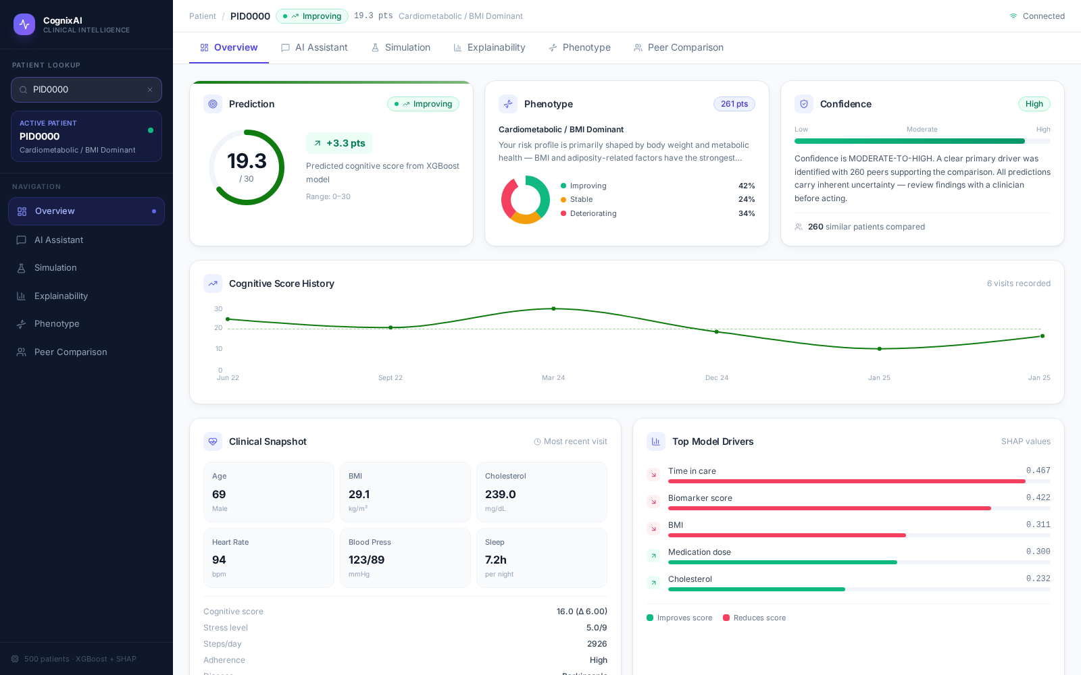
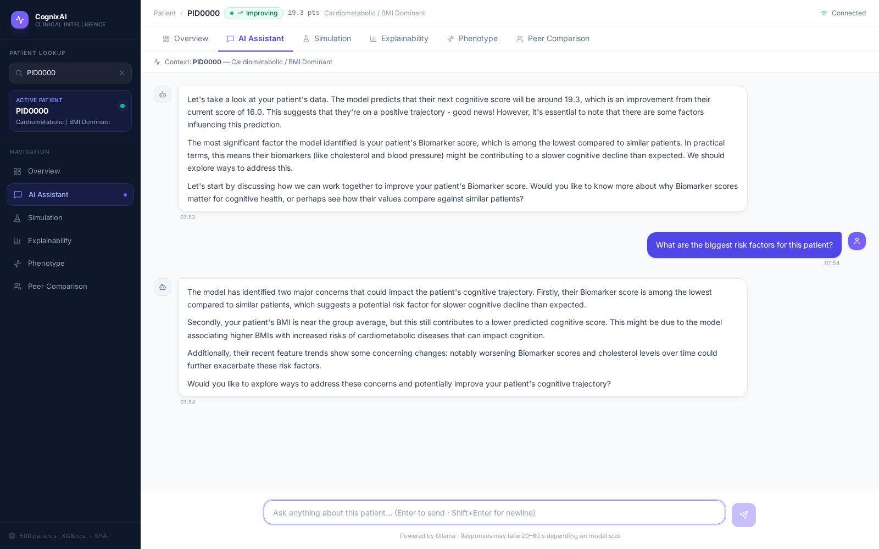
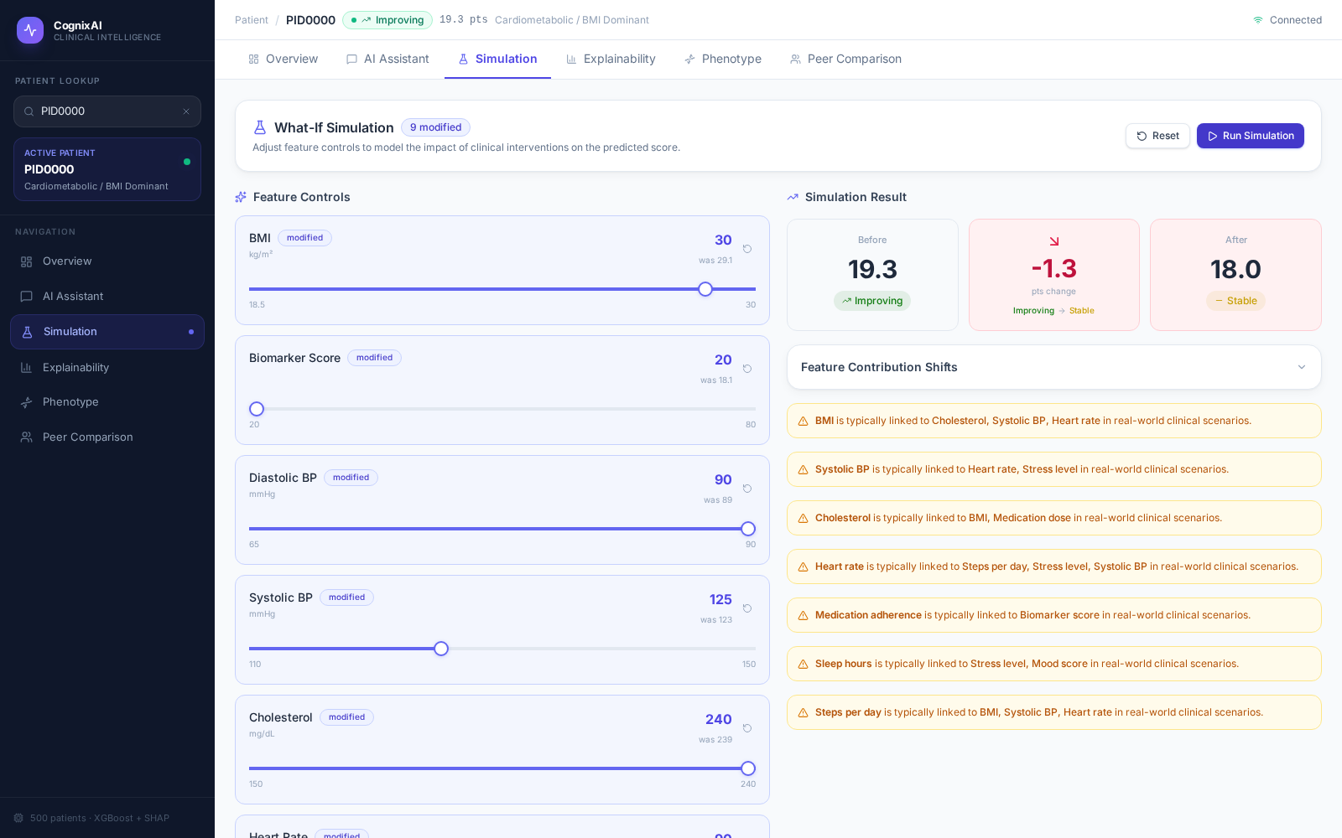
LIVE PRODUCT
12
Demonstration — Patient Workspace
CognixAI — live screenshots from the deployed clinical dashboard, patient PID0000
Overview
AI Assistant
What-If Simulation
At-a-glance patient snapshot — prediction, phenotype, confidence, and top SHAP drivers.
Evidence-grounded conversation — the model explains its own prediction in plain language.
Adjust clinical features and see the predicted score update, with feature contribution shifts.
Cognitive Decline Prediction — Explainable AI Pipeline

Slide 13
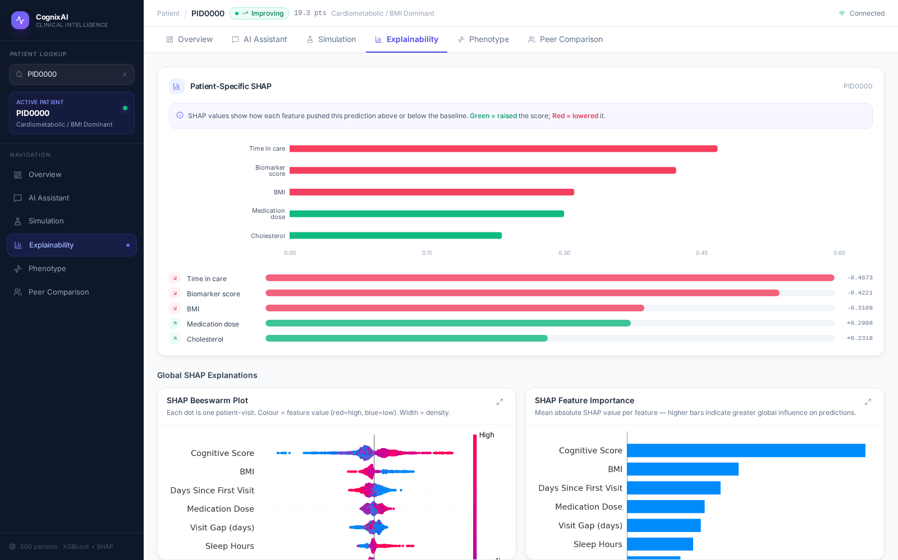
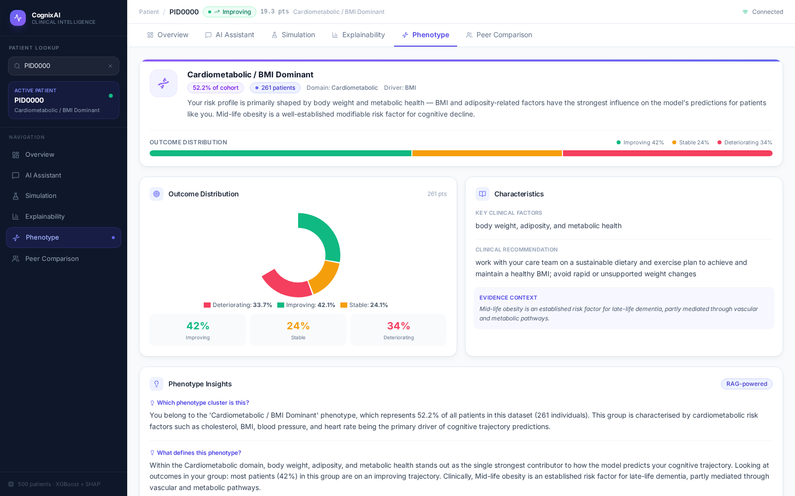
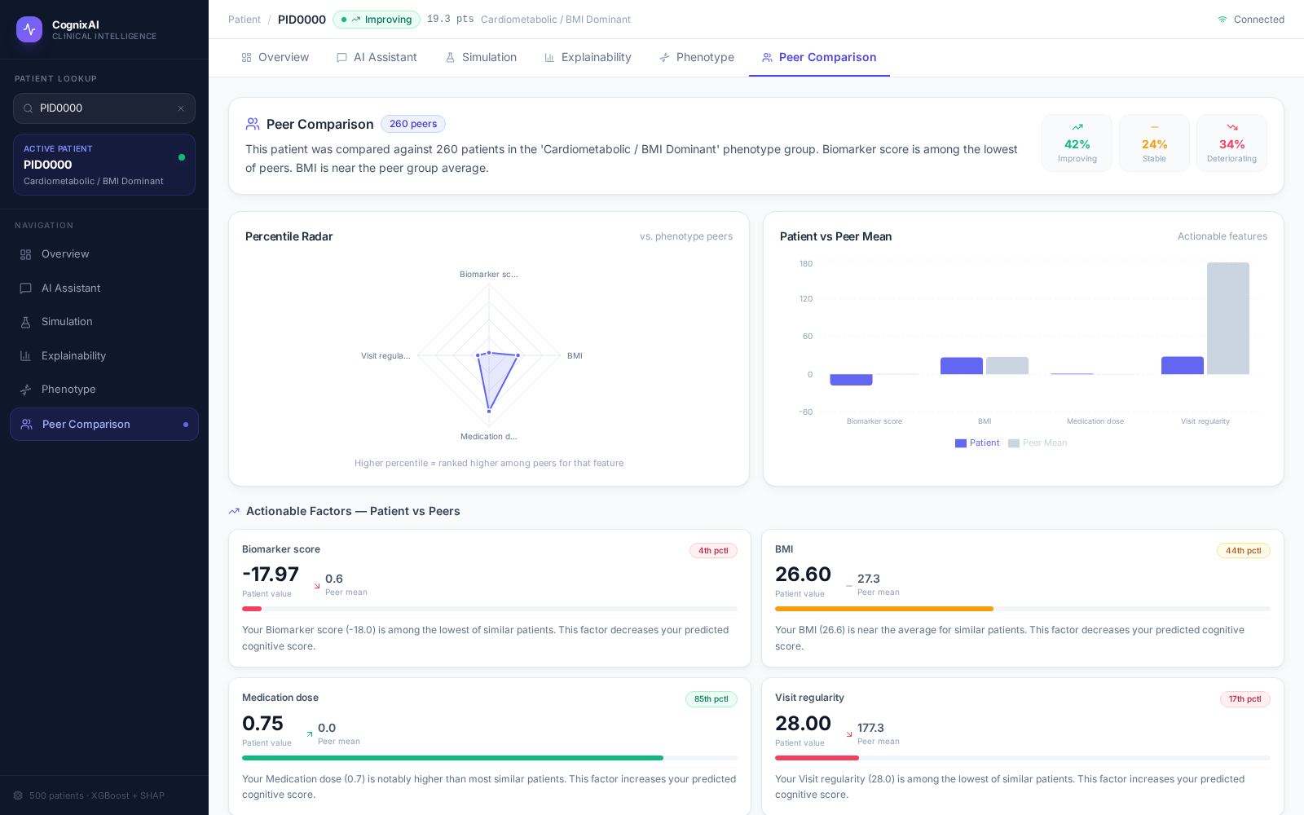
LIVE PRODUCT
13
Demonstration — Analysis & Insights
CognixAI — live screenshots from the deployed clinical dashboard, patient PID0000
SHAP Explainability
Phenotype
Peer Comparison
Per-patient and global SHAP plots reveal exactly what drives each prediction.
Cluster-level outcome rates and clinical characteristics for this patient's phenotype.
Percentile ranking against phenotype peers on actionable clinical features.
Cognitive Decline Prediction — Explainable AI Pipeline

Slide 14
HONEST ASSESSMENT
14
Limitations
● Synthetic dataset used instead of real clinical data.
● Predicts only a single outcome (future cognitive score).
● Simulations represent hypothetical model predictions, not causal clinical effects.
● SHAP explains model behavior, not cause-and-effect relationships.
● Local LLM has limited reasoning compared to larger cloud-based models.
● Intended as a clinical decision-support tool, not a replacement for clinicians.
Cognitive Decline Prediction — Explainable AI Pipeline

Slide 15
ROADMAP
15
Future Work
Data & Validation
Model Improvements
AI Assistant
Clinical Deployment
● Validate against real-world clinical datasets (IRB / privacy review)
● Evaluate performance through clinical studies and expert feedback
● Predict multiple clinical outcomes, not just cognitive score
● Incorporate multimodal data — imaging, genomics, wearables
● Expand SHAP phenotype domains beyond today's 5 categories
● Ground responses in medical guidelines via embeddings + similarity search
● Improve reasoning with more capable LLMs while keeping evidence grounding
● Chain multiple what-if simulations into multi-step care plans
● Integrate with Electronic Health Record (EHR) systems
● Clinician-facing decision support platform for routine use
● PHI/HIPAA-compliant hosting, access control, audit logging
LONG-TERM VISION
An explainable, AI-powered clinical decision support system that assists healthcare professionals in personalized patient monitoring and intervention planning.
Cognitive Decline Prediction — Explainable AI Pipeline

Slide 16
REFERENCE
16
Codebase Architecture
File | Role
pipeline.py | Data preprocessing: load, clean, engineer features, encode, split
xgboost_and_shap.py | Trains XGBoost, computes SHAP, evaluates, generates plots
generate_shap_phenotype.py | Clusters patients into phenotypes, builds knowledge base
reasoning.py | Peer comparison statistics + clinical language generation
prompt_builder.py | Assembles patient context, builds the LLM system prompt
simulation_engine.py | What-if scenario engine (re-runs model on edited features)
llm_backend.py | Ollama LLM provider with retry/backoff
llm_chatbot.py | Interactive entry point — the chatbot itself
Cognitive Decline Prediction — Explainable AI Pipeline

Slide 17
Thank You
Questions?
Cognitive Decline Prediction — Explainable AI Pipeline

