Slide 1

MeshAgent
Governed control plane for connected coding agents
Developer evidence
Analyst operations
CISO decisions
Live client demonstration · Real Cursor and GitHub workflow
alan.morgan@transformativeaiholding.com
Client demo · 01

Slide 2






The control gap appears between the coding agent and the security decision
Fast agent work is not the problem. Missing ownership, evidence, and decision continuity is.
Without a control plane
With MeshAgent
Cursor changes code
Prompts, tools, files, and package commands scatter across local history.
Observed once
Opted-in event stream with replay-safe ordering
Package risk appears late
A dependency can reach review without a reliable pre-install decision trail.
Decided with context
Exact policy, advisory, code, owner, and expiry
Security work fragments
Ownership, exceptions, remediation, and proof move into separate tools.
Proven end to end
Native evidence and immutable lifecycle history
MeshAgent governs the handoffs; it does not replace the developer's editor.
02

Slide 3



One governed journey across Developer, Analyst, and CISO
Every role sees the same underlying evidence at the level required for its decision.
Developer
Analyst
CISO
1. Works in Cursor
2. Receives package decision
3. Requests Security review
4. Triages one queue
5. Assigns and collaborates
6. Escalates case or exception
7. Reviews exact policy record
8. Decides independently
9. Verifies remediation proof
Outcome: one traceable chain from agent action to resolved control decision
Server-enforced role, owner, version, and separation-of-duties checks remain authoritative.
03

Slide 4






Customer-operated architecture with HyperMesh as evidence authority
Durable ledgers preserve workflow order; transactional outboxes project verified relationships into native HyperMesh stores.
DEVELOPER ENVIRONMENT
ROLE WORKSPACES
GitHub clone
remote · branch · commit
FastAPI control plane
Developer sessions
Analyst operations
CISO governance
Recorder + gate
ordered replay · package decision
Cursor / Claude
prompts · files · tools
Identity · capabilities · workflow · reconciliation
Durable relational ledgers
Sessions · cases · policy versions · approvals · remediation events
Native HyperMesh evidence
Code · packages · advisories · review episodes · policy versions · exception decisions · verification
Transactional outboxes
Boundary: single-tenant v1 · customer network · durable state · one writer per state directory
04

Slide 5
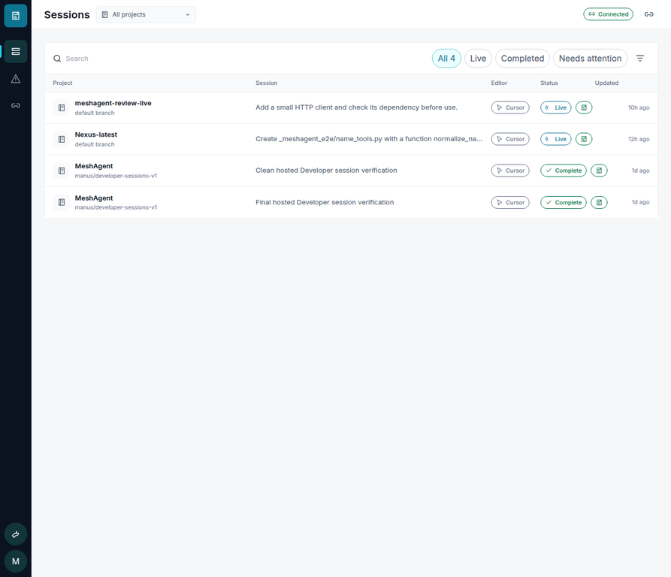




Developer stays in Cursor; MeshAgent provides attention and proof
The product is intentionally visual and non-IDE: sessions, security attention, and connection health.
What the developer gets
Real repository context
Git remote, branch, commit, editor, and session
Actionable security
Exact package, advisory, released fix, and linked code
One review request
Evidence freezes before Security receives it
Automatic verification
A later clean package check can verify requested change
Cursor remains the coding environment
Current production UI · live EngineGateway state · local demo identity visibly labelled
05

Slide 6
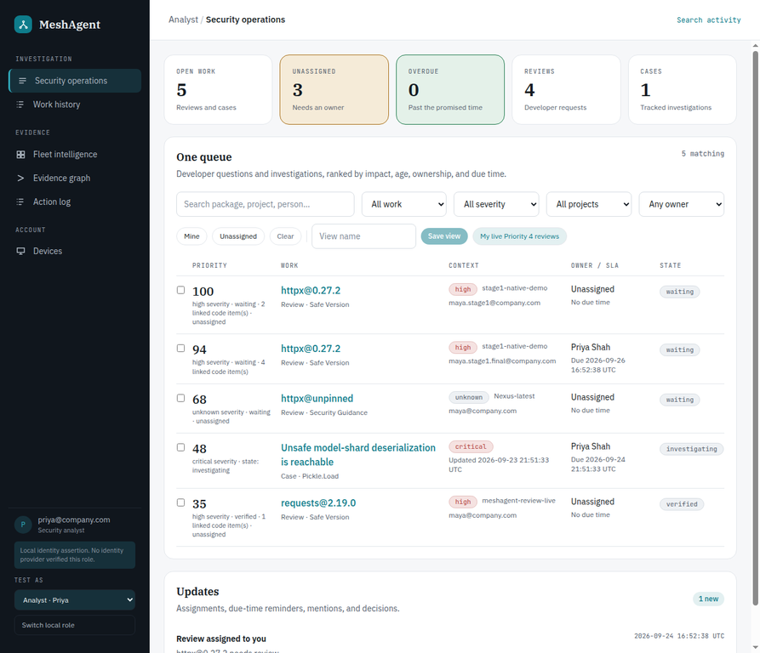




Analyst receives one queue with evidence and accountable work
Developer reviews and security cases are ranked together by impact, age, owner, and due time.
Security operations
Unified triage
Reviews + cases
Ownership + SLA
Bulk assignment and overdue state
Collaboration
Notes · mentions · history
Governed escalation
Case and exception handoff
Saved personal views and notification read state remain isolated by identity.
Operations endpoints are capability-protected; Developer access is denied server-side.
06

Slide 7
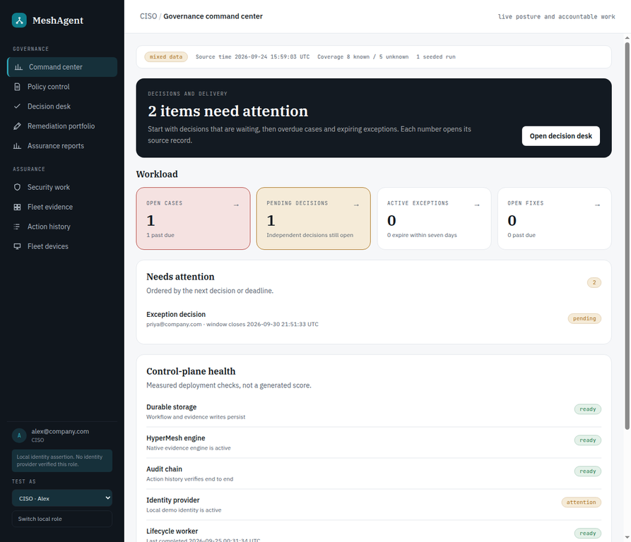
CISO sees the exact decision record—not a summary score
The command center opens the source policy, exception, case, remediation, and evidence record behind every signal.
POLICY CONTROL
Immutable versions
Exact digest and effective interval
DECISION DESK
Separation of duties
Requester cannot decide the request
REMEDIATION
Evidence required
Terminal outcome cannot be empty
ASSURANCE
Measured coverage
Unknown and unscanned stay visible
Current Priority 5D workspace · desktop and 390 × 844 responsive validation complete
07

Slide 8





HyperMesh records native governed relationships
The graph is evidence written by lifecycle transactions—not a visualization reconstructed from UI labels.
AUTHORITATIVE EVENT
DELIVERY CONTRACT
NATIVE EVIDENCE
SCOPED RETRIEVAL
Developer activity
code · package · policy evaluation
Policy graph
Policy-only roots and ancestry
No exception field leakage
HyperMesh
Review + case
request · decision · verification
Transactional outbox
canonical payload · SHA-256 · retry state
Exception graph
Request and decision
Recorded policy ancestry
commit once · retry safely
Native episode
stable ULID
explicit relation vocabulary
immutable ancestry
Governance event
version · exception · expiry
Partial projection is not served
Relational ledgers own workflow state; HyperMesh owns governed evidence and provenance.
08

Slide 9

25-minute live demonstration using real Cursor and GitHub work
A new session is created during the meeting. Seeded reference records are not presented as client activity.
0–2
Boundary
Cursor codes; MeshAgent governs
6–14
Developer + Analyst
Review · assign · note · case
21–23
CISO
Evidence · remediation
2–6
Cursor
Prompt · edit · package gate
14–21
Analyst + CISO
Exception · decision
23–25
Verify
Safe version · Git push
GitHub in v1: real clone, remote, branch, commit, and normal push. Pull-request and issue webhook ingestion are not claimed.
Contingency: local replay preserves the accepted causal prefix when the service is temporarily unavailable.
09

Slide 10
Ready for a controlled client demo; production deployment remains explicit
The package includes source, images, install/runbook documentation, recovery procedures, and this editable presentation.
Demo-qualified scope
Before production acceptance
✓ Real Cursor session and Git repository context
✓ Durable package evidence and Developer review
✓ Analyst queue, assignment, SLA, notes, case, and exception handoff
✓ CISO policy, approval, exception, remediation, and reports
✓ Native HyperMesh evidence with digest checks and scoped retrieval
✓ Mac Docker Compose path and read-only preflight
1. Configure OpenID Connect and distinct Analyst/CISO groups
2. Add customer Transport Layer Security ingress and network controls
3. Approve retention, backup encryption, and recovery custody
4. Connect monitoring, incident response, and change control
5. Complete customer acceptance with real storage and identity
v1 is single-tenant and one-writer per state directory
Next step: run the live workflow with the client’s approved repository and policy
alan.morgan@transformativeaiholding.com
10

