Slide 1
Real-Time Object Tracking using CV Border Defence System
Presented by
Sreejith S (TVE17EC049)
Sidharth N (TVE17EC046)
Abubakar Rashad (TVE17EC004)
Divakar Mahesh S (TVE17EC016)

Slide 2
Defining the Problem
India is widely believed to have arrived on the global state. India has successfully positioned herself as one of the core members of influential nations.
But the security scenario of India has attracted more vulnerability and complexities like never before as India has the disadvantage of being situated in close proximity to what is being described as the epicentre of global terrorism.
Presently our borders are protected by iron spike fences and a watchtower containing soldiers, continuously flashing the light over the border area.
Those persons are fully responsible to prevent any intrusion.
There is a huge work load and responsibility for the soldiers who have to work continuously on the border.

Slide 3
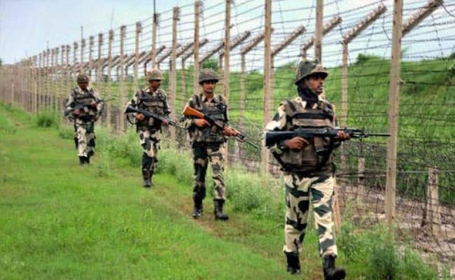

Slide 4
Our Solution
Here by it clarifies the significance of an automatic firing system which will replace soldiers with its effective protective measures.
Our defence system comprises of features like video recording, automatic human recognition, automatic motion sensing, automatic firing etc. This system, video cameras and mat lab processing in hand with embedded system can not only detect intrusion attempts, but also provide a video coverage of the suspicious area, for remote vigilance.
Also our system can withstand extreme climatic condition, thus requiring less maintenance.
In this concept we have designed a promising prototype, which on further development with sufficient time and resources, can be raised to international level.

Slide 5
Summarising the process
To accomplish this we propose a mechanism which will employ image processing in which a camera will be continuously observing the area under surveillance.
This data will be then processed, which will be running on a computer and will be able to detect the presence of intruder inside the border.
Depending on this processed data the information about the intruder location will be sent to a microcontroller through the serial port and then a servomotor-controlled gun will be used to point in the direction of the intruder.
This mechanism will be online, that is the gun will be continuously pointing the direction of the intruder.
Further depending on range, that is distance from the gun it can be activated and the target will be shot down.

Slide 6
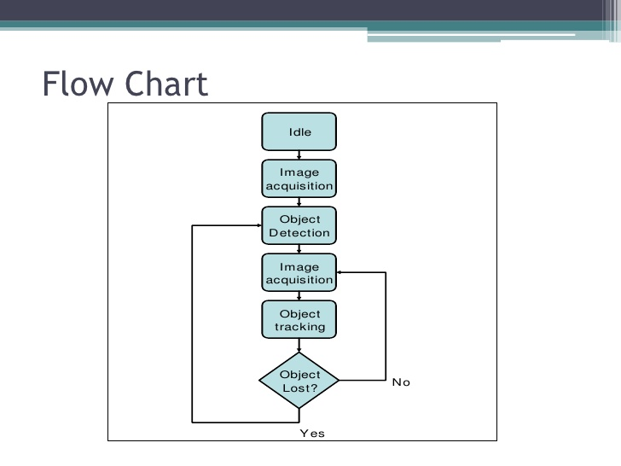
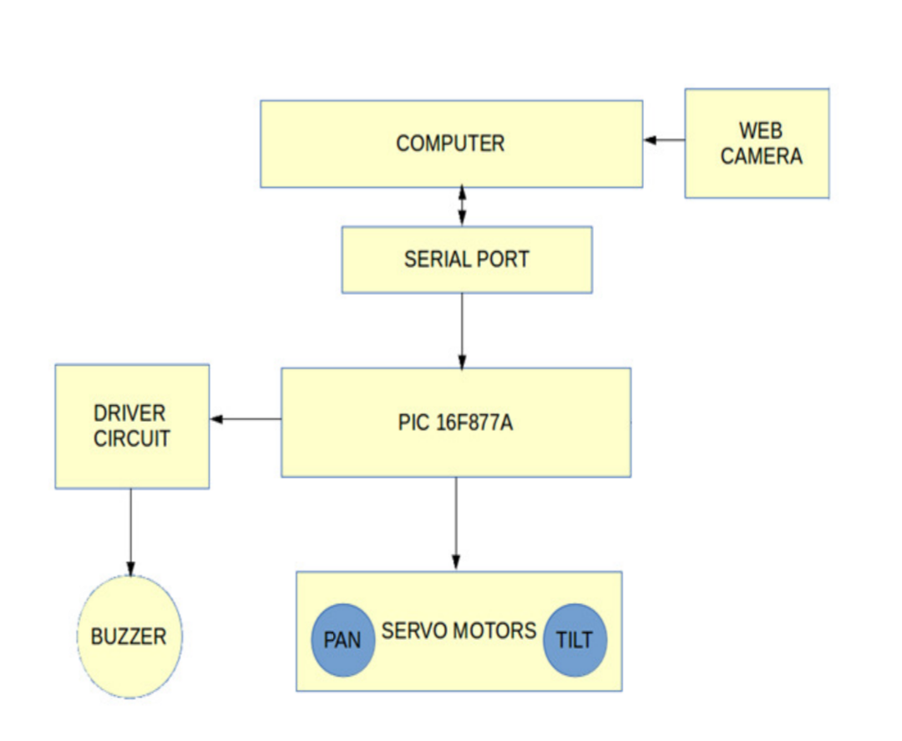
Flowchart and Block Diagram

Slide 7
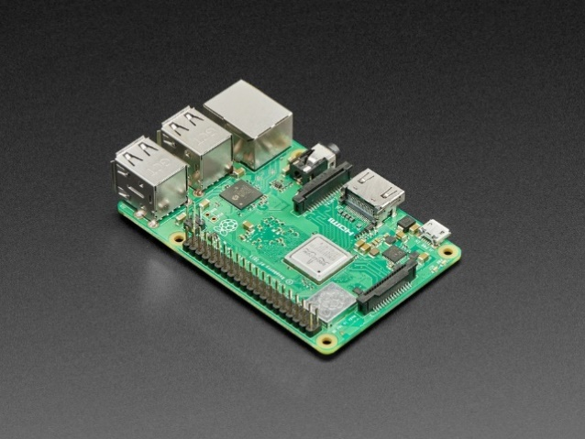
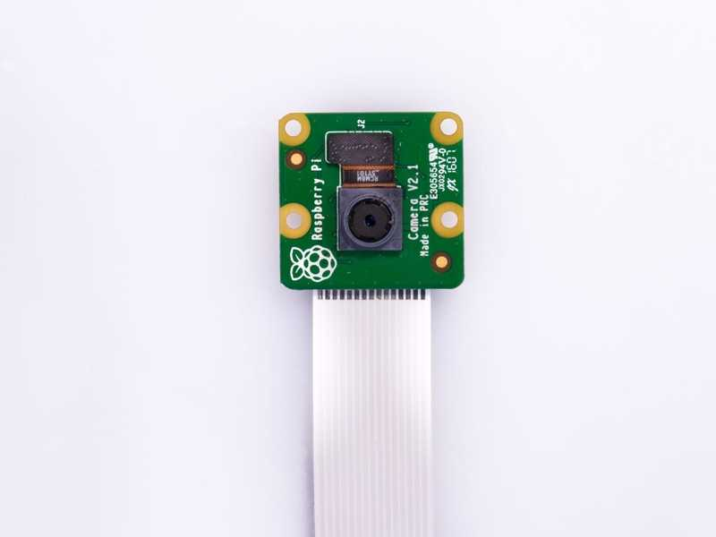
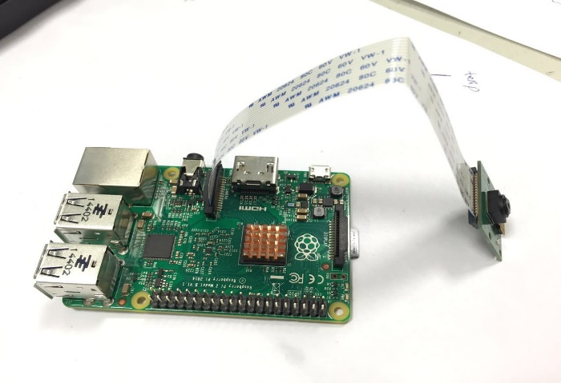
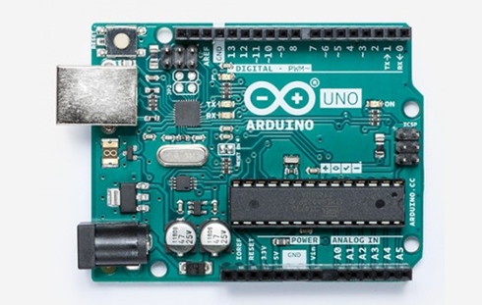
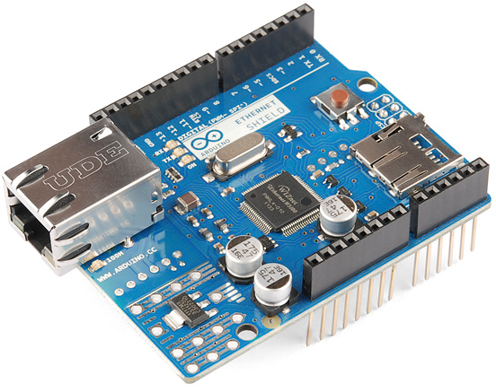
Components
Raspberry pi 3 b+ Pi Cam
Pi Camera with OpenCV for Raspberry PI
Arduino UNO Arduino Shield

Slide 8
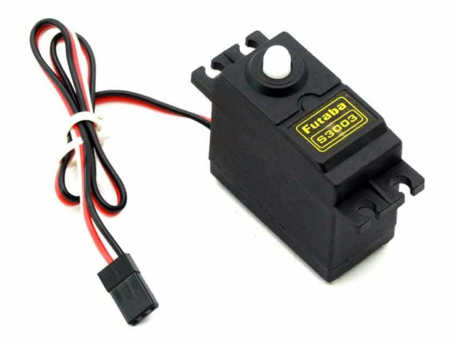
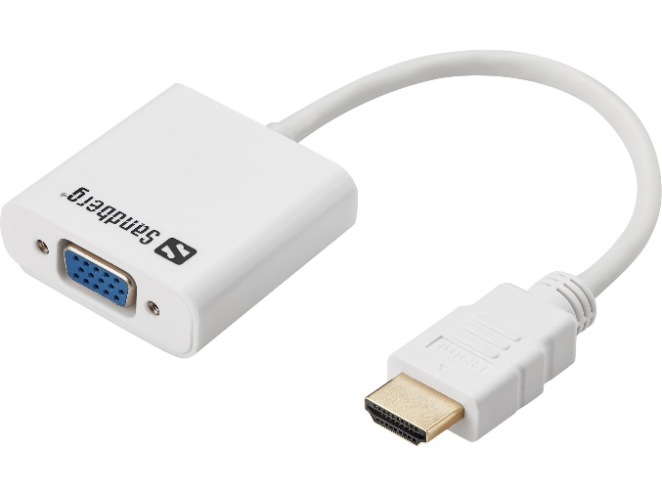
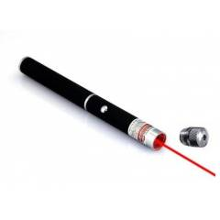
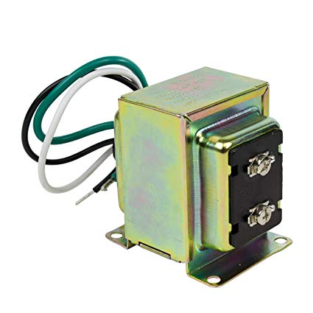
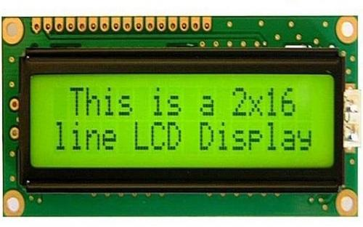
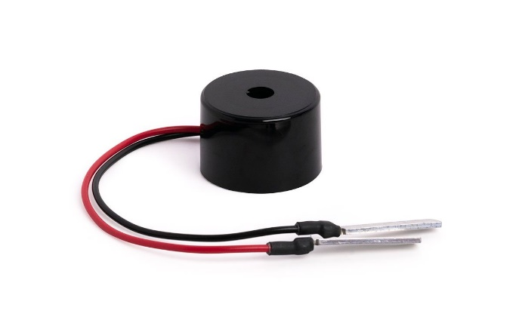
Servo Motor VGA to HDMI Convertor
Laser Pointer
LM016l LCD
Buzzer Transformer

Slide 9
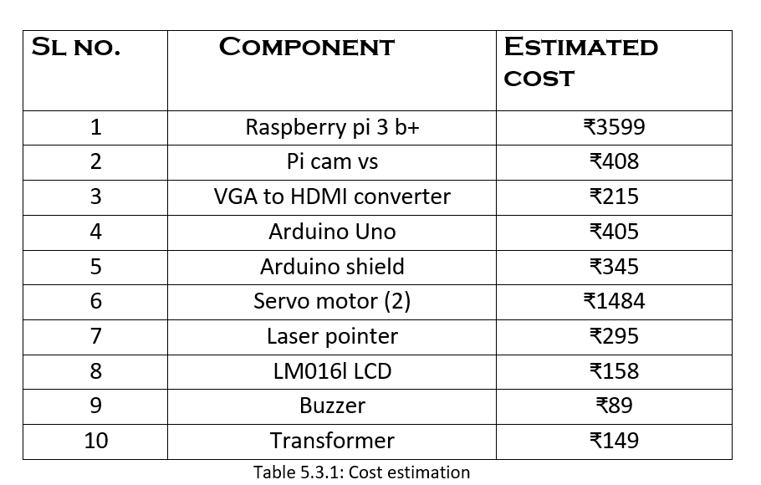
Cost estimation
TOTAL COST OF COMPONENTS - ₹7417 (+extras)

Slide 10
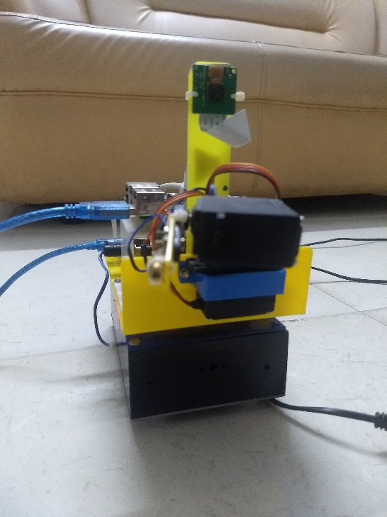
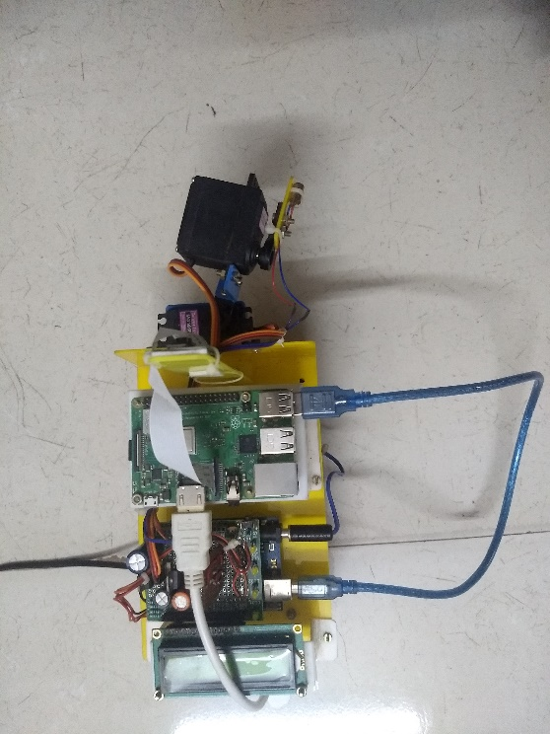
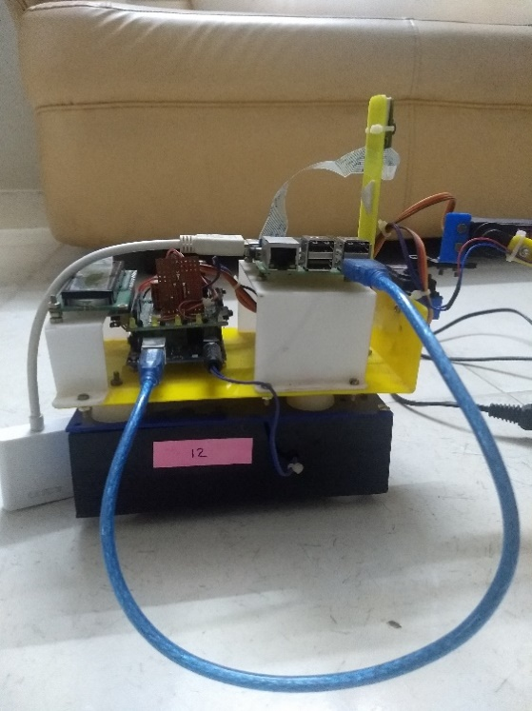
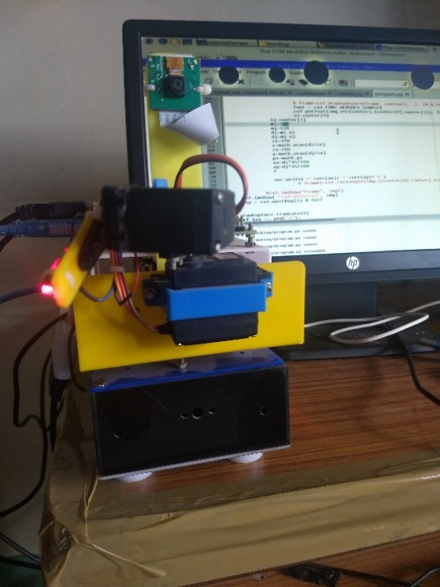
Final Product
Front View Top View
Side View Device On

Slide 11
Individual Contribution
Sreejith S.
OpenCV program development to track red objects
Serial communication between Arduino & Raspberry Pi
Final assembly of components together
Sidharth N.
Arduino coding to control the two servo motors
Implementation of Raspberry Pi in image processing
Final assembly of components together

Slide 12
Abubakar Rashad
Casing for power unit and transformer
Assembling the Arduino shield
Final assembly of components together
Divakar Mahesh S.
Basic circuit diagram for the project
Testing of final prototype
Final assembly of components together

Slide 13


