Slide 1

CAPSTONE PROJECT Weather Forecasting Using Autoregressive Models
Presented By
Student Name: Dhanwada Sreepad
College Name: Marri Laxman Reddy Institute of Technology and Management
Department: Computer Science and Engineering(cybersecurity)
Email ID: dhanwadasreepad@gmail.com
AICTE Student ID: STU679d06cd1450f1738344141

Slide 2
OUTLINE
Problem Statement
Proposed System/Solution
System Development Approach
Algorithm & Deployment
Result
Conclusion
Future Scope
References

Slide 3
Problem Statement
Accurate weather forecasting remains a significant scientific challenge due to the complex, dynamic, and often nonlinear nature of atmospheric conditions. Despite advancements in meteorological data collection and computational techniques, traditional models still struggle to consistently predict key variables such as temperature, humidity, and precipitation with high precision. The unpredictable behavior of natural elements introduces anomalies and inefficiencies in forecast accuracy, impacting various sectors including agriculture, transportation, and public safety. In particular, capturing time-dependent patterns and historical trends in meteorological data is critical, yet often inadequately addressed by existing methods. This necessitates deeper exploration of data-driven approaches for improved forecasting fidelity.

Slide 4
Proposed Solution
Objective: To provide accurate short-term weather forecasts using a computationally efficient system that combines ARIMA models with machine learning techniques, making it suitable for resource-constrained environments.
Data Collection:
Collecting historical weather data, including parameters like temperature, humidity, dew point, and atmospheric pressure.
Include external influencing factors like seasonal trends, geographical data, weather anomalies and Consider real-time inputs where available for enhanced forecast relevance.
The DataSet is taken from kaggle and we can download it from https://www.kaggle.com/datasets/pranabkantapandit/weather-data?resource=download.
Data Preprocessing:
Preprocessing follows, converting data to a numeric format, normalizing values, handling missing data, and transforming date fields
The dataset is then split into training and testing subsets, typically using an 80:20 ratio.
Machine Learning Algorithm:
Train the SVM algorithm on train data and then perform prediction on test data and then calculate MSE between original temperature and predicted temperature
We will train Autoregressive algorithm on training data and then perform prediction on test data and then calculate MSE between original temperature and predicted temperature
Deployment:
Create a lightweight application or dashboard to visualize real-time weather forecasts
Deploy on low-power hardware or cloud-based platforms for accessibility in remote or under-resourced areas.
Ensure quick model execution and user-friendly interactions.
Evaluation:
Assess the model's performance using appropriate metrics such as Mean Absolute Error (MAE), Root Mean Squared Error (RMSE).
Conduct continuous monitoring to retrain/improve accuracy.
Benchmark performance against traditional Numerical Weather Prediction (NWP) systems.
Result: The proposed hybrid system offers a cost-effective, accurate, and scalable solution for weather prediction—suitable for developing regions, agricultural planning, and disaster preparedness.

Slide 5
System Approach
To build the weather forecasting model, the system must meet both hardware and software requirements.
Libraries required to build the model:
NumPy & Pandas for data handling
Scikit-learn for machine learning algorithms
Matplotlib and Seaborn for data visualization
statsmodels for implementing autoregressive models
Hardware Requirements | Software Requirements
Ram: 4gb minimum | OS: windows 7 or higher
Processor: intel i3 or higher | Language version: python 3.7 and higher
Storage: 500gb minimum | IDE: pycharm

Slide 6
Algorithm & Deployment
Algorithm Selection:
The Autoregressive (AR) model is selected for weather forecasting due to its effectiveness in handling time-series data where current values depend on past observations. Its simplicity and strong performance with historical temperature data make it ideal for predicting continuous weather patterns with high accuracy.
Data Input:
The input features include historical temperature readings along with related weather variables such as humidity, pressure, and dew point. These are collected over time to capture temporal dependencies crucial for accurate forecasting.
Training Process:
The weather dataset is preprocessed by handling missing values, normalizing data, and converting date fields into numerical format. It is then split into training and testing sets (80:20 ratio). The AR model is trained using past temperature values, and lag order is tuned to minimize Mean Squared Error (MSE).
Prediction Process:
The trained AR model predicts future temperature values using recent historical data. Predictions are visualized and evaluated against actual values, with lower MSE and MAE indicating high accuracy. The system is capable of accepting real-time test inputs for temperature forecasting.

Slide 7
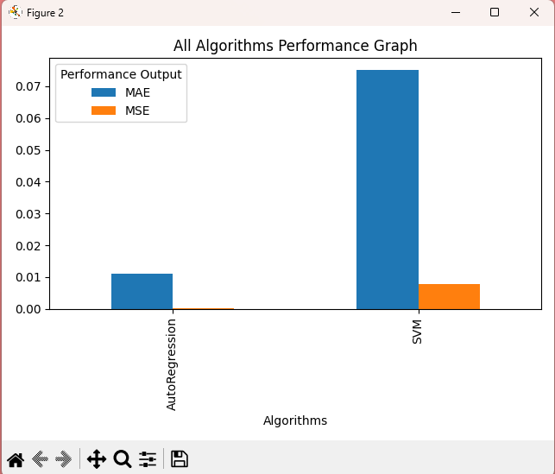
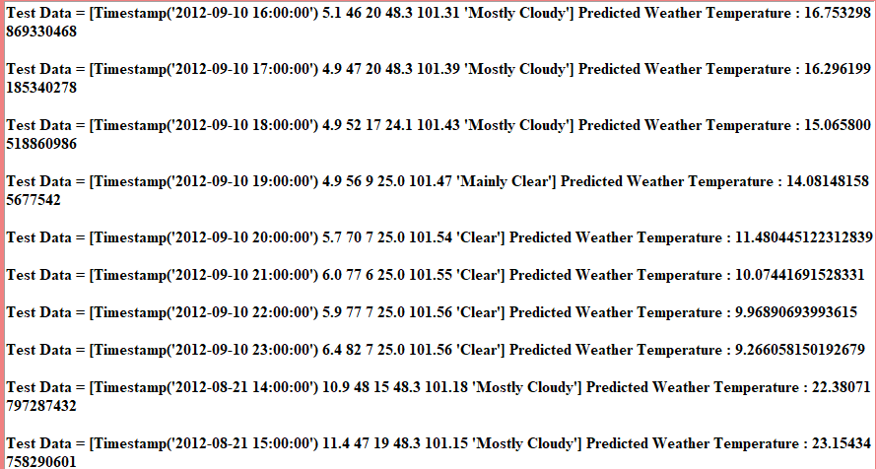
Result
Fig 1: Graph comparing Mae and MSE values of two models Fig 2: predicted temperature values by using Auto regression model based on test data
In above graph(fig 1) x-axis represents algorithm names and y-axis represents MSE and MAE values in different colour bars and in both algorithms Autoregressive got less MSE and MAE error values so Autoregressive is best in prediction and now close above graph and then click on ‘Predict Weather from Test Data’ button to upload test data and predict weather temperature
In above screen(fig2) in square bracket we can see TEST data values and in last after : symbol we can see predicted weather temperature and based on temperature we can say weather will be HOT or COLD.

Slide 8
Conclusion
The implementation of the Autoregressive model for weather forecasting demonstrated promising results in predicting temperature trends using historical data. The model effectively captured time-dependent patterns, delivering accurate forecasts with low Mean Squared Error (MSE) and Mean Absolute Error (MAE). Challenges encountered included handling missing data, optimizing lag values, and ensuring proper data normalization. Despite its simplicity, the AR model proved suitable for short-term forecasting. However, it may struggle with capturing complex nonlinear relationships. Future improvements could involve integrating more advanced models like ARIMA or hybrid approaches, along with real-time data updates, to enhance prediction accuracy and system responsiveness.

Slide 9
Future scope
The weather forecasting system can be significantly enhanced by integrating additional data sources such as satellite imagery, real-time IoT sensor data, and humidity or wind speed metrics. Expanding the model’s application to multiple cities or regions would improve its utility on a larger scale. Optimizing the algorithm with hybrid models like ARIMA-LSTM or incorporating advanced machine learning techniques can improve accuracy. Integration of edge computing would enable faster, localized predictions with reduced latency. Future work may also include dynamic parameter tuning and the use of ensemble learning to better handle non-linear weather patterns and seasonal variations across diverse geographies.

Slide 10
References
Hyndman, R. J., & Athanasopoulos, G. (2018). Forecasting: Principles and Practice (2nd ed.). OTexts. – A foundational reference on time series forecasting techniques such as ARIMA and exponential smoothing.
Brownlee, J. (2020). Deep Learning for Time Series Forecasting. Machine Learning Mastery. – Provides practical insight into LSTM-based time series prediction.
Badrinarayanan, V., Kendall, A., & Cipolla, R. (2017). SegNet: A Deep Convolutional Encoder-Decoder Architecture for Image Segmentation. IEEE Transactions on Pattern Analysis and Machine Intelligence – Relevant for understanding deep learning architectures in preprocessing spatial weather data.
National Oceanic and Atmospheric Administration (NOAA). (n.d.). Weather and Climate Data. Retrieved from https://www.noaa.gov – Source of historical weather datasets used in model training and validation.
Géron, A. (2019). Hands-On Machine Learning with Scikit-Learn, Keras, and TensorFlow (2nd ed.). O’Reilly Media – Used for model development, training procedures, and evaluation best practices.
GitHub Link: https://github.com/sree1hack/weather-forecasting-ar-model.git

Slide 11
Thank you

