Slide 1

DBMS CORNERSTONE PROJECT
ONLINE SHOPPING SYSTEM
Presented by:
• M. Sarika - 25B11CS544
• P. Divyanjali - 25B11CS758
• T. Devisree - 25B11CS933
• V. Bhavyasree - 25B11CSA19
Under esteemed guidance of:
Dr. K.VYDEHI
Assistant Professor, CSE

Slide 2

OUTLINE
1. Introduction
2. Problem Statement
3. Objectives
4. Requirement Analysis
5. End Users of the System
6. Main Entities
7. Entity Attributes
8. Relational Database Schema
9. Entity Relationships & Cardinality
10. Keys (Primary & Foreign)
11.ER Diagram
12. Conclusion

Slide 3
INTRODUCTION
An Online Shopping System is a database-driven application that enables customers to browse, search, and purchase products from a centralized e-commerce platform.
For Customers
• Browse products
• Search & filter
• Add to cart
• Place orders
• Track shipment
• Write reviews
For Sellers
• Manage inventory
• Post products
• Process orders
• View analytics
• Update prices
• Sales reports
DBMS Role
• Data storage
• Transactions
• Consistency
• Security
• Fast retrieval
• Concurrent access

Slide 4
PROBLEM STATEMENT
Traditional retail and manual e-commerce processes face critical challenges:
➢ Limited product visibility across different locations
➢ Manual inventory management leading to stockouts
➢ Time-consuming order processing and payment verification
➢ Difficulty tracking orders and managing logistics
➢ Lack of centralized customer data for personalization
➢ Inconsistent pricing and promotion management
Solution: Develop a centralized, efficient DBMS-backed online shopping system that streamlines product management, order processing, and inventory tracking.

Slide 5
OBJECTIVES
The Online Shopping System is designed to achieve the following core objectives:
Efficient Data Storage: Manage large volumes of product and customer data
Secure Transactions: Ensure safe and encrypted payment processing
Order Management: Streamline order placement, processing, and tracking
Inventory Control: Real-time stock management and updates
Customer Analytics: Track behavior patterns and generate insights

Slide 6
REQUIREMENT ANALYSIS
Functional Requirements
• User Registration & Authentication
• Product Browsing & Search
• Shopping Cart Management
• Order Placement & Payment Processing
• Order Tracking
• Customer Reviews & Ratings
• Sales Reports & Analytics
Non-Functional Requirements
• Performance: Fast response times during peak traffic
• Security: Data encryption & secure authentication
• Scalability: Handle increasing users and transactions
• Reliability: 24/7 availability with data backup
• Usability: Intuitive and user-friendly interface

Slide 7
END USERS OF THE SYSTEM
• Browse products
• Purchase items
• Track orders
• Write reviews
• Manage inventory
• Process orders
• Update prices
• View analytics
• User management
• System maintenance
• Dispute resolution
• Generate reports
Customers
Sellers/Vendors
Admin

Slide 8
MAIN ENTITIES
The system is built around 7 core entities:
👤
Customer
📦
Product
📋
Order
🛒
Orderitem
📂
Category
💳
Payment
⭐
Review

Slide 9
ENTITY ATTRIBUTES
Entity | Attributes
Customer | CustomerID, Name, Email, Phone, Address, Password
Product | ProductID, Name, Description, Price, Stock, CategoryID
Order | OrderID, CustomerID, OrderDate, Total, Status
OrderItem | OrderItemID, OrderID, ProductID, Quantity, Price
Category | CategoryID, Name, Description
Payment | PaymentID, OrderID, Amount, Method, Status
Review | ReviewID, ProductID, CustomerID, Rating, Comment

Slide 10
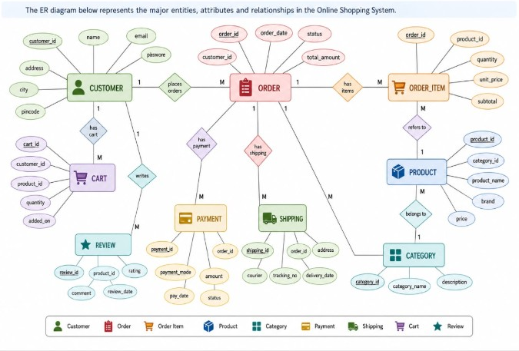
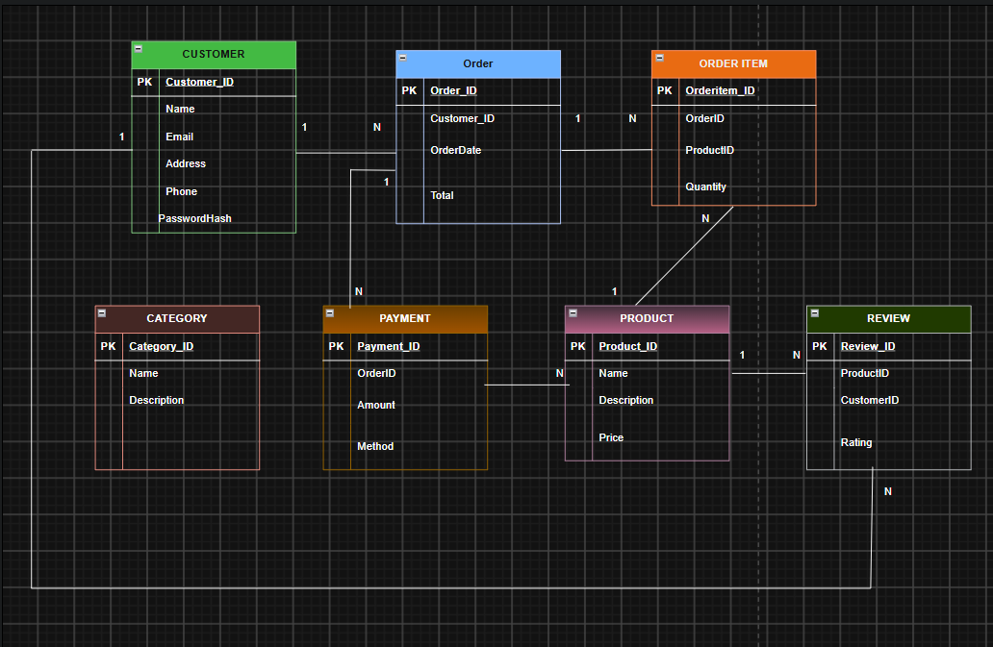
Relational Database Schema

Slide 11
ENTITY RELATIONSHIPS
& CARDINALITY
Entity 1 | Entity 2 | Relationship | Cardinality
Customer | Order | Places | One to Many
Customer | Review | Writes | One to Many
Order | OrderItem | Contains | One to Many
Product | OrderItem | Listed in | One to Many
Product | Category | Belongs to | Many to One
Product | Review | Receives | One to Many
Order | Payment | Has | One to One

Slide 12
KEYS (PRIMARY & FOREIGN)
Entity | Primary Key | Foreign Key
Customer | CustomerID | None
Product | ProductID | CategoryID
Order | OrderID | CustomerID
OrderItem | OrderItemID | OrderID, ProductID
Category | CategoryID | None
Payment | PaymentID | OrderID
Review | ReviewID | ProductID, CustomerID

Slide 13
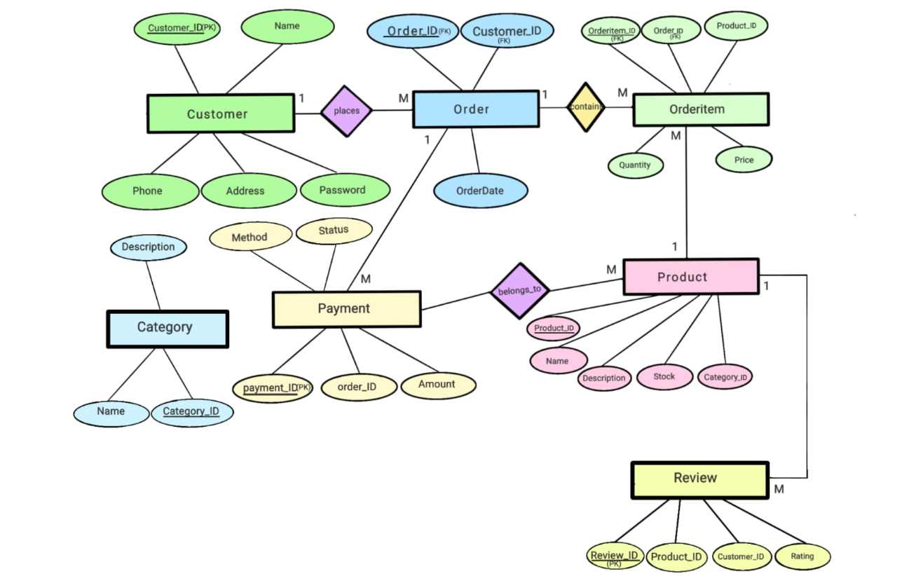
ER DIAGRAM
8 relations in 3NF – arrows show foreign-key references between tables.

Slide 14
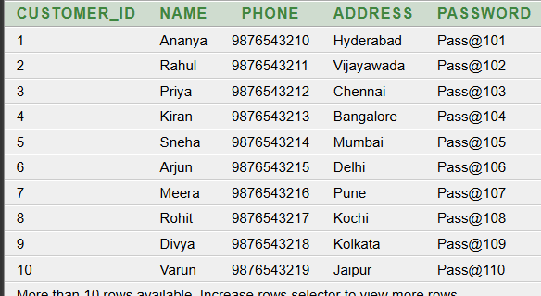
NORMALIZATION
Normalization is the process of organizing data into multiple related tables to reduce data redundancy and improve data consistency.
1NF – First Normal Form
A table is in 1NF when:
Each column contains only atomic (single) values.
There are no repeating groups of data.
Each record is uniquely identified using a primary key.

Slide 15
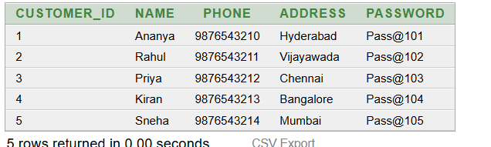
2NF – Second Normal Form
A table is in Second Normal Form (2NF) when:
It is already in 1NF.
Every non-key attribute is fully dependent on the primary key.
Partial dependency is removed.
In our system, customer, product, order and item information are separated into different tables.
CUSTOMER (example table):

Slide 16
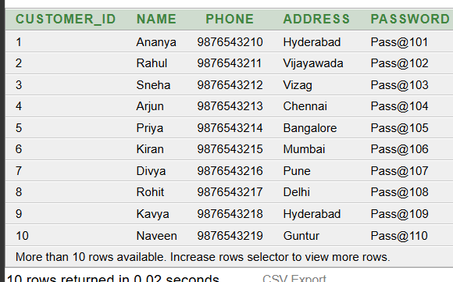
DECOMPOSITION FROM 1NF TO 2NF
Conversion from 1NF to 2NF:
Primary Key: CUSTOMER_ID
Since CUSTOMER_ID is a single-column primary key, there cannot be any partial dependency.
Functional Dependencies:
CUSTOMER_ID → NAME
CUSTOMER_ID → PHONE
CUSTOMER_ID → ADDRESS
CUSTOMER_ID → PASSWORD
1NF CUSTOMER TABLE
↓
Check Partial Dependency
↓
CUSTOMER_ID is a single-column
Primary Key
↓
No Partial Dependency
↓
2NF

Slide 17
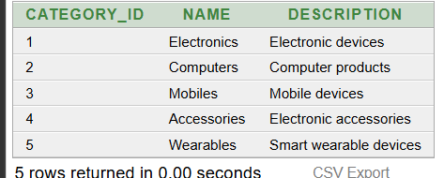
3NF – Third Normal Form
A table is in Third Normal Form (3NF) when:
It is already in 2NF.
There is no transitive dependency.
Non-key attributes depend only on the primary key.
In our system, category, payment and review information are stored separately.
CATEGORY ( Example table):

Slide 18
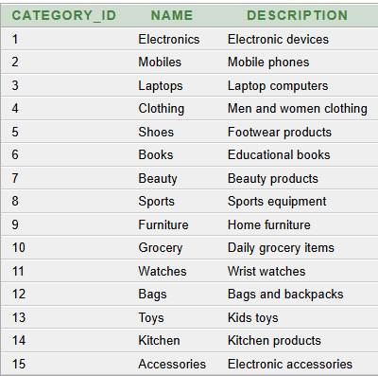
TABLE CREATION
CREATE TABLE CATEGORY (
Category_ID NUMBER,
Name VARCHAR2(50),
Description VARCHAR2(100),
PRIMARY KEY (Category_ID)
);
EXAMPLE:
INSERT INTO CATEGORY VALUES (1,'Electronics','Electronic devices');

Slide 19
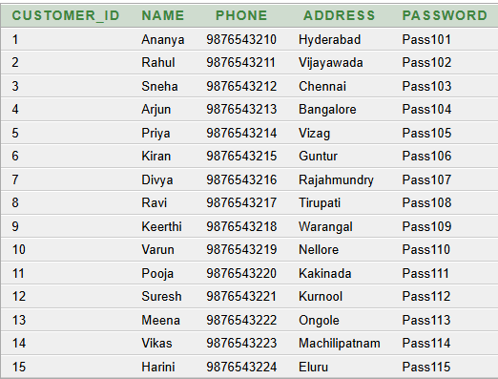
TABLE CREATION
CREATE TABLE CUSTOMER (
Customer_ID NUMBER,
Name VARCHAR2(50),
Phone VARCHAR2(15),
Address VARCHAR2(100),
Password VARCHAR2(50),
PRIMARY KEY (Customer_ID)
);
EXAMPLE:
INSERT INTO CUSTOMER VALUES (1,'Ananya','9876543210','Hyderabad','Pass101');

Slide 20
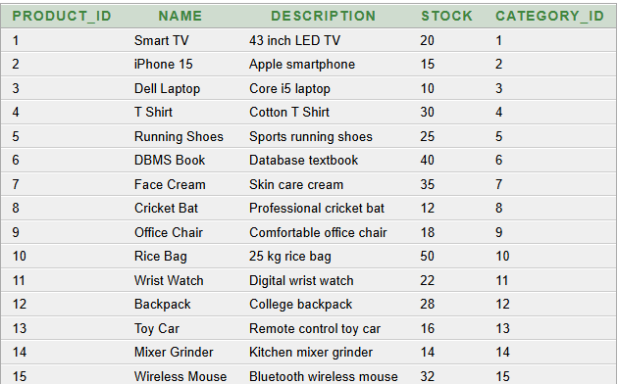
TABLE CREATION
CREATE TABLE PRODUCT (
Product_ID NUMBER,
Name VARCHAR2(50),
Description VARCHAR2(100),
Stock NUMBER,
Category_ID NUMBER,
PRIMARY KEY (Product_ID),
FOREIGN KEY (Category_ID) REFERENCES CATEGORY(Category_ID)
);
EXAMPLE:
INSERT INTO PRODUCT VALUES (1,'Smart TV','43 inch LED TV',20,1);

Slide 21
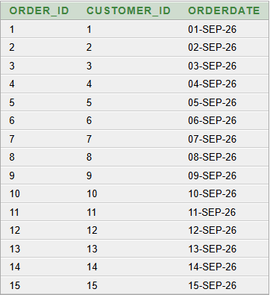
TABLE CREATION
CREATE TABLE ORDERS (
Order_ID NUMBER,
Customer_ID NUMBER,
OrderDate DATE,
PRIMARY KEY (Order_ID),
FOREIGN KEY (Customer_ID) REFERENCES CUSTOMER(Customer_ID)
);
EXAMPLE:
INSERT INTO ORDERS VALUES (1,1,TO_DATE('2026-09-01','YYYY-MM-DD'));

Slide 22
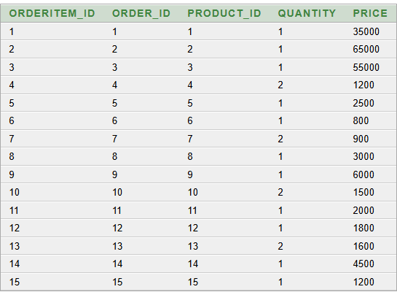
TABLE CREATION
CREATE TABLE ORDERITEM (
OrderItem_ID NUMBER,
Order_ID NUMBER,
Product_ID NUMBER,
Quantity NUMBER,
Price NUMBER,
PRIMARY KEY (OrderItem_ID),
FOREIGN KEY (Order_ID) REFERENCES ORDERS(Order_ID),
FOREIGN KEY (Product_ID) REFERENCES PRODUCT(Product_ID)
);
EXAMPLE:
INSERT INTO ORDERITEM VALUES (1,1,1,1,35000);

Slide 23
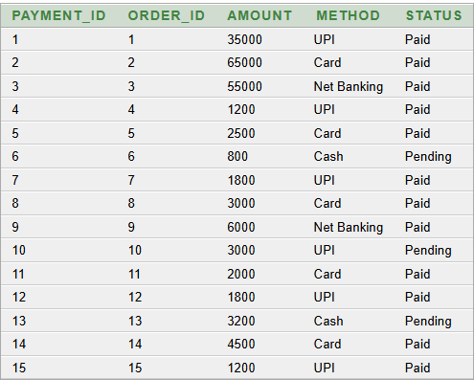
TABLE CREATION
CREATE TABLE PAYMENT (
Payment_ID NUMBER,
Order_ID NUMBER,
Amount NUMBER,
Method VARCHAR2(20),
Status VARCHAR2(20),
PRIMARY KEY (Payment_ID),
FOREIGN KEY (Order_ID) REFERENCES ORDERS(Order_ID)
);
EXAMPLE:
INSERT INTO PAYMENT VALUES (1,1,35000,'UPI','Paid');

Slide 24
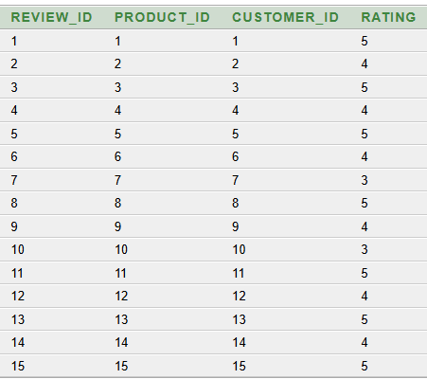
TABLE CREATION
CREATE TABLE REVIEW (
Review_ID NUMBER,
Product_ID NUMBER,
Customer_ID NUMBER,
Rating NUMBER,
PRIMARY KEY (Review_ID),
FOREIGN KEY (Product_ID) REFERENCES PRODUCT(Product_ID),
FOREIGN KEY (Customer_ID) REFERENCES CUSTOMER(Customer_ID)
);
EXAMPLE:
INSERT INTO REVIEW VALUES (1,1,1,5);

Slide 25
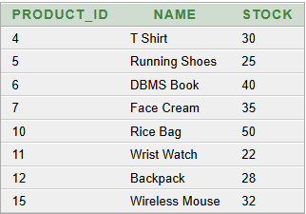
Sql queries
Question 1: Display products whose stock is greater than 20.
SELECT Product_ID, Name, Stock FROM PRODUCT WHERE Stock > 20;

Slide 26
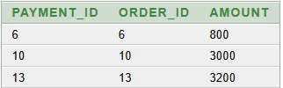
Sql queries
Question 2: Display the payment details of orders whose payment is pending.
SELECT Payment_ID, Order_ID, Amount
FROM PAYMENT
WHERE Status = 'Pending';

Slide 27

Sql queries
Question 3: Display customers whose address is Hyderabad.
SELECT Customer_ID, Name, Phone FROM CUSTOMER WHERE Address = 'Hyderabad';

Slide 28
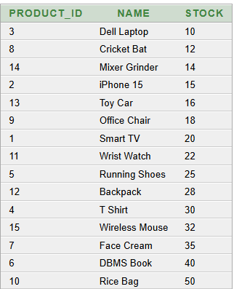
Sql queries
Question 4: Display products according to their stock in ascending order.
SELECT Product_ID, Name, Stock FROM PRODUCT ORDER BY Stock ASC;

Slide 29
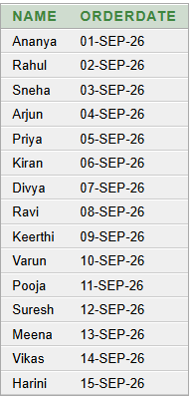
Sql queries
Question 5: Display the customer name and the date on which they placed the order.
SELECT C.Name, O.OrderDate FROM CUSTOMER C JOIN ORDERS O ON C.Customer_ID = O.Customer_ID;

Slide 30

Sql queries
Question 6: Find the highest available stock among all products.
SELECT MAX(Stock) AS Highest_Stock
FROM PRODUCT;

Slide 31
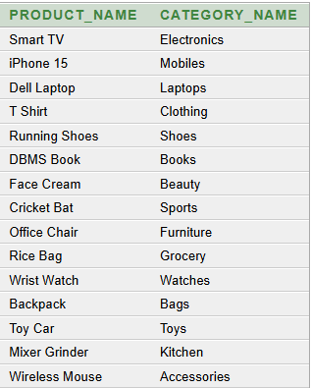
Sql queries
Question 7: Display the product name along with its category name.
SELECT P.Name AS Product_Name,C.Name AS Category_Name FROM PRODUCT P
JOIN CATEGORY C
ON P.Category_ID = C.Category_ID;

Slide 32
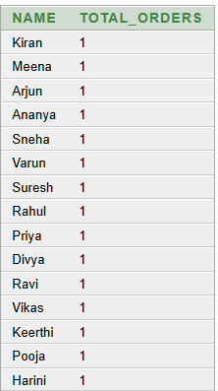
Sql queries
Question 8: Find the number of orders placed by each customer.
SELECT C.Name, COUNT(O.Order_ID) AS Total_Orders FROM CUSTOMER C
JOIN ORDERS O
ON C.Customer_ID = O.Customer_ID
GROUP BY C.Name;

Slide 33

Sql queries
Question 9: Find the average rating given to all products.
SELECT ROUND(AVG(Rating),2) AS Average_Rating
FROM REVIEW;

Slide 34
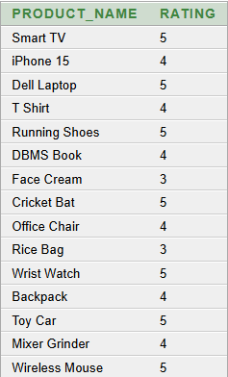
Sql queries
Question 10: Display each product along with the rating given to it.
SELECT P.Name AS Product_Name, R.Rating
FROM PRODUCT P
JOIN REVIEW R
ON P.Product_ID = R.Product_ID;

Slide 35
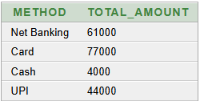
Sql queries
Question 11: Find the total payment amount for each payment method.
SELECT Method, SUM(Amount) AS Total_Amount FROM PAYMENT
GROUP BY Method;

Slide 36
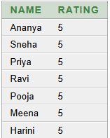
Sql queries
Question 12: Display the names of customers who gave a rating of 5.
SELECT C.Name, R.Rating FROM CUSTOMER C
JOIN REVIEW R
ON C.Customer_ID = R.Customer_ID
WHERE R.Rating = 5;

Slide 37
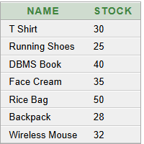
Sql queries
Question 13: Display products whose stock is greater than the average stock of all products.
SELECT Name, Stock FROM PRODUCT
WHERE Stock > (SELECT AVG(Stock) FROM PRODUCT);

Slide 38
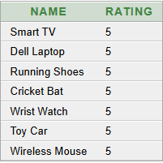
Sql queries
Question 14: Display the names of products that received the highest rating.
SELECT P.Name, R.Rating FROM PRODUCT P
JOIN REVIEW R
ON P.Product_ID = R.Product_ID
WHERE R.Rating = (SELECT MAX(Rating) FROM REVIEW);

Slide 39

Sql queries
Question 15: Display the product having the lowest available stock.
SELECT Name, Stock
FROM PRODUCT
WHERE Stock = (SELECT MIN(Stock) FROM PRODUCT);

Slide 40
CONCLUSION
•The Online Shopping System represents a comprehensive DBMS solution that addresses the complexities of modern e-commerce.
•By implementing a well-designed relational database with proper entity relationships, the system ensures efficient inventory management, secure transactions, and excellent customer experience.
• The structured approach to data management enables real-time order processing, personalized recommendations, and actionable business intelligence.
•This project demonstrates how DBMS principles create scalable, secure, and user-friendly e-commerce platforms benefiting both customers and business stakeholders.

Slide 41
THANK YOU

