Slide 1

anDROID
Presented by:
Sreekanth
Dedeepya
Bhavani

Slide 2

Contents
Introduction
Origin
Features
Versions
Security
Pros and Cons
Future of Android
Conclusion

Slide 3
Introduction
Android is a mobile operating system developed by Google.
It is based on a modified version of the Linux kernel and other open source software, and is designed primarily for touchscreen mobile devices such as smartphones and tablets.

Slide 4
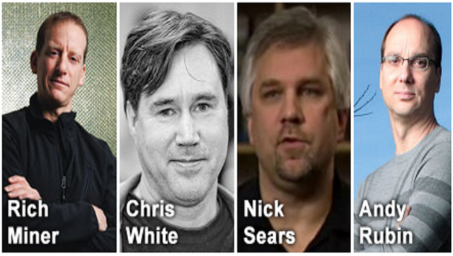
Origin of Android
Android was founded in California in October 2003 by Andy Rubin , Nick Sears, Rich Miner and Chris White who work at “Google” to develop.

Slide 5
Origin of Android
It was purchased by GOOGLE in August, 2005 for 50 Million$.
Android beta released – 12 November 2007

Slide 6
Features of Android
Android can run multiple apps at the same time.
It has better app market.
It gives more options to fit your budget.
Android keeps information visible on your home screen.

Slide 7
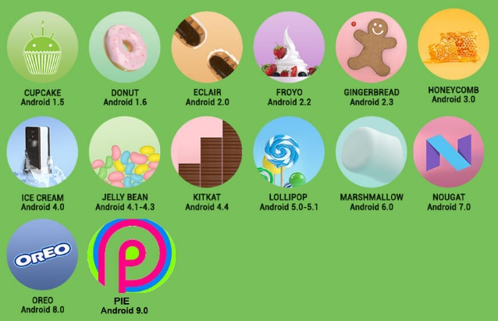
Versions

Slide 8
Versions
Code name | Version number | Initial release date
No Codename | 1 | September 23, 2008
Petit Four | 1.1 | February 9, 2009
Cupcake | 1.5 | April 27, 2009
Donut | 1.6 | September 15, 2009
Eclair | 2.0 – 2.1 | October 26, 2009
Froyo | 2.2 – 2.2.3 | May 20, 2010
Gingerbread | 2.3 – 2.3.7 | December 6, 2010
Honeycomb | 3.0 – 3.2.6 | February 22, 2011
Ice Cream Sandwich | 4.0 – 4.0.4 | October 18, 2011

Slide 9
Versions
Code name | Version number | Initial release date
Jelly Bean | 4.1 – 4.3.1 | July 9, 2012
KitKat | 4.4 – 4.4.4 | October 31, 2013
Lollipop | 5.0 – 5.1.1 | November 12, 2014
Marshmallow | 6.0 – 6.0.1 | October 5, 2015
Nougat | 7.0 – 7.1.2 | August 22, 2016
Oreo | 8.0 – 8.1 | August 21, 2017
Pie | 9 | August 6, 2018
Android Q | 10

Slide 10
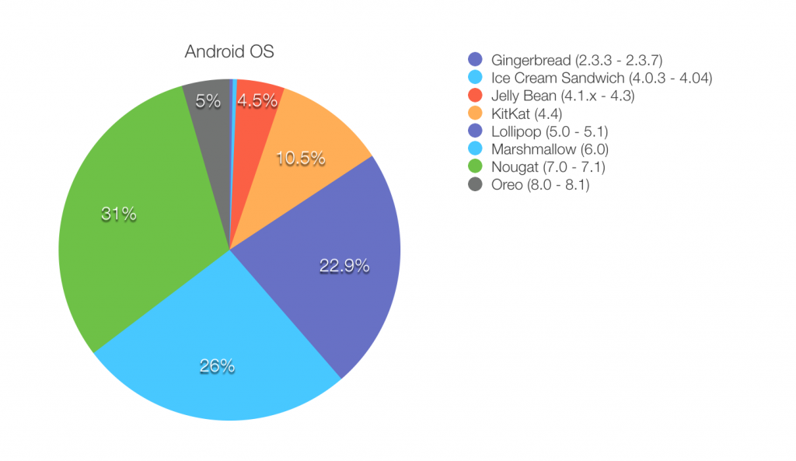
Android Version Statistics

Slide 11
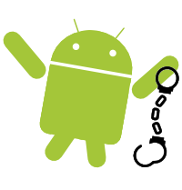
Security for Android
Android Application Security Scans
Storage of sensitive data on mass storage device.
Unsafe use of shared preferences.
Geared Towards User-Friendly Security
Permission based access control.

Slide 12
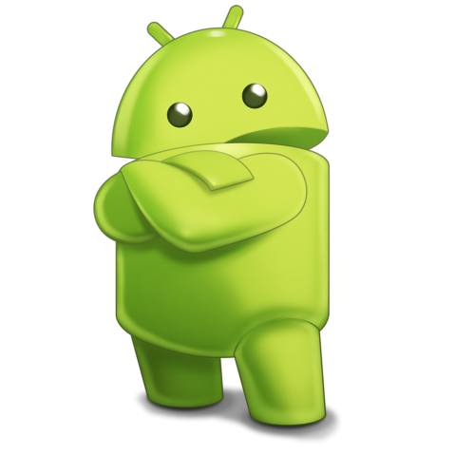
Pros
Allow access to core mobile devices.
All applications are equal.
Breakdown boundaries.
Fast and easy.

Slide 13
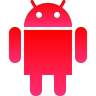
Cons
Security
Open source
Login
Incompetence.

Slide 14
Future of Android
Kotlin and multiplatform projects will change the way we think about mobile development
Chatbots will represent 25% of all customer service operations by 2040
Blockchain will be incorporated beyond financial apps

Slide 15
Conclusion
Android has grown rapidly over the past 5 years becoming the most used smartphone operating system in the world
Android's ability to customize is unparalleled compared to Apple's and Microsoft's software allowing the user to change and customize nearly every aspect of Android which most iPhone and Windows 7 users wouldn't dream possible.

Slide 16
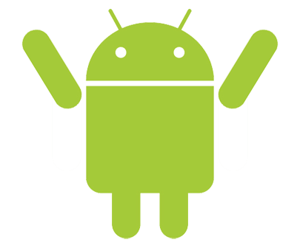
THANK YOU

