Slide 1
Online Furniture Shopping
Presented by:
Sreekanth
Bhavani
Hanumantharao
Hemalatha

Slide 2
Contents
Introduction
Purpose
Tools & Technologies
MVC Architecture
Flow of the Project
Database Schema
Functionalities & UI Design
Conclusion

Slide 3
Introduction
It is very helpful for where the customer can directly buy the products or items from home through internet connection on mobile or system.
It is directly delivery to buyer home and we choose different products based on categories.
It can help to manage the goods, products and services online by choosing the listed products from online shopping store websites.

Slide 4
Purpose
During the economic recession, the furniture retail industry was negatively impacted as consumers cut back on non-essential spending, but now there is an uptick in demand.
One of the most top trend was fastest-growing channel in developing markets.
The demand for luxury furniture is increasing.

Slide 5
Tools & Technologies
User Interface : HTML, CSS, Bootstrap
Client-side Scripting : JavaScript
Programming Language : Java 1.8
Server-side Technologies : Servlets, JSP
Workbench : Eclipse Neon IDE
Database : MySQL 5.1
Server Deployment : Tomcat 8.5
Connection : JDBC

Slide 6
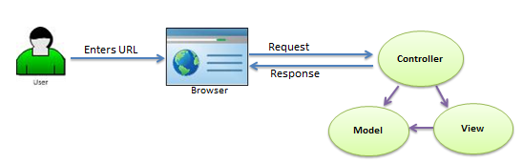
MVC Architecture

Slide 7
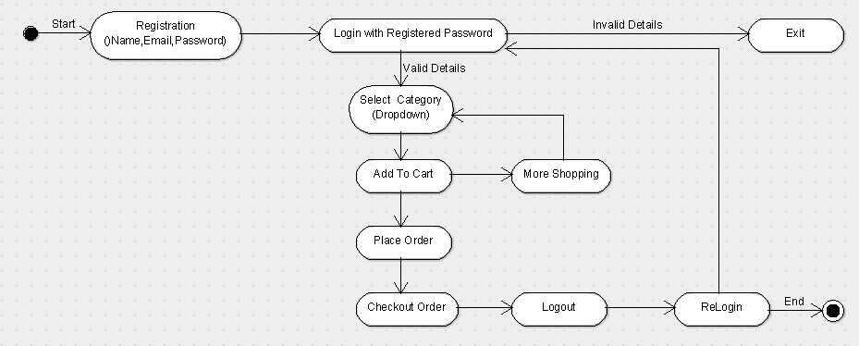
Flow of Project

Slide 8
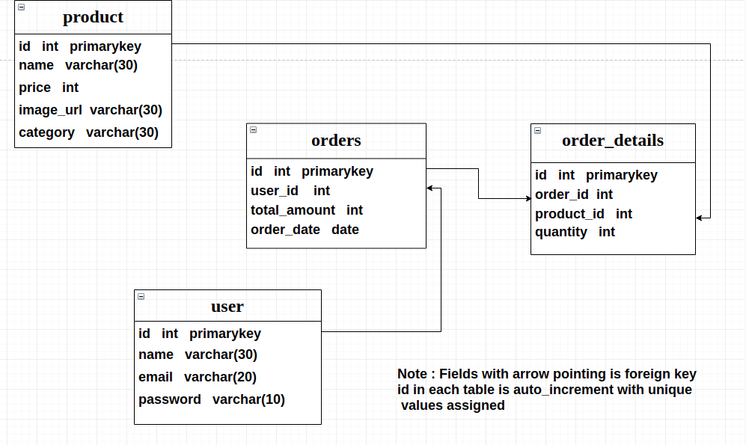
Database Schema

Slide 9
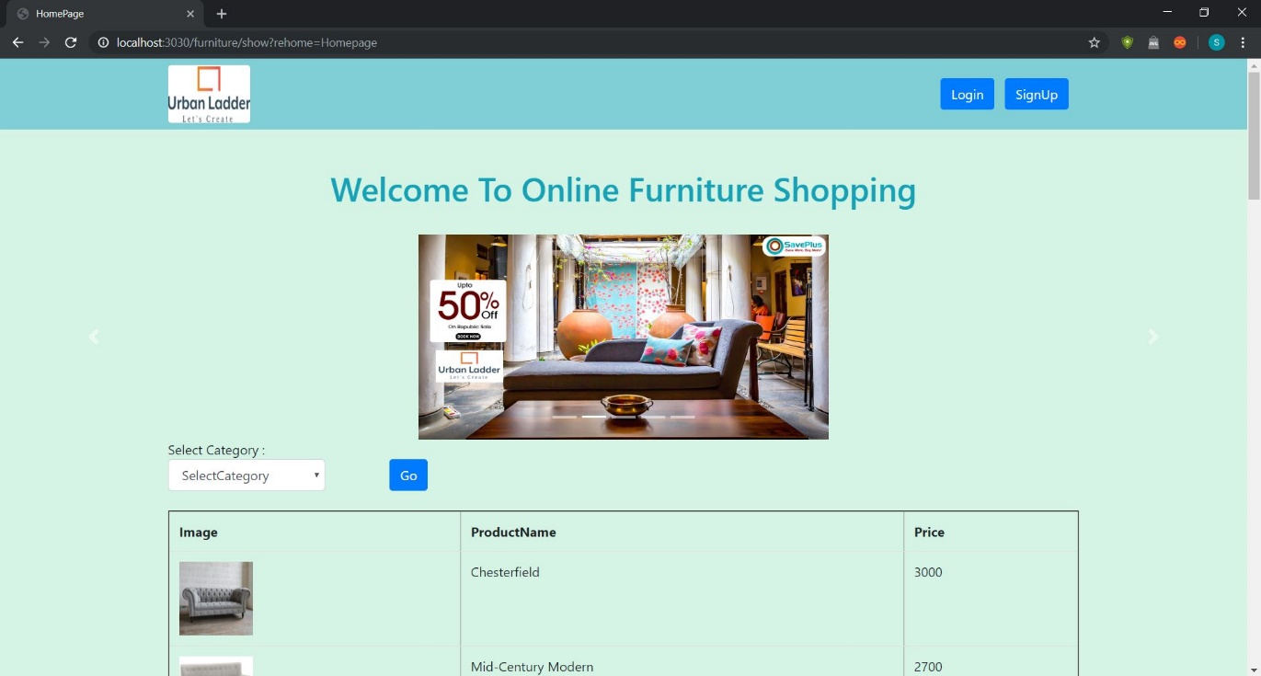
HomePage
The homepage is considered as most important part of the whole site. It is the first page that visitors will view the products, which are available.

Slide 10
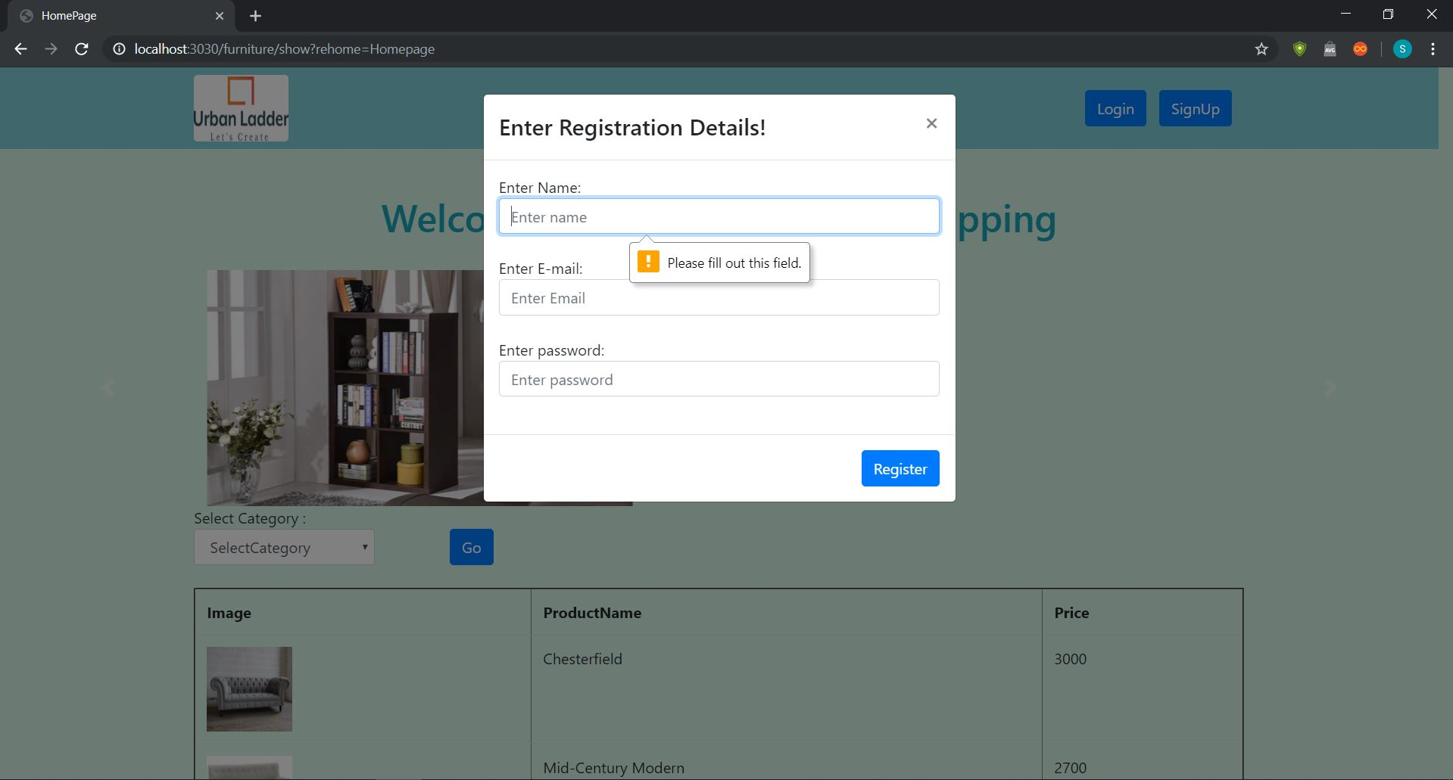
Registration
For accessing the products need a registration details for secure. And it is Mandatory to fill required details.

Slide 11
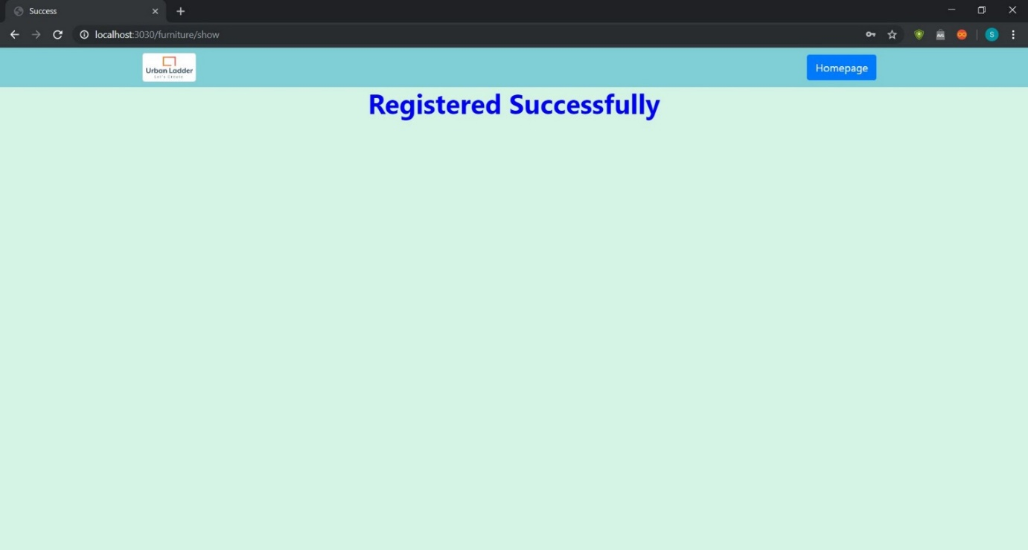
Registration Success
After Registration needs a confirmation message to user support.

Slide 12
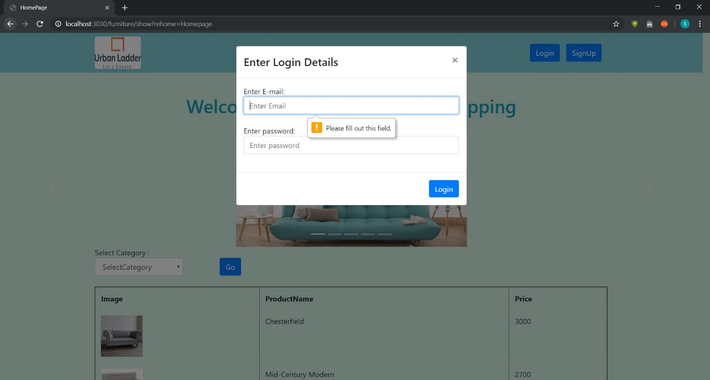
Login Details
Login Details is a set of credentials used to authenticate a user. It consists of E-mail and Password to access shopping products.

Slide 13
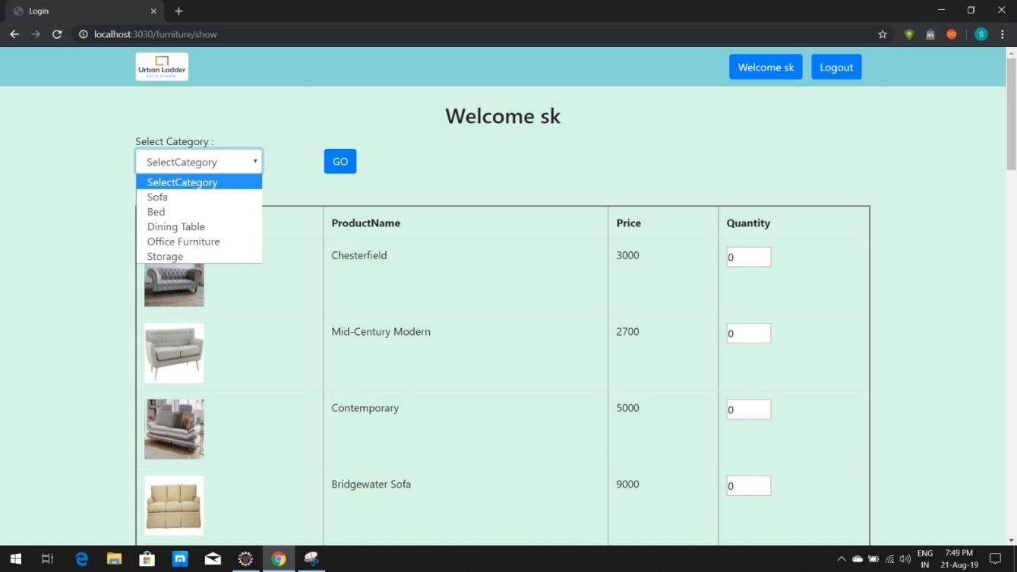
Login Home
Login Home represents the selecting the category of required products and adds the quantity.

Slide 14
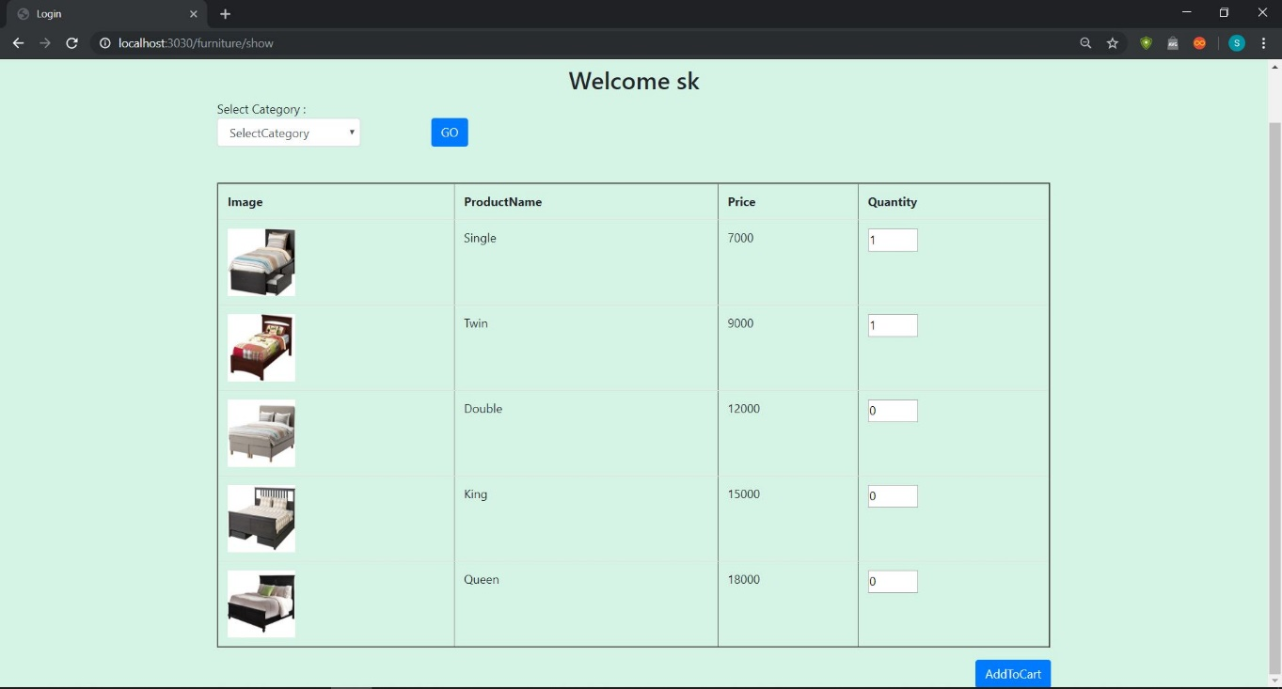
Add to cart
A handy snippet to let users customize a product directly from the products category, and add it to the cart.

Slide 15
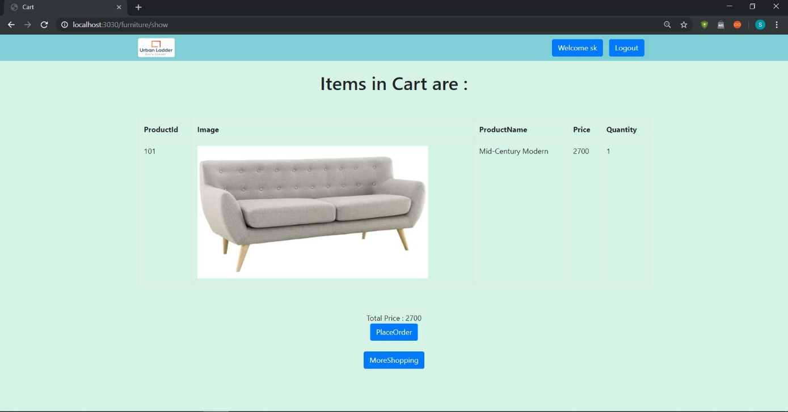
Cart Page
By clicking on cart, that particular item gets added into the shopping cart. Users can add as many items as they want in their shopping cart and “Place Order”. For more products to purchase click on “More Shopping”.

Slide 16
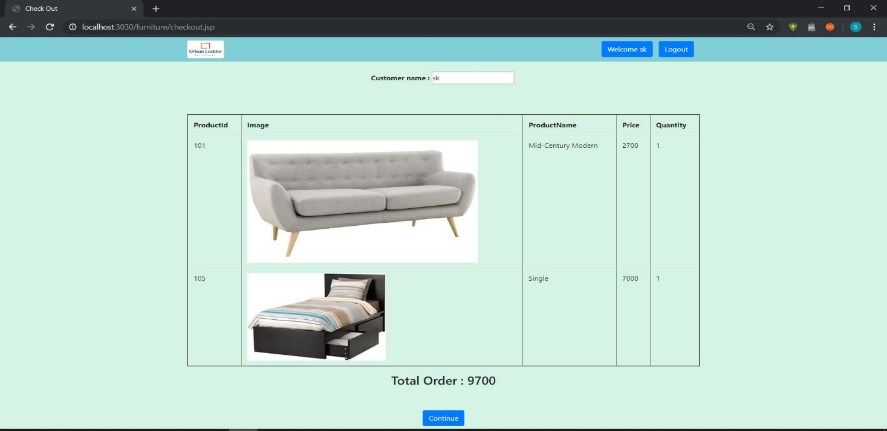
Checkout
The checkout process is the process that a customer must go through when checking out the items in the cart and continue for billing.

Slide 17
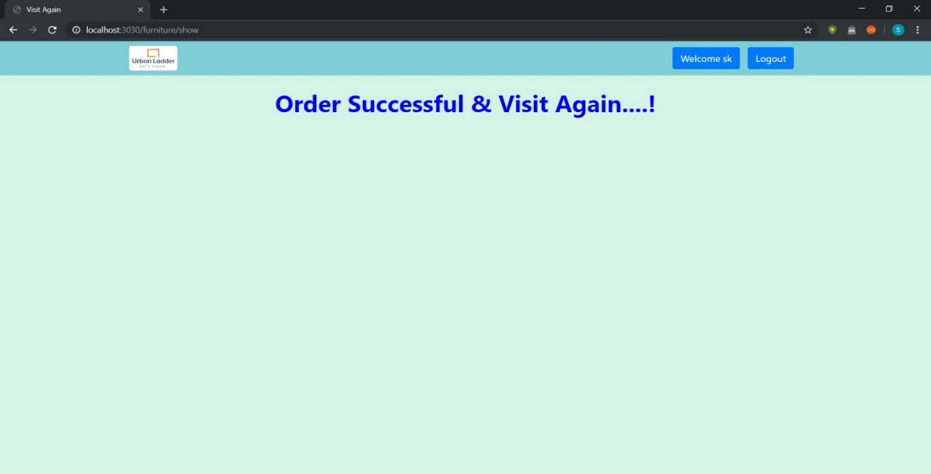
Order Success
A good order success page increases lifetime customer value and provides with loyal customers who redeems store and bring us new clientele.

Slide 18

Logout
Logging out of a session is very important because there are risk with not logging out.

Slide 19
Conclusion
In the current market for online shopping, we do not have many applications to be precisely for furniture shopping. This application facilities more user-friendly interfaces, experience, on the go selections.
There is a scope for further development in our project to great extend. A number of features can be added to this system in future like providing moderator more control over products so that each moderator can maintain own products.

Slide 20
THANK YOU

