Slide 1
MedAssist AI – Symptom Checker
MS AI NSI_INTERNSHIP PROJECT
Image
Presented By:
Sreekanth Jonnakuti
JB Institute of Engineering & Technology
Computer Applications
sreekanth.j26@gmail.com
STU67e77aaa0243c1743223466

Slide 2
Outline
Problem Statement
Proposed System
Architecture
System Development Approach
Algorithm & Deployment
Result
Conclusion
Future Scope
References

Slide 3
Problem Statement
In today's digital age, individuals frequently rely on internet searches to self-diagnose medical symptoms. While convenient, this often leads to misinformation, unnecessary anxiety, or delayed professional care. The lack of accessible, reliable, and personalized tools for symptom analysis creates a gap in early health guidance.
Key issues:
Unreliable symptom interpretation
Overwhelming and incorrect data
Lack of real-time health assistance

Slide 4
Proposed Solution
MedAssist AI is a full-stack, real-time healthcare assistant designed to address the limitations of online self-diagnosis. It leverages both Machine Learning (ML) and Generative AI (LLM) to analyze user-input symptoms and provide reliable condition suggestions and care recommendations:
AI-powered (Cohere LLM) health suggestions
ML-based (Random Forest) disease predictions
Intuitive UI for symptom input
Trustworthy and quick responses

Slide 5
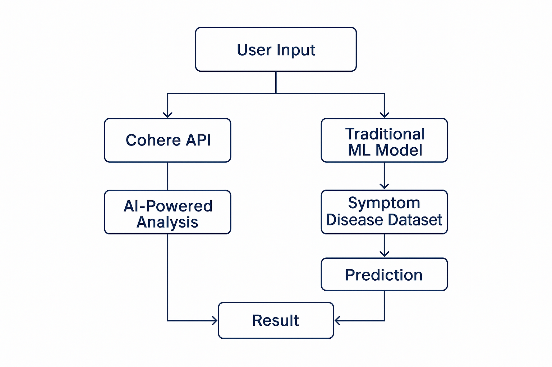
Architechture

Slide 6
System Development Approach
Operating System: Windows
Frontend: ReactJs, Material UI,NodeJs, axios, dotenv
Backend: FastAPI (Python), fastapi, uvicorn, pandas
AI Model: Cohere (Generative LLM)
ML Model: Random Forest (scikit-learn)
Data: Public symptom datasets
Deployment: Vercel (Frontend), Render (Backend)

Slide 7
Algorithm & Deployment
Model: Supervised Learning (Random Forest)
Features: Age, Gender, Symptom Vectors
Labels: Disease Categories
Text Encoding: TF-IDF Vectorization
Deployment:
Frontend: Vercel
Backend: Render

Slide 8
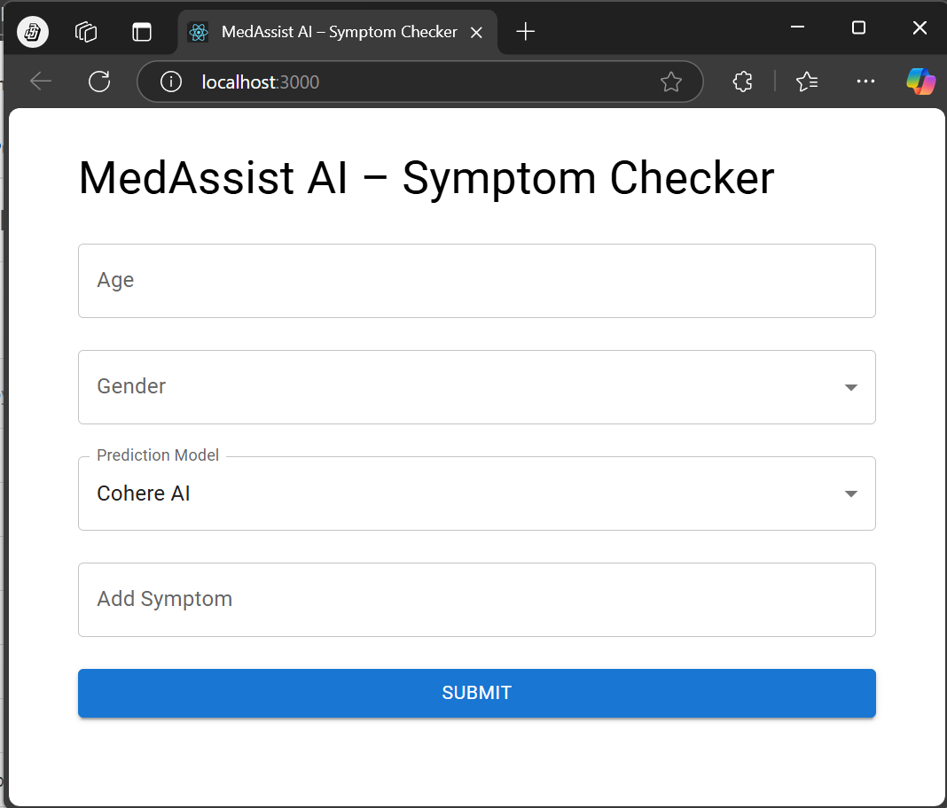
Output
React UI Interface Enter Age, Select Gender, Prediction Model(Cohere AI/Traditional ML), Add Symptoms and Enter then Submit.

Slide 9
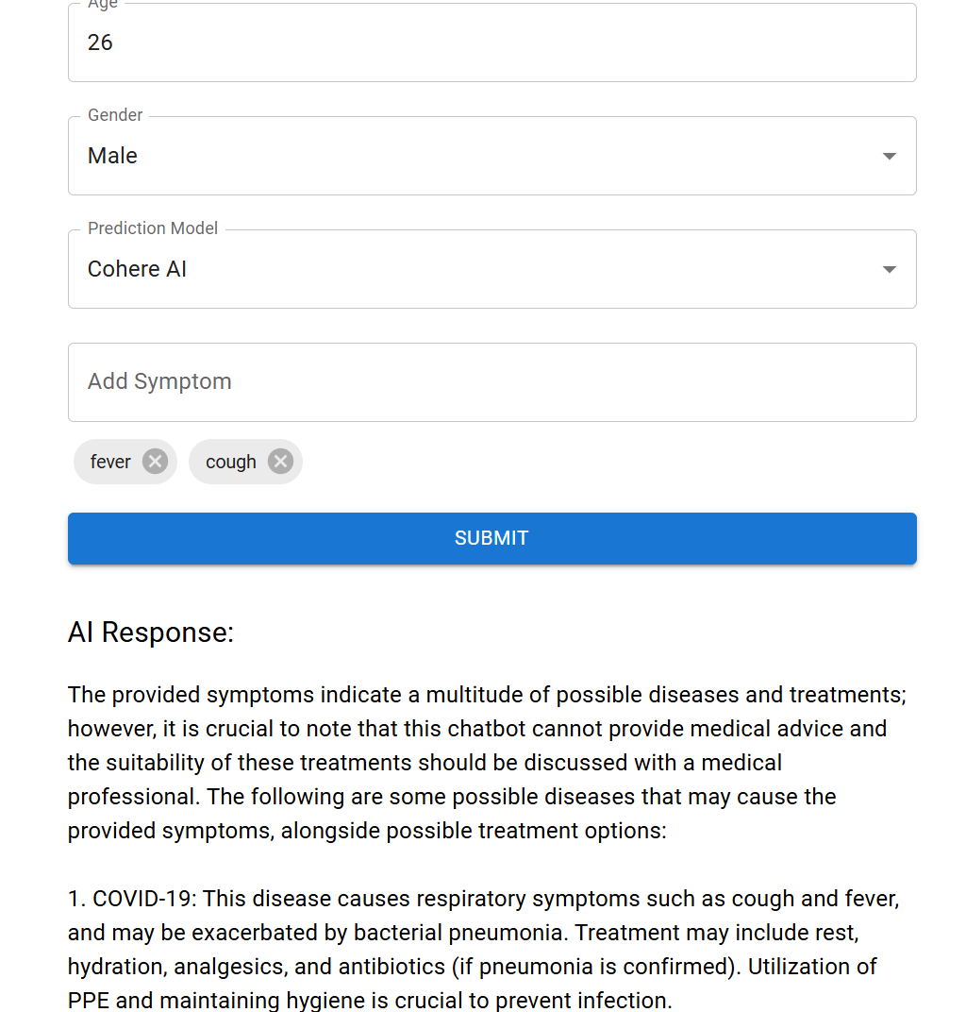
Cohere AI Output

Slide 10
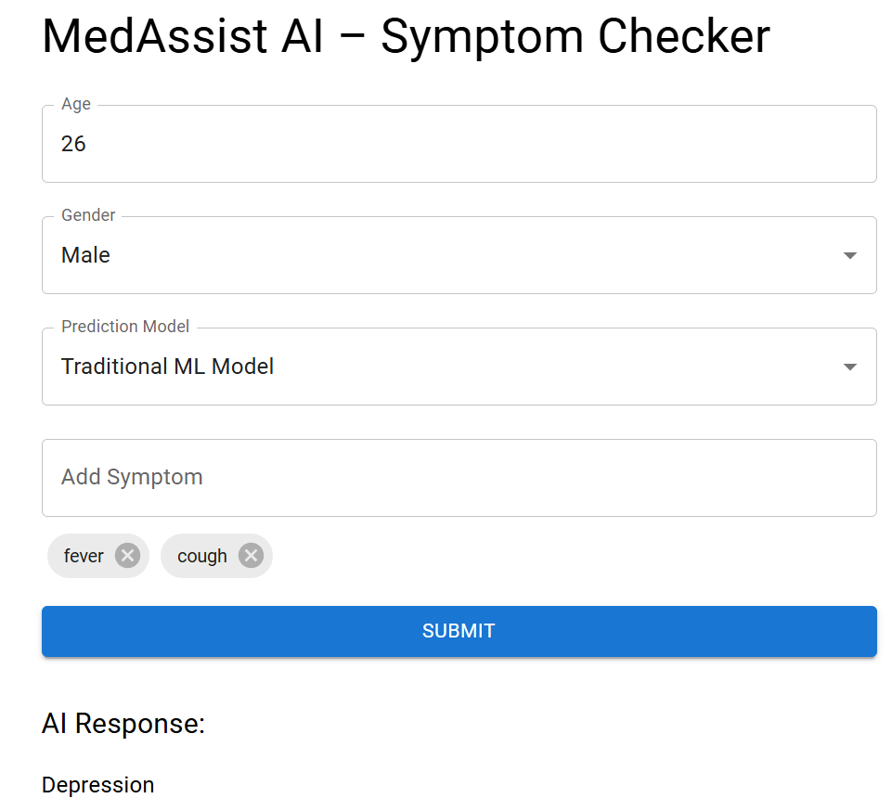
Traditional ML Output

Slide 11
Conclusion
MedAssist AI bridges the gap between symptom checking and professional help.
Uses AI/ML for accessible symptom analysis
Reduces self-diagnosis risks
Available as a web application
Fast, reliable, and user-friendly

Slide 12
Future Scope
Add multilingual support
Integrate medical databases (e.g., ICD-10)
Include mental health symptom analysis
Mobile app version
User history tracking with secure login

Slide 13
References
Cohere AI Documentation
Scikit-learn Random Forest
FastAPI Docs
Public Symptom Datasets (Kaggle/UCI)
React + Material UI Docs
GitHub Link: https://github.com/sree2694/ai-symptom-checker.git
Deployment Link: ai-symptom-checker-delta.vercel.app

Slide 14
Thank you

