Slide 1
BECM399J INDUSTRIAL INTERNSHIP
KODAVALLA SREE VENKAT
21BLC1512
CO:CO2 RATIO PREDICTION USING MACHINE LEARNING BY PYTHON

Slide 2
INDUSTRY COMPLETE ADDRESS & CONTACT PERSONS WITH PHONE NUMBERS
ADDRESS: 1ST Floor, Learning and development centre, Rashtriya Ispat nigam limited(vizag steel plant), Visakhapatnam, Andhra Pradesh, India,530031.
T.V Kameswara Rao,Computer Department, Vizag steel plant phn:7702277238

Slide 3
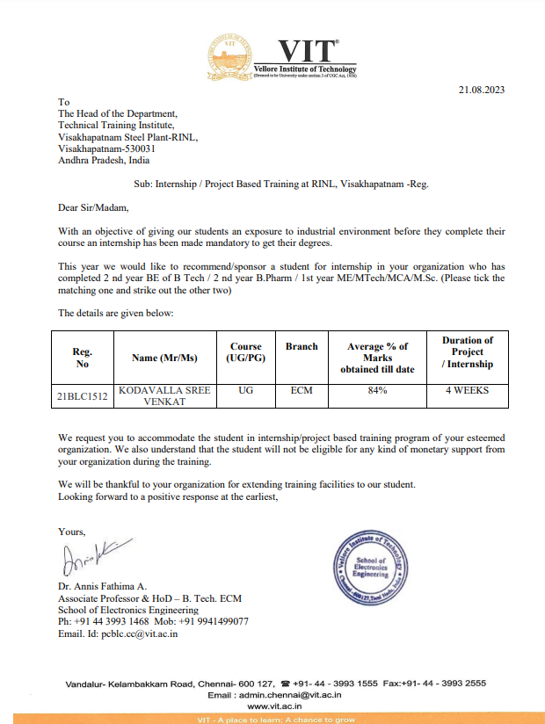

INTERNSHIP COMPLETION Certificate
BONAFIDE CERTIFICATE

Slide 4
AGENDA
About the company
Overview of the project
Proposed model
Model development
Model Evaluation & Implementation
Integration into flask
Conclusion
References

Slide 5
About the company
Rashtriya Ispat Nigam Ltd, (abbreviated as RINL), also known as Vizag Steel, is a central public sector undertaking under the ownership of Ministry of Steel, Government of India based in Visakhapatnam, India. Rashtriya Ispat Nigam Limited (RINL) is the government entity of Visakhapatnam Steel Plant (VSP), India's first shore-based integrated steel plant built with state-of-the-art technology.
Visakhapatnam Steel Plant (VSP) is a 7.3 MTPA plant. It was commissioned in 1992 with a capacity of 3.0 MTPA of liquid steel. The cpsu subsequently completed its capacity expansion to 6.3 MTPA in April 2015 and to 7.3 MTPA in December 2017.

Slide 6
The steel plant is in the southern part of Visakhapatnam city, Andhra Pradesh state of India. The company has blast furnace grade Limestone captive mine at Jaggayyapeta (Krishna District), a captive mine for Dolomite at Madharam (Khammam), a manganese ore captive mine at Cheepurupalli (Vizianagaram). It also has a mining lease for river sand on the river Champavathi.
RINL operates a 7.3 million tonne per annum capacity steel plant in Visakhapatnam. During the initial periods, the company suffered huge losses. Later the profits have gone up by 200% making it the only steel industry to achieve such a target. Its annual capacity is expected to reach almost 7.5 million tonnes by 2020.

Slide 7
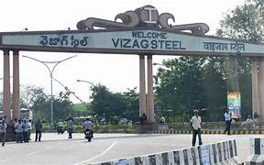
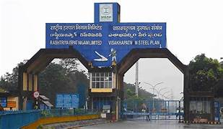
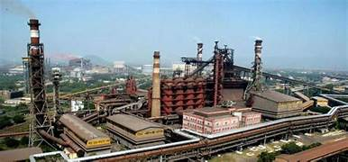
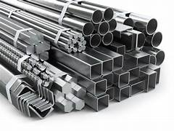

Slide 8
Overview of the project
Our project is to develop a machine learning model that can accurately predict the carbon monoxide (CO) to carbon dioxide (CO2) ratios at different time intervals based on various environmental parameters. The goal is to analyse the relationship between these ratios and the environmental factors to gain insights into the air quality and combustion process
The environment used in our project is a Python-based data analysis and machine learning environment. It includes several popular libraries and tools that enable data processing, modelling, visualization, and web application development.

Slide 9
Proposed model
RANDOM FOREST REGRESSOR: Random Forest Regression is a supervised learning algorithm that uses ensemble learning method for regression. Ensemble a learning method is a technique that combines predictions from multiple machine learning algorithms to make a more accurate prediction than a single model.

Slide 10
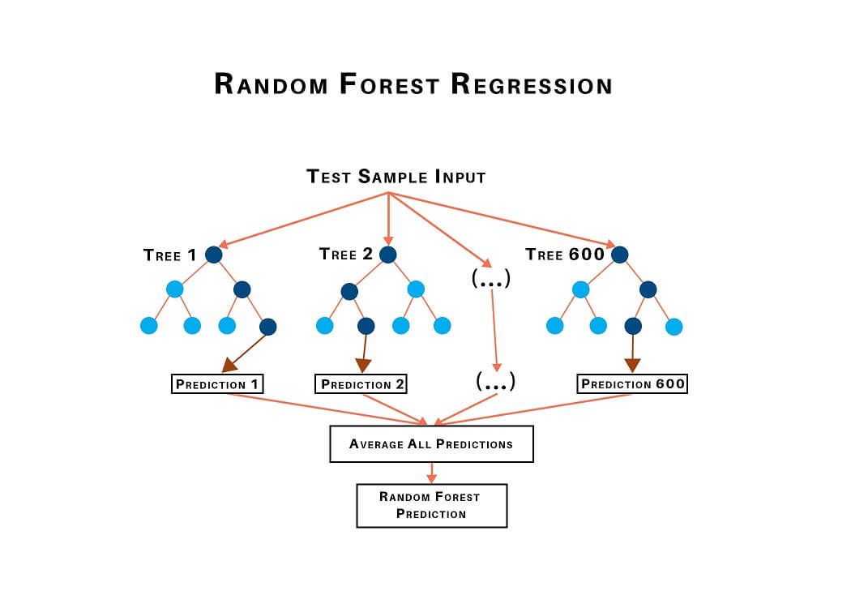

Slide 11
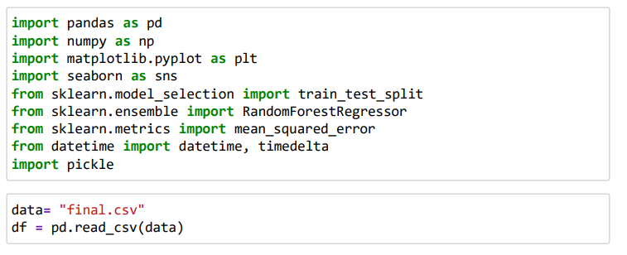
Model development
The following source code is used to train the model using the dataset"co_co2.csv”.

Slide 12
The approach used to predict the development model for the project involves the following steps:
1. Data Preprocessing: The input dataset is preprocessed to handle missing values. In this case, the missing values in the CO:CO2 ratios are filled with the median values. Additionally, the dataset is split into input features (X) and target variables (y).
2. Training and Testing Split: The dataset is split into training and testing sets using the train_test_split function from the scikit-learn library. This allows for model training on a portion of the data and evaluation on unseen data.
3. Model Selection and Training: A Random Forest Regressor model is chosen as the prediction model. The Random Forest Regressor is an ensemble model that combines multiple decision trees to make predictions. The model is trained using the training set and the CO:CO2 ratios at different time intervals as target variables.

Slide 13
4. Model Evaluation: The trained model is evaluated using the testing set. Mean squared error (MSE) is calculated to assess the performance of the model. Additionally, accuracy is derived by subtracting the MSE from 1.
5. Saving and Loading the Model: The trained model is saved to a file using the pickle module, allowing for future use without the need for retraining. The saved model can be loaded later for making predictions on new data.

Slide 14
Model Evaluation & Implementation
In our project, accuracy and mean squared error (MSE) are calculated to evaluate the performance of the regression model. Here's the purpose of calculating these metrics:
1. Mean Squared Error (MSE): MSE is a commonly used metric to measure the average squared difference between the predicted and actual values. In the project, MSE is calculated for each of the predicted CO:CO2 ratio values after 1, 2, 3, and 4 hours. It provides a quantitative measure of how well the model's predictions align with the actual values. A lower MSE indicates better predictive performance, as it means the model's predictions are closer to the actual values.
2. Accuracy: While accuracy is typically used in classification tasks, in this project, the term "accuracy" is used to represent a metric that complements the MSE calculation. It is calculated as 1 minus the MSE, so higher accuracy values indicate lower MSE and better model performance. However, it's worth noting that the term "accuracy" is not typically used in regression tasks, where metrics like MSE or root mean squared error (RMSE) are more commonly employed

Slide 15
By calculating MSE and accuracy, the project aims to assess the quality of the regression model's predictions. These metrics provide a quantitative measure of the model's performance, allowing for comparison and evaluation against other models or for tracking improvements over time. They help in understanding how well the model is capturing the patterns and variability in the data and can guide further model refinement or selection
GRAPHICAL REPRESENTATION Representing the predicted values and their differences from the actual values in graphical form has several benefits:
1. Visual Comparison: Graphical representations allow for a quick and intuitive comparison between the predicted values and the actual values. It provides a visual means to assess how well the model's predictions align with the ground truth. By plotting the data points or lines, any discrepancies or patterns can be easily identified and interpreted.

Slide 16
2.Pattern Visualization: Graphs can reveal patterns or trends in the data that may not be apparent from numerical values alone. By visualizing the data, it becomes easier to observe any systematic variations, cyclic patterns, or other relationships between the predicted and actual values. This can provide insights into the performance of the model and potential areas of improvement.
3. Communicating Results: Graphical representations are often more accessible and easier to interpret for stakeholders or non-technical audiences. By presenting the data in a visual form, the results of the model's predictions can be effectively communicated, facilitating better understanding and decision-making.

Slide 17
4.Error Analysis: Graphs can aid in error analysis by highlighting regions where the model performs well or poorly. For example, by plotting the absolute differences between predicted and actual values, it becomes evident which areas have higher or lower prediction errors. This information can guide further investigation into the underlying factors contributing to the errors and inform model refinement strategies. Visualizing the predicted values and their differences in graphical form enhances the interpretability, understanding, and communication of the model's performance. It allows for quick insights, pattern recognition, and error analysis, ultimately facilitating better decision-making and guiding further improvements in the model.

Slide 18
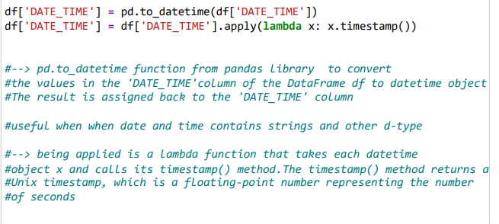


Slide 19
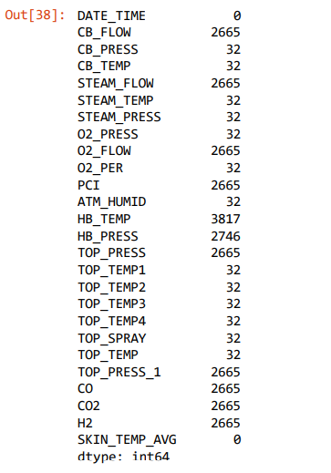


Slide 20
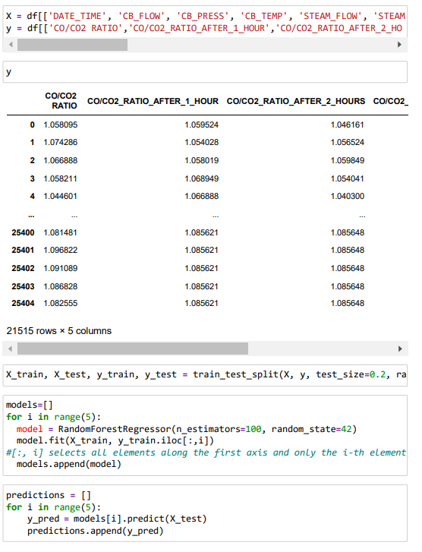
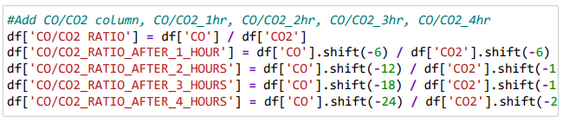
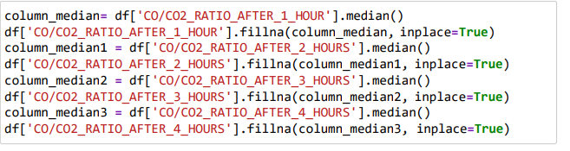

Slide 21
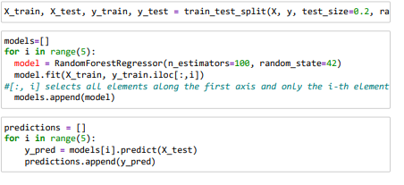
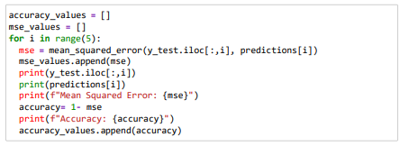
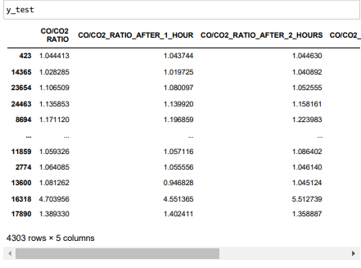
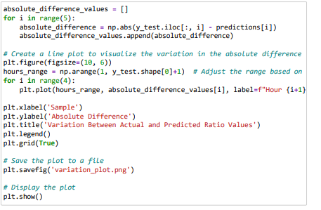

Slide 22
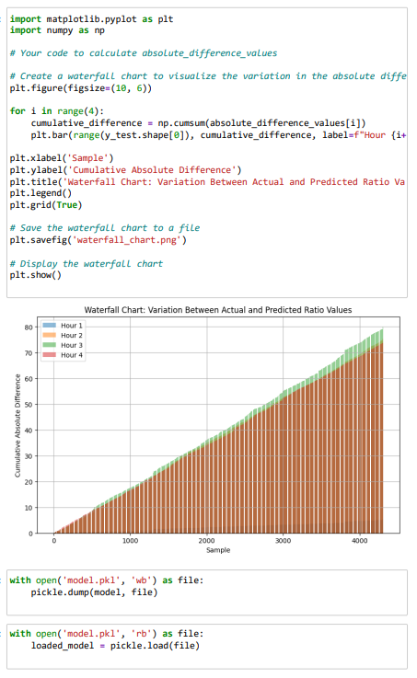
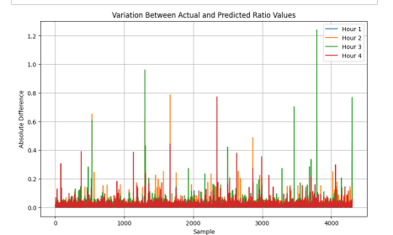
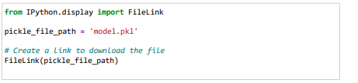

Slide 23
Integration into flask
INTEGRATION INTO A FLASK APPLICATION The machine learning model was developed using a Random Forest Regressor algorithm to predict the CO:CO2 ratios after 1, 2, 3, and 4 hours. Once the model was trained and evaluated, it was integrated into a Flask web application. The Flask code served as the backend of the system, handling HTTP requests and generating responses. The trained machine learning model (Random Forest Regressor) was loaded within the Flask application. The Flask routes were set up to handle incoming requests, gather the required input data, and make predictions using the loaded model. The predictions were then used to generate the desired output, which included the predicted ratios, visualizations, and other relevant information. By integrating the machine learning model with the Flask code, the system was able to provide real-time predictions based on user input. This allowed users to interact with the model through a user-friendly web interface, making it more accessible and practical for practical use.

Slide 24
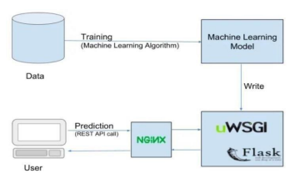

Slide 25
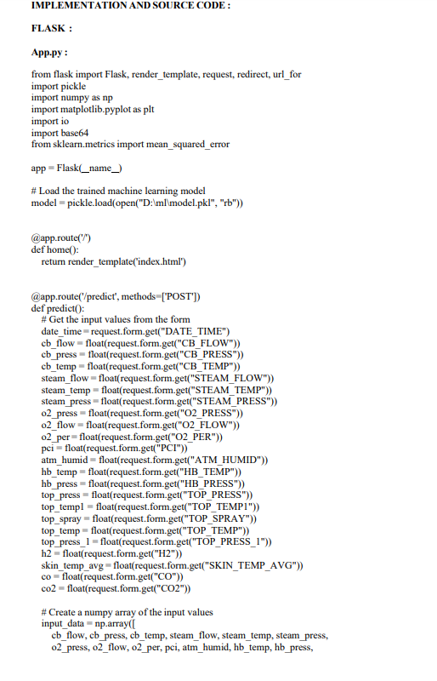
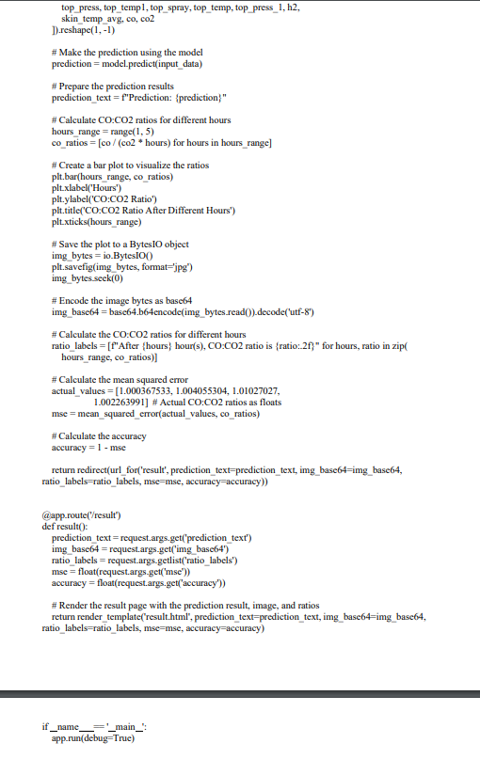

Slide 26
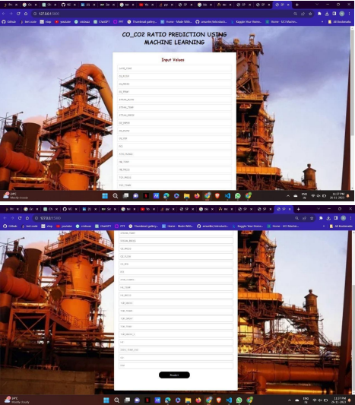
This represents the web page which takes the Blast furnace parameters as the input and using those input values along with the trained Machine Learning model it calculates the predicted co and co2 ratio values after certain time intervals. The prediction values are clearly shown in the result page using a graphical representation. Since the ratios are decreases as the time interval increases, the accuracy is good for the model.

Slide 27
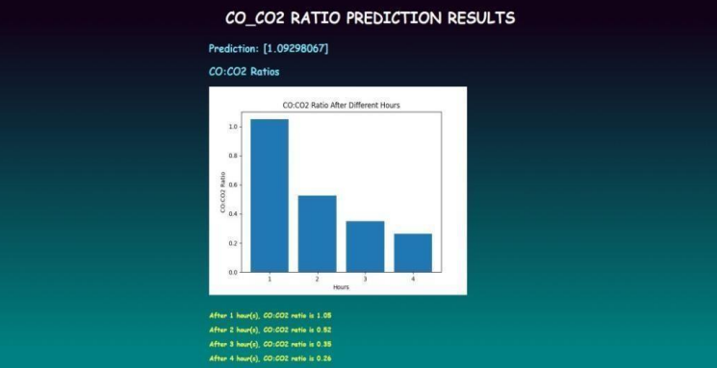
Conclusion
In conclusion, the CO:CO2 Ratio Prediction project aimed to develop a machine learning model to predict the CO:CO2 ratio based on various input parameters. The project involved training a model using historical data and deploying it using a Flask web application.

Slide 28
The machine learning model was trained on a dataset containing input parameters such as temperature, pressure, flow rates, and other environmental factors. The target variable was the CO:CO2 ratio. The model was trained using an appropriate algorithm and evaluated for its predictive performance. Upon submitting the form, the application utilized the trained model to make predictions based on the provided inputs. The predicted CO:CO2 ratio was displayed to the user. Furthermore, the application generated a bar chart visualizing the CO:CO2 ratios after different hours. The chart provided insights into the change in the ratio over time. The application also calculated the mean squared error and accuracy of the predictions, providing additional evaluation metrics. Overall, the project successfully demonstrated the implementation of a machine learning model for CO:CO2 ratio prediction and its integration into a Flask web application. The system enables users to make predictions and visualize the results, facilitating decision-making in relevant domains such as emissions control, energy production, or environmental monitoring

Slide 29
REFERENCES
1. Zhang, Y., Gao, S., & Zhang, J. (2019). Predicting the CO and CO2 concentration in coke oven gas using random forest and support vector regression. Journal of Chemical Engineering of Japan, 52(3), 267-273.
2. Sun, H., Li, X., Li, M., & Fang, H. (2016). Prediction of coke oven gas heating value using an optimized least squares support vector machine. Energy, 100, 46-56.
3. Liu, J., Li, W., & Zhang, Y. (2019). Prediction of coke oven gas quality based on a combination of BP neural network and least squares support vector regression. Energy Procedia, 158, 3462-3467.
4. Chang, K. L., Lu, C. M., Chen, S. J., & Liao, S. Y. (2016). Prediction of coke oven gas composition by adaptive network-based fuzzy inference system. Journal of the Taiwan Institute of Chemical Engineers, 66, 278284.

Slide 30
5. Li, L., Li, Z., & Zhang, J. (2018). Prediction of coke oven gas composition using an improved least squares support vector machine. Journal of Chemical Engineering of Japan, 51(3), 257-262.
6. Zhang, J., Wang, H., & Gao, S. (2018). Prediction of coke oven gas composition using extreme learning machine optimized by improved differential evolution algorithm. Journal of Chemical Engineering of Japan, 51(3), 251- 256.
7. Sánchez-Marcano, J., Solano, A. F., Córdova, F. M., & Durán, G. (2020). Prediction of coke oven gas composition through an artificial neural network model. Petroleum Science, 17(6), 1762-1774.

Slide 31
8. Scikit-learn: Machine Learning in Python - https://scikit-learn.org/stable/
9. Flask Documentation - https://flask.palletsprojects.com/en/2.1.x/
10. Matplotlib Documentation - https://matplotlib.org/stable/contents.html
11. Python Pickle Module Documentation - https://docs.python.org/3/library/pickle.html
12. NumPy Documentation - https://numpy.org/doc/ 13. OpenAI GPT-3.5 Documentation - https://platform.openai.com/docs/guides/chat

