Slide 1
Coursera Capstone Project Battle of the Neighbourhoods
Sree Akshaya

Slide 2
Introduction
Chennai is one of the largest and busiest cities in India making it a great place to set up a business. It has a population of around 70 lakhs over an area of 400 km sq. The issue is, a city as large as itself with thousands of businesses, could be over saturated. Not every neighbourhood might be ideal for all businesses. For example opening a clothing store in a neighbourhood with many already existing prominent stores is not a good business decision. So, in this project, we seek to help clients with such motives to find out the most profitable neighbourhoods in Chennai to start up a food related business.

Slide 3
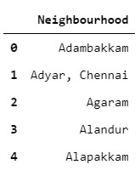
Data
The data required for this project is the list of all neighbourhoods in
Chennai, which was taken from Chennai's wikipedia page by web
scraping using the Python library BeautifulSoup.

Slide 4
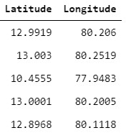
We also require the geocoding details of each neighbourhood, that is, their latitude and longitude values which were taken from Bing's Geocoder API using a basic account.

Slide 5
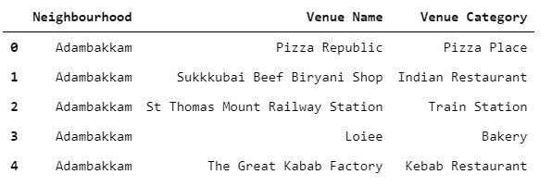
Now, to gather the venues in each neighbourhood to reach a decision based on them, we used the Foursquare API. From this, we were able to gather a list of businesses in each neighbourhood.

Slide 6
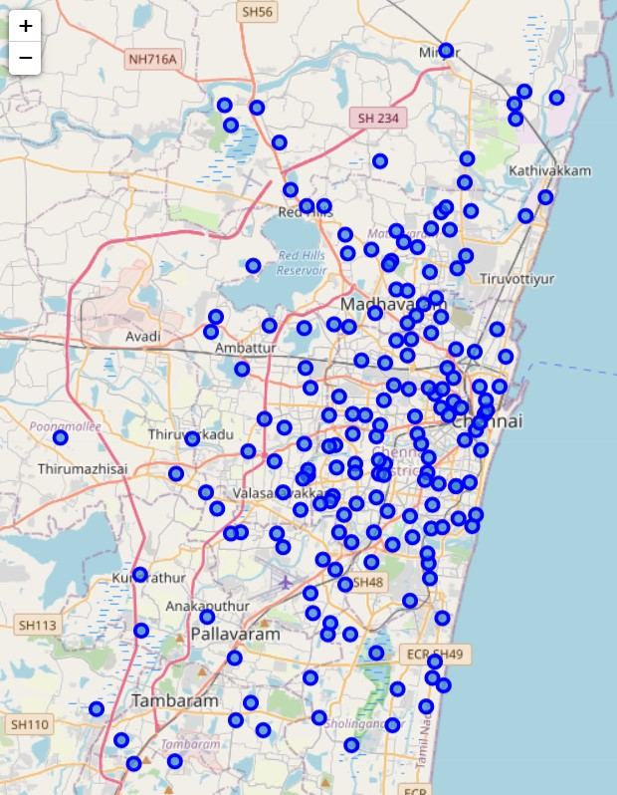
Methodology
Folium was used to create an interactive map of Chennai with the neighbourhoods in question highlighted.

Slide 7
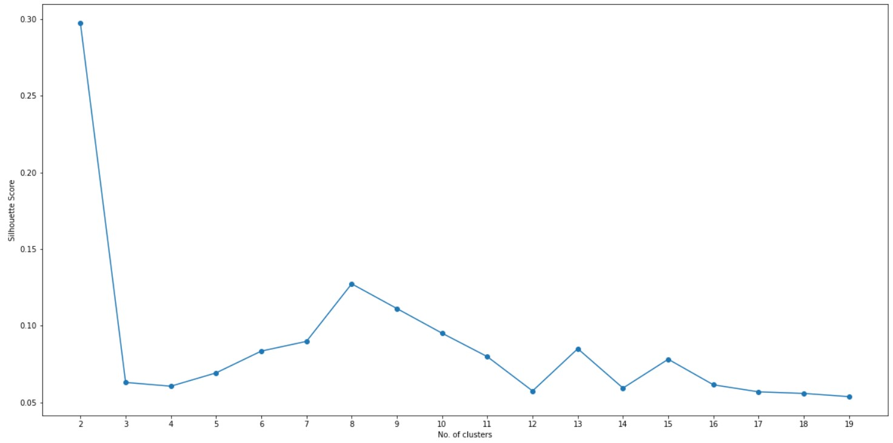
The Silhouette Score was used to determine how many clusters gave optimal results. Since 2 clusters are too less, 8 clusters, with the next best score was chosen.

Slide 8
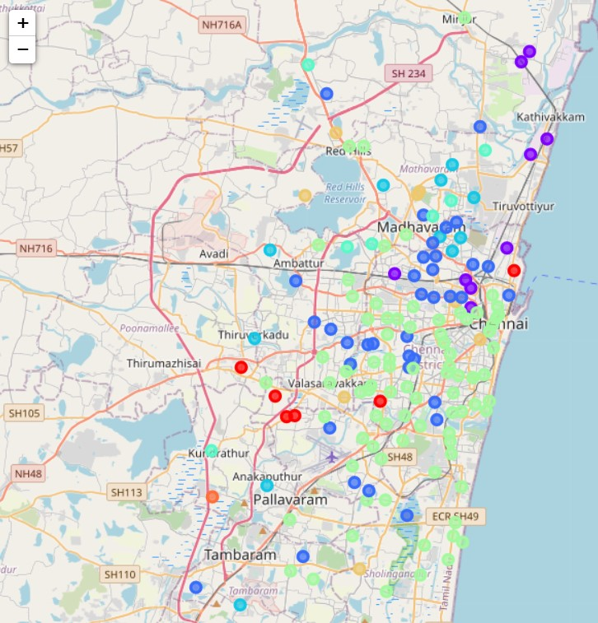
K - Means Clustering Algorithm was used to get the optimal clusters. In the image we can see 8 different colours with each colour representing a different cluster.

Slide 9
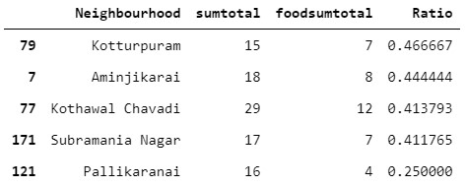
Results
To determine which of the eight clusters was best for starting a food related business, we calculated the number of business venues and food related business venues in each neighborhood. And then found which cluster had the largest number of neighborhoods with the number of business venues larger than average (making it a busy place) and the number of food related business venues smaller than average, making it an optimal location and ensuring good business. The cluster that had these properties was Cluster 3, and in that 5 specific neighborhoods were the best possible choices.

Slide 10
Conclusion
We have found that for a client who wants to open a food related business in Chennai, it is recommended to open it in one of the neighborhoods in cluster 3, and specifically one of the 5 above mentioned neighborhoods, for a profitable business venture.

