Slide 1

SQL Analysis: Sales Data Insights
SREE BHAIRAVI

Slide 2
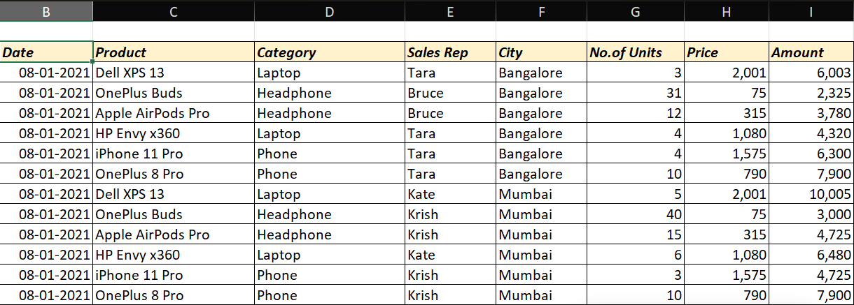
Introduction
Project Overview:
- Analyze sales data to extract actionable business insights.
Objective:
- Identify key sales drivers, trends, and opportunities.
Dataset Summary:
- Sales data including product, category, sales amount, units sold, city, sales rep, and date.

Slide 3
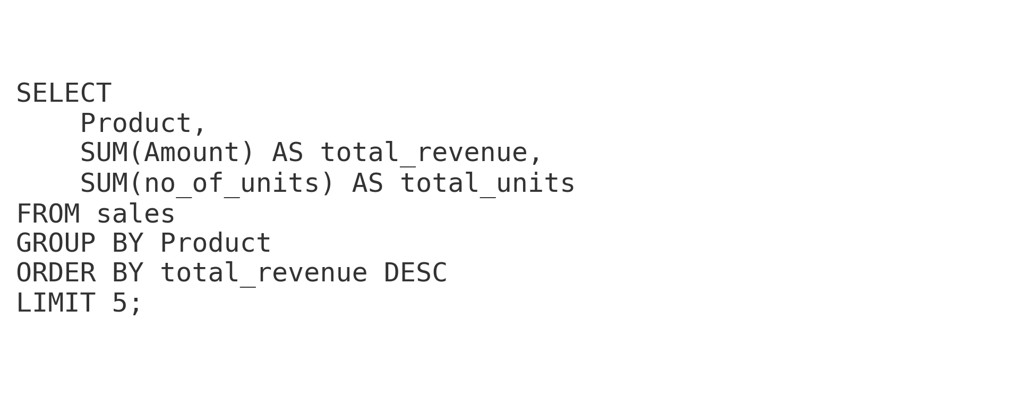
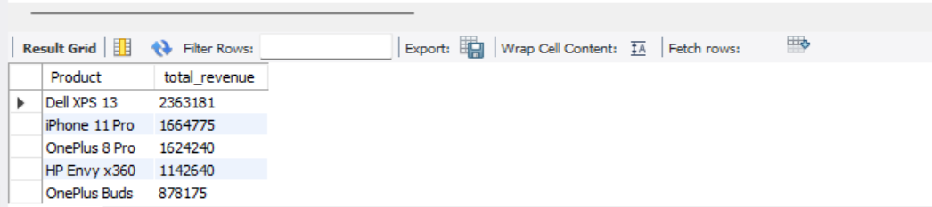
Top-selling Products
Find the top 5 products by total sales amount.
INSIGHTS –
The top 5 products contribute the highest share of total revenue, indicating strong demand and profitability.
These products should be prioritized for marketing, stock planning, and sales focus.

Slide 4
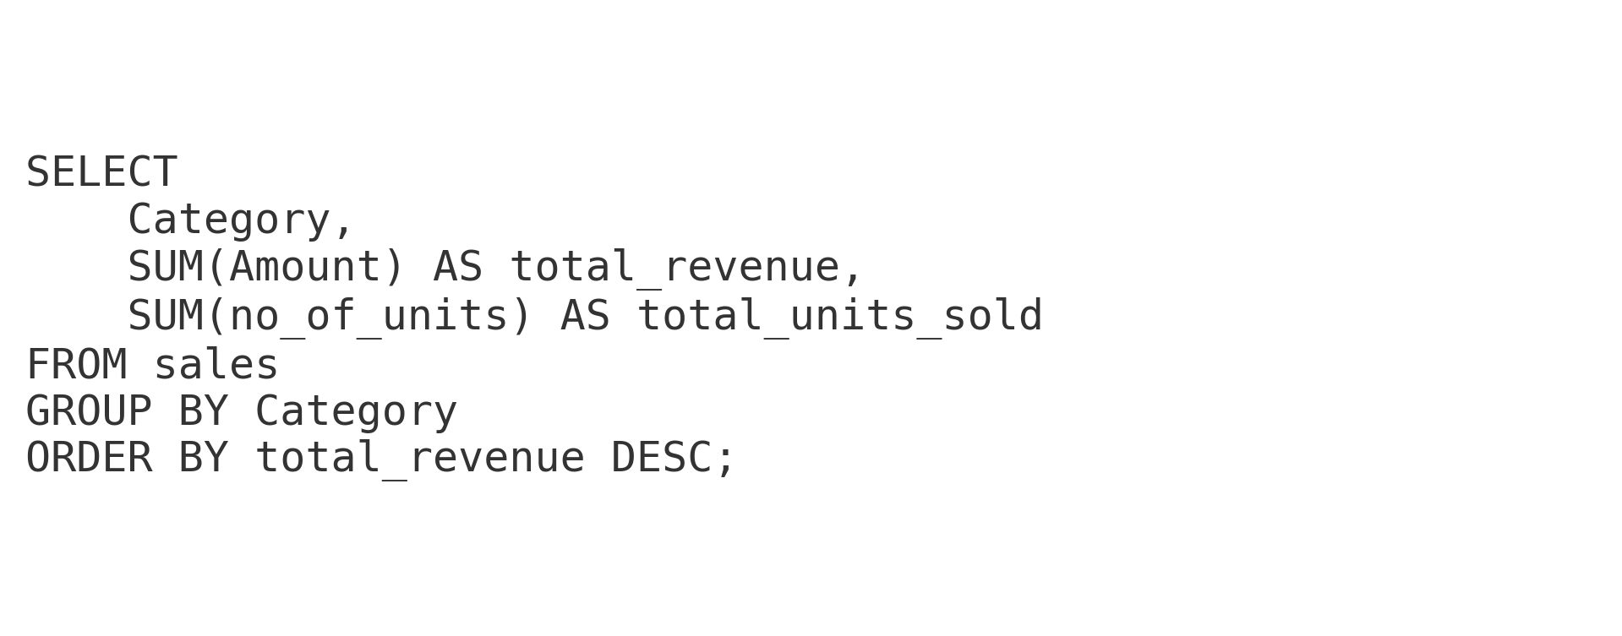
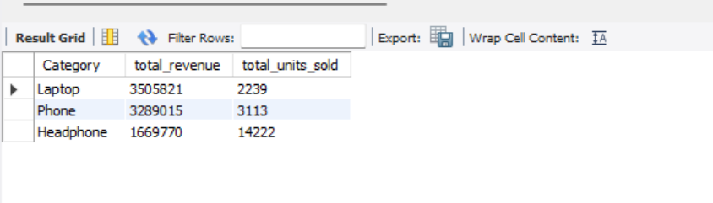
Category-wise Performance
Compare total sales and units sold for each category (Laptop, Headphone, Phone, etc.).
INSIGHTS-
This query reveals which product categories generate the highest revenue and how many units they sell.
It helps identify whether high sales volumes are translating into proportional revenue across categories.

Slide 5
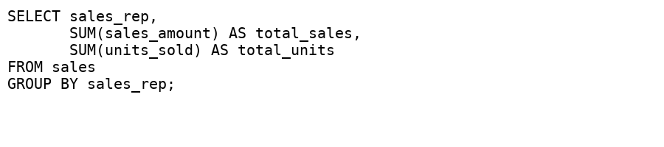
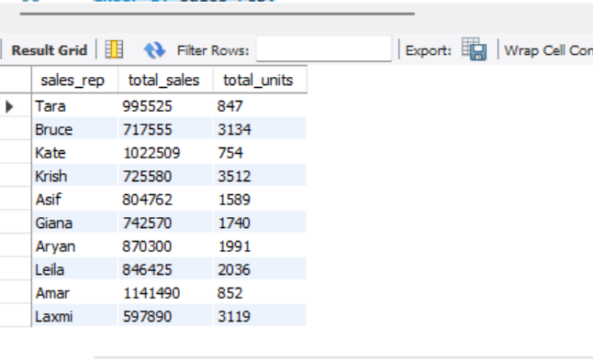
Sales Rep Performance
Calculate total sales amount and units sold per sales representative.
INSIGHTS-
This query reveals which product categories generate the highest revenue and how many units they sell.
It helps identify whether high sales volumes are translating into proportional revenue across categories.

Slide 6
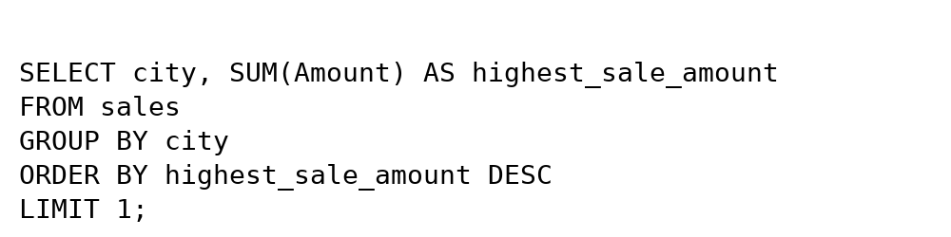
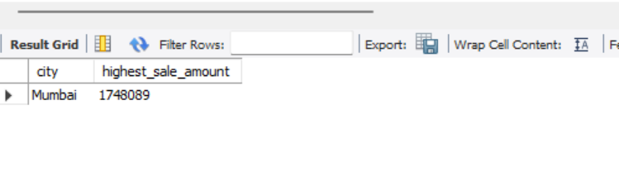
City-wise Sales Distribution
Determine which city has the highest total sales amount.
INSIGHTS-
Highlights the single most revenue-generating city, enabling data-driven focus on top-performing markets for maximum ROI.

Slide 7
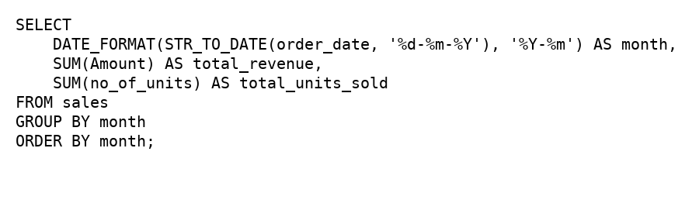
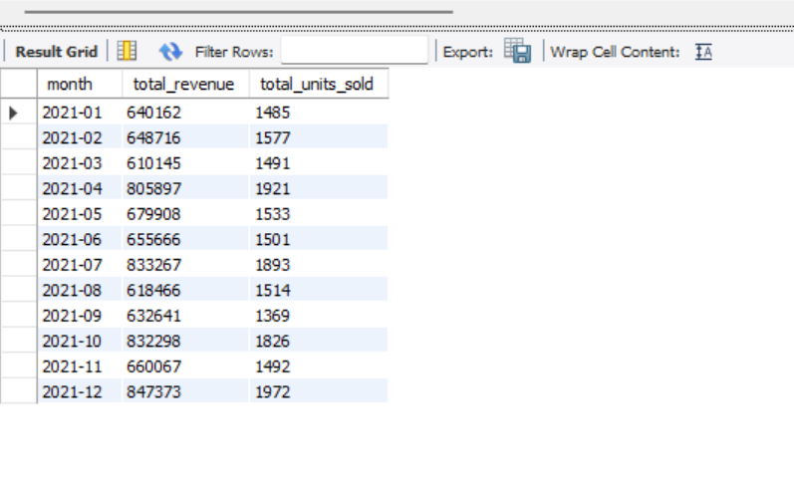
Monthly Sales Trends
Group sales by month to see revenue trends over time.
INSIGHTS-
It helps identify sales trends over time, detect seasonal spikes, and analyze how sales volume correlates with revenue month-by-month.

Slide 8
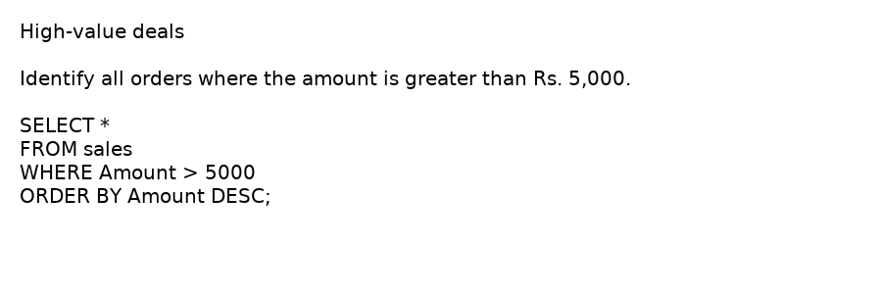

High-Value Deals
Identify all orders where the amount is greater than ₹5,000.
INSIGHTS-
Filters only the orders where the Amount > Rs. 5,000, meaning these are big-ticket purchases.
Useful for:
Identifying premium customers.
Targeting upsell/cross-sell opportunities.

Slide 9
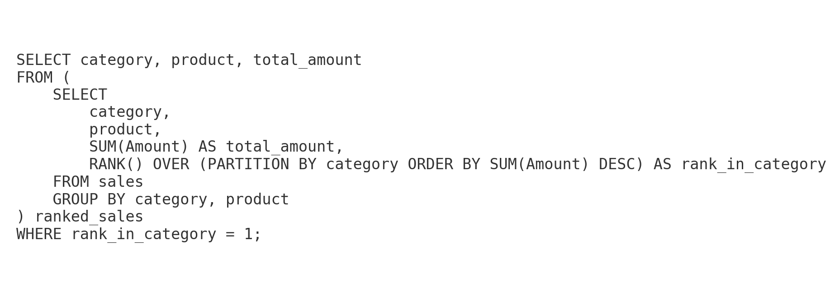
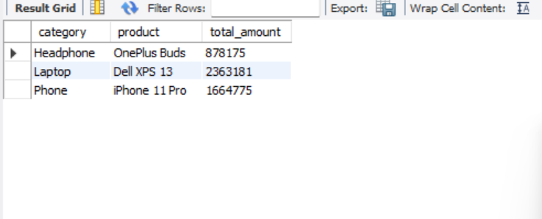
Most Profitable Product in Each Category
For each category, find the product with the highest sales amount.
INISGHTS-
You’ll see which products have generated the highest revenue.
By scanning the list, you can spot the top product in each category.

Slide 10
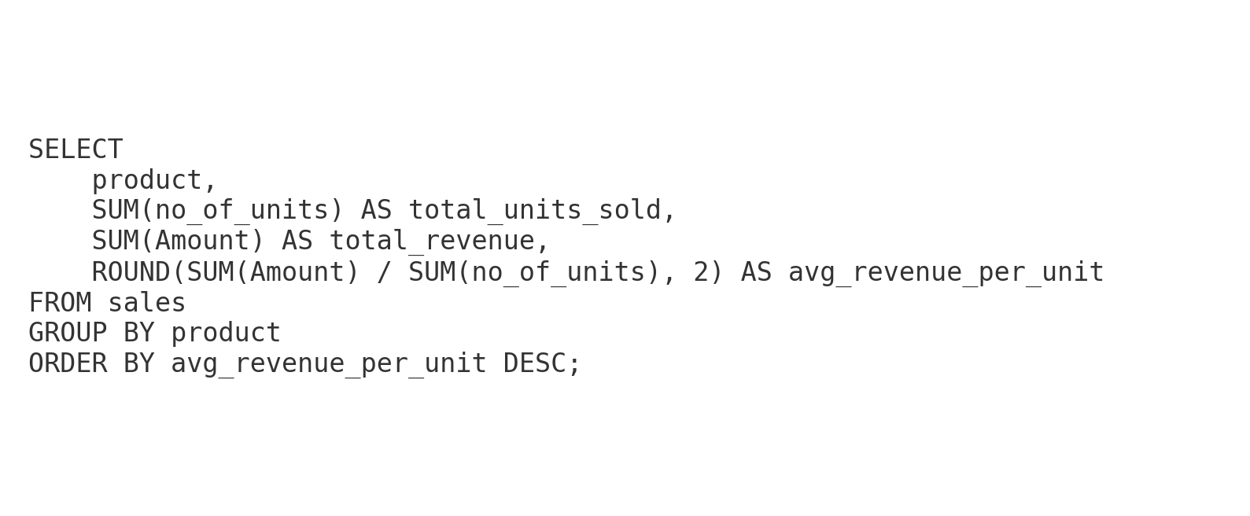
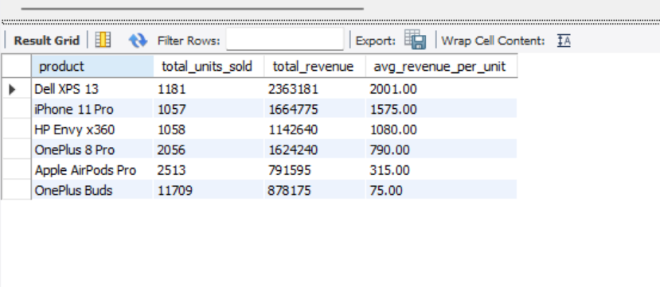
Units vs. Revenue Correlation
Compare which products have high units sold but low revenue, and vice versa.
INSIGHTS-
This analysis can help in strategic pricing — increasing prices slightly for high-volume low-revenue products could boost profits, while targeted marketing could improve sales of high-value low-volume products.

Slide 11
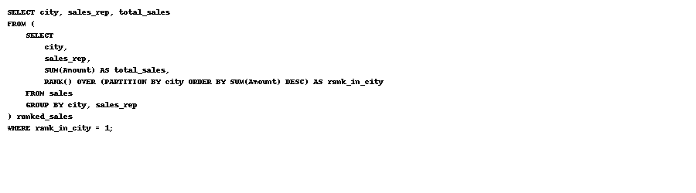
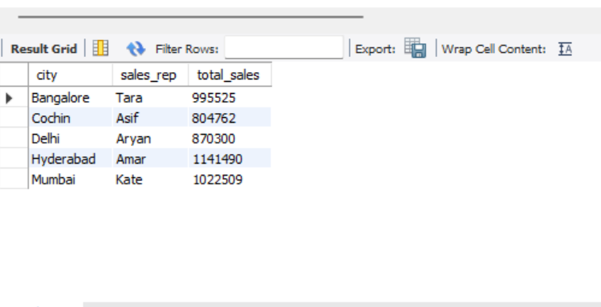
Sales Rep City Dominance
For each city, find the sales rep with the maximum sales.
INSIGHTS-
The analysis identifies the top-performing sales representative in each city, highlighting regional sales leadership and dominance.
Insights reveal potential for cross-city strategy sharing and targeted incentives to boost performance in lower-revenue markets.

Slide 12
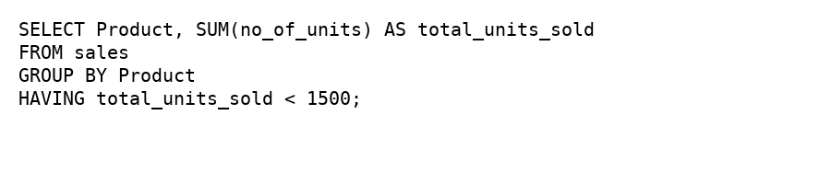
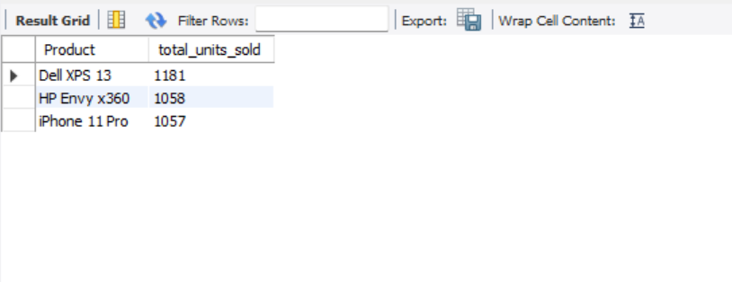
Slow-moving Products
List products that have sold less than 1500 units in total.
INSIGHTS-
The query highlights low-performing products with total sales volume below 1,500 units, signaling low demand or limited market penetration.
These products may require targeted marketing, promotional discounts, or a reassessment of inventory investment to improve sales performance.

Slide 13

Sales Analysis – Key Insights
🔎 Key Insights
Top Revenue Driver: Dell XPS 13
Laptops = 52% of revenue
Mumbai leads in sales
Amar & kate are top reps
Avg. order value = ₹4,223
🚀 Business Recommendations
Promote phones + bundle headphones
Strengthen laptop campaigns
City-focused campaigns (Cochin, Hyd)
Incentivize & train reps
Tiered pricing strategy

Slide 14









Summary
Sales Analysis Summary
Title: Comprehensive Sales Insights
Top Performers Identified – Revenue is concentrated in a few top-selling products and category leaders.
Category-Level Strengths & Gaps – Laptops lead in revenue, but other categories have growth potential.
Sales Rep Impact – Clear city-wise leaders, revealing regional dominance patterns.
Market Hotspots – Certain cities consistently outperform others in revenue.
Seasonality Detected – Monthly trends highlight clear sales peaks and off-seasons.
High-Value Contribution – Large orders significantly boost revenue share.
Profitability Drivers – Identified the most profitable products in each category.
Unit–Revenue Imbalance – Some products sell well in quantity but contribute less to revenue.
Low-Performance Alerts – Slow-moving products detected, indicating possible dead stock.

Slide 15
Strategic Recommendations
Title: Action Plan for Growth & Optimization
Double Down on Winners – Increase marketing spend, stock, and availability for top-selling products.
Replicate Success – Share sales strategies from top-performing reps & cities to underperforming areas.
Leverage Seasonality – Align promotions, launches, and campaigns with peak months.
Push Premium Sales – Encourage upselling and loyalty rewards to boost high-value orders.
Optimize Margins – Adjust pricing/packaging for high-unit but low-revenue products.
Revive or Retire Low Movers – Use targeted discounts for slow movers; discontinue if no improvement.
City-Focused Growth Plans – Tailor product mix & offers to match regional preferences.

Slide 16

THANK YOU

