Slide 1
Balancing academic curricula by using a mutation-only genetic algorithm
Submitted by ,
M.Sri Charan 16CO228
M. Chakradhar 16CO226
R. Umesh Sai 16CO240
Kunal 16CO227

Slide 2
Introduction :
The balanced academic curriculum problem consists in the assignation of courses to academic periods satisfying all the load limits and prerequisite constraints .
An intuitive intention would be to have the courses distributed into semesters so that the load of the students over different semesters is as balanced as possible.
In this paper, we present the design of a solution to the balanced academic curriculum problem by using Genetic Algorithm.

Slide 3
The BACP Formulation :
Load Limits : A minimum and a maximum number of courses, denoted by and , respectively, can be assigned to each term.
Prerequisites : Based on their content, some courses have prerequisites, that is, a set of courses that the students must attend earlier . If course “i” is a prerequisite of course “j”, then it has to be assigned to a teaching period that strictly precedes the one assigned to course .
Equal Distribution of Load : The distribution of credits among the teaching periods must be balanced. Ideally, each term should have the same number of credits.

Slide 4
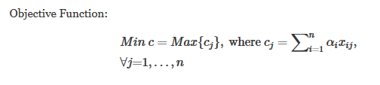
Genetic Algorithm :
In the above mathematical formulation, it represents the objective of optimizing the problem, which is minimizing the deviation of the credit load from the mean credit load of all the periods, in terms of the academic credits assigned to it

Slide 5

Solution approach :
Representation :
The representation of a candidate solution is done by using a one dimesnsional array equals to number o periods ,where each member of the array is a list .
The array equals the number of periods , where the length of each list is determined by the number of assigned courses at a certain period

Slide 6
Mutation Operators :
Swap Operator :
In order to apply a number of swaps between different courses of a given individual, the swap operator iterates through a loop for a number of iterations (as specified by sw parameter)
During the course of a single iteration, two distinct periods (i.e p,q ) are selected randomly, and then, their respective feasible courses (i.e. courses that satisfy the perquisite constraint) are enlisted (ie CLp , CLq) .
Afterwards, the first pair of courses, which is obtained by combing courses from CLp , CLq lists and that produces a feasible mutation, is used to mutate the current individual Im ,by swapping the places of the selected courses.

Slide 7
Mutation Operators :
Shift Operator :
The shift operator (see Algorithm 2) is also executed for several iterations, as specified by sh parameter .
During the progress of a given iteration, initially, a random period is selected, and then, one of its courses (i.e. course c ) During the progress of a given iteration, initially, a random period is selected, and then, one of its courses (i.e. course .
Next, the periods that can accept course c , are initially outlined, and then, one of them is selected randomly as the period that will accept the envisioned course.

Slide 8
Initialization :
In a typical instance of the academic curricula balancing problem, courses are ordered based on the number of prerequisites they have.
Courses with no prerequisites are placed first then courses with one prerequisite and so on.
At the beginning in order to start with a balanced curricula, in terms of the number of courses, each period is set (estimated) to accept equal number of courses, unless there is an odd number of courses, which requires that some of the periods have an additional course.
Next ,by following the ascending order of the number of perquisites, the courses are dispatched into the available periods, subject to the constraints of min/max credit load and course perquisites
After forming the initial population, we evaluate the fitness of each individual in the population and they are ordered based on their fitness values.

Slide 9
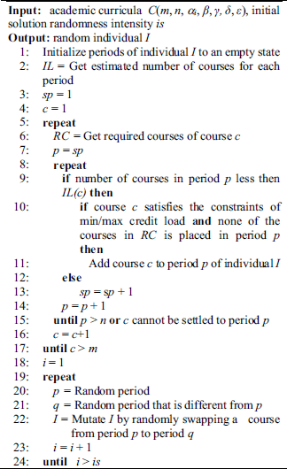

Slide 10
Implementation :
At the very start of the algorithm, a list of two possible operators to be used is defined, which is made of swap and shift operators.
Then, a population P of ps individuals , is created by using the procedure for creating the initial solution . Next, in the repetitive phase of the algorithm, at each iteration, the following steps are undertaken:
Evaluation of all individuals. In case a new best individuals is found, it is saved as the best solution found so far,
Formation of the new population by selecting the parents based on tournament selection and fitness function and by mutating them through the operator (i.e. swap or shift) used in the running iteration
Before the next generation commences, based on the af parameter, one of the two operators is picked for acting as a mutation operator in the next stage.

Slide 11
THANK YOU !

