Slide 1
AI-Powered Security Operations Center (SOC)
Sentinel: a mobile-integrated SOC for detecting, analysing and remediating risky Android apps
K. Sreecharan (2411CS040159) | TV. Sreehari (2411CS040163)
Department of Cyber Security | Malla Reddy University | Under the guidance of Mrs. Priyanka Chandragiri

Slide 2
Abstract
Sentinel is a mobile-integrated SOC. An Android app detects every new install on a paired phone, sends the app's fingerprint and file to a laptop server, and shows the verdict to the user.
The server runs a static analysis pipeline (manifest, certificates, code API references, strings and IOCs, YARA), scores the evidence, and drafts YARA and Sigma rules for the analyst to review.
An analyst dashboard shows the live evidence chain. The analyst can override a verdict, and the phone is told.
Uninstalls are never silent: the user always confirms in Android's own dialog.

Slide 3
Introduction
Mobile apps are installed far faster than they are reviewed, and a malicious app can read messages or run hidden code.
A Security Operations Centre normally watches servers and networks, not the phones its users carry.
Sentinel brings the SOC workflow to the phone: detection on install, evidence-based verdicts, and a controlled response.

Slide 4
Problem Statement
Manual malware triage is slow and needs specialist skill.
Automated tools produce many technical findings that the user cannot act on.
Phones have no SOC of their own: a user who installs a risky app is alone with the decision.
Goal: detect risky Android apps at install time, explain why in plain language, and let the user act with one confirmed tap.

Slide 5
Literature Survey
Static analysis of Android packages (manifest permissions, certificates, DEX references) is established practice; androguard is an open tool for it.
YARA rules describe byte patterns and are widely used for malware family matching.
Sigma is a generic, vendor-neutral format for detection rules.
MITRE ATT&CK for Mobile gives a shared vocabulary for mobile behaviour, used here to tag every signal.
Sandbox-based dynamic analysis (CAPE, emulators) is the usual next step; it is a stretch goal in this project.

Slide 6
2. System Analysis: Existing System
Security tools on the phone scan files but do not give evidence the user can read.
Enterprise SOC platforms need a server agent and are not built for personal or small-team phones.
Analysts lose time correlating results from several tools by hand.

Slide 7
2. System Analysis: Proposed System
One pipeline from install event to verdict, with every step stored as an event (the evidence chain).
Static analysis produces explainable signals with severity and ATT&CK mapping.
Verdicts are rule-based today; the reasoning stage is a seam for a later model (on hold).
The phone never removes anything silently, and every decision is audited.

Slide 8
2. System Analysis: Requirements
Server: Python 3.13, Django 5, Django REST Framework, Channels (Daphne), Celery, Redis, SQLite (Postgres optional).
Analysis: androguard 4.1, yara-python, lxml, cryptography, jsonschema, PyYAML.
Dashboard: server-rendered Django templates with plain JavaScript and CSS; no framework.
Phone: Android (minSdk 26), Kotlin, AppCompat, OkHttp, WorkManager, SQLite. No Compose, no Material.
Hardware: a Windows laptop with 8 GB RAM and 10 GB free disk; an Android phone connected by USB or Wi-Fi.

Slide 9
2. System Analysis: Feasibility
Technical: every component is open source and runs locally; no cloud service is needed.
Operational: the phone and laptop only need to reach each other, by USB tunnel or on the same Wi-Fi.
Economic: no paid licences; the test samples are harmless fixtures and apps the team already owns.
Legal and safety: samples are never executed on the laptop; the test malware is a harmless fixture.

Slide 10
3. Architectural Design: Modules
Install detection and upload (Android app): watches installs, hashes the APK, submits it, polls for verdicts.
Ingestion API (Django): device pairing, submission and upload checks (hash, ZIP magic, size limit).
Static analysis engine: manifest, certificates, DEX API references, native libraries, entropy, strings and IOCs, YARA.
Signal engine and reasoner seam: explainable signals; a placeholder rule engine produces the verdict.
Remediation policy: guardrails decide whether an uninstall proposal is allowed; the phone confirms it.
Rules: YARA and Sigma drafts with self-test and false-positive test; approval before activation.
SOC dashboard: overview, submissions, evidence, verdicts, overrides, remediation, rules, settings.

Slide 11
3. Architectural Design: Pipeline
1. Phone detects an install and computes the SHA-256 of the base APK.
2. Server stores the submission; the phone uploads the APK if the server asks.
3. Worker runs static analysis, stores the Evidence, and validates it against the JSON schema.
4. Reasoner scores the signals; the verdict is stored with its provider name and version.
5. Phone is notified through its command queue; malicious and suspicious verdicts raise an alert.
6. Analyst can override, propose an uninstall, or generate rules. Each action is an event.

Slide 12
3. Architectural Design: Technologies
Django + DRF + Channels + Celery + Redis: API, realtime events and the background pipeline.
Android (Kotlin) + WorkManager: install detection and reliable uploads that survive network drops.
androguard + yara-python: static analysis of APK structure and rule matching.
JSON schemas shared by both sides: every Evidence and Verdict is validated before it is stored.

Slide 13
4. Implementation and Testing
Backend tests, live end-to-end checks and UI test cases

Slide 14
4. Testing: Automated Tests
Backend unit tests: 16 (guardrails, Sigma evaluator, signal catalogue, archive safety).
Backend integration tests: 31 (device API, pipeline, remediation lifecycle, roles, rules, security headers).
Live end-to-end script: 27 checks over real HTTP, playing the phone and the analyst against the running stack.
All 47 pytest tests pass.

Slide 15
4. Testing: UI Test Cases
TC1 Recent scans list shows safe, malicious and suspicious: PASS
TC2 Verdict display of a malicious file: PASS
TC3 YARA and Sigma rules of a malicious file: PASS
TC4 Analysis page of a malicious APK: PASS
TC5.1 Override the verdict from the laptop: PASS
TC5.2 Override notification appears on the phone: PASS

Slide 16
5. Results
Live screenshots from the running system

Slide 17
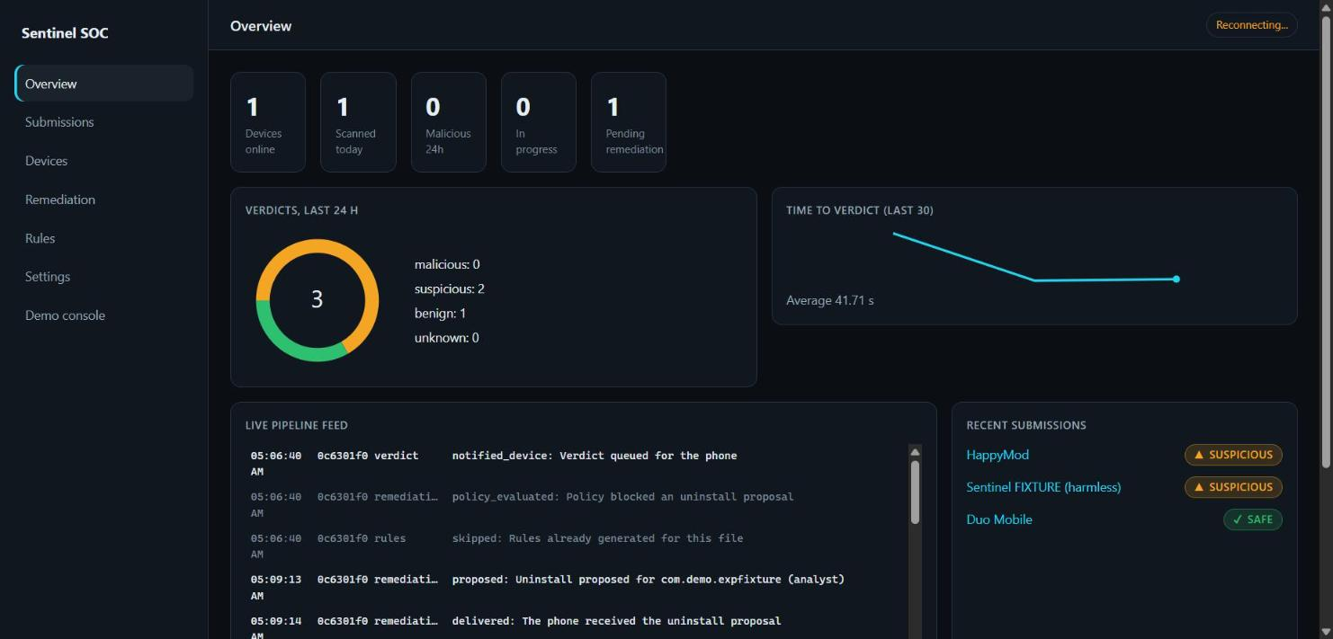
5.1 SOC Dashboard: Overview (live)
Live overview: devices online, scans today, verdict breakdown and the pipeline feed.

Slide 18
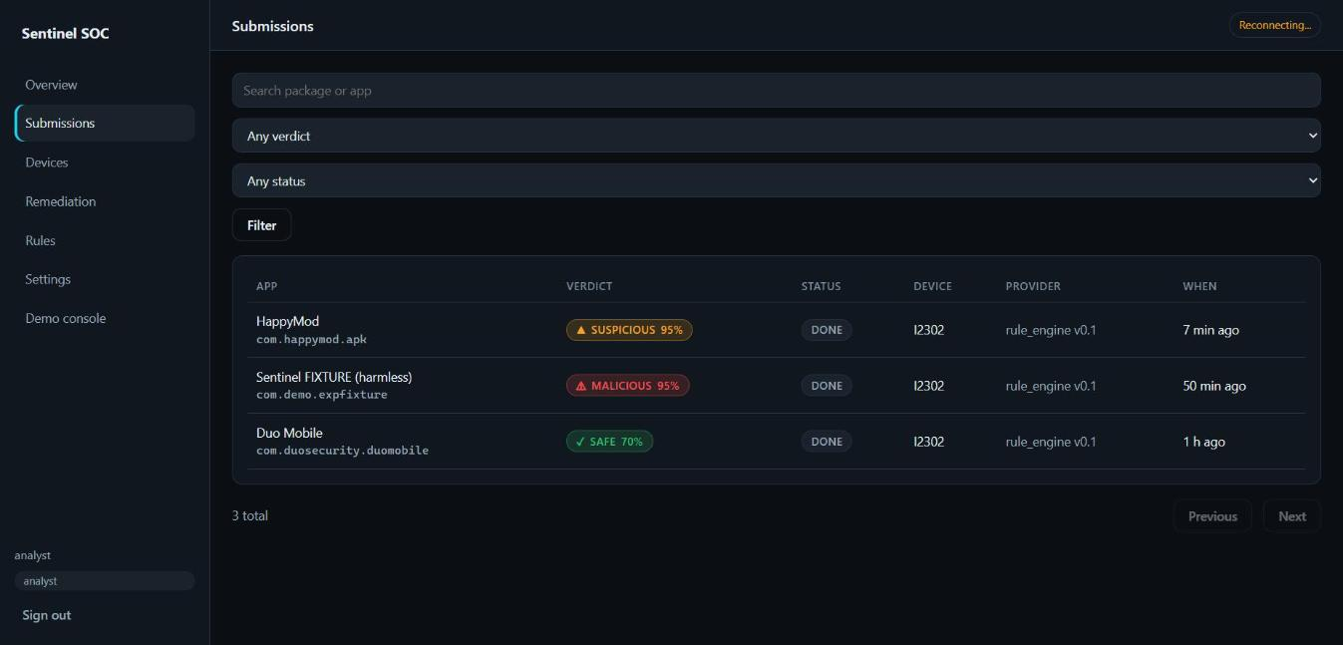
5.2 Recent scans: safe, malicious and suspicious (live)
Three analysed apps with verdicts, confidence, status and device.

Slide 19
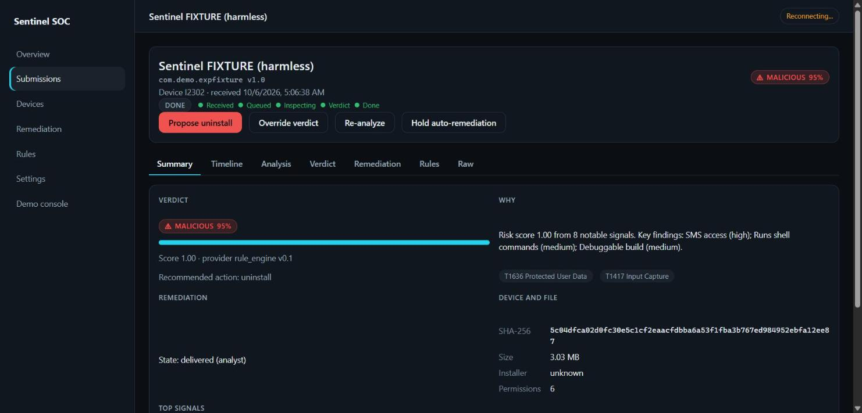
5.3 Verdict display of a malicious file (live)
MALICIOUS 95% with explanation, risk score, recommended action and ATT&CK tags.

Slide 20
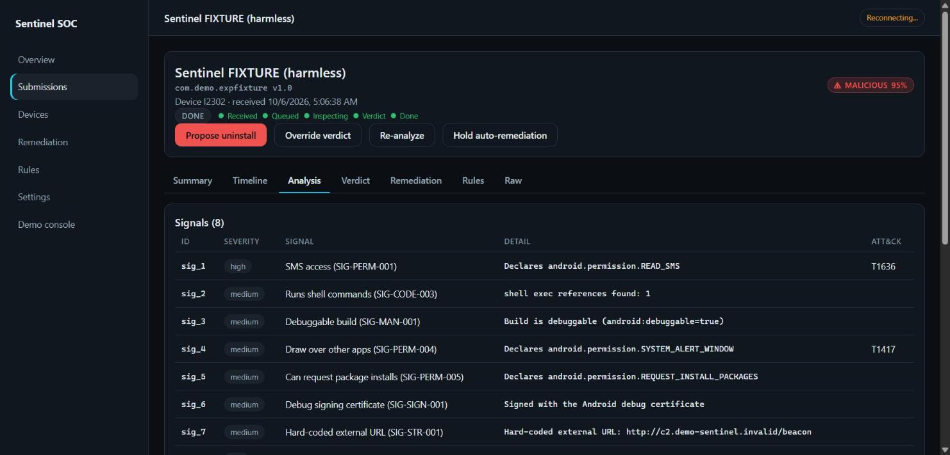
5.4 Analysis page of the malicious APK (live)
Signals with severity, detail and ATT&CK mapping, as stored in the Evidence.

Slide 21
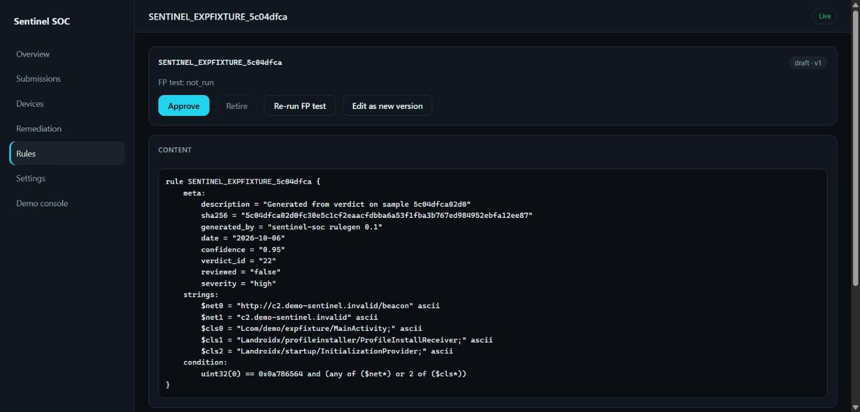
5.5 YARA rule generated from the malicious APK (live)
Draft rule: DEX magic, beacon URL and class names, condition and metadata.

Slide 22
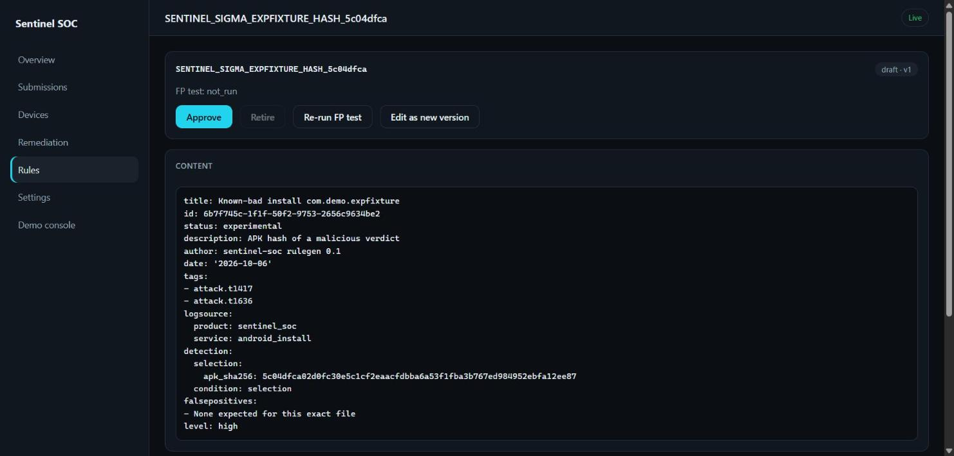
5.6 Sigma rule generated from the malicious APK (live)
Draft Sigma rule matching the file's SHA-256 (custom log source sentinel_soc/android_install).

Slide 23
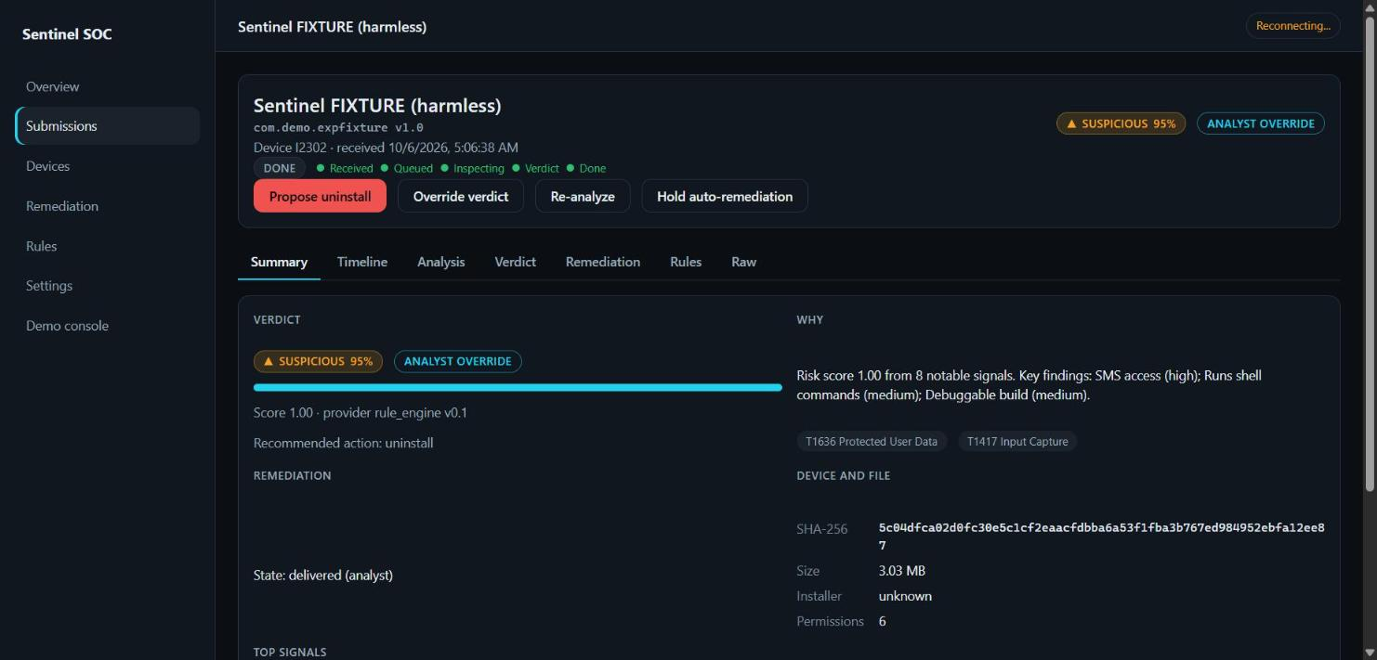
5.7 Override from the laptop (live)
Verdict overridden to Suspicious with a reason; the header shows the Analyst override tag.

Slide 24
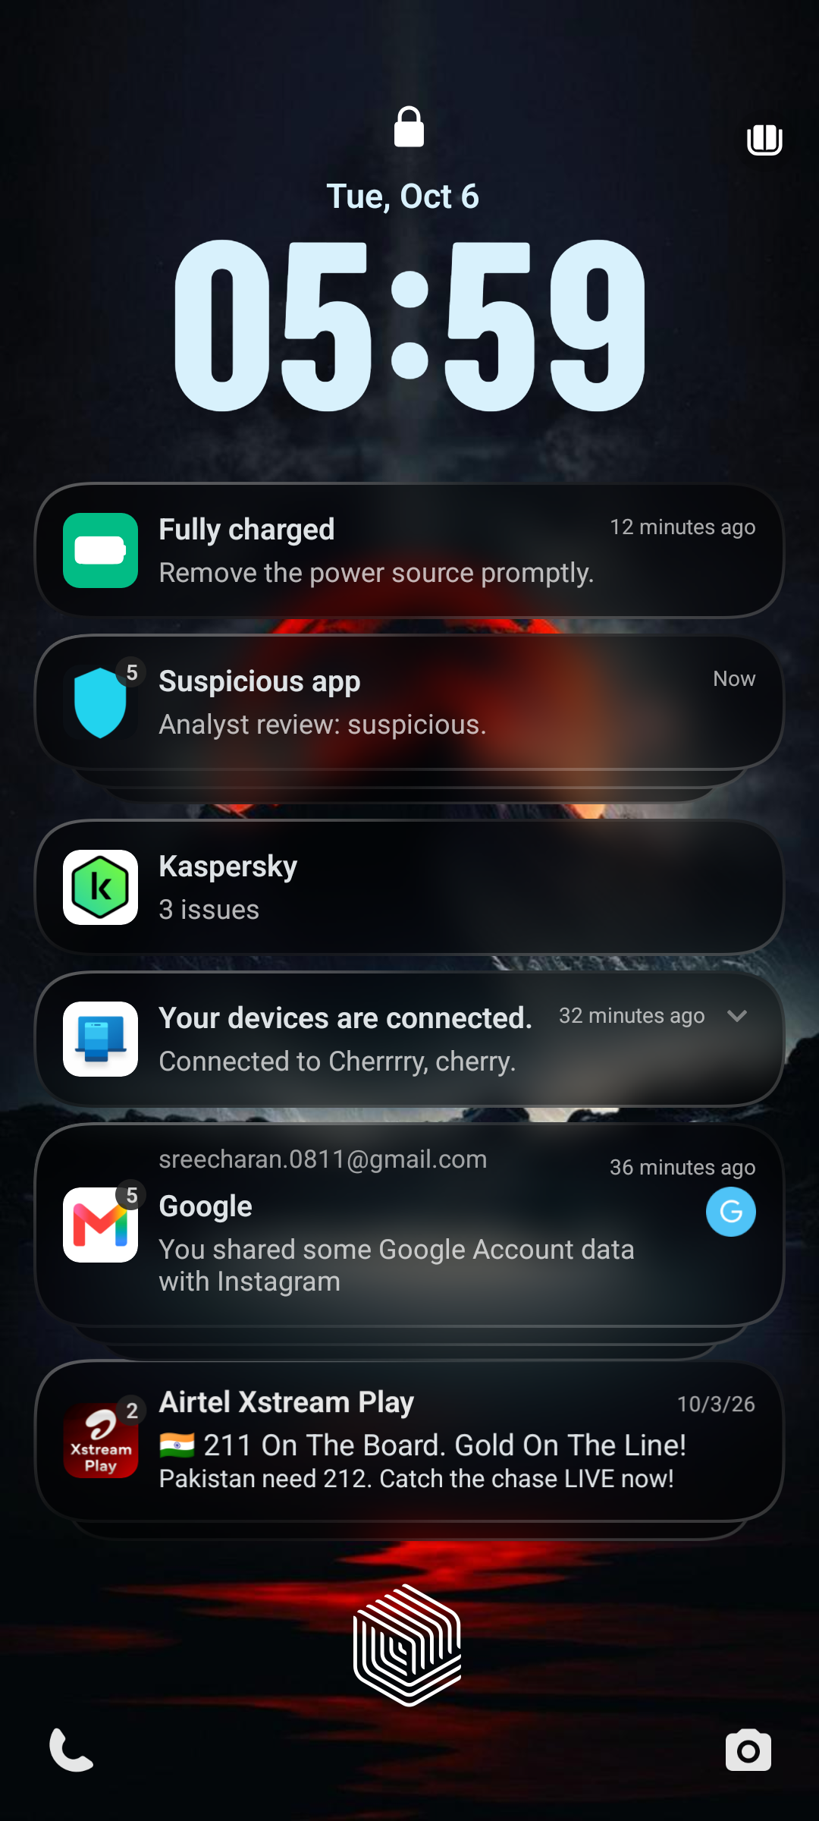
5.8 Override notification on the phone (live)
The phone shows "Suspicious app: Analyst review: suspicious." from the override.

Slide 25
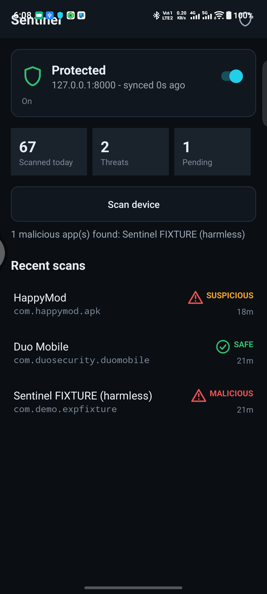
5.9 Phone app: live main screen
Protected and synced; Recent scans show the verdicts; the report reads 1 malicious app found.

Slide 26
6. Results: Discussion
The end-to-end flow works on a real phone: install, upload, verdict, notification and override.
Verdicts are explainable: every verdict lists the signals, their severity and their ATT&CK tags.
Rule drafts are created with a self-test; the false-positive test needs a benign corpus that is not built yet.
Uninstall is always confirmed by the user in Android's own dialog.

Slide 27
6. Results: Limitations
Verdict weights are a placeholder. Large, legitimate apps can be flagged suspicious because they use common library code.
The reasoning stage (agent-based explanation) is on hold; only the rule-based reasoner is built.
Dynamic analysis in an emulator is not built; the analysis is static only.
The false-positive test runs against an empty benign corpus, so it reports not_run.
Third-party antivirus (Kaspersky) flags the harmless test APK; an exclusion is needed for demos.
Phone-to-laptop link needs the USB tunnel or the same Wi-Fi network.

Slide 28
7. Future Work
Calibrate scoring against a labelled corpus of benign and malicious apps; filter known library code.
Add the reasoning stage: an explanation model that cites the evidence it used.
Add emulator-based dynamic analysis for uncertain verdicts.
Build the benign corpus so the rule false-positive test can run.
Package the phone app for release and use HTTPS instead of plain HTTP.

Slide 29
8. References
androguard: Android APK analysis library (androguard.readthedocs.io).
YARA: pattern matching for malware research (virustotal.github.io/yara).
Sigma: generic signature format for log events (github.com/SigmaHQ/sigma).
MITRE ATT&CK for Mobile (attack.mitre.org/matrices/mobile).
Android developer documentation: package visibility, foreground services, WorkManager (developer.android.com).
Django, Django REST Framework, Channels and Celery documentation.

Slide 30
Thank You
Sentinel SOC

