Slide 1
Algorithm Analysis for VRP
Performance, Time & Space Complexity Evaluation

Slide 2
1. Brute Force Optimizer
Exhaustively searches all possible nodal assignments.
- Best Case Time Complexity: O(N!)
- Average Case Time Complexity: O(N!)
- Worst Case Time Complexity: O(N!)
- Space Complexity: O(N)

Slide 3
2. Greedy Fleet Dispatch
Nearest-neighbor adaptation with clustering.
- Best Case Time Complexity: O(N²)
- Average Case Time Complexity: O(N²)
- Worst Case Time Complexity: O(N²)
- Space Complexity: O(N)

Slide 4
3. Genetic Fleet Optimizer
Evolutionary algorithm iterating fixed generations.
- Best Case Time Complexity: O(P × G × N) -> O(N)
- Average Case Time Complexity: O(P × G × N) -> O(N)
- Worst Case Time Complexity: O(P × G × N) -> O(N)
- Space Complexity: O(P × N)
*Where P = Population size (200), G = Max Generations (600)

Slide 5
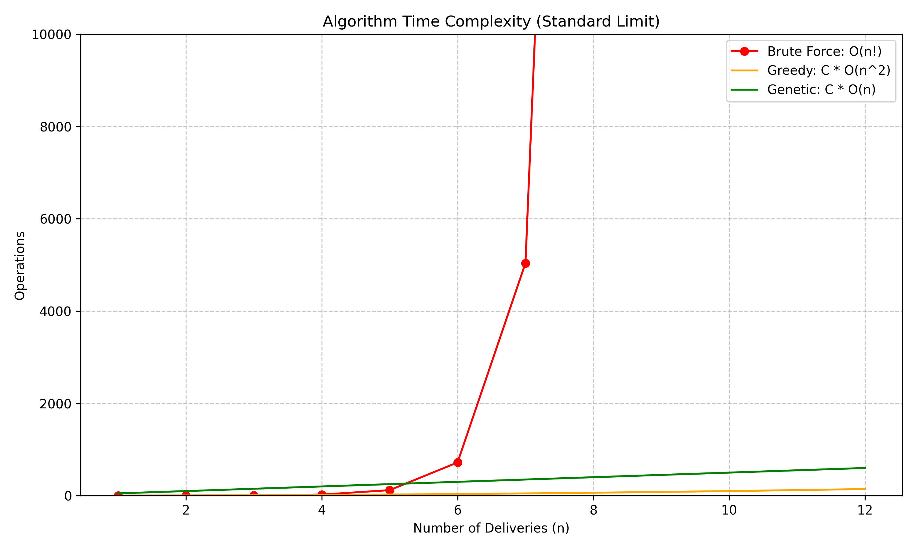
Complexity Comparison (Standard LIMIT)

Slide 6
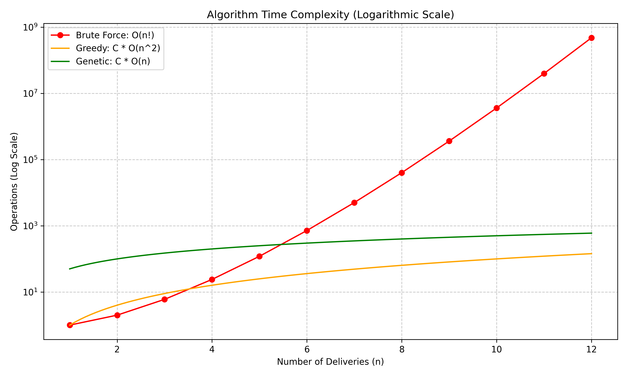
Complexity Comparison (Log Scale)

Slide 7
Conclusion
Scalability Analysis:
Brute Force is entirely unscalable for N > 12.
Greedy Approach provides a fast heuristic O(N²) which works well for localized delivery zones.
Genetic Optimizer scales linearly relative to problem size, offering the best approximation logic for large fleets.

