Slide 1
Control Hazards & Branch Prediction
We tested 4 hardware architectures against 2 workloads:
1. Random Workload: Unpredictable branches (rand() % 100 < 50).
2. Patterned Workload: A predictable loop (i % 4 != 0).
Goal: Observe how advanced hardware 'learns' software patterns to avoid pipeline flushes.

Slide 2
Phase 1: Random Workload Execution
Hypothesis: Predictors cannot find a pattern in random data. Mispredictions will be universally high.
• LocalBP: 6,505 Mispredictions | 56,351 Flushes
• BiModeBP: 6,801 Mispredictions | 56,348 Flushes
• TournamentBP: 6,489 Mispredictions | 57,981 Flushes
• PerceptronBP: 6,558 Mispredictions | 59,648 Flushes

Slide 3
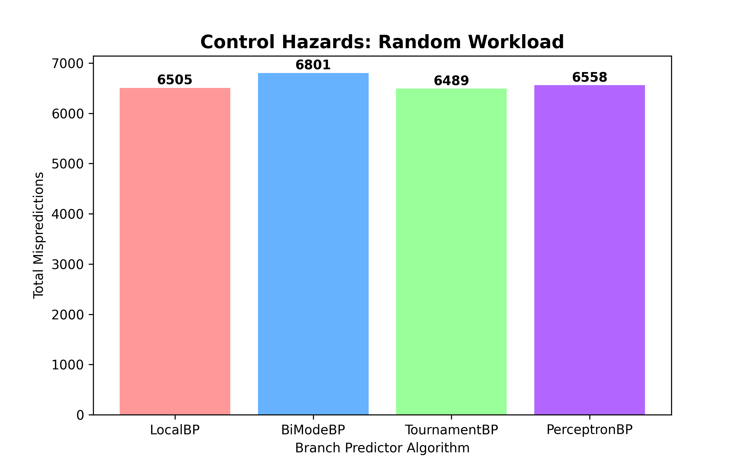
Visualizing the Random Workload

Slide 4
Phase 2: Patterned Workload Execution
Hypothesis: Advanced predictors will 'learn' the repeating mathematical loop and avoid flushes.
• LocalBP: 25,828 Mispredictions | 402,453 Flushes
• BiModeBP: 1,084 Mispredictions | 2,504 Flushes
• TournamentBP: 829 Mispredictions | 2,486 Flushes
• PerceptronBP: 30,248 Mispredictions | 445,712 Flushes

Slide 5
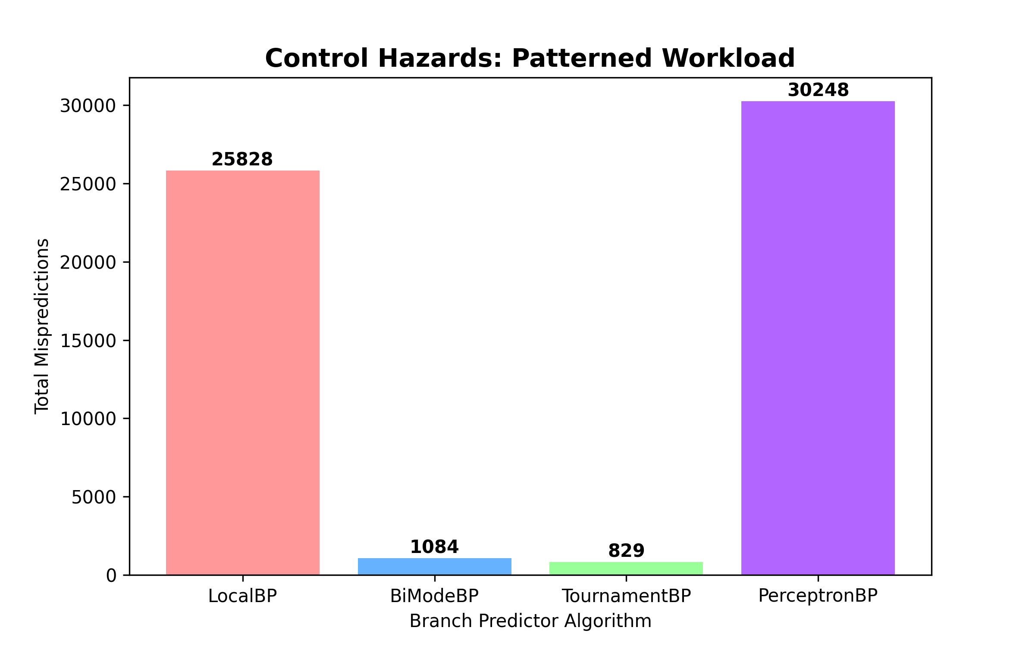
Visualizing the Patterned Workload

Slide 6
Measuring Performance: CPU Clock Cycles
Total simulated execution time (Ticks) for the Patterned Workload:
• LocalBP: 13,318,968,000 Ticks
• BiModeBP: 12,885,099,000 Ticks
• TournamentBP: 12,869,626,000 Ticks
• PerceptronBP: 13,343,397,000 Ticks

Slide 7
The Real-World Impact
What do these saved clock cycles actually mean for performance?
By minimizing pipeline bubbles, the optimal predictor saved 473,771,000 CPU Ticks compared to the slowest predictor.
This represents a 3.55% reduction in total execution time.
In massive data centers or high-performance environments, a ~3.5% speedup across billions of instructions saves significant processing time and power, simply by choosing the correct hardware architecture!

Slide 8
The AI Paradox: Why the Perceptron Failed
The PerceptronBP uses Neural Networks, so why did it perform poorly?
1. Training Overhead: Machine learning models require a 'warm-up' period to train their weights. 100k loops was not enough data for it to stabilize.
2. Over-engineering: The Tournament predictor uses a simple meta-table, allowing it to instantly recognize the short loop pattern.
Conclusion: Throwing AI hardware at simple code is highly inefficient!

