Slide 1

Comparative Analysis of Flood Prediction Using Machine Learning Algorithms
by
V.Sreekanth
Roll No. 184G1A0594
P.V.Sreedevi
Roll No. 184G1A05b0
B.Sai Sushma
Roll No. 184G1A0579
M.Sravani
Roll No. 184G1A0592
Under the guidance of
Mr. Lingam Suman, M.Tech, (Ph.D)
Assistant Professor
GitHub Link: https://github.com/sreedevi22/-Comparative_Analysis_of_flood_prediction_using_ML
Department of Computer Science and Engineering
Srinivasa Ramanujan Institute of Technology
(Affiliated to JNTUA & Approved by AICTE) (Accredited by NAAC with ‘A’ Grade & Accredited by NBA (EEE, ECE & CSE)
Rotary Puram Village, B K Samudram Mandal, Ananthapuramu – 515701.
2021 - 2022

Slide 2
Abstract
The unusual rainfall and global climate change has led to floods in different parts of the world.
The research on the advancement of flood prediction model has been contributing to risk reduction, minimizing human loss, reducing property damage.
To mimic the complex mathematical expressions of physical processes of floods, during the past two decades, machine learning (ML) methods have highly contributed in the advancement of prediction systems providing better performance and cost-effective solutions.

Slide 3
contents
Introduction
Existing System
Proposed System
Literature Survey
Problem Definition
Planning
Requirements
Architecture
Design
Implementation
References

Slide 4
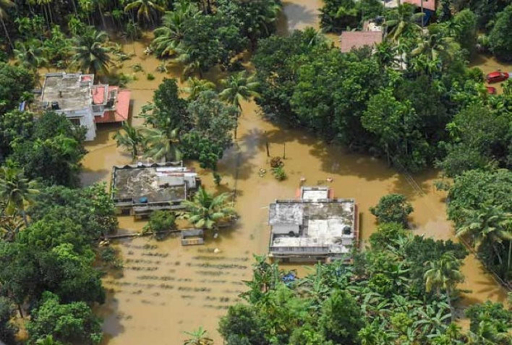
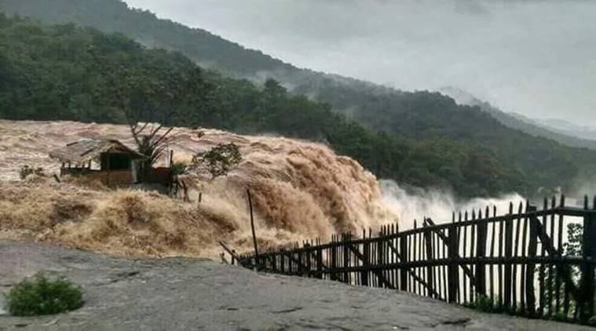
Introduction
Floods are among the most damaging and highly complex natural disaster.
Caused due to rainfall, overflow of water from dams, storms, coastal storms or earthquake.
Floods can come with no warning.
So in order to overcome this problem we have come up with this project
which predicts the occurrence of floods.

Slide 5
Contd…
The main objective is to design a model to predict the flood using the rainfall data.
The prediction of different models is taken &compared with in each other to find the best model that has high accuracy.
The flood can be predicted in different states of India ,if data set is available.

Slide 6
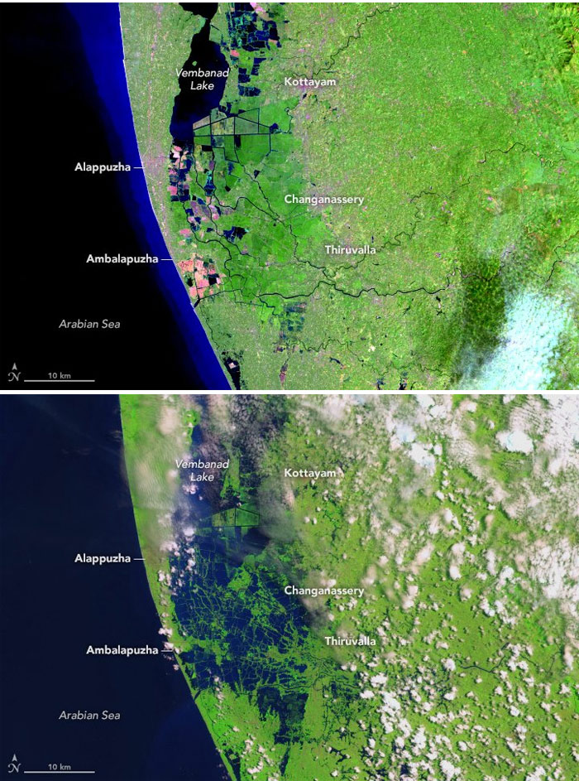
Existing System
Flood forecasting is highly complicated and expensive.
In orthodox methods satellite images ,remote sensing and radars are used.
Weather and rainfall are factors of predicting the flood.
The advanced technologies uses simulations supported by differential equations and physics.
With this accurate results are not predicted.

Slide 7
Proposed System
The aim of this project is to predict the flood, based on the provided rainfall dataset in different regions of India.
By providing real time input to models of machine learning like Logistic Regression(Sigmoid Function), Decision tree, KNN, SVC, Random Forest.
The input provided to models are preprocessed and patterns are extracted by getting maximum accuracy.
The available dataset(kerela.csv) is used.

Slide 8
Literature Survey
A. Improving real time flood forecasting using fuzzy inference system.[1]
Anil kumar lohani et al proposed the system in order to improve the real time forecasting of floods, this paper proposes a modified Takagi Sugeno (T–S) fuzzy inference system termed as threshold subtractive clustering based Takagi Sugeno (TSC-T–S) fuzzy inference system by introducing the concept of rare and frequent hydrological situations in fuzzy modeling system. The proposed modified fuzzy inference systems provide an option of analyzing and computing cluster centers and membership functions for two different hydrological situations, i.e. low to medium flows (frequent events) as well as high to very high flows (rare events) generally encountered in real time flood forecasting. The methodology has been applied for flood forecasting using the hourly rainfall and river flow data of upper Narmada basin, Central India.

Slide 9
Contd…
B. A Review On Fuzzy Based Flood Warning Expert System using IoT and LoRa Technology.[2]
Flood is the most destructive natural hazard. Other than rainfall different parameters like temperature, water flow speed, humidity, moisture level of land. As parameters of flood are uncertain so that algorithm which deals with uncertain inputs that is fuzzy logic is used to develop flood detection system. Fuzzy logic has ability to deal with nonlinearities and uncertainties. Fuzzy logic produces results that have resemblance with human results. As mentioned earlier different parameters are responsible for occurrence of flood so that use of IoT with power of different sensors is appropriate. LoRa is an emerging technique which is a wireless technique accepts data from sensors and transfer this data to main controlling system where this data is processed using fuzzy logic and result is produced.

Slide 10
Problem Definition(proposed in detail)
Problem statement:
Inadequate results
Topographic issues
Inability to produce accurate results
Problem definition:
Prediction of floods plays an important role in determining the occurrence of floods in coastal regions.
Here we are addressing the problem of flood prediction based on occurrence of rains.
Here we mainly focus on disaster prevention and flood prediction.

Slide 11
Requirements :
Hardware requirements
Ram : 512Mb
Hard Disk : 40GB.
Software Requirements
Operating system : windows 7.
Language : python.
Tools : PyCharm.
Libraries : NumPy, Matplotlib, Pandas, Sklearn.

Slide 12
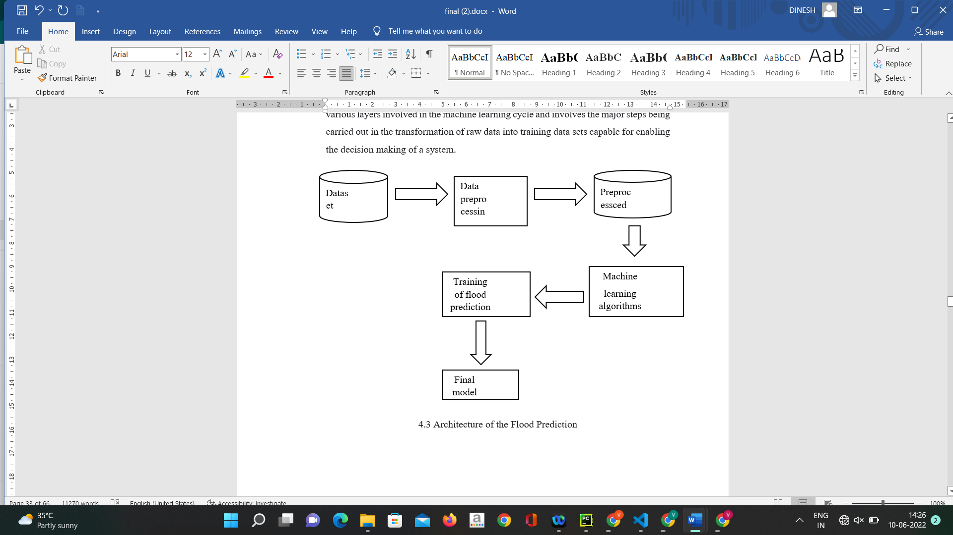
Architecture

Slide 13
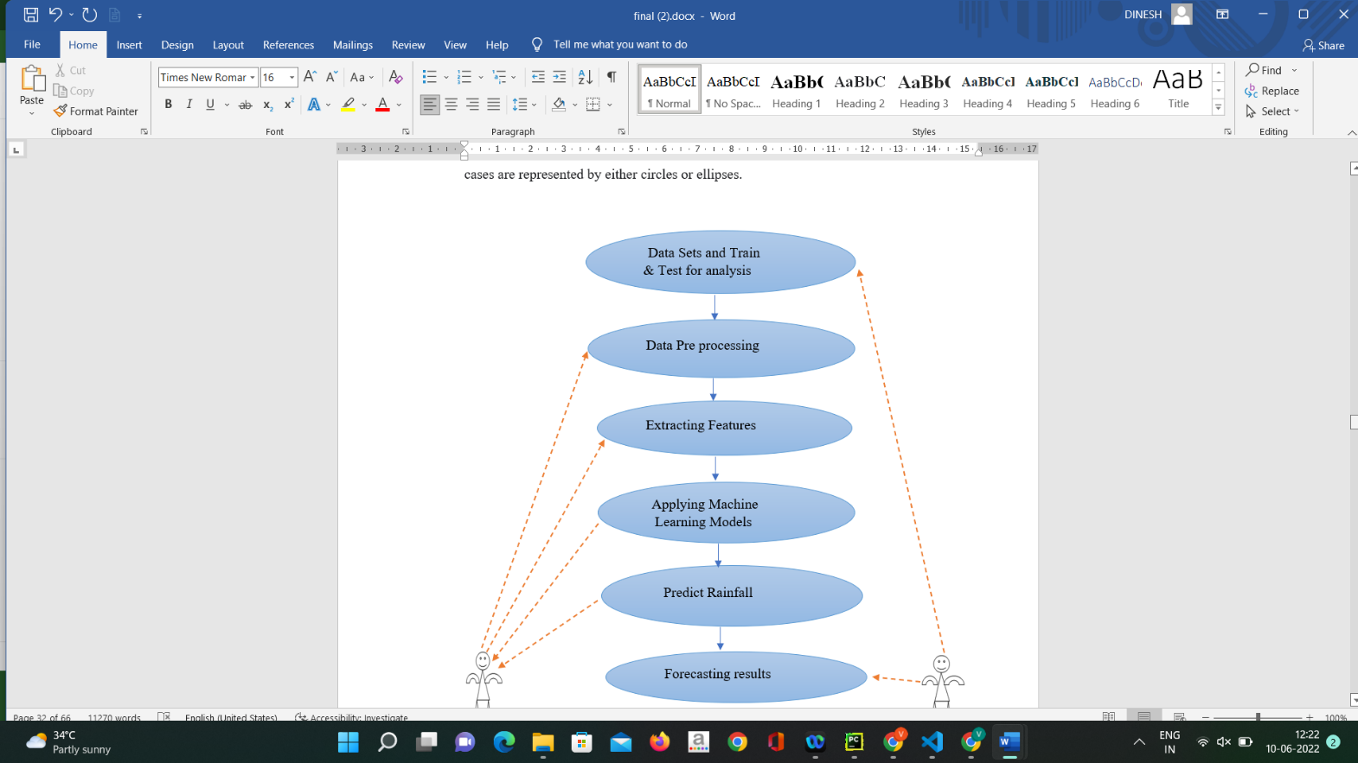
Design
UML Diagram:
system
user

Slide 14
Implementation:
Data Insights
Loading the required libraries and cleaning the data set for missing values and doing the analysis of the data set.
Machine Learning model:
Using sklearn for classification , Regression and clustering the data.
Prediction Algorithms:
1.KNN Classifier to predict
2.Logistic Regression to predict
3.Support Vector Classification to predict
4.Decision Tree Classifier to predict
5.Random Forest

Slide 15
Contd…
Python libraries like NumPy, Matplotlib, Pandas, Sklearn have been used.
NumPy:
NumPy stands for ‘Numerical Python’ or ‘Numeric Python’. It is an open source module of Python which provides fast mathematical computation on arrays and matrices. NumPy provides the essential multi-dimensional array-oriented computing functionalities designed for high-level mathematical functions and scientific computation.
Pandas:
Pandas is one of the most widely used python libraries in data science. It provides high-performance, easy to use structures and data analysis tools.

Slide 16
Contd…
Matplotlib:
Matplotlib is an amazing visualization library in Python for 2D plots of arrays. Matplotlib is a multi-platform data visualization library built on NumPy arrays.
Matplotlib consists of several plots like line, bar, scatter, histogram etc., and it comes with a wide variety of plots. Plots help to understand trends, patterns, and to make correlations.
Sklearn:
Scikit-learn is a free software machine library for Python programming language. It features various classification, regression and clustering algorithms

Slide 17
Take Dataset:
The dataset is collected from the Kaggle website (kaggle.com).
The Data set columns are year, region, monthly rainfall ,annual ,floods.
Pre-processing:
In pre-processing first of all we will check whether there is any missing values.
To check the missing values ,we use isnull() function.

Slide 18
Training the data:
Irrespective of the algorithm we select the training is the same for every algorithm.
Given a dataset we split the data into two parts training and testing.
We can split data into anything we want but it is just good practice to split the data such that the training has more data than the testing data, we generally split the data into 80% training and 20% testing.
The algorithms we were using is :
KNN Classifier.
Logistic Regression.
Decision Tree Classifier.
Support Vector Classifier.
Random Forest classifier

Slide 19
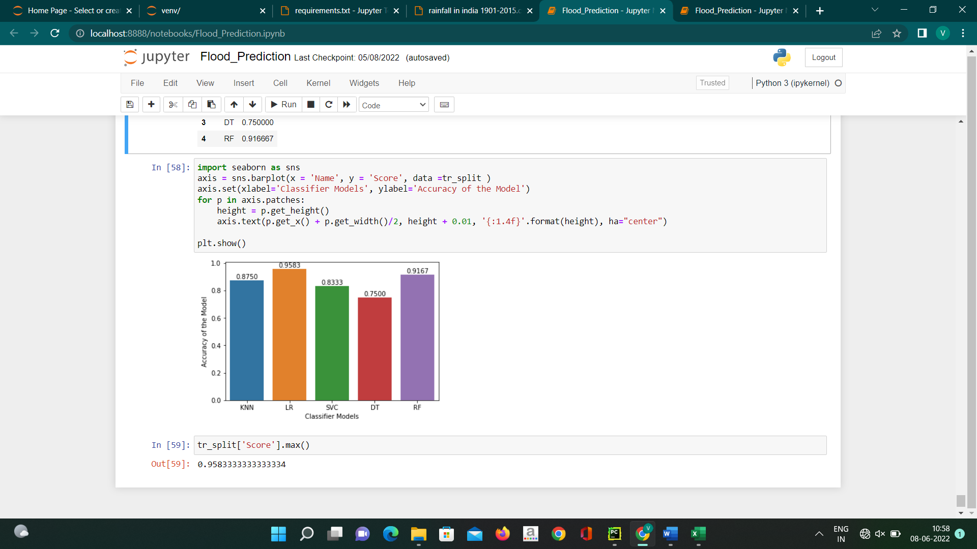
Execution
Accuracy of model

Slide 20
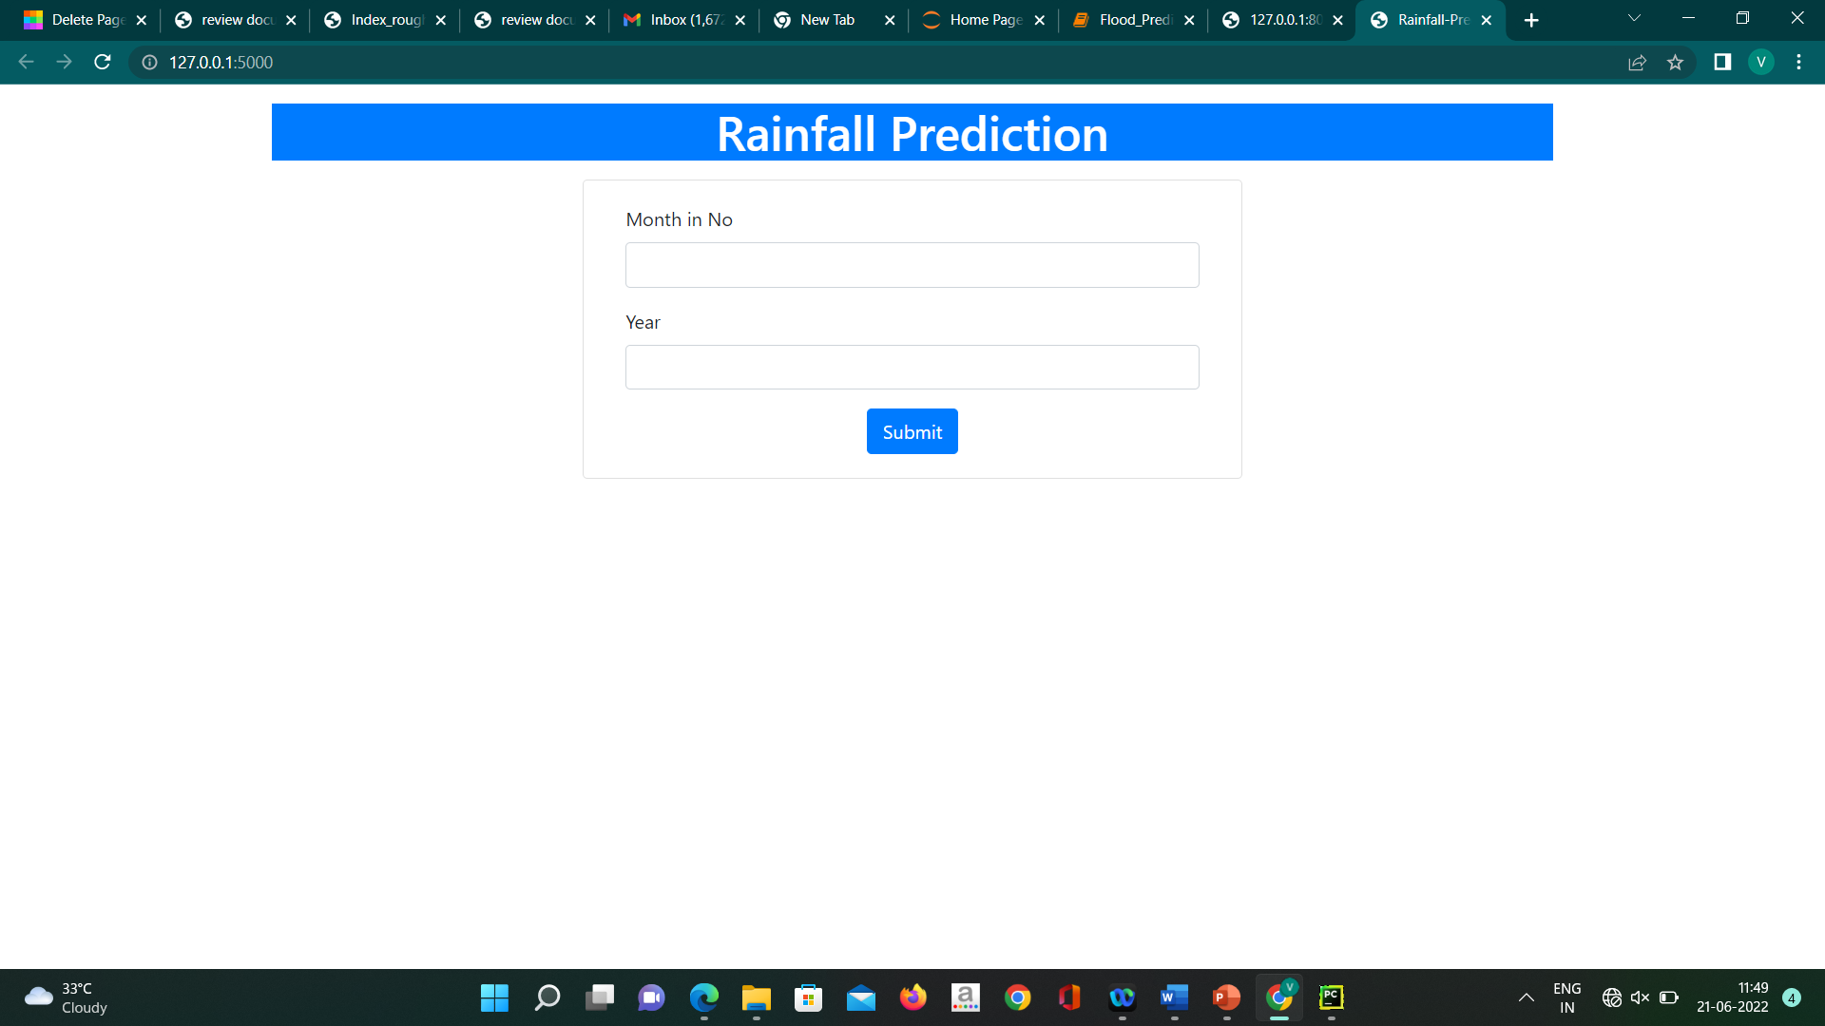
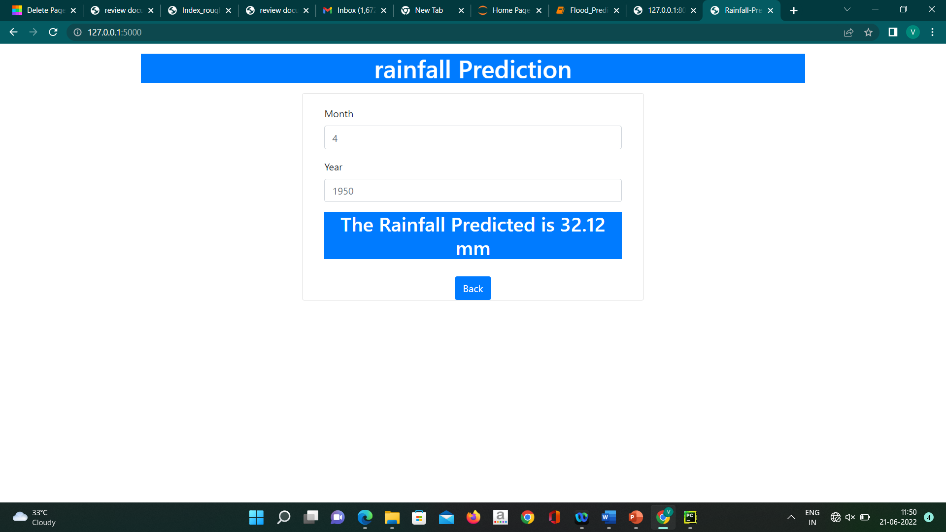
Contd…
UI for rainfall prediction

Slide 21
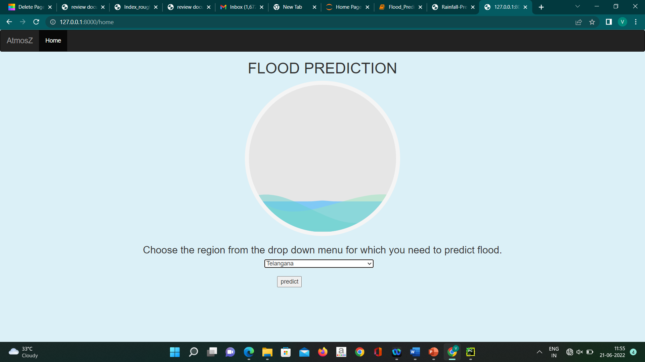
Contd…
Graphical representation for floods

Slide 22
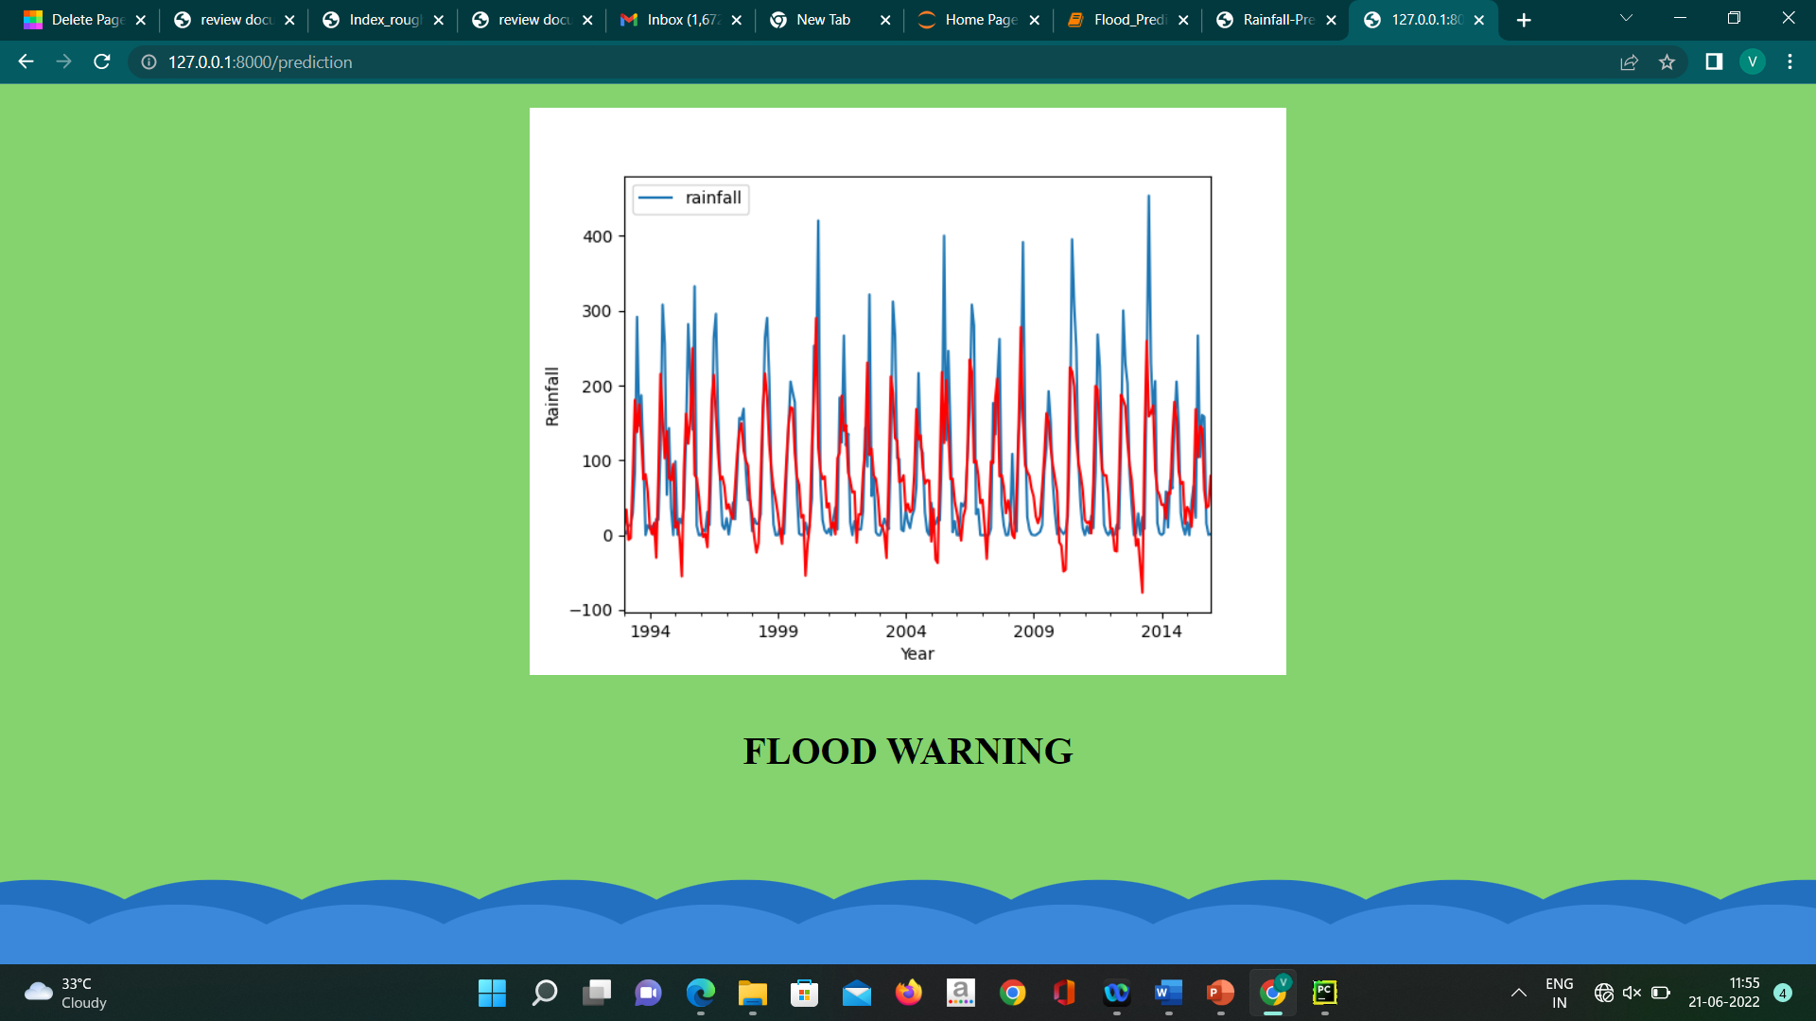
Contd…

Slide 23
Conclusion
The machine learning system ignited by data cleaning and processing, replacing or removing the null values, model building and evaluation. At the end the flood prediction model has given different accuracy results from four different models. From the above results and analysis, the best algorithm for flood prediction is Logistic Regression with (95%). In this, the simple machine learning algorithm to predict the accuracy of the flood occurrence is implemented.
When compared with the other algorithms, the Logistic Regression algorithm gives more accurate results and provide high performance accuracy and easy to understand. It can provide historical dataset with more mutable and adaptable form.

Slide 24
References
[1]. Anil Kumar Lohani et al. “Improving real time flood forecasting using fuzzy inference system”.
[2]. Deepak Jayant Dattawadkar, Sunita Babanrao Vani “A Review on Fuzzy Based Flood Warning Expert System using IoT and LoRa Technology”.
[3]. A.Kolvankar “International Journal of Trend in Research and Development”, Volume 6(6), ISSN: 2394-9333.
[4]. Available dataset(kerela.csv) .

Slide 25
Thank You!!!

