Slide 1
vacation
File created on: 10/08/22 9:16:18 AM GMT+05:30

Slide 2
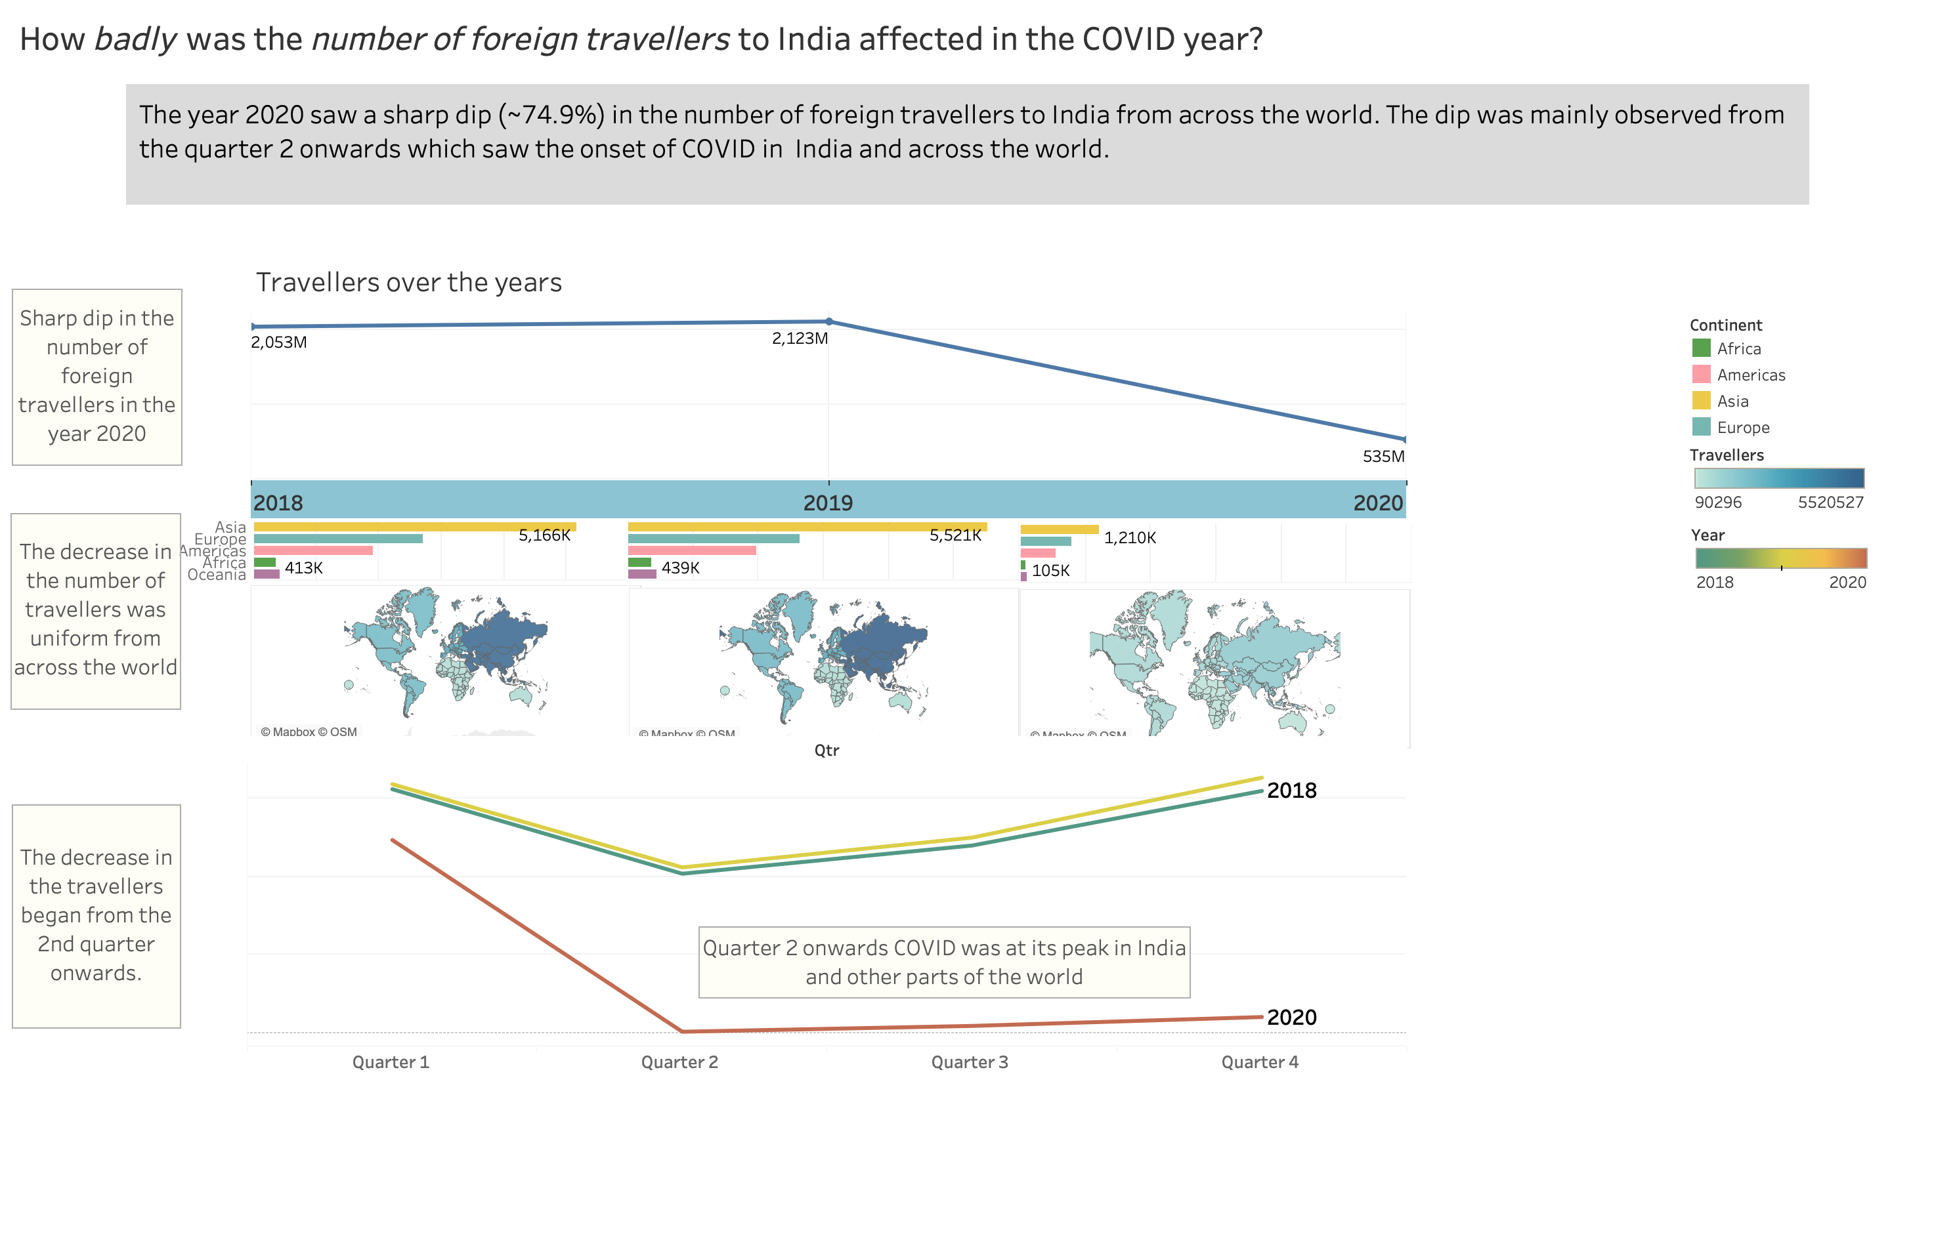

Slide 3
