Slide 1

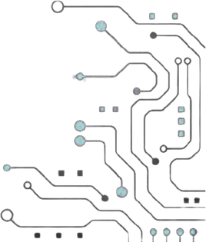



TEAM NAME : xFactors
PROBELM STATEMENT NO : 04
PROBLEM STATEMENT TITLE : Configurable Dual-Clock Asynchronous FIFO with Gray Code Pointers
PS Category : Software

Slide 2
Problem Statement
Safe data transfer between different clock domains
Prevent metastability and data loss
Accurate Full/Empty detection
Synchronize Gray-code pointers
Achieve timing-clean implementation
Why it matters: Asynchronous FIFO enables reliable data buffering and transfer between independent clocks.
Key challenges: CDC • Metastability • Pointer synchronization • Timing closure

Slide 3
Project name: Asynchronous FIFO Design and Physical Implementation using OpenLane
One-line solution: Designed and implemented a robust asynchronous FIFO for reliable data transfer between two independent clock domains.
How it solves the problem: Uses separate read/write clock domains with synchronized control signals and Gray-code pointers to safely manage data transfer, followed by complete RTL-to-GDS physical implementation including floorplanning, placement, CTS, routing, timing, power, and signoff checks.

Slide 4
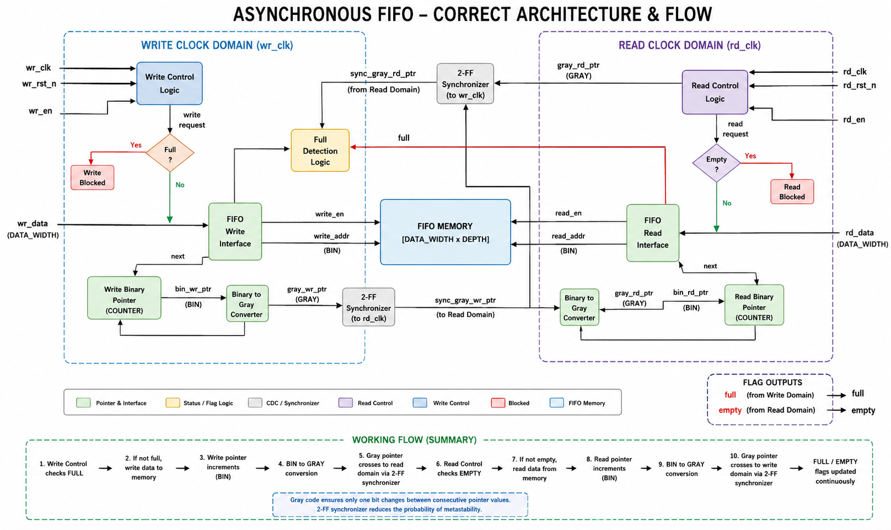
Architectural Block Diagram

Slide 5
Purpose of Blocks
Input: wr_data, rd_en/wr_en, wr_clk/rd_clk — capture data and control signals.
Processing: FIFO memory, binary/Gray pointers, and 2-FF synchronizers — safely manage data transfer between independent clock domains.
Output: rd_data, Full/Empty flags — provide stored data and FIFO status.

Slide 6
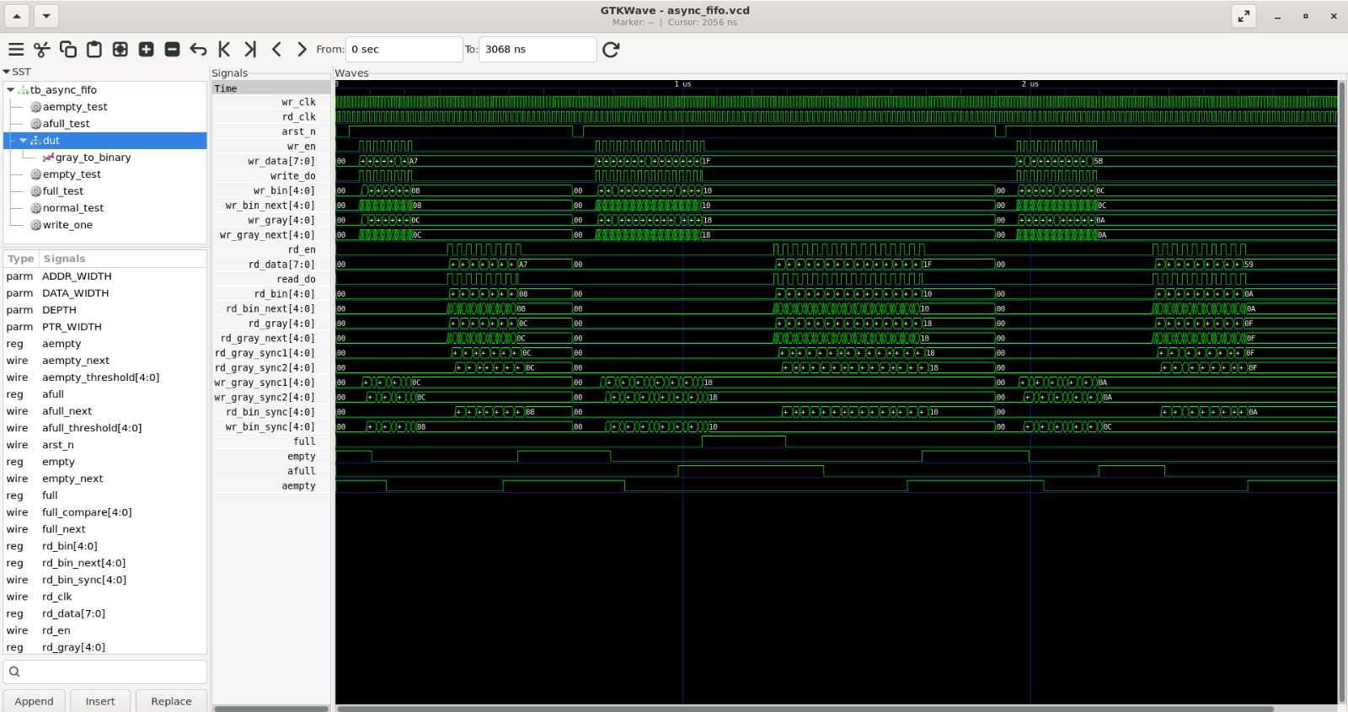
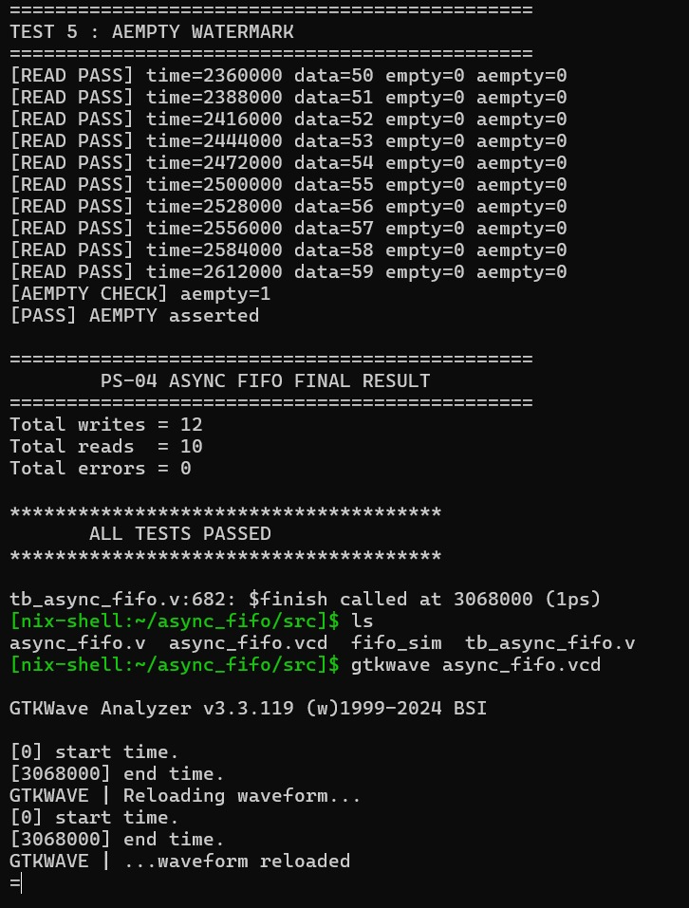
VERIFICATION & WAVEFORM EVIDENCE
GTKWave – Gray pointers, synchronized pointers, read/write clocks and flags
Self-checking testbench result
12 writes • 10 reads • 0 errors • ALL TESTS PASSED

Slide 7
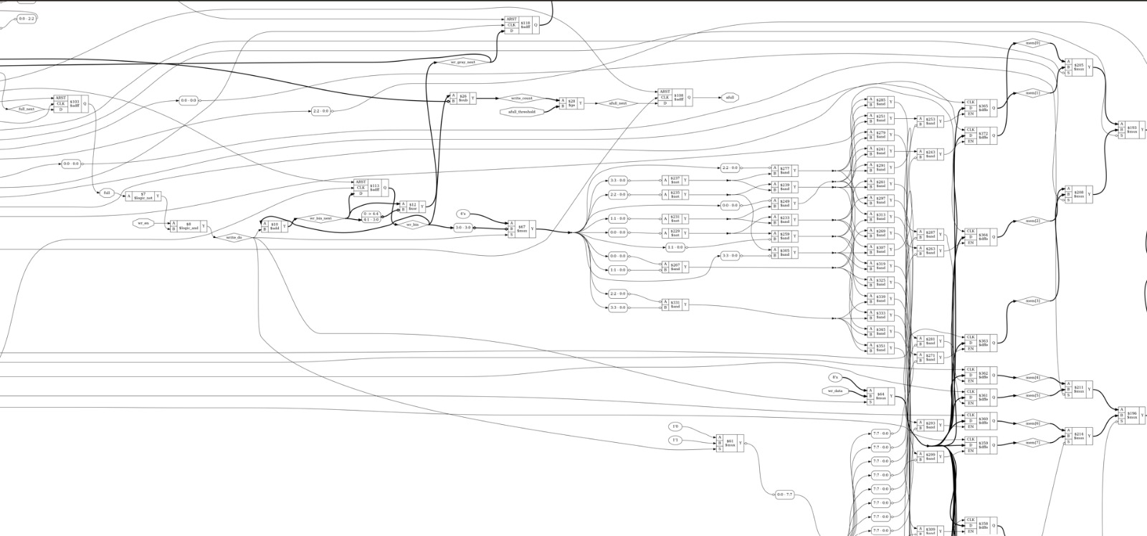
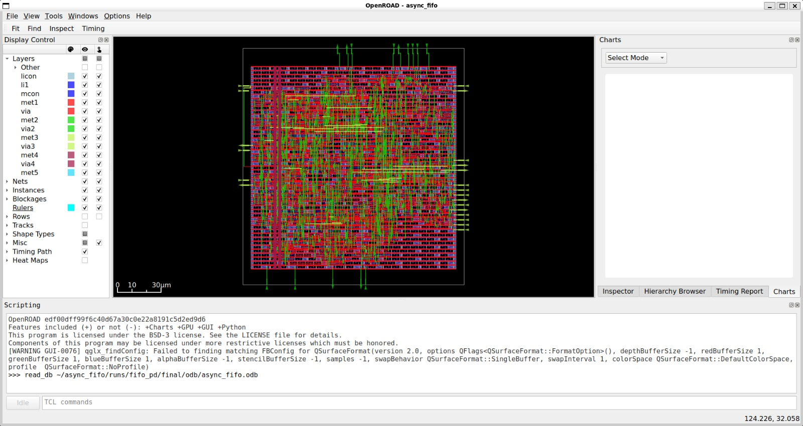
RTL-to-GDSII IMPLEMENTATION
1. RTL async_fifo.v
2. Simulation VCD + self-checking TB
3. Synthesis Yosys / standard cells
4. Constraints SDC + CDC exceptions
5. Physical Design Floorplan → Placement → CTS
6. Routing Global + Detailed Route
7. Signoff Timing / DRC-style checks / Power
6
Synthesized gate-level/netlist representation
OpenROAD physical implementation view
Implemented using open-source RTL-to-GDSII tooling; final database (ODB) generated in the project run.

Slide 8
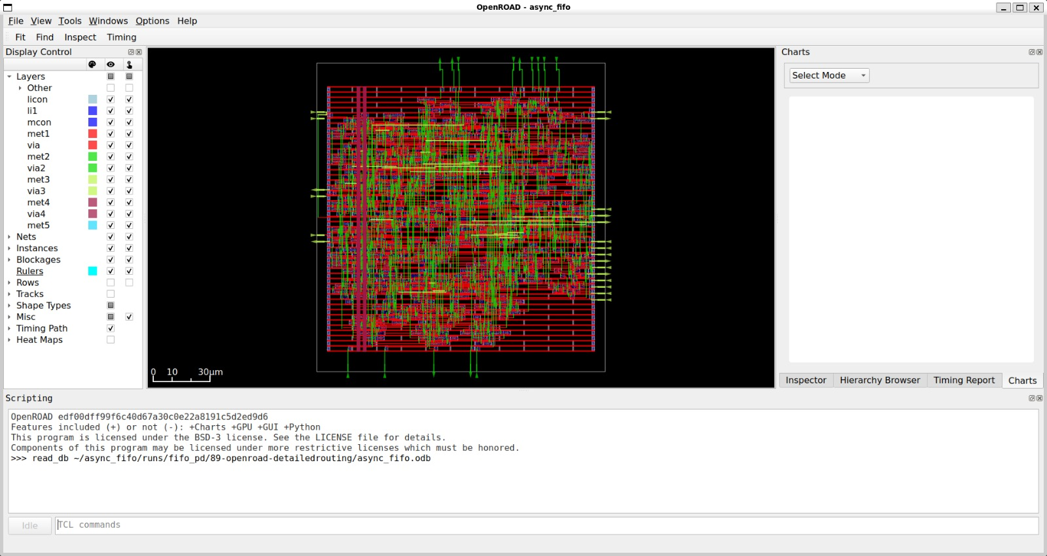
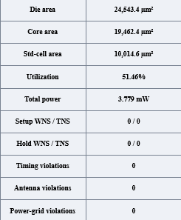
RESULTS & PHYSICAL DESIGN VALIDATION
Post-route OpenROAD layout
PS-04 STATUS: FUNCTIONAL ✓ | PHYSICAL CHECKS CLEAN ✓

Slide 9
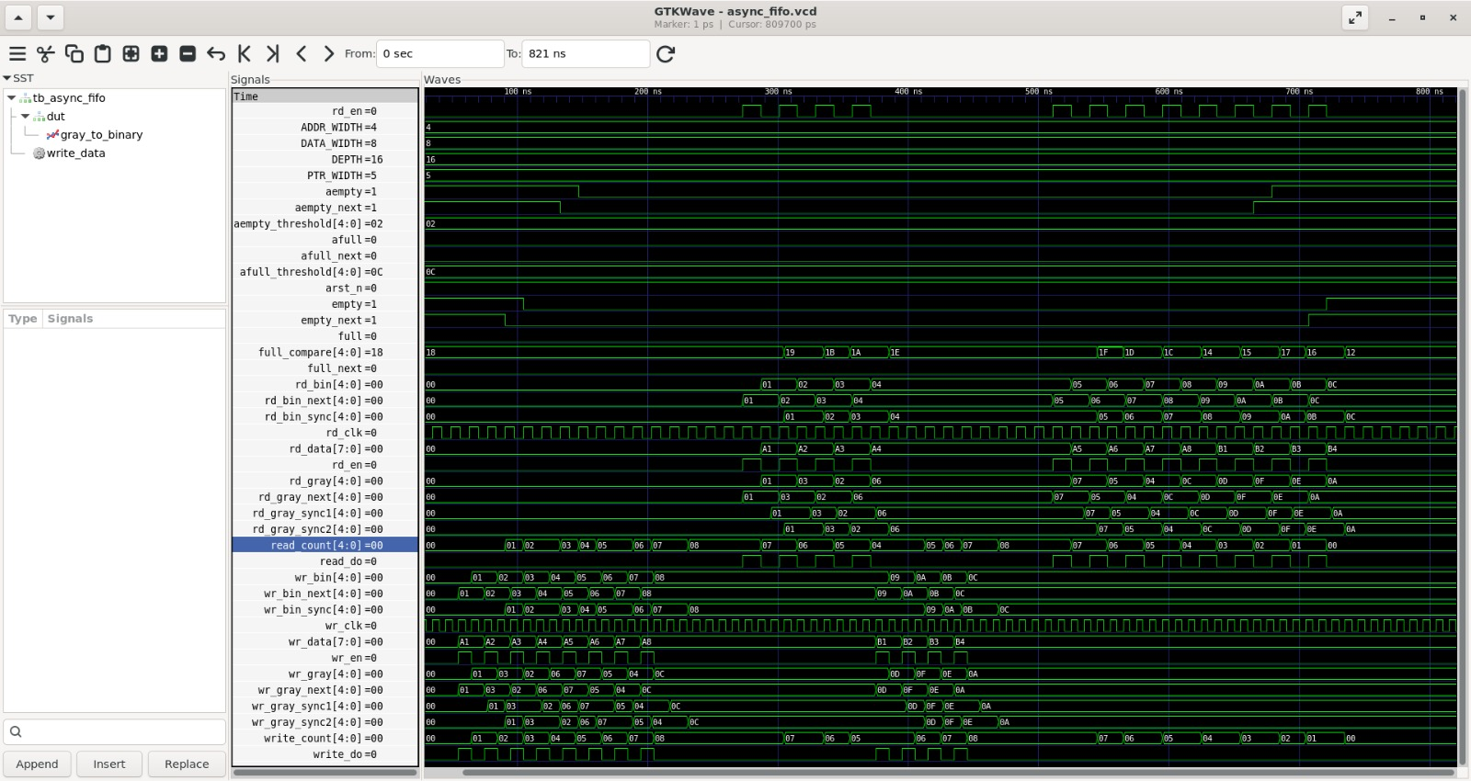

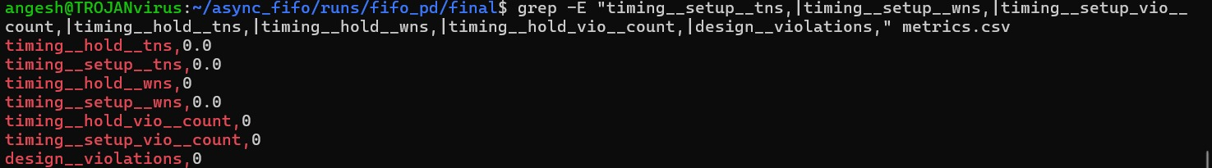
RESULTS & OUTPUTS

Slide 10
RESEARCH AND REFERENCES
C. E. Cummings, Simulation and Synthesis Techniques for Asynchronous FIFO Design, SNUG San Jose, 2002.
C. E. Cummings and P. Alfke, Simulation and Synthesis Techniques for Asynchronous FIFO Design with Asynchronous Pointer Comparisons, SNUG San Jose, 2002.
An Efficient Asynchronous Pipeline FIFO for Low-Power Applications, IEEE Conference Publication.
F. Gray, Pulse Code Communication, U.S. Patent 2,632,058, 1953.
IEEE, IEEE Standard for Verilog/SystemVerilog hardware description and verification languages — for RTL implementation methodology.

