Slide 1
Kafka Powering Event Driven Systems
By Sreedhar Singaraju

Slide 2
Day 1
Theme
Understand Event Driven Systems Paradigm atleast one practical use case
Understanding Foundation and building blocks of Kafka
Should be able to setup Environment using Apache Kafka
Use Apache Kafka CLI commands to be able to send and receive messages

Slide 3
Agenda-Day 1
Event Driven Paradigm
Practical Use Case
First Look at Kafka
Kafka Components Anatomy
Bringing Concepts To Play using Kafka CLI
DIY Exercise

Slide 4
Concepts- Day 1
Refer Draw.io diagrams

Slide 5
Enriching Concepts-Day 1
Install Apache Kafka
Start Following Services
Zookeeper
Kafka One Broker Server
Create Topic
Produce Messages using one Broker to the Topic
Consume Messages using one Broker from the Topic

Slide 6
DIY Exercise- Day1
Install Apache Kafka
Create one Kafka Broker server
Create one Topic
Create Producer service producing messages to the topic
Create Consuming Service polling and reading messages from the topic
Repeat above with two Topics
How are the Kafka CLI commands working ?
Are the Topic names case sensitive?
Can you modify number of partitions of a Topic ones they are created?
List the port numbers on which Zookeeper, Broker(s), Producer, Consumer are running?
Command to list all Kafka topics in your environment

Slide 7
Day 2
Theme
Day 1 Recap and Exercises QnA
Further understand the Foundational Concepts of Kafka in standalone and distributed topologies
Use CLI to practically establish these learned concepts

Slide 8
Agenda-Day 2
Day 1 Recap
Day 1 Exercise QnA
Foundational aspects of Kafka
Key based Producer and Consumer
Partitions
Consumer Groups
Offsets
Distributed Topology
Bringing Concepts To Play using Kafka CLI
DIY Exercise

Slide 9
Concepts- Day 2
Refer Draw.io diagrams

Slide 10
DIY Exercise- Day 2
Whatever we demoed in Day 2
Observe and demonstrate which partitions is the produced message going
Create a broker failure and then repair scenario and demonstrate resiliency
Observe and establish in a multi broker scenario messages the replicated messages are going to follower partitions
Lower priority
Understand Kafka Partition Optimization using Sticky Partition
Demo Sticky Partition
Consumer groups demo

Slide 11
Day 3
Theme
Developing Applications in Java to produce messages using Producer APIs

Slide 12
Agenda - Day 3
Producer API Constructs
Producer API Internals and Configurations
Standalone Java Application Send messages using Producer API
Sending with Key
Synchronously
Asynchronously
DIY Exercise

Slide 13
Producer API Constructs - Day 3
KafkaProducer
Class using which Applications can interact with Kafka servers.
ProducerRecord
Class which helps define the message payload.
Properties (MAP<String,String)
Properties which help configure following at minimum
BootStrapServers, Serializer, Deserializer
RecordMetadata
Class which contains the status of message sent

Slide 14
DIY Exercise - Day 3
Develop a Command Line Application which can take any Key and Value strings from User and send to Kafka.

Slide 15
Day 4
Theme
Understanding Producer much better
Understand various Configs to tune Producer Applications

Slide 16
Agenda - Day 4
Day 3 QnA
Producer API Internals and Configurations
DIY Exercise

Slide 17
Producer API Internals and Configurations – Day 4
Refer Draw.io
acks
The number of acknowledgments the producer requires the leader to have received before considering a request complete. This controls the durability of records that are sent.
Possible Values 0, 1, All
acks=1 this is default configuration. This ensures the Message record is written successfully to Leader Partition
acks=all This ensures the Message record is written successfully not only to Leader but also to All the Follower Partitions
acks=0 No guarantee of writes to be successful even to Leader partition. This however gives highest throughput but very less reliability
min.insync.replicas

Slide 18
Producer API Internals and Configurations – Day 4…
retries
The number of acknowledgments the producer requires the leader to have received before considering a request complete. This controls the durability of records that are sent.
retry.backoff.ms
The amount of time to wait before attempting to retry a failed request to a given topic partition. This avoids repeatedly sending requests in a tight loop under some failure scenarios.
max.in.flight.requests.per.connection
The maximum number of unacknowledged requests the client will send on a single connection before blocking.
enable.idempotence
When set to 'true', the producer will ensure that exactly one copy of each message is written in the stream. If 'false', producer retries due to broker failures, etc., may write duplicates of the retried message in the stream.
Note: There are three pre-conditions, max.in.flight.requests.per.connection < 5, retries > 0 , acks =all

Slide 19
DIY Exercise - Day 4
Apply configs in the application and demo the impact
Try and make idempotent configuration

Slide 20
URLs
https://learn.microsoft.com/en-us/azure/event-hubs/apache-kafka-configurations
https://kafka.apache.org/documentation/#producerconfigs
https://kafka.apache.org/documentation/#producerapi

Slide 21
Apache Kafka UI Tools
Confluent Control Centre
Lenses
Datadog Kafka Dashboard
Cloudera Manager
Yahoo Kafka Manager
KafDrop
LinkedIn Burrow
Kafka Tool
xInfra Monitoring tool(https://github.com/linkedin/kafka-monitor)

Slide 22
Day 5
Theme
Developing Java Applications Consume Messages from Kafka using APIs

Slide 23
Agenda - Day 5
Day 4 Recap & QnA
Consumer API Constructs
Poll loop
DIY Exercise

Slide 24
Consumer API Constructs – Day 5
KafkaConsumer
Class using which Applications can interact with Kafka servers to read messages.
Properties (MAP<String,String)
Properties which help configure following at minimum
BootStrapServers, Deserializer, groupid
ConsumerRecord
Class which contains the messages read by the poll, this is a list of multiple message records read.
auto.offset.reset
Property is used to instruct the kafka consumer to read either from beginning offset or the latest offset of the topic with the given group.id when the consumer makes the connection to topic for first time.
earliest – results in reading from beginning
latest (default) – results in reading from latest record

Slide 25
DIY Exercise - Day 5
Create a Kafka Messages Consuming Application using Apache Kafka Consumer APIs
Demonstrate impact of the property auto.offset.reset=latest/earliest

Slide 26
Day 6
Theme
Understand Consumer Internals and Configurations
Programming Consumer for various requirements

Slide 27
Agenda - Day 6
Day 5 Recap & QnA
Consumer Internals
Current and Commit Offsets (Avoiding Duplicates)
DIY Exercise

Slide 28
Consumer Internals - Day 6
Refer Draw.io

Slide 29
Programmatically Committing offsets - Day 6
Committing offset by default commits last record offset read by the Poll
Pre-requisite
Enable.auto.commit = false
Two mechanisms
commitSync in KafkaConsumer
commitAsync in KafkaConsumer
Can register callback

Slide 30
DIY Exercise - Day 6
Add Consumer configs and demonstrate impact of the today learned Consumer configs
Demonstrate capability of Scaling and processing more messages
Demonstrate Error handling while processing messages from the Queue
Demonstrate behavior of Independency of Offsets between two different Consumer Groups
Add code to perform Offset Commits during rebalancing

Slide 31
Day 7
Theme
Handling Offsets

Slide 32
Agenda - Day 7
Day 6 Recap & QnA
Rebalancing & Scaling (max.poll.interval.ms)
Programmatically Committing offsets Strategies
DIY Exercise

Slide 33
Programmatically Committing offsets Strategies – Day 7
Committing Offsets upon Processing each Message
Stop Processing remaining Messages ones Encountered Error
Prepare Retry Topics with Dead Letter Queue Strategy for Errors & Commit Offsets
Committing Last successful Polled offset during Rebalancing
Store Offset in an External Store and Retrieve during Consumer boot up

Slide 34
DIY Exercise - Day 7
Add Consumer configs and demonstrate impact of the today learned Consumer configs
Add code to perform Offset Commits during rebalancing
Implement each of Learned Offset handling Strategies
Make sure Consumer always reads from beginning or end of Queue whenever it starts. (seekToBeginning, seekToEnd APIs)
Implement the following design

Slide 35
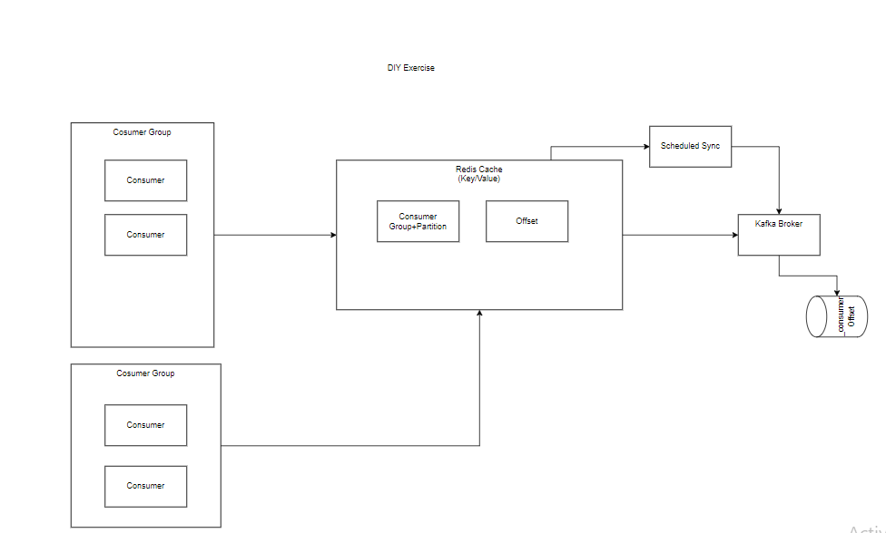
DIY Exercise - Day 7

Slide 36
Day 8
Theme
Enabling Logger
Producing and Consuming Custom data

Slide 37
Agenda - Day 8
Day 7 Recap & QnA
Logback Logger
Creating Custom Serializer
Producer Producing Custom Data
Creating Custom Deserializer
Consumer Consuming Custom Data
DIY Exercise

Slide 38
DIY Exercise - Day 8
Implement Logger using Logback
Implement Sending and Receiving Custom Data based payloads

Slide 39
Day 9
Theme
Microservices Producing Messages

Slide 40
Agenda - Day 9
Day 8 Recap & QnA
Steps For Producing Messages from Microservices
Sync
Async
DIY Exercise

Slide 41
Producing Messages from Microservices – Day 9
Create Application.yml file with Kafka configurations
KafkaTemplate is the Spring Kafka class used to Send Messages
Auto wire KafkaTemplate Instance
Send method variants of KafkaTempate can be used to send Messages
Sent status details are captured in SendResult

Slide 42
DIY Exercise - Day 9
Implement Sending Messages from Microservices
Add functionality to send Messages in Async Way

Slide 43
Day 10
Theme
Microservice Producing Messages with headers
Configuring and tuning the Producer
Basic Microservice based Kafka Consumer

Slide 44
Agenda - Day 10
Day 9 Recap & QnA
Sending messages with Header
Programmatic control on Configuration
Configuring and Tuning the Producer
Microservice Consuming Messages From Kafka
Configure delivery.timeout.ms with lesser value than retries. Check the behavior and error received
DIY Exercise

Slide 45
Programmatic Control On Configuration – Day 10
Add a Class with @Configuration annotation
Create Configuration Map using values from properties or directly in the code
Create ProducerFactory using the Configuration
Create KafkaTemplate instance using the ProducerFactory

Slide 46
DIY Exercise - Day 10
Try out different config properties and observe the behavior
Create a Producer library which is agnostic of the Payload and Header
Implement a Producer fail recovery pattern

Slide 47
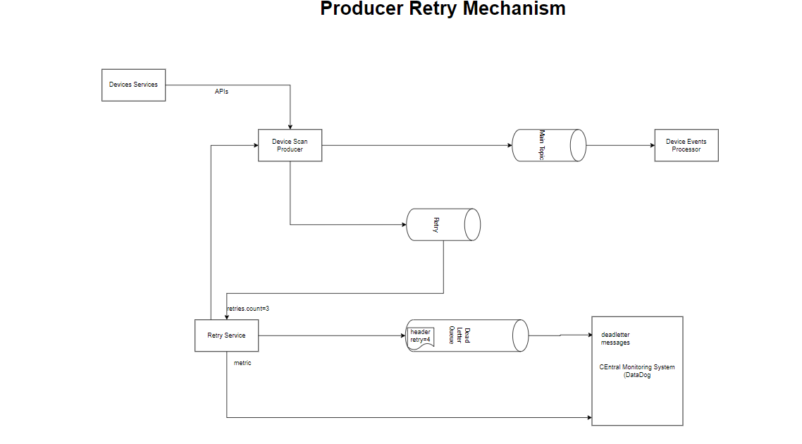
DIY Exercise - Day 10

Slide 48
Day 11
Theme
Microservices Producer Tuning and Fail Recovery
Basic Microservice based Kafka Consumer

Slide 49
Agenda - Day 11
Day 10 Recap & QnA
Configuring and Tuning the Producer
Fail Recovery in Producer
Microservice Consuming Messages From Kafka
DIY Exercise

Slide 50
DIY Exercise - Day 11
Demonstrate different Producer Configurations
Implement a Producer fail recovery pattern
Implement the Basic Consumer

Slide 51
Day 12
Theme
How to Test the Kafka Producer and Consumer
Persistency of Messages
Consumer Internals

Slide 52
Agenda - Day 12
Day 11 Recap & QnA
Integration Testing of Producer
Embedded Kafka
Using H2 DB and save the messages read in Consumer
Spring Kafka Consumer Internals
DIY Exercise

Slide 53
DIY Exercise - Day 12
Create Integration test for Consumer
Multiple consumer instances
Improve the Persistent data to store Partition and offset into along with Topic name

Slide 54
Day 13
Theme
Spring Kafka Consumer Internals
Tuning Consumer configurations

Slide 55
Agenda - Day 13
Day 12 Recap & QnA
Spring Kafka Consumer Internals
Offset Management
Scaling Consumer
DIY Exercise

Slide 56
Spring Kafka Consumer Internals - Day 13
Refer draw.io

Slide 57
Offset Management – Day 13
Spring Kafka starting from version 2.3 sets enable.auto.commit to false
AckMode
RECORD
Commit the offset when the listener returns after processing the record.
BATCH
Commit the offset when all the records returned by the poll() have been processed
MANUAL
he message listener is responsible to acknowledge() the Acknowledgment. After that, the same semantics as BATCH are applied.
MANUAL_IMMEDIATE
Commit the offset immediately when the Acknowledgment.acknowledge() method is called by the listener
Default behavior - Batch commit
Override Configuring for Manual commit
Ref: https://docs.spring.io/spring-kafka/reference/html/#ooo-commits

Slide 58
Scaling Consumer – Day 13
Two MessageListenerContainers
KafkaMessageListenerContainer
Receives all message from all topics or partitions on a single thread
ConcurrentMessageListenerContainer
Delegates to one or more KafkaMessageListenerContainer instances to provide multi-threaded consumption

Slide 59
DIY Exercise - Day 13
Configure the Consumer Listener to different AckModes and check the behavior
Improve the Apache Kafka SDK based Consumer polling implementation to spin up configured number of concurrent processing

Slide 60
Day 14
Theme
Error Handling in Consumer
Failure Recovery in Consumers
Intro to Security

Slide 61
Agenda - Day 14
Day 13 Recap & QnA
Error Handling
Custom Error Handling Configuration
Fixed Back off
Exponential Back off
Tuning Retry Policy to ignore Exceptions which need not be retried
Plug in additional handling during Retries
Failure Handling Strategies
DIY Exercise

Slide 62
Error & Fault Recovery Implementation Insights - Day 14
Refer draw.io
Reference:
https://docs.spring.io/spring-kafka/reference/html/#dead-letters

Slide 63
Failure Handling Strategies – Day 14
Approach 1 : Retry the failed messages
Example: Dependent Services temporarily down
Approach 2: Discard the Messages in a trackable way
Example: Invalid payloads

Slide 64
DIY Exercise - Day 14
Implement the Retry service which reads from Retry topic and triggers the re-processing
Re-establish the Error and failure recovery handling in producer with sufficient demos
Save the messages in the DLT to H2 Database
Explore Transactions

Slide 65
Day 15, 16,17
Theme
Securing Kafka Infrastructure

Slide 66
Agenda - Day 15, 16,17
Day 14 Recap & QnA
Security Requirements in Kafka
Authentication and Authorization
SSL in Kafka Architecture
Configure SSL in Server and Client
DIY Exercises

Slide 67
Encryption Authentication & Authorization - Day 15,16,17
Encryption
Converting a human readable plain text into incomprehensible text which is known a cipher text
Authentication
Authentication is the process of proving the identity (of Client to Server and vice versa)
Authorization
Authorization is the process of defining the permissions to the Authenticated users, on the System in context

Slide 68
Kafka Security Protocols – Day 15,16,17
SSL - Secured Sockets Layer/TLS (Transport Layer Security)
SASL - Simple Authentication and Security Layer
Refer Draw.io

Slide 69
SSL in Kafka Architecture - Day 15,16,17
Encryption
Converting a human readable plain text into incomprehensible text which is known a cipher text
Authentication
Authentication is the process of proving the identity (of Client to Server and vice versa)
Authorization
Authorization is the process of defining the permissions to the Authenticated users, on the System in context

Slide 70
Configure SSL in Server and Client - Day 15,16,17
Generate Server Keystore
Setup Local CA
Create CSR(Certificate Signing Request)
Sign the Server Certificate by Local CA
Add the signed Certificate to Server Keystore
Configure Server Certificate on Kafka Server
Create Client Trust store
Add Root Signed Certificate to Client Trust Store
Configure SSL on Kafka Clients

Slide 71
SASL - Simple Authentication and Security Layer – Day 15,16,17
SASL (Simple Authentication Security Layer) is a framework that provides developers of applications and shared libraries with mechanisms for authentication, data integrity-checking, and encryption.
Clients using SSL Authentication, would need the Certificates deployment overhead. Thus a Simple mechanisms such as username/password, Oauth Tokens etc. can help solve the overhead of SSL.
SASL is the common framework in Kafka to implement such Authentication Mechanisms.

Slide 72
SASL - Simple Authentication and Security Layer – Day 15,16,17
SASL enables implementing following Auth mechanisms
GSSAPI (Generic Security Services Application Programming Interface)
Uses Kerberos or Active Directory server for authentication
OAUTHBEARER
Enables the use the OAuth 2 Authorization framework in a SASL context.
SCRAM (Salted Challenge Response Authentication Mechanism)
Uses usernames and passwords stored in ZooKeeper. Credentials are created during installation.
PLAIN
Uses a simple username and password for authentication.
Delegation
LDAP
Ref: https://docs.confluent.io/platform/current/kafka/overview-authentication-methods.html#mtls
https://kafka.apache.org/documentation/#security

Slide 73
SCRAM – Salted Challenge Response Authentication Mechanism – Day 15,16,17
Salted Challenge Response Authentication Mechanism (SCRAM), or SASL/SCRAM, is a family of SASL mechanisms that addresses the security concerns with traditional mechanisms that perform username/password authentication like PLAIN.
Authentication of secrets/passwords is done securely by transmitting a computed hash
The SCRAM implementation in Kafka stores SCRAM credentials in ZooKeeper. Because of this, you must create SCRAM credentials for users in ZooKeeper.
Supported Hash functions are SHA 256 and SHA 252
Ref: https://docs.confluent.io/platform/current/kafka/authentication_sasl/authentication_sasl_scram.html#configuring-scram

Slide 74
Authorization – Day 15,16,17
Draw.io

Slide 75
DIY Exercise - Day 15, 16, 17
Configure 2 way SSL Encryption and Authentication on your System
Configure 2 way SSL between Zookeeper and Kafka Servers
Setup WSL and setup Kafka deployment and setup SASL based topology

Slide 76
Day 18
Theme
Handling Data Streams from Kafka Topics

Slide 77
Agenda - Day 18
Day 15, 16, 17 Recap & QnA
Kafka Streams – Introduction
Streaming Frameworks
Kafka Streaming Concepts
End-to-End Kafka Streaming Application

Slide 78
Kafka Streams – Introduction - Day 18
Data Processing and transformation library within Kafka SDK
Standard Java Application
Highly Scalable, elastic, fault tolerant
Exactly Ones Capability
One Record at a time Processing. True streaming and not Batching

Slide 79
Streaming Frameworks - Day 18
Other Streaming Frameworks – Flink, Storm, Spark etc.,
Micro batching vs per Data Streaming
Cluster versus No Cluster
Scaling easily (No Configuration needed)
Exactly Ones vs At least Ones

Slide 80
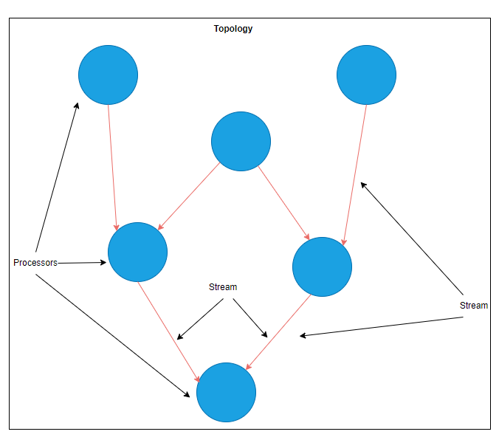
Kafka Streaming Concepts – Day 18
Stream
Is a sequence of immutable data records that is ordered, can be replayed, and is fault tolerant
Processors
Is a Node in the processor topology (graph). It transforms incoming streams record by record and may create a new stream from it.
Topology
Is a graph of processors chained together by streams

Slide 81
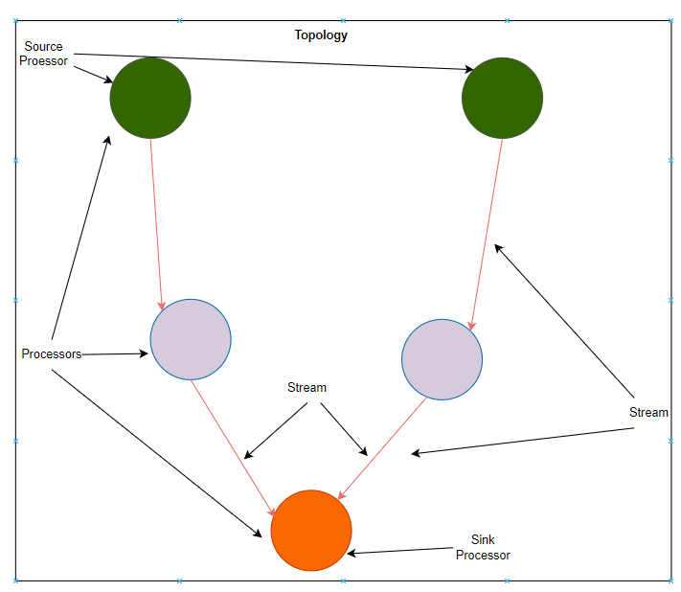
Kafka Streaming Concepts… – Day 18
Source Processor
Is Special Processor that takes its data directly from a Kafka Topic. It has no predecessor Processor in a Topology and does not transform data. It however generates a Stream.
Sink Processor
Is the Special Processor that does not have successors in a Topology. It sends the Stream data to the Kafka Topic directly.

Slide 82
Day 19
Theme
Kafka Streams Architecture and DSL (Domain Specific Language)

Slide 83
Agenda - Day 19
Day 18 Recap & QnA
Kafka Streams Architecture
DSL (Domain Specific Language)
Word Count Kafka Streams Application

Slide 84
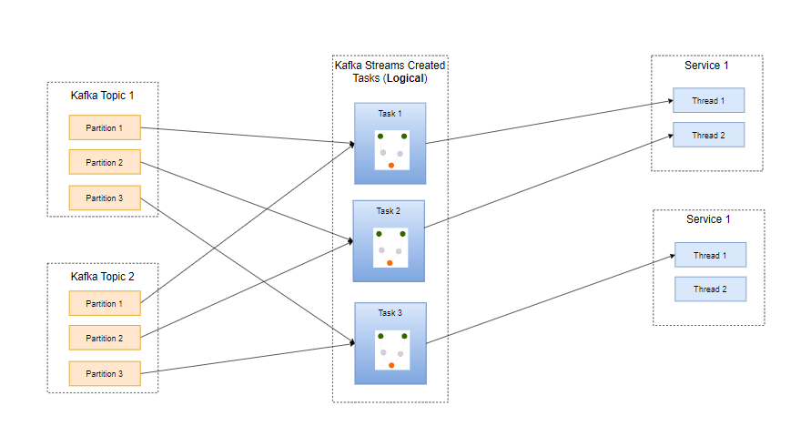
Kafka Streams Architecture - Day 19

Slide 85
DSL - Day 19
The Kafka Streams DSL (Domain Specific Language) is built on top of the Streams Processor API. Most data processing operations can be expressed in just a few lines of DSL code.
DSL supports
Build-In Abstractions for Streams and Tables in the form
KStreams
Ktables
GlobalKTable
Declarative Functional Style Programing for
Stateless Transformations e.g. map and filter
Stateful Transformations such as Aggregations (e.g. count and reduce) & Joins (e.g. leftjoin)
Windowing (e.g. session windowing)
Topologies are defined using DSL

Slide 86
Word Count Streaming App - Day 19
Demo & Draw.io

Slide 87
DIY Exercise - Day 19
Demonstrate the scaling of the Streaming Application
Demonstrate Fault tolerance and Offset commit behavior
Create a Streaming Application which does following:
Stream all log messages but filter out only Errors to a destination topic
Accepts data for favorite color for each User, filters records whose Users like RED, GREEN, BLUE only. Ones filtered generate a final count against each RGB color
Note: Updates are possible, in such case only consider the new value
Input | Output
Punit, Red Anshul, Blue Sreedhar, Voilet Punit, Green Bhaskar, Green | Red,0 Blue,1 Green, 2

Slide 88
Day 20
Theme
Few More Streaming Application Examples
Deeper Understand DSL

Slide 89
Agenda - Day 20
Day 19 Recap & QnA
Few More Streaming Applications
KStreams vs Ktables
KTables
DSL Processors

Slide 90
DSL Ktable & KStream - Day 20
Refer Draw.io

Slide 91
DSL KTable - Day 20
Upserts (With A Demo)
Repartitioning - Keys selection and its impact on Stateful Operations like Count
Changelog – State Stores Fault Tolerance
Table Cache & Emit rates

Slide 92
DSL Stateless Processors- Day 20
mapValues/map
Transforms the data from one form to other based on processing logic
flatMap/flatmapValues
Takes one record and produces zero, one or more record
map | mapValues
Affects both key and value Triggers a Repartition For KStreams only | Only Effects Values Does not change keys Does not trigger repartition For KStreams and KTables
<VR> KStream<K, VR> mapValues(final ValueMapper<? super V, ? extends VR> mapper); | <KR, VR> KStream<KR, VR> map( KeyValueMapper<? super K, ? super V, ? extends KeyValue<? extends KR, ? extends VR>> mapper )
flatMap | flatMapValues
Changes key Triggers a Repartition For KStreams only | Only Effects Values Does not change keys Does not trigger repartition For KStreams
<KR, VR> KStream<KR, VR> flatMap(final KeyValueMapper<? super K, ? super V, ? extends Iterable<? extends KeyValue<? extends KR, ? extends VR>>> mapper); | <VR> KStream<K, VR> flatMapValues(final ValueMapper<? super V, ? extends Iterable<? extends VR>> mapper);

Slide 93
DSL Stateless Processors… - Day 20
filter/filterNot
Takes one record and produce zero or one record
selectKey
Assigns a new key to the record
filter | filterNot
Does not change key/value Does not Triggers a Repartition For KStreams and KTables | Inverse of filter
public abstract KStream<K, V> filter( org.apache.kafka.streams.kstream.Predicate<? super K, ? super V> predicate ) | public abstract KStream<K, V> filterNot( org.apache.kafka.streams.kstream.Predicate<? super K, ? super V> predicate )
selectKey
Marks data for repartitioning Best practice is to isolate that transformation to know exactly where the partitioning helps
<KR> KStream<KR, V> selectKey(final KeyValueMapper<? super K, ? super V, ? extends KR> mapper);

Slide 94
References
https://kafka.apache.org/28/documentation/streams/developer-guide/dsl-api.html

Slide 95
Day 21
Theme
Stateful transforms using DSL processors
An Application using the Stateful DSL processors

Slide 96
Agenda - Day 21
Day 20 Recap & QnA
Count
Aggregates
Reduce
Joins
Windowing
Bank Balance Application

Slide 97
Stateful DSL Processors - Day 21
Refer Draw.io & Demo

Slide 98
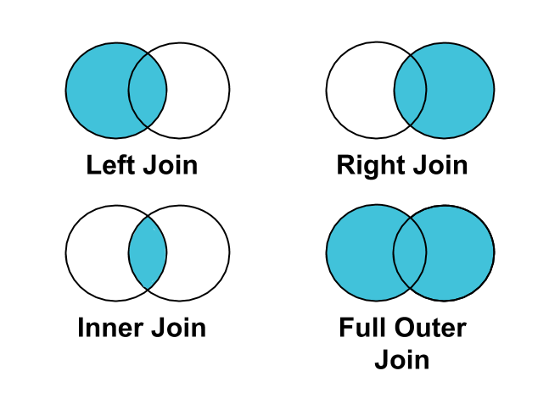
Joins - Day 21
Join Operation | Results | Join Types | Data Set
KStream-KStream | KStream | Inner, Left, Right, Outer | Windowed
KStream-KTable | KStream | Inner, Left, Outer | Non-Widowed
KTable-KTable | KTable | Inner, Left, Right, Outer | Non-Widowed
KStream-GlobalKTable | KStream | Inner, Left | Non-Widowed

Slide 99
Joins-Key Points - Day 21
Streams or Tables must have valid Key
All Topics must have same number of Partitions
Data in Topics must be co-partitioned (Partition Strategy should be same)
Co-Partitioning for Kstream-GlobalTable joins is not mandatory
Kstreams must always be on Left side for any type of Join

Slide 100
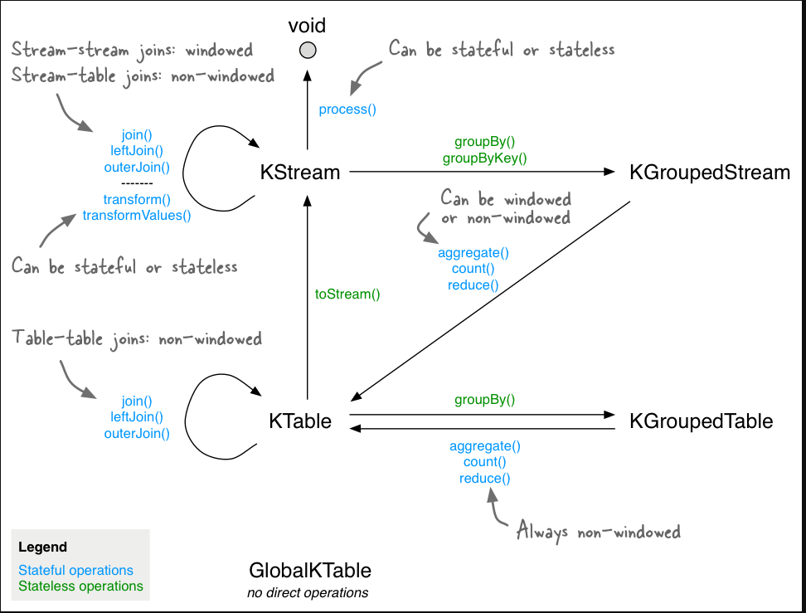
Kafka Streams Stack Map – Day 21

