Slide 1
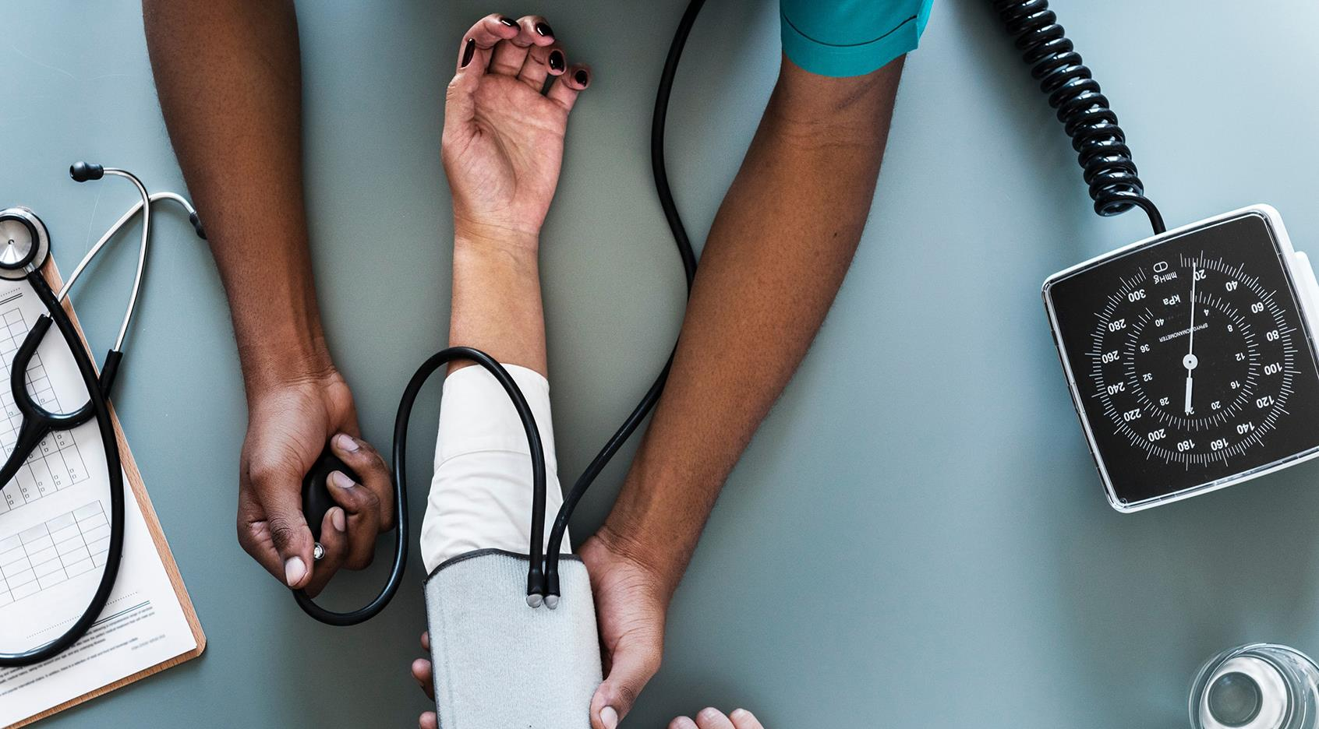
COVID-19 Detection using X-Ray Images
Machine Learning Mini-Project

Slide 2
Contents
Introduction
Datasets
Initialization and data pre-processing
Model Architecture
Model evaluation
Prediction

Slide 3
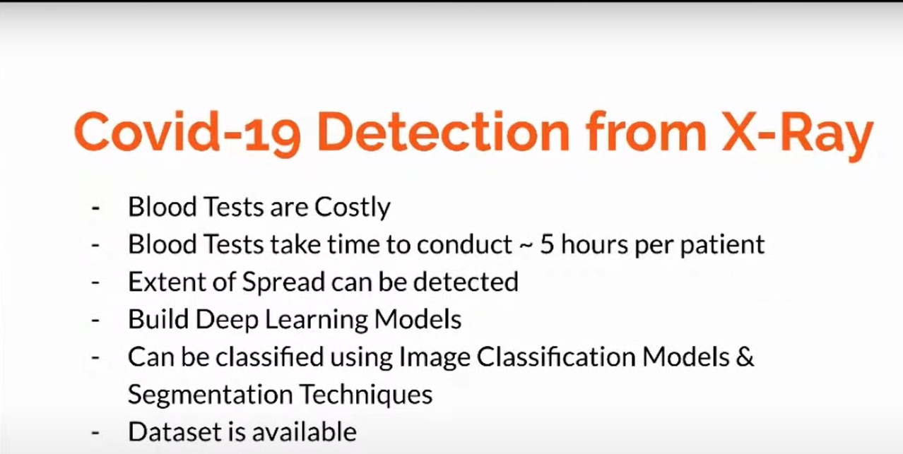

Slide 4
Introduction
COVID-19 takes a lot of effort to identify using blood tests. It costs a lot of money and time to do so. The projects helps to identify the covid presence using CNN (convolution Neural Networks) and predict the results based on lung images.

Slide 5
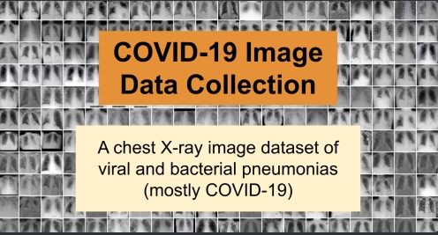
Dataset with Covid
https://github.com/ieee8023/covid-chestxray-dataset
an open database of COVID-19 cases with chest X-ray or CT images.
Size : 950 Images

Slide 6
Dataset of normal Class
https://www.kaggle.com/paultimothymooney/chest-xray-pneumonia
1250 Images under normal class

Slide 7
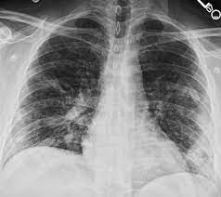
Initialization and data Pre-processing
The images all have the different square size pixels. We need to load the images and reshape the data arrays to have a RGB color channel to get more accuracy.
Each image in the dataset are unsigned integers in the range between 0 and 255. we will normalize the data to range [0,1]
80% Train 20% Test
Batch size :32

Slide 8
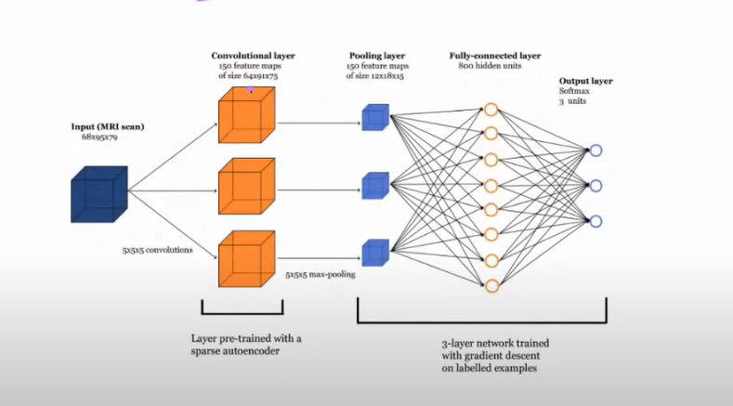
Model Architecture
The model has two main aspects: the feature extraction front end comprised of convolutional and pooling layers, and the classifier backend that will make a prediction.

Slide 9
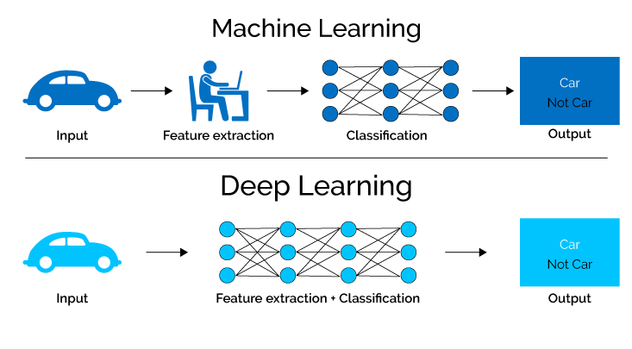
Why deep learning?
We need to do more feature extractions on a micro scale. Small and minute features are needed to identify the changes in lung X-ray images. Features cannot be identified using naked eye.

Slide 10
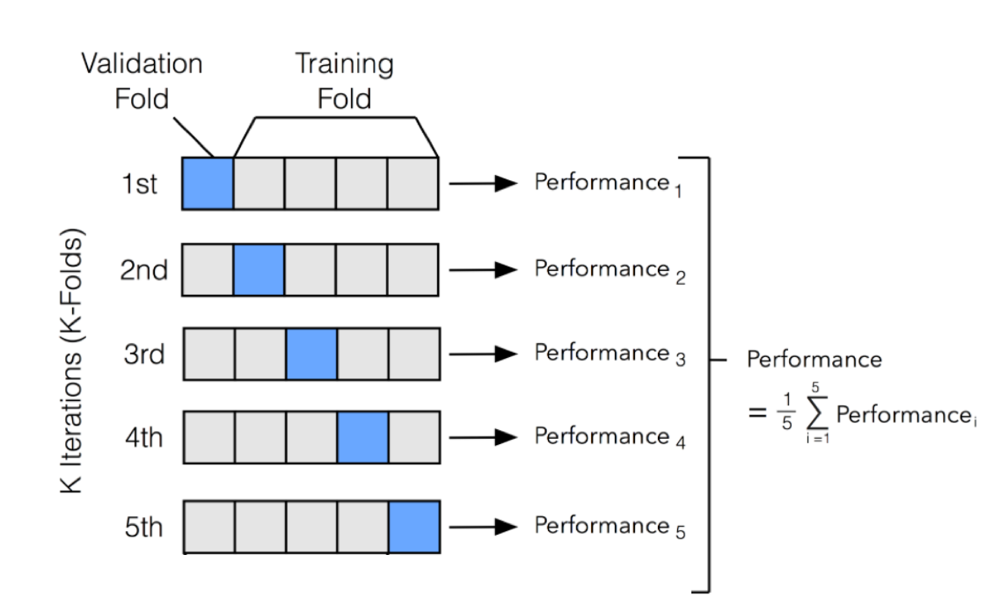
Model Evaluation
The K-Fold class from the scikit-learn API to implement the k-fold cross-validation evaluation of a given neural network model.

Slide 11
Further Model Improvements:
Dropout Regularization
Image Data Augmentation
Changing the stochastic nature of the algorithm or evaluation procedure.

Slide 12
Prediction
The model will predict if a image is belonging to COVID set or not.

Slide 13

Thank You
Sreedhar V 161
Sudharshan R 173
Shri Charan RS 147
Yeshwanth SV 204

