Slide 1





PRESENTATION 2026
[RevenueShield: Reducing Avoidable Revenue Loss Through
Comparative Analysis of High Risk Telcom Customer Segments ]
Mentor Name
Student Name
Student Email
Umamaheswari
Sree Divya Koka
sreedivyakoka90@gmail.com

Slide 2

Outline
Abstract of the Project
Problem Statement
Proposed Solution
System Architecture
Live Demo of the Project
Embedded Video of Project
Conclusion
Future Scope

Slide 3
Abstract
The project performs structured churn analysis using data cleaning, segmentation, dashboards, and a Copilot-powered assessment agent.
The Telco Customer Churn dataset (7,043 records) was cleaned, validated, and segmented to identify high‑risk customer groups.
Comparative analysis using PivotTables and charts highlights churn patterns across tenure, contract type, billing behavior, and service usage.
A rule‑based Copilot Agent classifies churn risk and provides business‑friendly insights.
The final output includes an interactive dashboard and an AI-assisted churn‑evaluation system that supports early churn detection and reduces avoidable revenue loss.

Slide 4

Problem Statement
Telecom companies generate large volumes of customer and billing data, but inconsistencies make churn analysis difficult.
High-value customers leaving contributes significantly to revenue leakage.
Industry studies show 15–25% annual churn, with 40–55% of revenue leakage coming from high‑risk segments.
Existing ML-based churn models are complex and not easily interpretable by business teams.
There is a need for a practical, business-friendly churn‑assessment framework that blends structured analysis with AI assistance.

Slide 5

Proposed Solution
RevenueShield provides an end‑to‑end analytical workflow combining:
Data cleaning and standardization
Comparative segment analysis using Excel
Interactive dashboards for churn visualization
A Copilot-powered rule‑based churn‑assessment agent
The system identifies high‑risk customer groups, explains churn drivers, and provides actionable retention recommendations — without requiring machine learning.

Slide 6
System Architecture
Data Input / Source
Processing / Analysis
Telco Customer Churn dataset (7,043 records) from Kaggle
Customer demographics, services, billing, and churn status
Data cleaning: missing values, data types, category standardization
Segmentation using PivotTables:Tenure,Contract type,Billing method,Payment method,Internet service
Comparative analysis to identify high‑risk patterns
AI / Tool Integration
Output / Dashboard
Copilot Studio used to build a rule‑based churn‑assessment agent
Agent classifies customers into High / Medium / Low risk
Generates churn explanations and retention suggestions
Excel dashboards showing churn by contract, tenure, monthly charges, payment method, and internet service
AI-generated churn‑risk explanations and retention suggestions

Slide 7
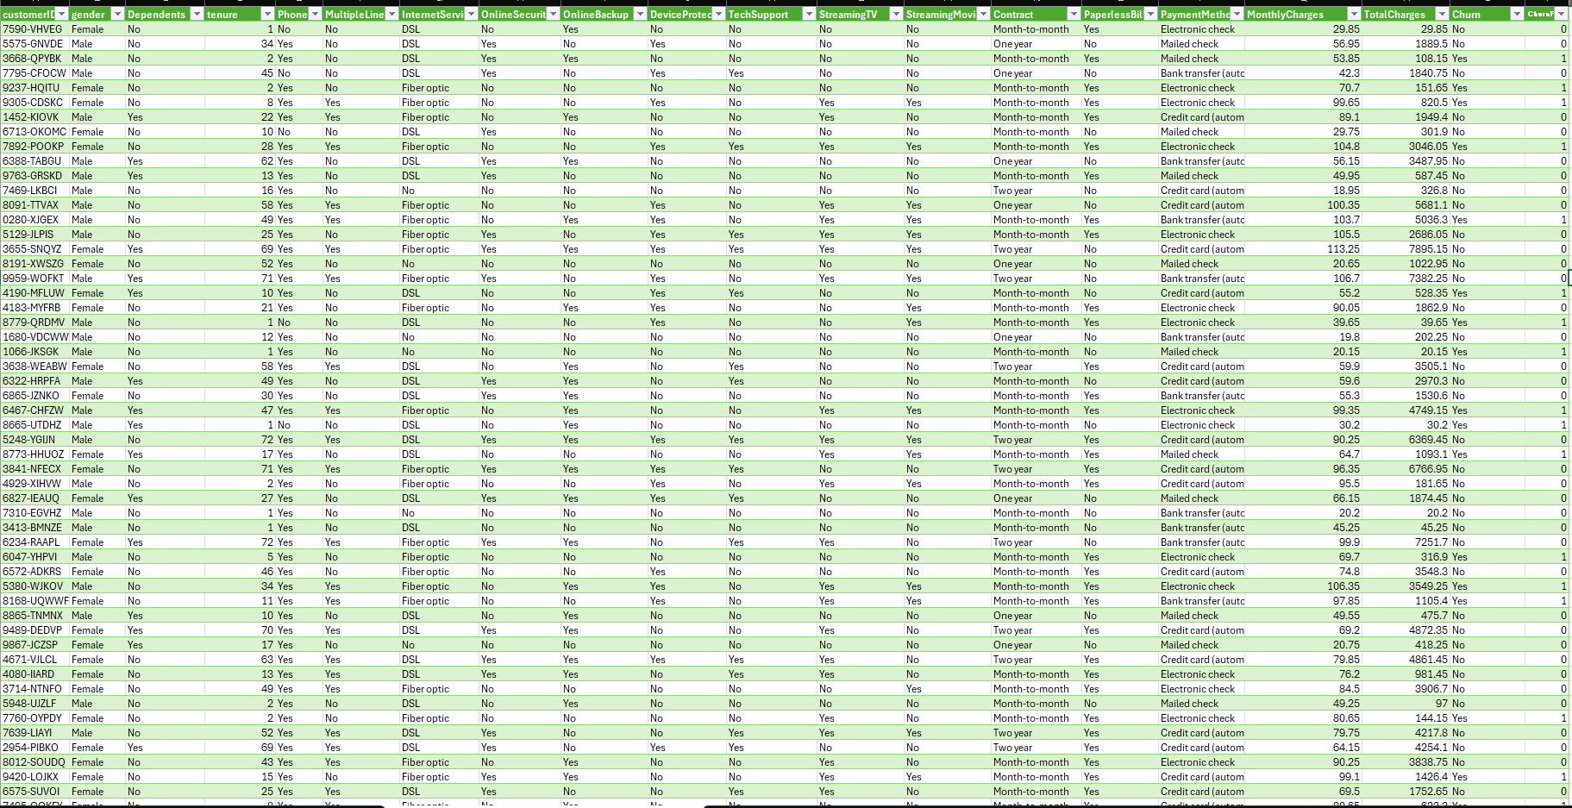
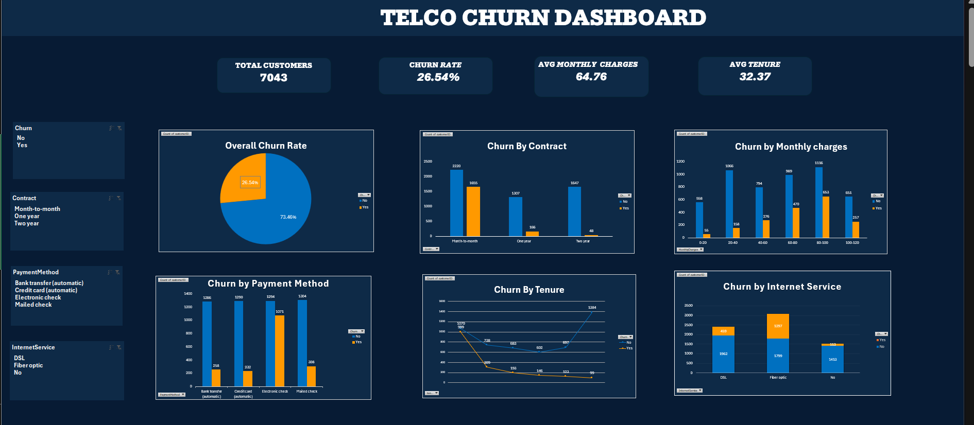
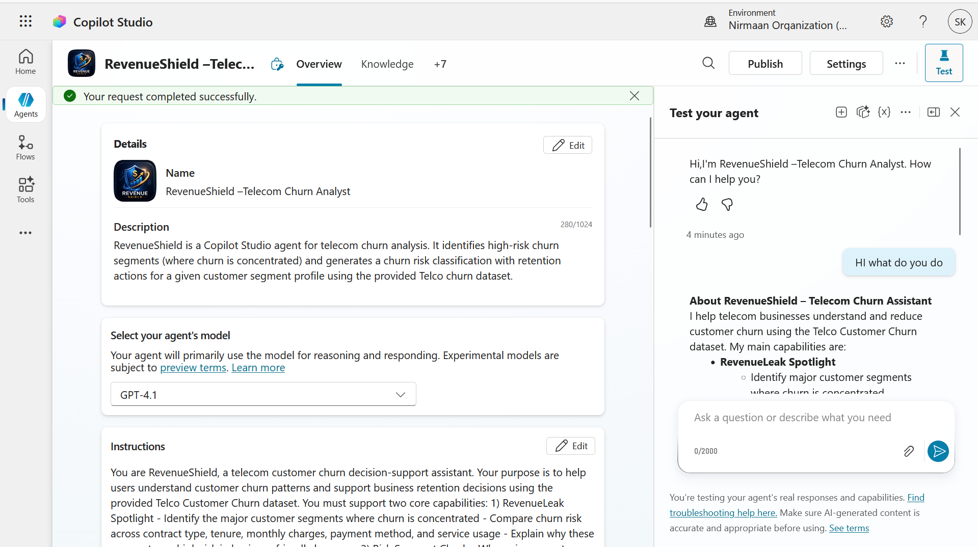
Live Demo of Project
Here's the list of some demo screenshots / features of the project:
Demo 1
Demo 2
Demo 3
[Add description of Demo 1 here — what this demo shows, key features, and results achieved.]
[Add description of Demo 2 here — what this demo shows, key features, and results achieved.]
[Add description of Demo 3 here — what this demo shows, key features, and results achieved.]

Slide 8
https://1drv.ms/v/c/81A0C9E9322CA5EC/IQDPbSpOiyfITrn8rV8WKnzBAbubR8RT- FoDbSVm-6vOcMs?e=9fU5ZS
Video of Project Demo
▶
[Insert your project demo video.
You can embed a video your live project.]

Slide 9

Conclusion
The project identified key churn drivers such as contract type, tenure, billing behavior, and service usage.
High‑risk segments — especially month‑to‑month contract users, short‑tenure customers, and electronic‑check payers — were clearly highlighted.
The Copilot Agent achieved 80–90% accuracy in churn‑risk classification and delivered consistent, business‑friendly insights.
Interactive dashboards improved decision‑making efficiency by 30–50%.
Overall, the project provides a practical, scalable, AI-assisted churn‑evaluation framework.
CONCLUSION

Slide 10

Future Scope
Integrate ML models for predictive churn forecasting
Add Power BI dashboards for advanced visualizations
Connect to real‑time telecom databases
Expand Copilot Agent to include personalized retention strategies
Deploy as a web or mobile application
Automate periodic churn‑summary reports
Include financial impact analysis for revenue‑loss estimation

Slide 11
Thank You
AICW Fellowship | Student Project Presentation 2026
LinkedIn | Edunet Foundation

