Slide 1
DevSecOps Training – Day 01
Project Setup & Java Build Fundamentals

Slide 2
Day 01 Agenda
Why projects are needed in real-world development
Java project setup using IntelliJ IDEA
Build tools & package managers
Maven basics
Java packaging (JAR)
Archive file types and usage

Slide 3
Why Do We Need a Project?
Organizes code in a structured manner
Provides a standard folder and module structure so code is easy to read, maintain, and extend.
Enables collaboration among developers
Allows multiple developers to work on the same codebase without conflicts through clear structure and ownership.
Supports version control (Git)
Works seamlessly with Git to track changes, manage branches, and maintain code history.
Required for CI/CD and DevOps pipelines
CI/CD tools expect a well-structured project to automate build, test, and deployment processes.
Helps in scalability, testing, and deployment
Makes it easy to add new features, write automated tests, and deploy applications reliably

Slide 4
Java Class vs Java Project
Java Class: Single file, manual compile & run
Java Project: Structured folders (src, resources)
Uses build tools for automation
Industry-standard approach

Slide 5
What is a Build Tool?
Automates compilation and packaging
Manages dependencies
Runs tests
Example: Maven, Gradle

Slide 6
What is a Package Manager?
Downloads and manages libraries
Avoids manual JAR handling
Resolves dependency conflicts
Maven Central Repository

Slide 7
Introduction to Maven
Apache Maven is a build and dependency management tool mainly used for Java projects.
In simple words: 👉 Maven automates how your Java project is built, tested, and packaged.
Instead of:
Manually compiling code
Downloading JARs
Creating JAR/WAR files
Maven does all of this automatically using configuration defined in pom.xml.
It follows standard project structure and widely used in DevOps pipelines

Slide 8
Maven Build Lifecycle
validate - validate the project is correct and all necessary information is available
compile - compile the source code of the project
test - test the compiled source code using a suitable unit testing framework. These tests should not require the code be packaged or deployed
package - take the compiled code and package it in its distributable format, such as a JAR.
verify - run any checks on results of integration tests to ensure quality criteria are met
install - install the package into the local repository, for use as a dependency in other projects locally
deploy - done in the build environment, copies the final package to the remote repository for sharing with other developers and projects.

Slide 9
Java Packaging (JAR)
JAR = Java Archive
Contains compiled .class files
Used for application distribution
Executed using JVM

Slide 10
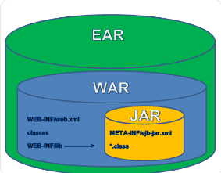
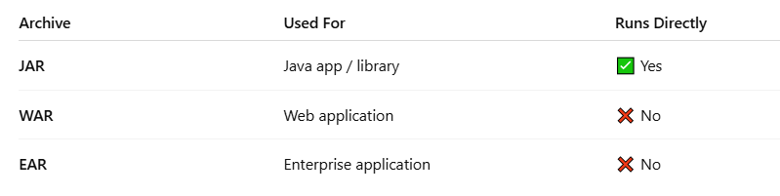
Types of Archive Files
JAR: Java application
WAR: Web application
EAR: Enterprise application

Slide 11
Why Archive Files Are Important
Easy distribution
Standard deployment format
Used in CI/CD pipelines
Platform independent

Slide 12
Relevance in DevOps / DevSecOps
Projects are input to CI/CD pipelines
Maven builds automated in pipelines
Artifacts stored in repositories
Security scanning on JARs

Slide 13
Assignment
🧪 Assignment 1: Convert a Plain Java Program into a Maven Build
🎯 Objective What Maven build really means
Standard Maven folder structure
How Maven replaces javac and java
How a JAR is created
Problem Statement
You have a Java program that you compile and run using javac and java. Convert this program into a Maven project and build a JAR file using Maven.

Slide 14
Assignments
Assignment 2: Add Dependency & Build an Executable JAR (FULL EXAMPLE)
By completing this assignment, you will learn:
What a dependency JAR is
How Maven downloads dependencies automatically
How to build an executable JAR
How Maven replaces javac and java -cp
📌 Problem Statement
Create a Maven project that uses an external library (Apache Commons Lang) to manipulate strings. Package the application as an executable JAR and run it using java -jar.

Slide 15
Day 01 Summary
Importance of projects
Java project setup using IntelliJ
Build tools & Maven
Maven build lifecycle
Java packaging concepts

