Slide 1
CI/CD pipeline in GitHub

Slide 2
GitHub CI/CD
What is GitHub Actions (CI/CD)?
GitHub Actions is GitHub’s built-in automation tool to implement:
CI (Continuous Integration) → build, test on every push/PR
CD (Continuous Deployment) → deploy automatically after merge
Everything is defined using YAML files inside your repo.
Only YAML files inside .github/workflows/ are treated as pipelines

Slide 3
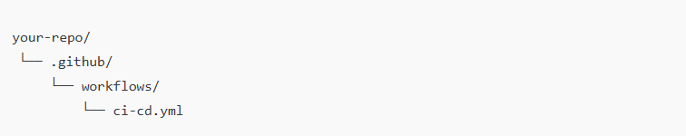
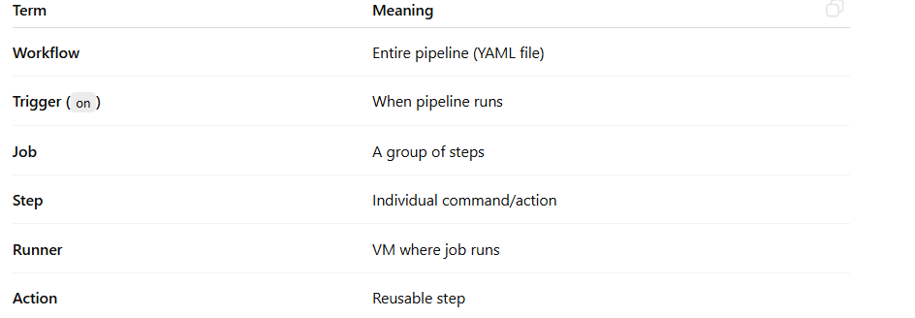
Folder Structure (Mandatory)

Slide 4
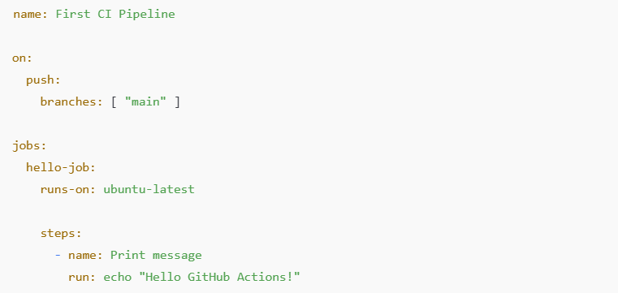
Simplest CI Pipeline (Hello World)

Slide 5
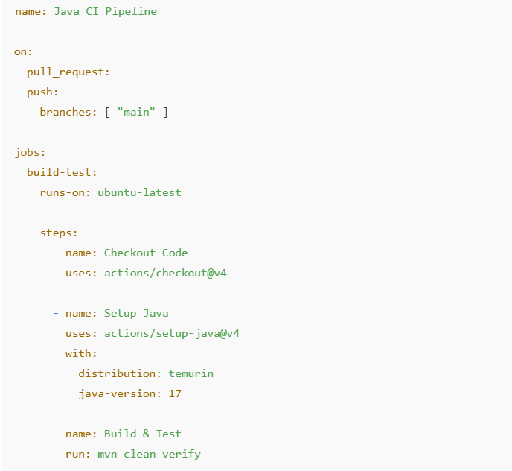
Java + Maven CI Pipeline
What this does:
Pull request → build + test
Push to main → build + test

Slide 6
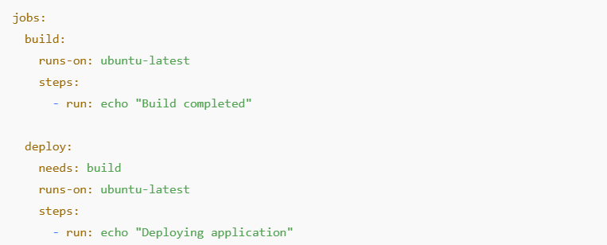
Job Dependency (One Job After Another)

Slide 7
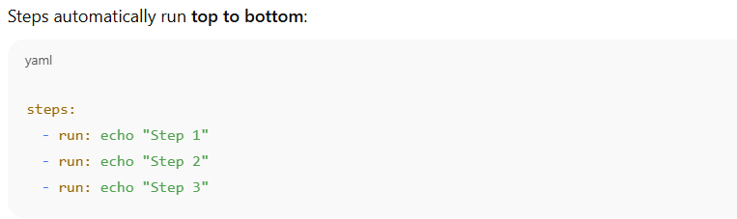
Step Dependency (Sequential by Default)

Slide 8
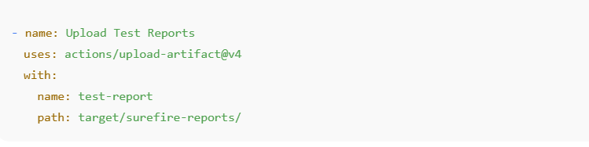
Publish Test Reports / Artifacts

Slide 9
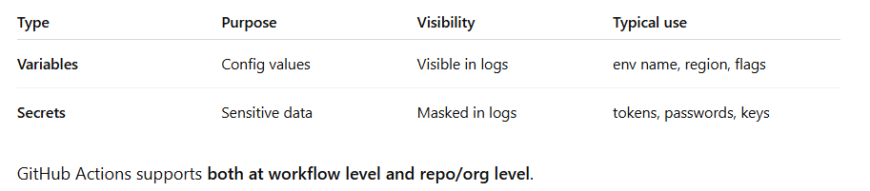
GitHub Actions variables & secrets

Slide 10
Declaring Secrets
Declaring Secrets (Secure Way)
🔹 A. Add secrets in GitHub UI
Go to Repository → Settings → Secrets and variables → Actions
Click New repository secret
Add:
Name: DOCKER_PASSWORD
Value: ********
📌 Secrets can also be defined at:
Environment level
Organization level

Slide 11
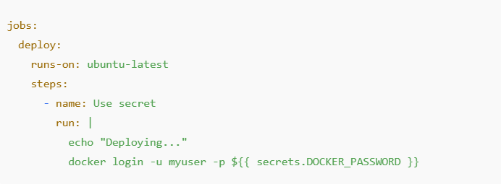
Using secrets in workflow

Slide 12
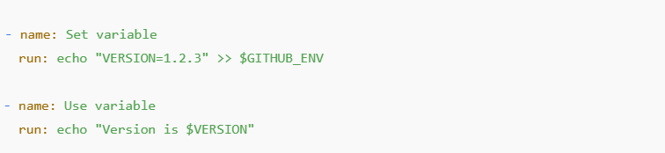
Passing variables Between steps

Slide 13
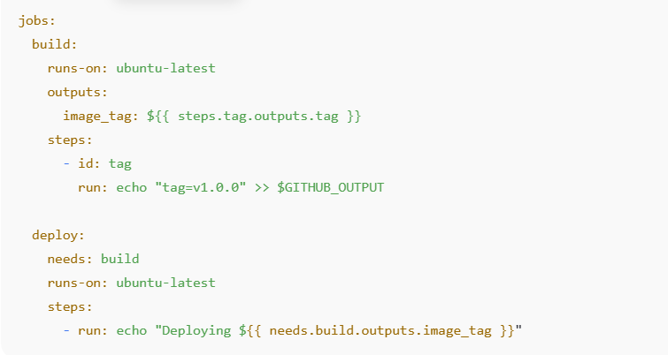
Passing Variables Between Jobs

Slide 14
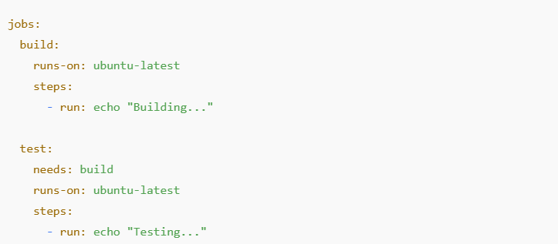
Basic Job Dependency

Slide 15
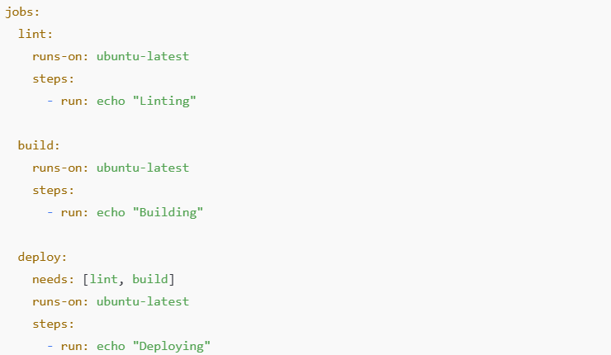
Multiple job dependencies

Slide 16
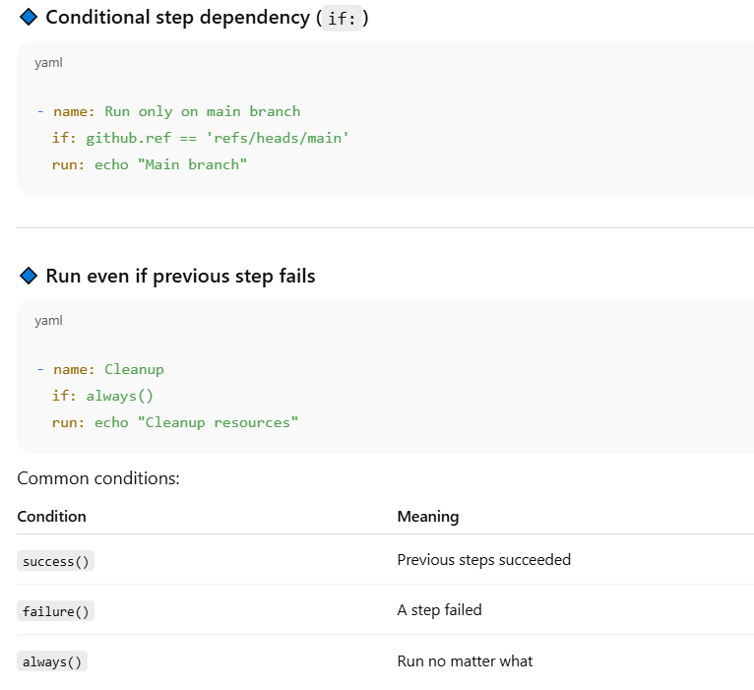
Conditional Steps dependencies

Slide 17
Self-Hosted Runner
A self-hosted runner is a machine you manage that runs GitHub Actions jobs instead of GitHub-hosted runners.
Instead of:
runs-on: ubuntu-latest
You use:
runs-on: self-hosted
The runner polls GitHub for jobs and executes them locally.

Slide 18
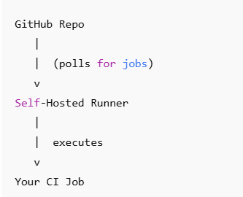
Self Hosted Runner: Why?
Why Use a Self-Hosted Runner?
✅ When it makes sense
When need custom tools
Need root access / system-level tools
Run on private network (DBs, internal APIs)
Avoid GitHub-hosted minute limits
Use GPU / high-memory machines
Enterprise / air-gapped environments

Slide 19
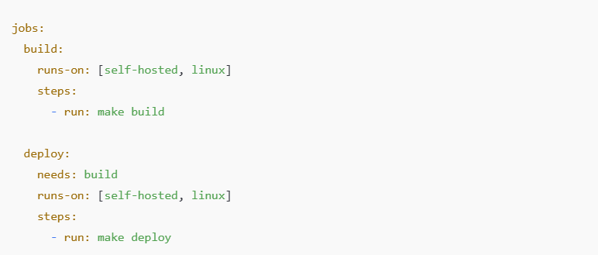
Job Dependency + Self-Hosted Runner

