Slide 1
Docker & Kubernetes

Slide 2
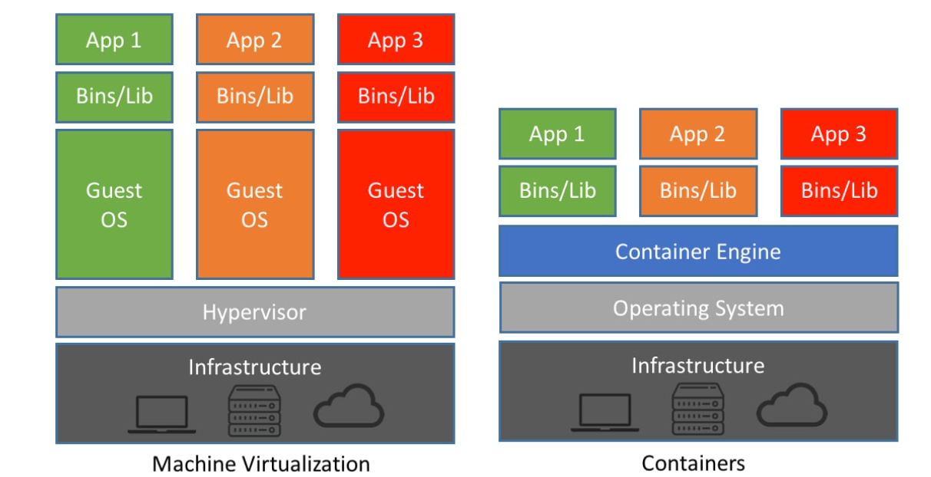
VM vs Containers

Slide 3
Docker
What Docker Does
Docker allows you to package an application with everything it needs (runtime, libraries, configs) into a container.
Think of Docker as “Make my app run the same everywhere.”
Core Concepts
Image → Blueprint of your app
Container → Running instance of an image
Dockerfile → Instructions to build an image
Registry → Stores images (e.g. Docker Hub)

Slide 4
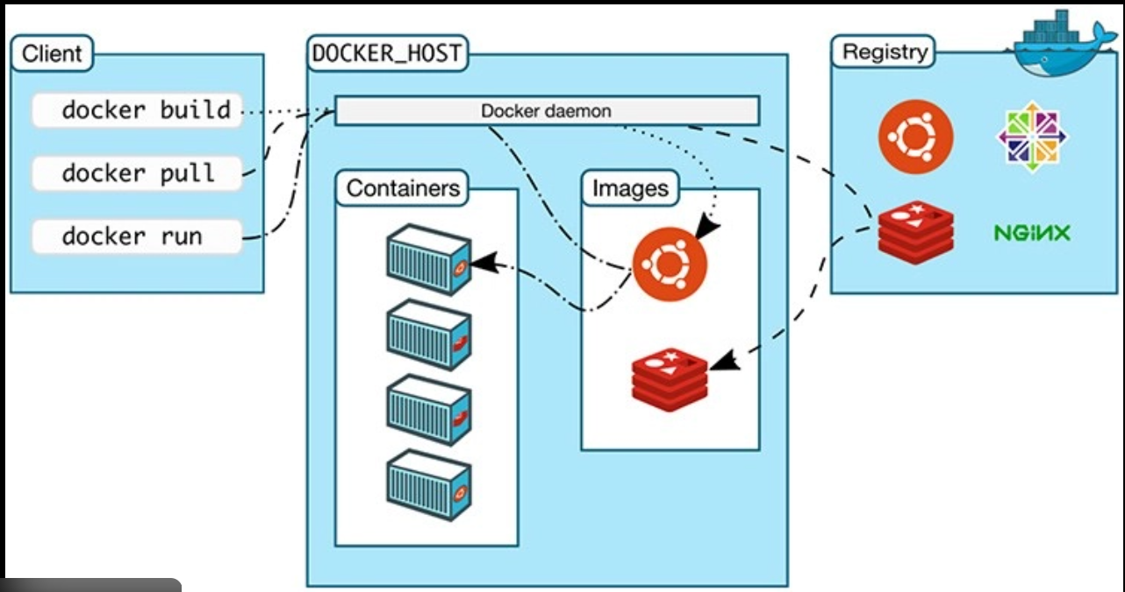

Slide 5
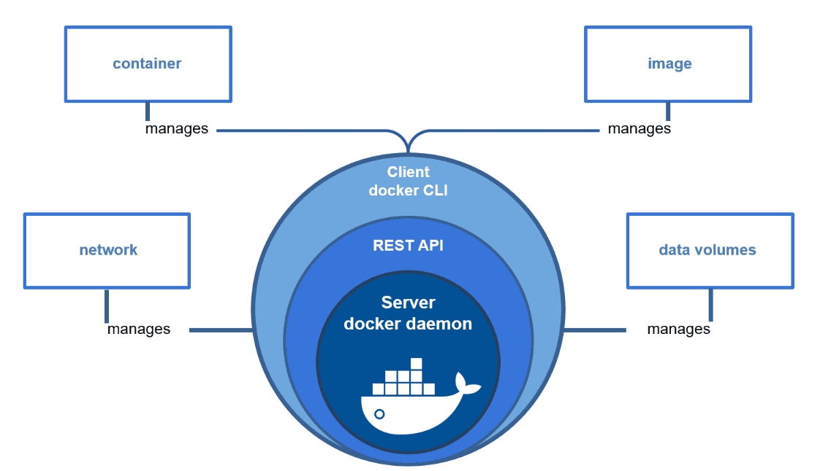

Slide 6
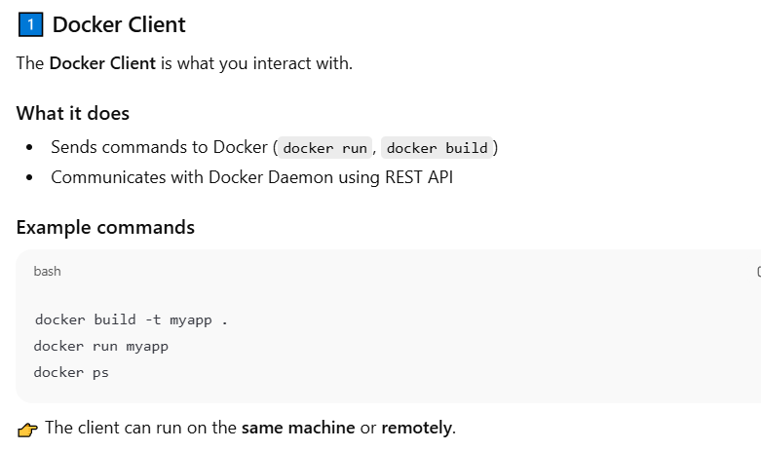
Docker Client

Slide 7
Docker Engine
Docker Engine
Docker Engine** = Client + Daemon + REST API**
Components
dockerd → Daemon
REST API → Communication
Docker CLI → User interface
When you install Docker, you’re installing Docker Engine.

Slide 8

Docker Daemon

Slide 9
Docker Image
Docker Images
What is an Image?
Read-only template
Built from a Dockerfile
Contains app + dependencies
Example
FROM python:3.12
COPY app.py .
CMD ["python","app.py"]
Images are layered → faster builds & smaller size.

Slide 10
Docker Container
Docker Containers
What is a Container?
Running instance of an image
Isolated (process, network, filesystem)
Key Properties
Lightweight
Starts in milliseconds
Shares host OS kernel
docker run nginx

Slide 11
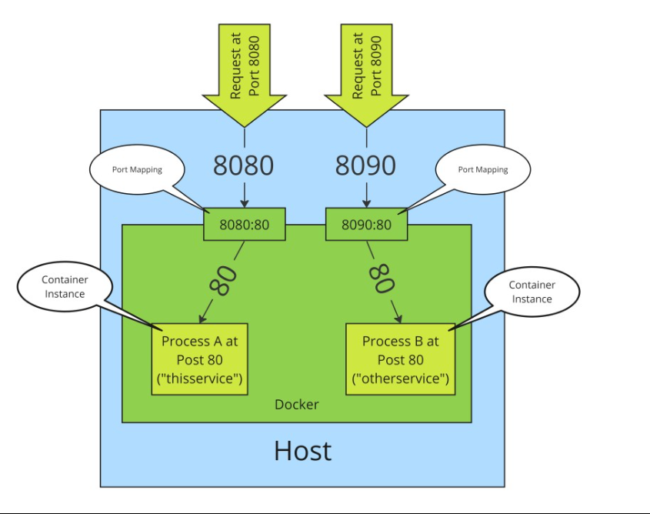
Docker: Port Mapping

Slide 12
Docker Registry
Docker Registry
Stores Docker images.
Popular Registries
Docker Hub
AWS ECR
Google Artifact Registry
GitHub Container Registry
Flow
docker push → registry
docker pull ← registry

Slide 13
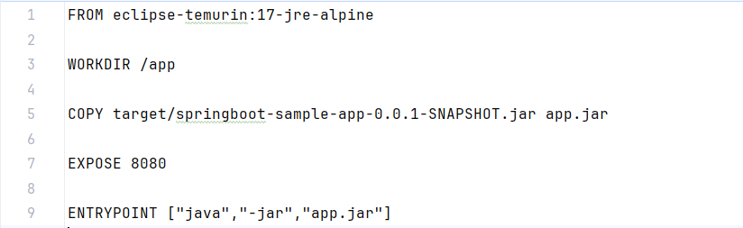
Dockerfile : Single Stage

Slide 14
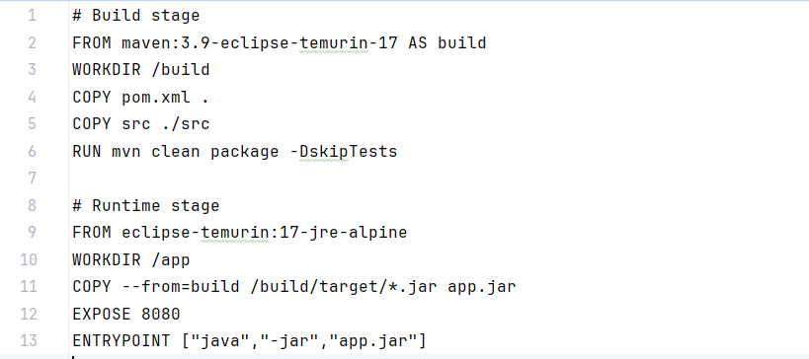
Dockerfile : Multi-stage

Slide 15
Docker Compose
Docker Compose is a tool that lets you define, run, and manage multi-container applications using one YAML file (docker-compose.yml) and simple commands.
In one line
Docker Compose runs many containers together as one application.
Why Docker Compose exists (the problem it solves)
Without Compose, to run your app you’d have to:
Create networks manually
Start containers in the right order
Remember port mappings
Link containers together
Stop and clean up everything later
Docker Compose does all of this automatically.

Slide 16
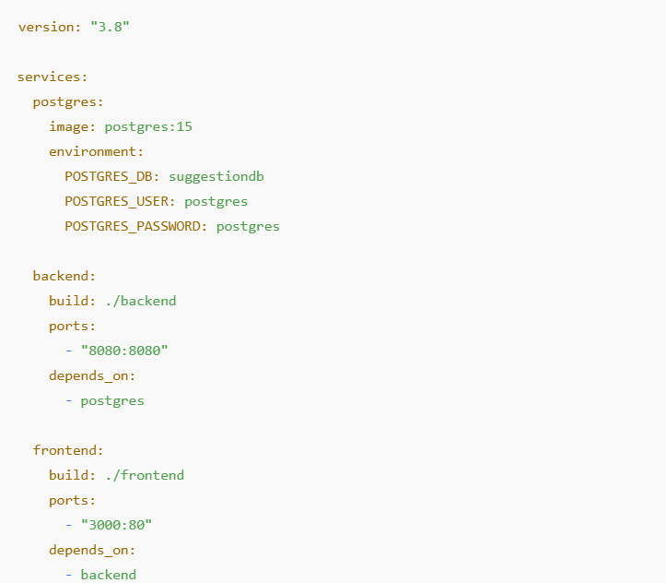
Docker Compose

Slide 17
Docker compose commands
docker-compose up – Start all services
docker-compose up --build – Rebuild images and start services
docker-compose up -d – Start services in background
docker-compose build – Build images only
docker-compose build --no-cache – Build images without cache
docker-compose down – Stop and remove containers and network
docker-compose stop – Stop running containers
docker-compose start – Start stopped containers
docker-compose restart – Restart services
docker-compose ps – List running services
docker-compose logs – Show logs
docker-compose logs -f – Follow logs
docker-compose config – Validate compose file
docker-compose logs <service> – Show service logs
docker-compose rm – Remove stopped containers
docker-compose version – Show compose version

