Slide 1
Docker Compose
Docker Compose is a tool that lets you define, run, and manage multi-container applications using one YAML file (docker-compose.yml) and simple commands.
In one line
Docker Compose runs many containers together as one application.
Why Docker Compose exists (the problem it solves)
Without Compose, to run your app you’d have to:
Create networks manually
Start containers in the right order
Remember port mappings
Link containers together
Stop and clean up everything later
Docker Compose does all of this automatically.

Slide 2
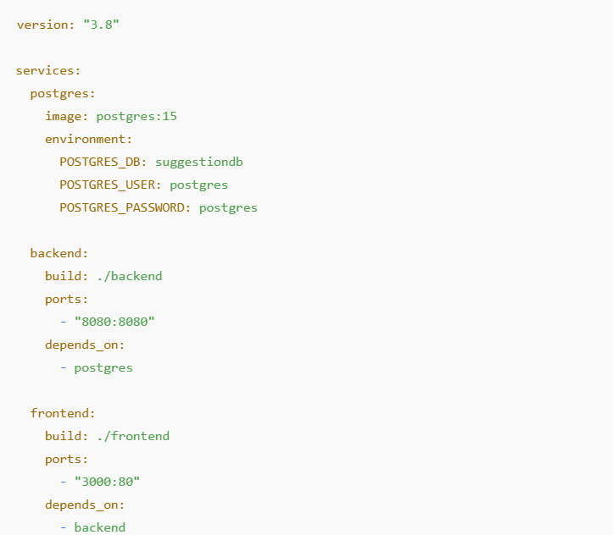
Docker Compose

Slide 3
Docker compose commands
docker-compose up – Start all services
docker-compose up --build – Rebuild images and start services
docker-compose up -d – Start services in background
docker-compose build – Build images only
docker-compose build --no-cache – Build images without cache
docker-compose down – Stop and remove containers and network
docker-compose stop – Stop running containers
docker-compose start – Start stopped containers
docker-compose restart – Restart services
docker-compose ps – List running services
docker-compose logs – Show logs
docker-compose logs -f – Follow logs
docker-compose config – Validate compose file
docker-compose logs <service> – Show service logs
docker-compose rm – Remove stopped containers
docker-compose version – Show compose version

Slide 4
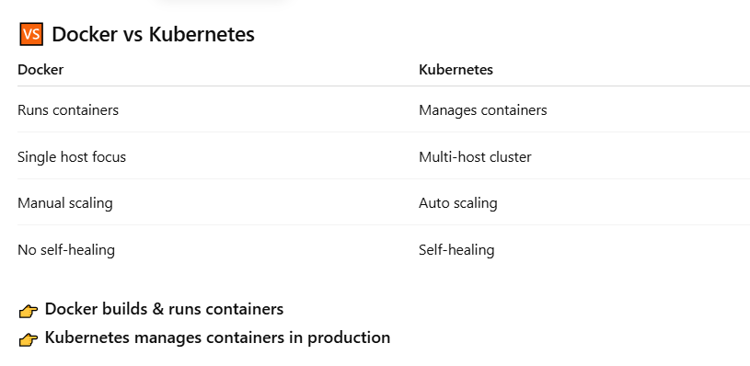
Docker vs Kubernetes

Slide 5
What is Kubernetes
Kubernetes (often called K8s) is an open-source container orchestration platform used to deploy, manage, scale, and heal containerized applications automatically.
In simple terms:
👉 If Docker runs containers, Kubernetes runs containers at scale.
🔍 Why Kubernetes is needed
When applications grow, you often have:
Many containers
Multiple servers (nodes)
Need for auto-scaling, self-healing, and zero-downtime deployments
Managing this manually is hard. Kubernetes does it for you.

Slide 6
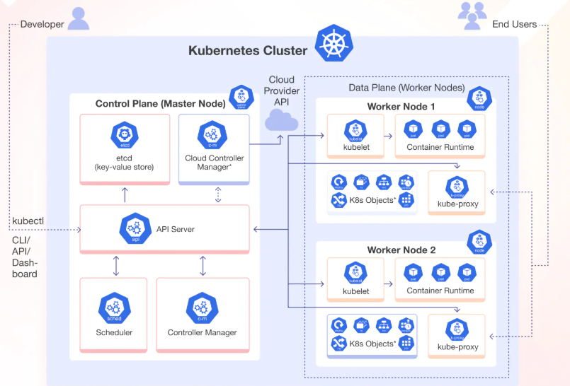
Kubernetes Architecture

Slide 7
Control Plane (Master Node)
The brain of the Kubernetes cluster. It makes all decisions
🔹 API Server
Entry point for Kubernetes
All commands (kubectl) go through this
Validates and processes requests
🔹 Scheduler
Decides which worker node a Pod should run on
Considers CPU, memory, affinity, taints, etc.
🔹 Controller Manager
Runs controllers that maintain desired state
Examples:
Node Controller
ReplicaSet Controller
Deployment Controller
🔹 etcd
Distributed key-value store
Stores cluster state:
Pods
Nodes
Configs
Secrets
📌 If etcd is lost → cluster state is lost

Slide 8
Worker Node
🔹 Kubelet
Agent running on each node
Talks to API Server
Ensures containers are running as expected
🔹 Container Runtime
Runs containers
Examples:
containerd
Docker
CRI-O
🔹 Kube-Proxy
Handles networking
Load balances traffic to Pods
Implements Services
🔹 Pods
Smallest deployable unit
One or more containers
Share:
Network
Storage
IP

Slide 9
How Components Work Together (Flow)
How Components Work Together (Flow)
Developer runs kubectl apply
Request goes to API Server
Scheduler selects a node
Controller Manager ensures desired state
Kubelet creates Pods on worker node
Container Runtime runs containers
Kube-Proxy routes traffic

Slide 10
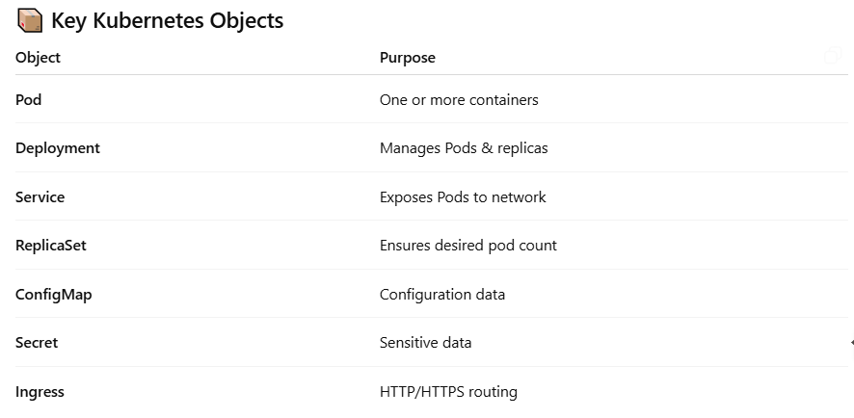
Kubernetes Objects

Slide 11
Kubernetes Namespace
In Kubernetes, a Namespace is a logical partition inside a cluster used to organize, isolate, and manage resources.
👉 Think of a Namespace like a folder inside a Kubernetes cluster.
🔍 Why Namespaces are needed
Multiple teams share the same cluster
You want to separate dev / test / prod
You need resource isolation
You want RBAC-based access control
Without namespaces → everything lives together → chaos 😵‍💫

