Slide 1
Python Build and Pipelines

Slide 2
Python – Interpreted
Why Java is called compiled & Python interpreted (final clarity)
Java:
Compilation is mandatory
.class files are final artifacts
JVM expects bytecode input
Python:
Compilation is optional & invisible
.pyc is a cache
Python can run without .pyc
👉 That’s the classification difference.

Slide 3
JAVA vs Python
Java:
Faster execution
Slower development
Complex build pipelines
Python:
Faster development
Slower execution
Simple build pipelines
That’s why:
Java dominates backend systems
Python dominates AI, scripting, DevOps
🔑 Both Python and Java use a VM, but Java pushes work to compile-time and optimizes at runtime, while Python defers most decisions to runtime and primarily interprets bytecode.

Slide 4
Python compiles automatically to bytecode
Bytecode is interpreted by Python VM
Virtual environment isolates dependencies
.pyc speeds up large projects
Python is interpreted, not CPU-compiled

Slide 5
Python Compilation
Internally Python does:
Reads app.py
Compiles source code to bytecode
Stores bytecode as .pyc in __pycache__/
Sends bytecode to Python VM for execution
📌 Important
This compilation is automatic
No compile command like Java or C
.pyc is not CPU executable
One-line takeaway
Python compilation is hidden, automatic, and produces bytecode (.pyc).

Slide 6
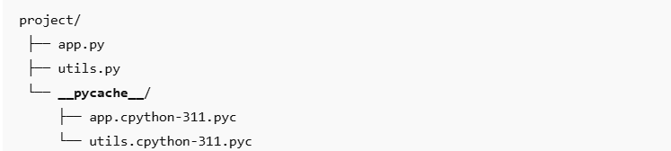
Python Bytecode
What is Python Bytecode (.pyc) and why it exists
What .pyc is
Precompiled Python bytecode
Platform-independent
Specific to Python version
Why .pyc exists (large project reason)
Avoid recompiling unchanged files
Faster application startup
Faster imports in big projects

Slide 7
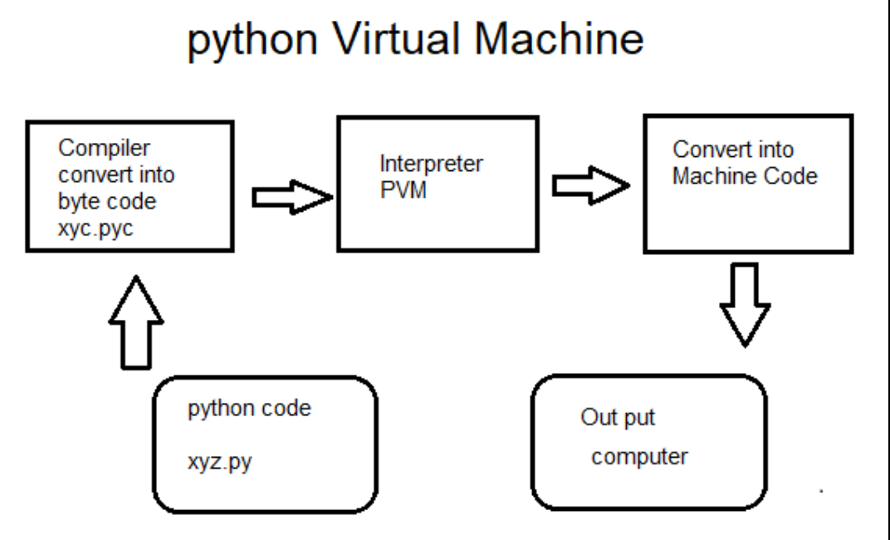
Python Virtual Machine
What the Python VM does
Reads bytecode instructions
Executes them step by step
Manages:
  Memory
  Stack
  Function calls
  Exceptions
Execution flow
.py → .pyc → Python VM → CPU
📌 CPU never runs .py or .pyc directly
📌 CPU runs the Python interpreter, which runs the bytecode
Python VM is the engine inside Python that interprets bytecode.

Slide 8
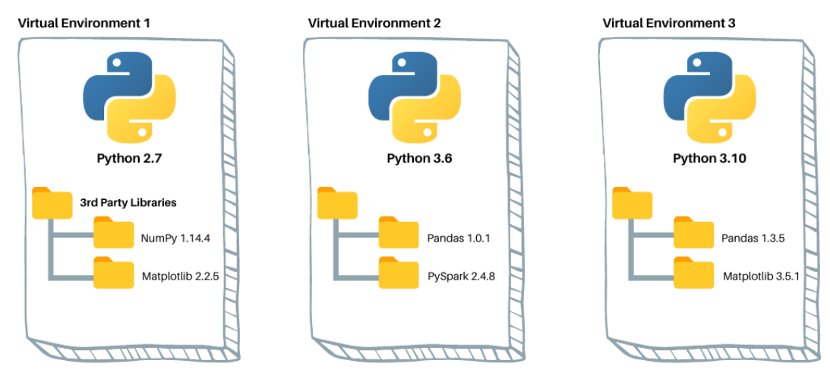
What venv is
Isolated Python installation for a project
Separate packages per project
Prevents dependency conflicts
Why we need it (example)
Project A → flask==1.1
Project B → flask==2.3
venv allows both on same machine

Slide 9
Python Build
What does “Python Build” actually mean?
In Python, build ≠ compile to machine code (like C/C++).
A Python build usually means:
Organizing code into a package
Managing dependencies
Creating distributable artifacts (.whl, .tar.gz)
Making it reproducible (same results everywhere)
Preparing for CI/CD pipelines
👉 Python does compile, but to bytecode (.pyc), not native CPU code.

Slide 10
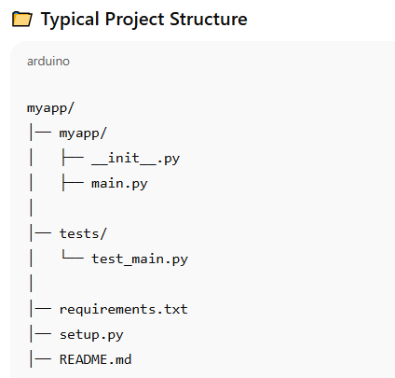
Normal (Classic) Python Build
Step 1: Create Virtual Environment
python -m venv venv
source venv/Scripts/activate
Why?
Isolates dependencies
Prevents version conflicts
Step 2: Install Dependencies
pip install -r requirements.txt
requirements.txt
flask==2.3.2
requests==2.31.0

Slide 11
Normal (Classic) Python Build
Step 3: setup.py (Build Configuration)
from setuptools import setup, find_packages
setup(
name="myapp",
version="0.1.0",
packages=find_packages(),
install_requires=[
"flask==2.3.2",
"requests==2.31.0"
],
)
Step 4: Build the Project
python setup.py sdist bdist_wheel
Artifacts produced:
dist/
├── myapp-0.1.0.tar.gz
├── myapp-0.1.0-py3-none-any.whl

Slide 12
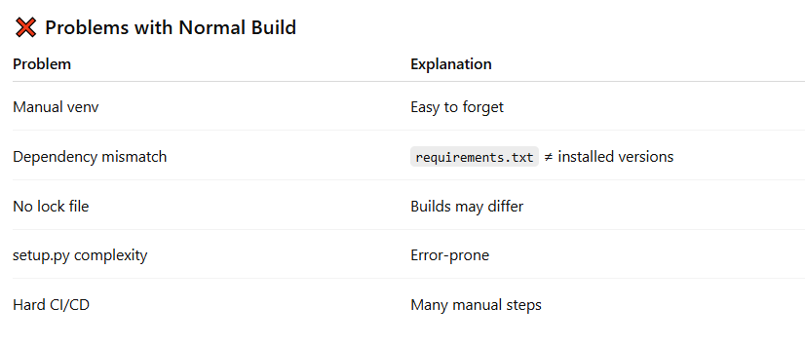
Problem with Normal Build

Slide 13
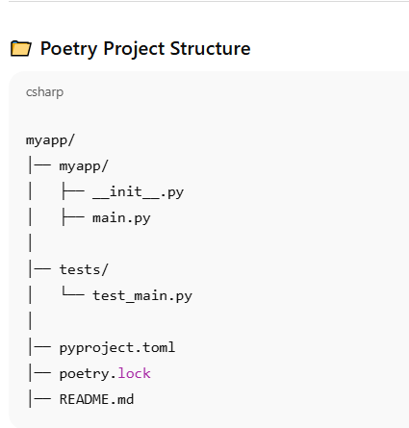
Python Build Using Poetry (Modern Way)
Poetry automates everything:
Virtual env
Dependency resolution
Locking
Build
Publish
Think of Poetry as Maven + pip + venv combined.

Slide 14
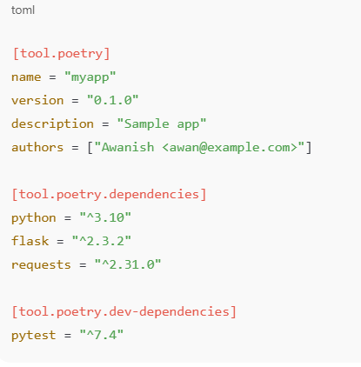
Step by step Poetry Build
Step 1: Create Project
command: poetry new myapp
cd myapp
Step 2 : Add dependency
poetry add flask requests
Poetry automatically:
  Creates virtual environment
  Resolves compatible versions
  Updates config
Step 3: pyproject.toml (Like pom.xml)

Slide 15


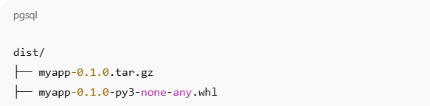
Step by step Poetry Build
Step 4: Lock File (Very Important)
poetry.lock
Exact resolved versions
Guarantees reproducible builds
Step 6: Run App
Step 5: Build with Poetry
Artifacts

Slide 16
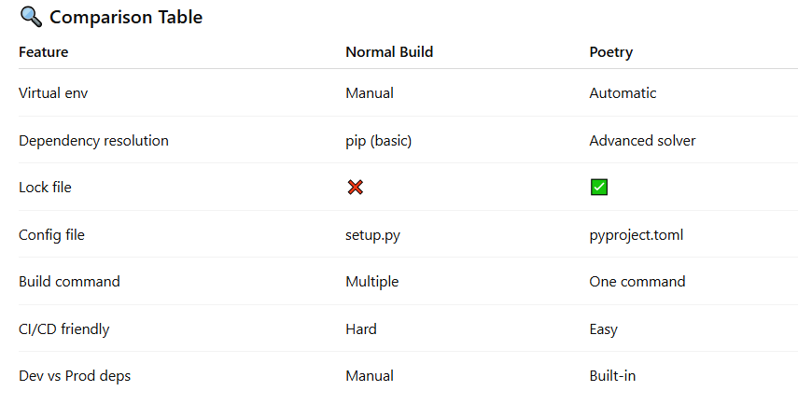
Why Poetry is Better

