Slide 1
Branching Strategy

Slide 2
What is Branching Strategy
A branching strategy is a set of rules and conventions that a team follows to decide:
How branches are created
When they are merged
Which branch is used for what purpose
How code moves from development to production
In simple words:
A branching strategy defines how a team works on code in parallel without breaking the main application.

Slide 3
Popular Types
Git Flow (Classic & Structured)
GitHub Flow (Simple & Modern)
GitLab Flow (Environment-Based)
Trunk-Based Development (DevOps Favorite)

Slide 4
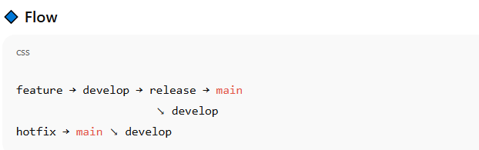
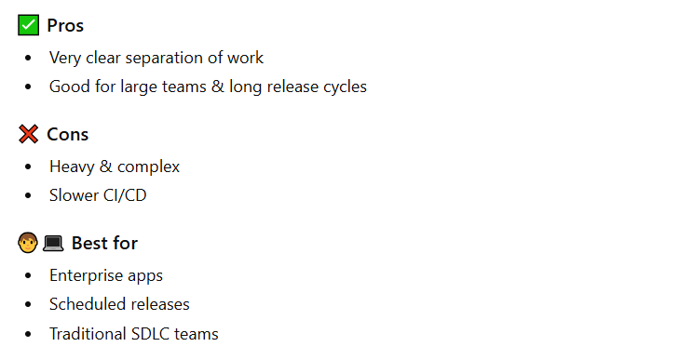
Git Flow
Branches
main (or master) → production-ready code
develop → integration branch
feature/* → new features
release/* → release preparation
hotfix/* → urgent production fixes

Slide 5
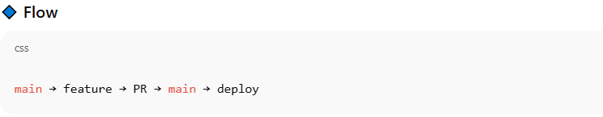
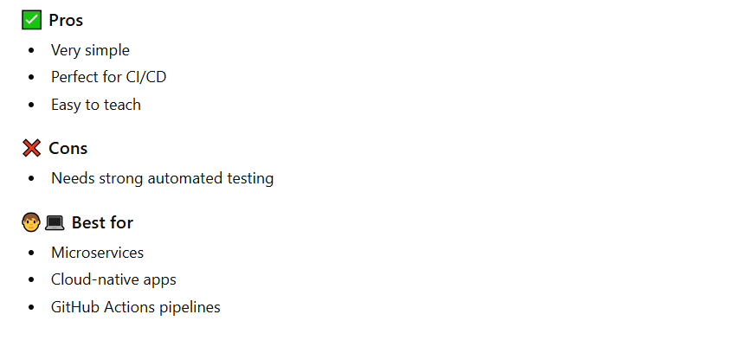
GitHub Flow
🔹 Branches
Main
feature/* (short-lived)

Slide 6
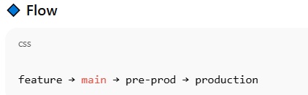
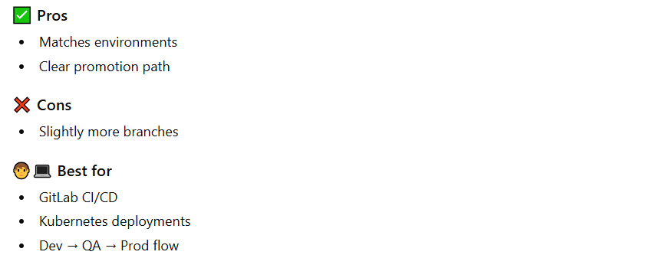
GitLab Flow
Branches
Main
feature/*
pre-prod
production

Slide 7
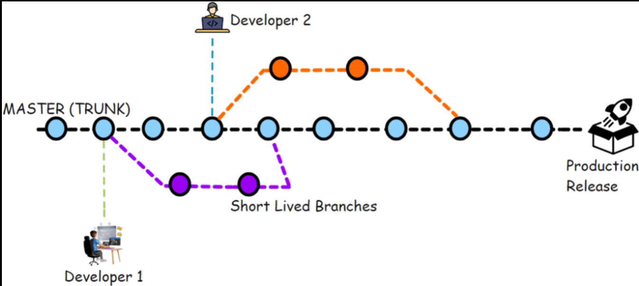
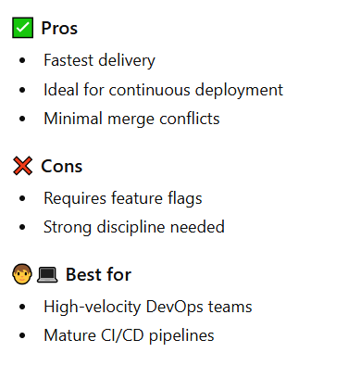
Trunk Based Development
🔹 Branches
main (trunk)
Very short-lived feature branches (hours/days)

Slide 8
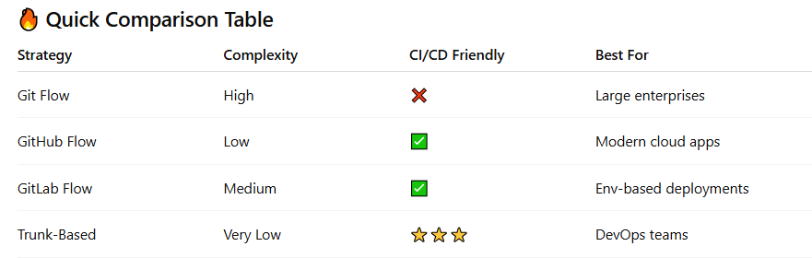
Comparison

Slide 9
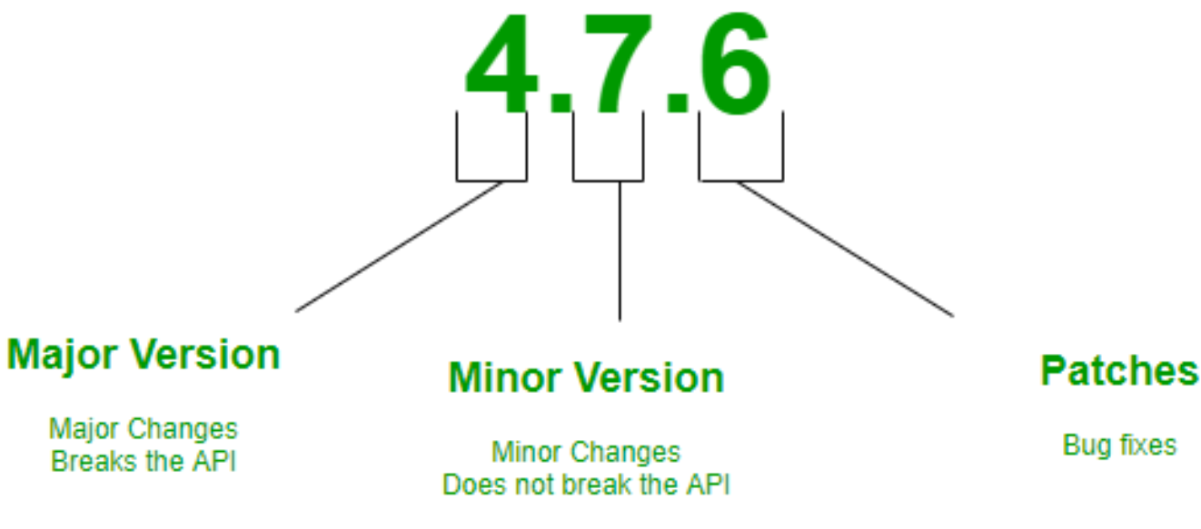
Semantic Versioning
Semantic Versioning is a standard way of versioning software so that version numbers clearly communicate the type of change made in a release.
🔄 Why Semantic Versioning Is Important?
✅ Predictable upgrades ✅ Safe dependency management ✅ Easy CI/CD automation ✅ Clear communication to users

Slide 10
What is Terraform
Terraform is an Infrastructure as Code (IaC) tool that lets you define, provision, and manage infrastructure (VMs, networks, Kubernetes, cloud services, etc.) using declarative configuration files.
It is developed by HashiCorp.
📌 In simple words:
Terraform allows you to create and manage infrastructure using code instead of clicking in the UI.
🧠 Why Terraform?
Without Terraform:
Manually create servers
Error-prone
Hard to repeat
No version control.
With Terraform:
Infrastructure = code
Repeatable & automated
Version controlled (Git)
Works across AWS, Azure, GCP, Kubernetes, etc

Slide 11
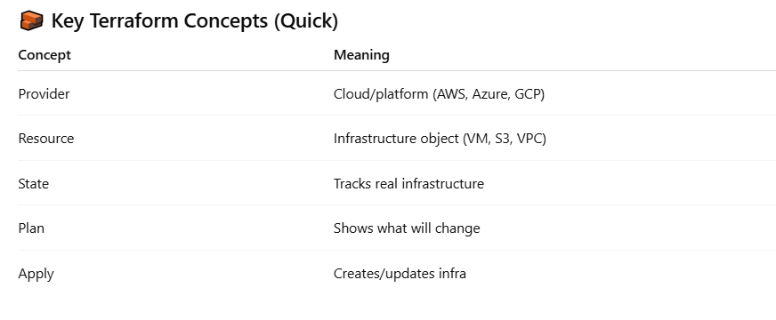
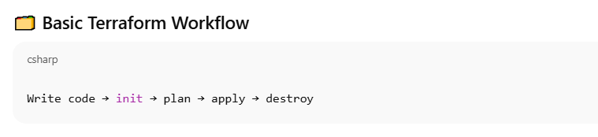
Key Terraform Concepts

Slide 12
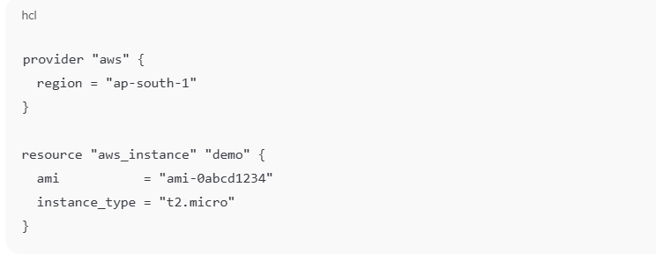
Example Terraform File (main.tf)

Slide 13
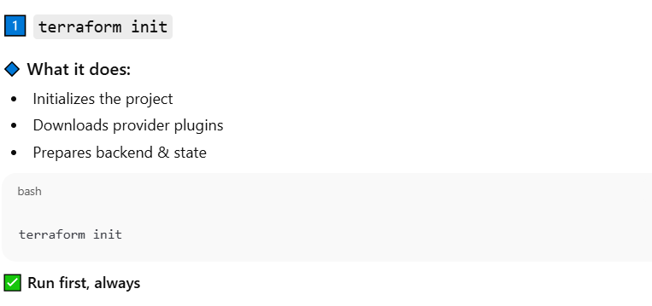
1️⃣ terraform init

Slide 14
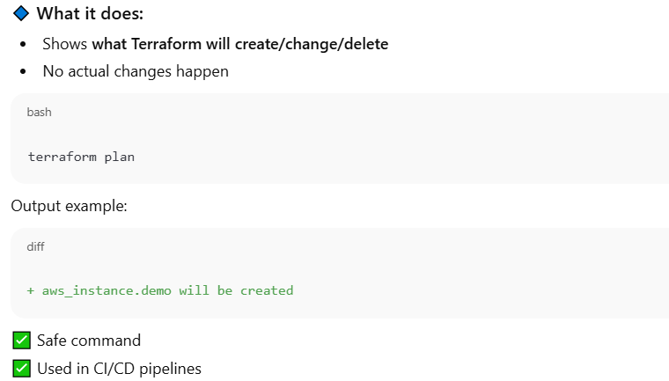
2️⃣ terraform plan

Slide 15
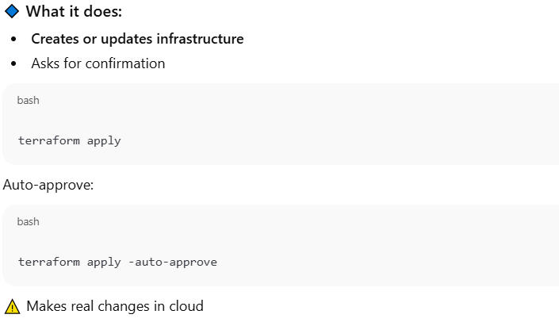
3️⃣ terraform apply

Slide 16
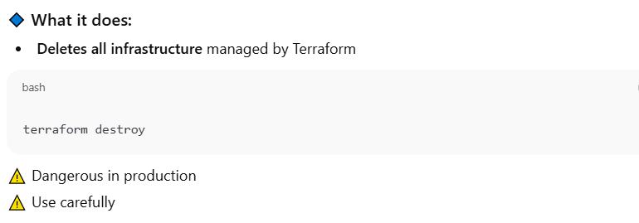
4️⃣ terraform destroy

Slide 17
Some other Terraform Commands
6️⃣ terraform fmt
🔹 What it does:
Formats Terraform files
Improves readability
terraform fmt
8️⃣ terraform state
🔹 What it does:
Advanced state management
List, move, remove resources
terraform state list
terraform state rm aws_instance.demo
7️⃣ terraform show
🔹 What it does:
Displays current state
Shows real infrastructure details
terraform show
9️⃣ terraform output
🔹 What it does:
Displays output values
terraform output

Slide 18
What is Cloud
Cloud computing means renting computing resources (servers, storage, network) over the internet instead of owning them.
❌ Traditional (On-Premise)
Buy servers
Manage hardware
High upfront cost
Scaling is slow
✅ Cloud
Pay as you use
No hardware management
Scale in minutes
High availability

Slide 19
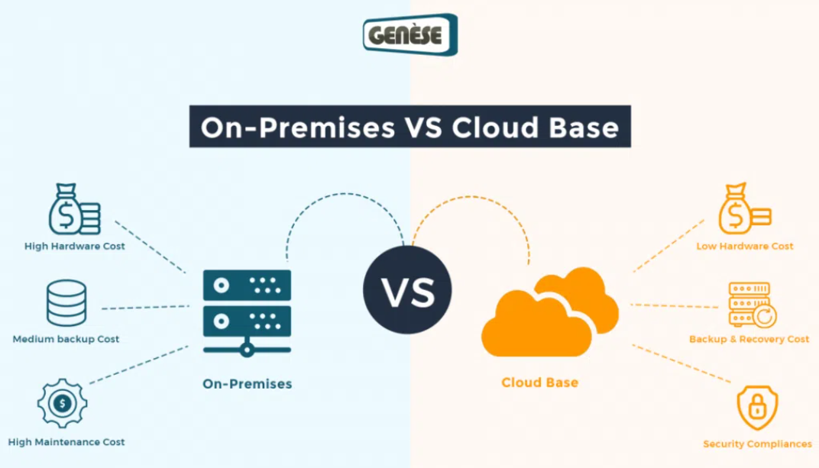
What is Cloud

Slide 20
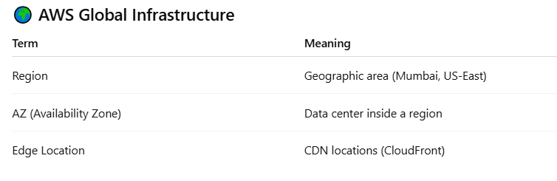
Amazon Web Services (AWS)
Amazon Web Services (AWS) is a cloud computing platform that lets you create IT resources over the internet instead of buying and managing physical hardware.
It is the largest cloud provider, offering 200+ services on demand.
AWS Provides:
Compute (servers)
Storage
Databases
Networking
Security
DevOps tools

Slide 21
AWS Global Infrastructure – Deep Dive
AWS is designed so applications are highly available, fault tolerant, and scalable across the world.
1️⃣ AWS Region
📌 What is a Region?
A Region is a geographical location where AWS has multiple data centers.
📌 What is an AZ?
An Availability Zone is one or more physically separate data centers inside a region.
📌 What is an Edge Location?
Edge locations are used to cache content closer to users.

Slide 22
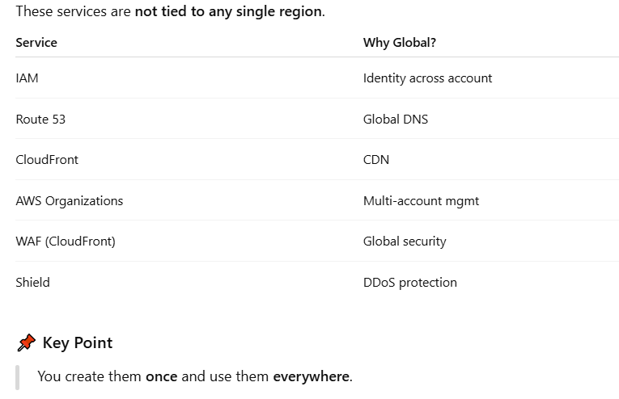
🌐 Global AWS Services

Slide 23
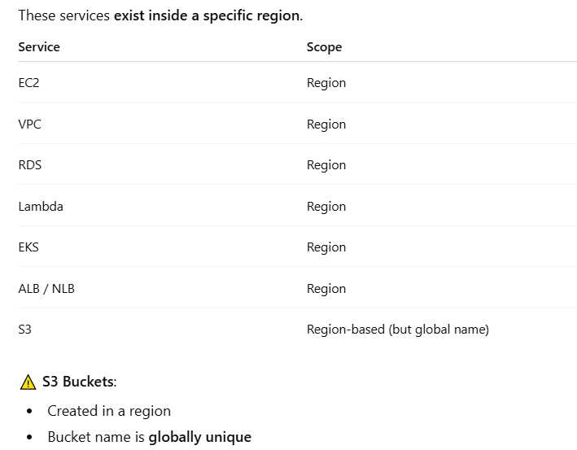
🏢 Regional AWS Services

