Slide 1

Lending Club Case Study
Exploratory Data Analysis
Group Facilitator : Munirathinam Duraisamy
Group Member: Sreedhar K

Slide 2
Table of Contents
•
•
•
•
•
Problem Statment
Business Objective and Aim Exploratory Data Analysis Methodology Analysis
Conclusion

Slide 3
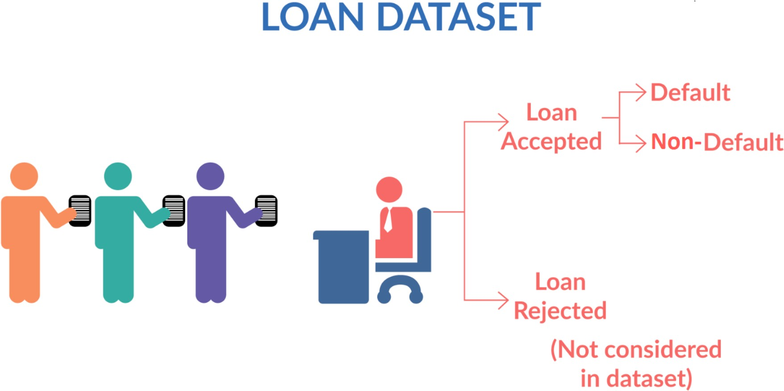
Problem Statement
Working for a consumer finance company which specialises in lending various types of loans to urban customers. When the company receives a loan application, the company has to make a decision for loan approval based on the applicant’s profile. Two types of risks are associated with the bank’s decision:
•
•
If the applicant is likely to repay the loan, then not approving the loan results in a loss of business to the company
If the applicant is not likely to repay the loan, i.e. he/she is likely to default, then approving the loan may lead to a financial loss for the company
When a person applies for a loan, there are two types of decisions that could be taken by the company:
Loan accepted: If the company approves the loan, there are 3 possible scenarios described below:
•
•
•
Fully paid: Applicant has fully paid the loan (the principal and the interest rate)
Current: Applicant is in the process of paying the instalments, i.e. the tenure of the loan is not yet completed. These candidates are not labelled as 'defaulted'.
Charged-off: Applicant has not paid the instalments in due time for a long period of time, i.e. he/she has defaulted on the loan
Loan rejected: The company had rejected the loan (because the candidate does not meet their requirements etc.). Since the loan was rejected, there is no transactional history of those applicants with the company and so this data is not available with the company (and thus in this dataset)

Slide 4
Business Objective & Aim
Like most other lending companies, lending loans to ‘risky’ applicants is the largest source of financial loss (called credit loss). The credit loss is the amount of money lost by the lender when the borrower refuses to pay or runs away with the money owed. In other words, borrowers who default cause the largest amount of loss to the lenders. In this case, the customers labelled as 'charged-off' are the 'defaulters'.
The company wants to understand the driving factors (or driver variables) behind loan default, that is, the variables which are strong indicators of defaulters.
The company would be able to utilise this knowledge for its risk assessment and portfolio.
If one is able to identify these risky loan applicants, then such loans can be reduced thereby cutting down the amount of credit loss. Identification of such applicants using EDA is the aim of this case study.
Our aim is to identify the loan application which can be defaulted or deliquanted which may be used for taking actions such as denying the loan, reducing the amount of loan, lending (to risky applicants) at a higher interest rate
Dataset : Loan data 2007 - 2011

Slide 5
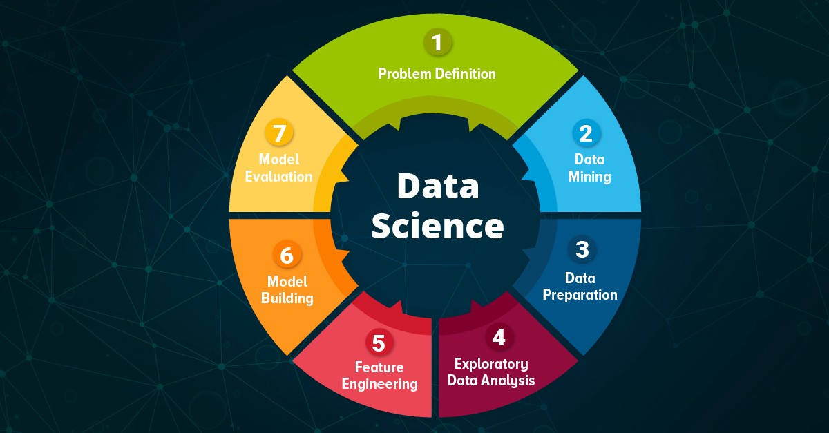
Exploratory Data Analysis and Methodology
Steps
Import Required Libraries
Data Overview
Data Cleaning
a. Missing Data Treatment
b. Standardizing Values
c. Remove Irrelevant Variables
d. Outliers Analysis and Treatments
e. Derived Metrics & Binning
Data Analysis
a. Univariate Analysis
b. Bivariate Analysis
c. Multivariate Analysis
Insights
Recommendations

Slide 6
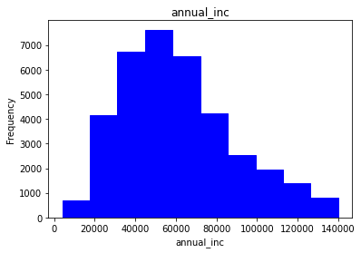
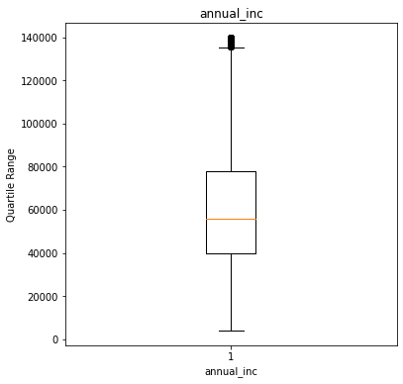
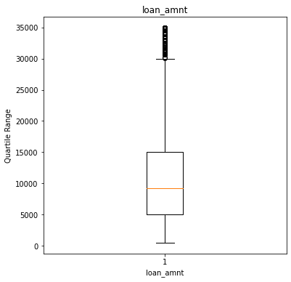
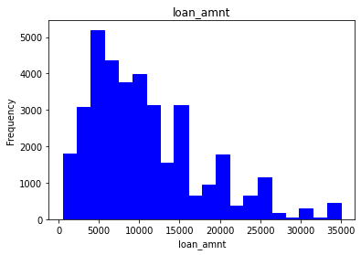
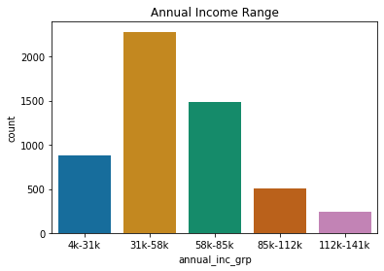
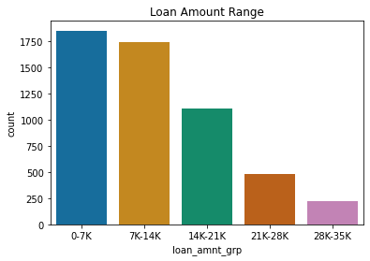
Highlights:
14.76% of the entire applicants are charged off. Maximum number of loans are approved for the loan applicants whose annual income is roughly between $50000 and $60000 47.24% of clients bought the loan for Debit Consolidation purpose. 44.4% of clients got loan approval without being verified. This is very risky. Maximum loan applications were in the slab of loan amount around $5000. Maximum number of loans were in 36 terms itself. | Maximum number of loan applications were roughly in between 150 and 275 installments Maximum number of loan applications were approved roughly in between 11.75 and 14 interest rate Maximum number of loan applications were approved for moderate risky clients with DTI roughly between 12 to 16 There are around 5.5% of loan applicants who have derogatory public records , and they are risky applicants
Analysis
Univariate Analysis
1. Annual income
After removing the outliers, maximum number of loan applications are under the slab between $50000 and $60000.
The clients with Charged Off Accounts whose annual income is in the range of 31K to 58K are having the highest defaulters.
2. Loan amount
Maximum loan applications are of the loan amount around 5000.
Out of the charged-off accounts, the loan amount range between 0 and 7000 has highest number of defaulters, and similar to the loan amount range between 7000 and 14000.

Slide 7
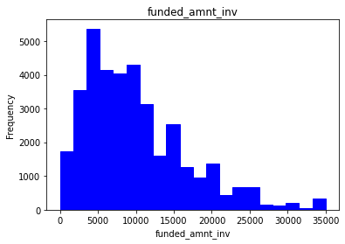
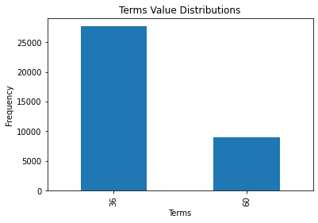
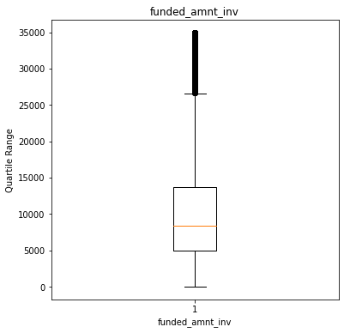
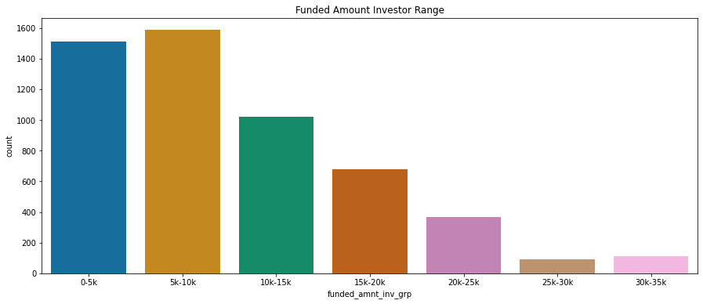
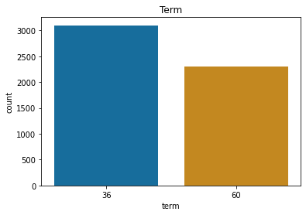
Highlights:
14.76% of the entire applicants are charged off. Maximum number of loans are approved for the loan applicants whose annual income is roughly between $50000 and $60000 47.24% of clients bought the loan for Debit Consolidation purpose. 44.4% of clients got loan approval without being verified. This is very risky. Maximum loan applications were in the slab of loan amount around $5000. Maximum number of loans were in 36 terms itself. | Maximum number of loan applications were roughly in between 150 and 275 installments Maximum number of loan applications were approved roughly in between 11.75 and 14 interest rate Maximum number of loan applications were approved for moderate risky clients with DTI roughly between 12 to 16 There are around 5.5% of loan applicants who have derogatory public records , and they are risky applicants
Analysis
Univariate Analysis
3. Funded amount investor
Maximum loan applications are of the funded loan investor amount around 5000.
The clients whose funded amount by investor is in the range of 5K to 10K are having highest defaulters
4. Term
Here, we have only two terms of 36 months & 60 months. Maximum number of loan applications are in the term of 36 months, in case of both charged-off accounts alone and charged-off + fully paid accounts.

Slide 8
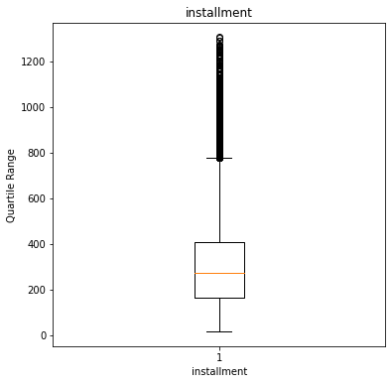
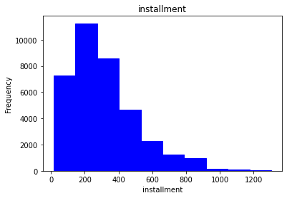
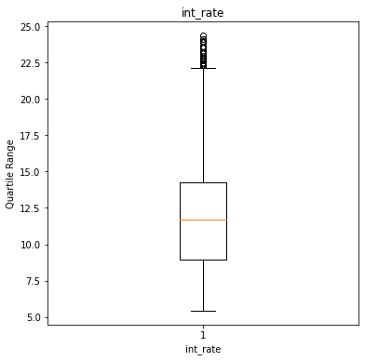
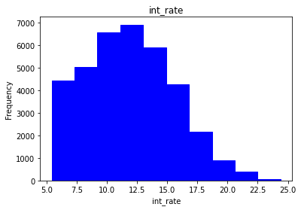
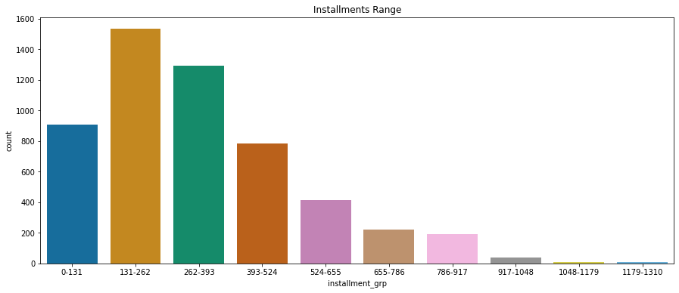
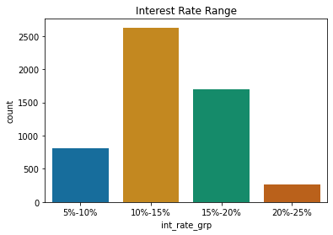
Highlights:
14.76% of the entire applicants are charged off. Maximum number of loans are approved for the loan applicants whose annual income is roughly between $50000 and $60000 47.24% of clients bought the loan for Debit Consolidation purpose. 44.4% of clients got loan approval without being verified. This is very risky. Maximum loan applications were in the slab of loan amount around $5000. Maximum number of loans were in 36 terms itself. | Maximum number of loan applications were roughly in between 150 and 275 installments Maximum number of loan applications were approved roughly in between 11.75 and 14 interest rate Maximum number of loan applications were approved for moderate risky clients with DTI roughly between 12 to 16 There are around 5.5% of loan applicants who have derogatory public records , and they are risky applicants
Analysis
Univariate Analysis
5. Instalment
Maximum number of loan applications are roughly between 150 and 275 installments.
From the charged-off accounts, the clients whose installments are between 131-262 are having the highest defaulters.
6. Interest Rate
Maximum number of loan applications are in the range of roughly between 11.75 %and 14.25% interest rate.
The interest rate range between 10% and 15% has highest number of defaulters out of the charged-off accounts.

Slide 9
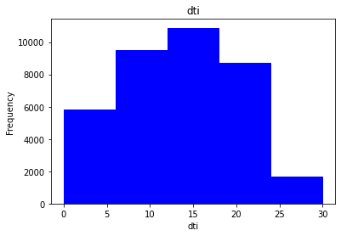
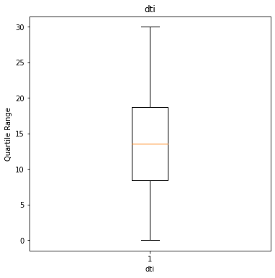
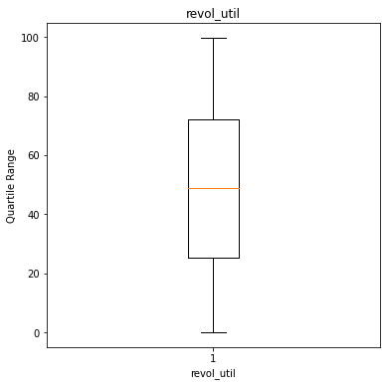
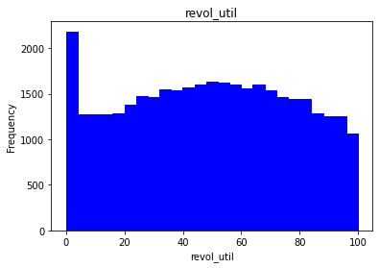
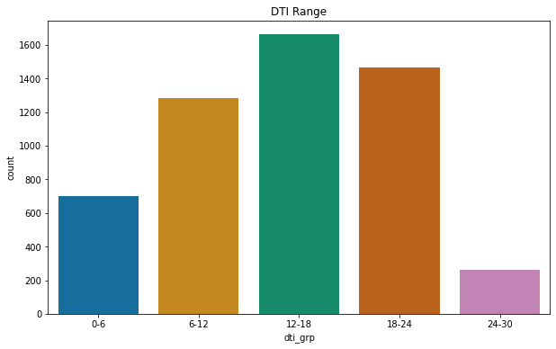
Highlights:
14.76% of the entire applicants are charged off. Maximum number of loans are approved for the loan applicants whose annual income is roughly between $50000 and $60000 47.24% of clients bought the loan for Debit Consolidation purpose. 44.4% of clients got loan approval without being verified. This is very risky. Maximum loan applications were in the slab of loan amount around $5000. Maximum number of loans were in 36 terms itself. | Maximum number of loan applications were roughly in between 150 and 275 installments Maximum number of loan applications were approved roughly in between 11.75 and 14 interest rate Maximum number of loan applications were approved for moderate risky clients with DTI roughly between 12 to 16 There are around 5.5% of loan applicants who have derogatory public records , and they are risky applicants
Analysis
Univariate Analysis
7. Debt-to-Income ratio (dti)
Maximum number of loan applicants have their dti roughly between 12 to 18 and they are moderately risky clients.
8. Revolving Credit
There is no major difference in the utilization of revolving credit , except for in the range of 0-4%. At the same time there are good number of users utilizing the maximum credit which could be risky.

Slide 10
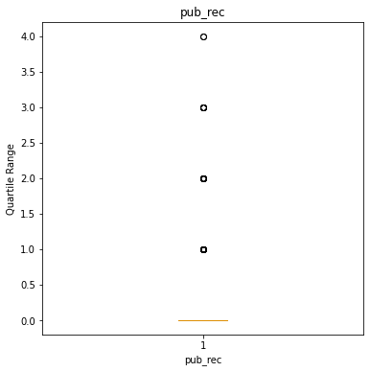
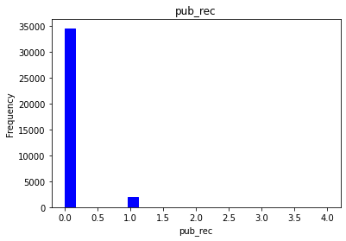
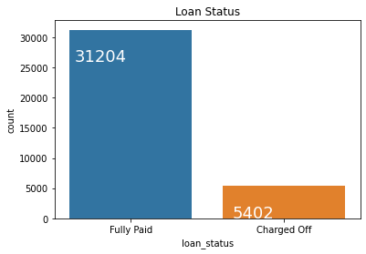
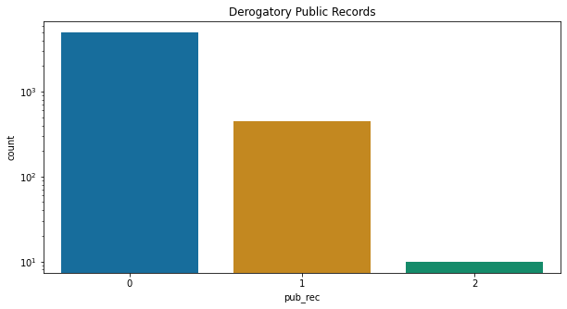
Highlights:
14.76% of the entire applicants are charged off. Maximum number of loans are approved for the loan applicants whose annual income is roughly between $50000 and $60000 47.24% of clients bought the loan for Debit Consolidation purpose. 44.4% of clients got loan approval without being verified. This is very risky. Maximum loan applications were in the slab of loan amount around $5000. Maximum number of loans were in 36 terms itself. | Maximum number of loan applications were roughly in between 150 and 275 installments Maximum number of loan applications were approved roughly in between 11.75 and 14 interest rate Maximum number of loan applications were approved for moderate risky clients with DTI roughly between 12 to 16 There are around 5.5% of loan applicants who have derogatory public records , and they are risky applicants
Analysis
Univariate Analysis
9. Public Records
There are around 5.5% of loan applicants who have derogatory public records and they are the risky applicants.
10. Loan status
5402 applicants are charged off. For our further analysis, we have considered only charged-off data.

Slide 11
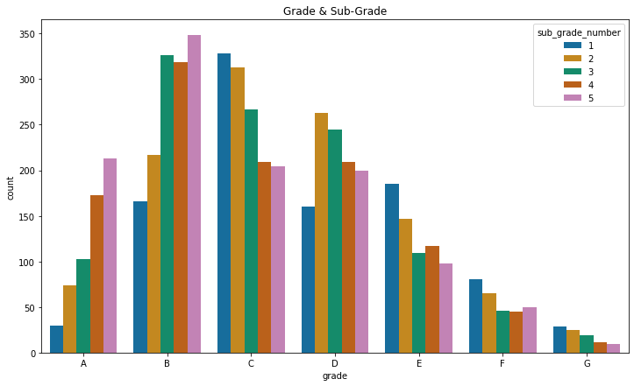
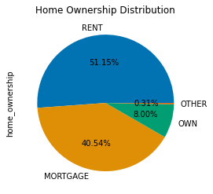
Highlights:
14.76% of the entire applicants are charged off. Maximum number of loans are approved for the loan applicants whose annual income is roughly between $50000 and $60000 47.24% of clients bought the loan for Debit Consolidation purpose. 44.4% of clients got loan approval without being verified. This is very risky. Maximum loan applications were in the slab of loan amount around $5000. Maximum number of loans were in 36 terms itself. | Maximum number of loan applications were roughly in between 150 and 275 installments Maximum number of loan applications were approved roughly in between 11.75 and 14 interest rate Maximum number of loan applications were approved for moderate risky clients with DTI roughly between 12 to 16 There are around 5.5% of loan applicants who have derogatory public records , and they are risky applicants
Analysis
Univariate Analysis
11. Grades and sub-grades
Highest number of defaulters are in Grade B irrespective of sub-grades, of which
the highest number of defaulters are in sub-Grade B-5
12. Home ownership
Rented home clients the riskiest of all.
Mortgage ownership clients are also almost equally risky to Rented home clients.
So, Rent and Mortgage home ownership clients are riskier when compared to other categories.

Slide 12
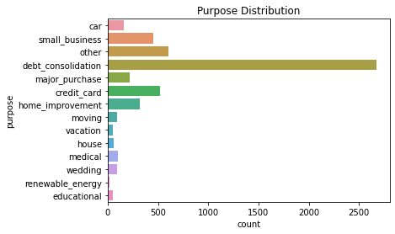
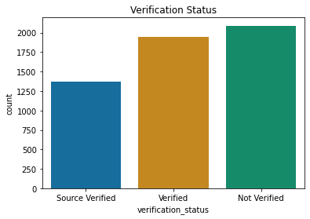
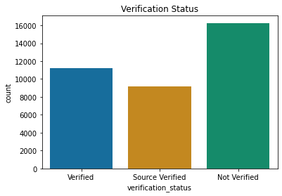
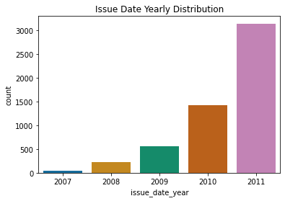
Highlights:
14.76% of the entire applicants are charged off. Maximum number of loans are approved for the loan applicants whose annual income is roughly between $50000 and $60000 47.24% of clients bought the loan for Debit Consolidation purpose. 44.4% of clients got loan approval without being verified. This is very risky. Maximum loan applications were in the slab of loan amount around $5000. Maximum number of loans were in 36 terms itself. | Maximum number of loan applications were roughly in between 150 and 275 installments Maximum number of loan applications were approved roughly in between 11.75 and 14 interest rate Maximum number of loan applications were approved for moderate risky clients with DTI roughly between 12 to 16 There are around 5.5% of loan applicants who have derogatory public records , and they are risky applicants
Analysis
Univariate Analysis
13. Purpose of Loan insights
From the charged-off accounts, Clients who bought loans for Debt-Consolidation purpose are more defaulters.
14. Verification status
In both scenarios of charged-off accounts and charged-off + fully paid accounts, Non-verified clients are having highest possibilities of defaulting.
.
15. Issue date distribution
The loans which are issued in the month of Dec are more defaulted.
The loans which are issued in the year 2011 are more defaulted. It might be because of recession.

Slide 13
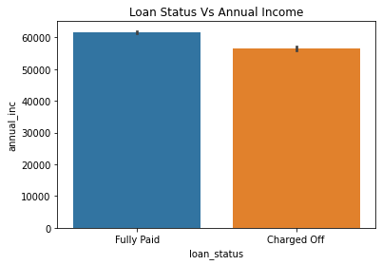
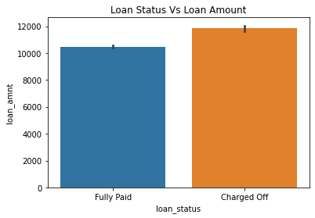
Highlights:
14.76% of the entire applicants are charged off. Maximum number of loans are approved for the loan applicants whose annual income is roughly between $50000 and $60000 47.24% of clients bought the loan for Debit Consolidation purpose. 44.4% of clients got loan approval without being verified. This is very risky. Maximum loan applications were in the slab of loan amount around $5000. Maximum number of loans were in 36 terms itself. | Maximum number of loan applications were roughly in between 150 and 275 installments Maximum number of loan applications were approved roughly in between 11.75 and 14 interest rate Maximum number of loan applications were approved for moderate risky clients with DTI roughly between 12 to 16 There are around 5.5% of loan applicants who have derogatory public records , and they are risky applicants
Analysis
Bivariate Analysis
Loan Status Vs Annual Income
If annual income is less, charge-off probability is more.
2. Loan status vs Loan Amount
If Loan amount is more than 10K, probability of charged-off applicants is more.

Slide 14
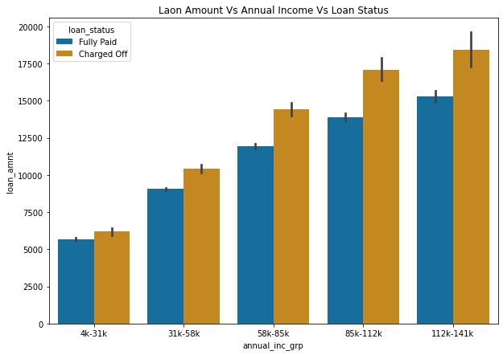
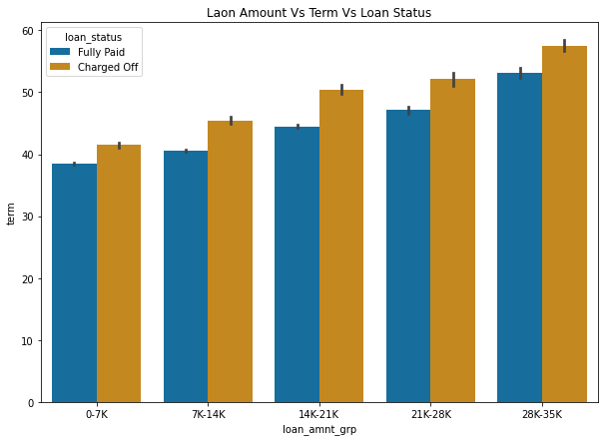
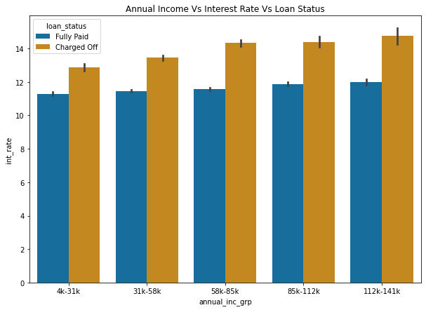
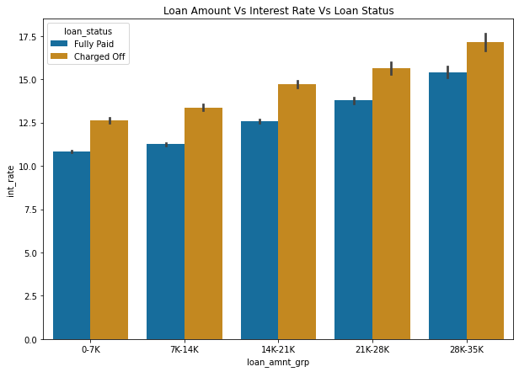
Highlights:
14.76% of the entire applicants are charged off. Maximum number of loans are approved for the loan applicants whose annual income is roughly between $50000 and $60000 47.24% of clients bought the loan for Debit Consolidation purpose. 44.4% of clients got loan approval without being verified. This is very risky. Maximum loan applications were in the slab of loan amount around $5000. Maximum number of loans were in 36 terms itself. | Maximum number of loan applications were roughly in between 150 and 275 installments Maximum number of loan applications were approved roughly in between 11.75 and 14 interest rate Maximum number of loan applications were approved for moderate risky clients with DTI roughly between 12 to 16 There are around 5.5% of loan applicants who have derogatory public records , and they are risky applicants
Analysis
Multivariate Analysis

Slide 15
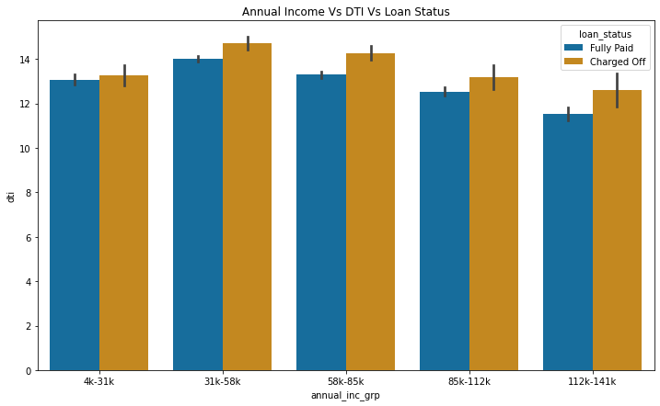
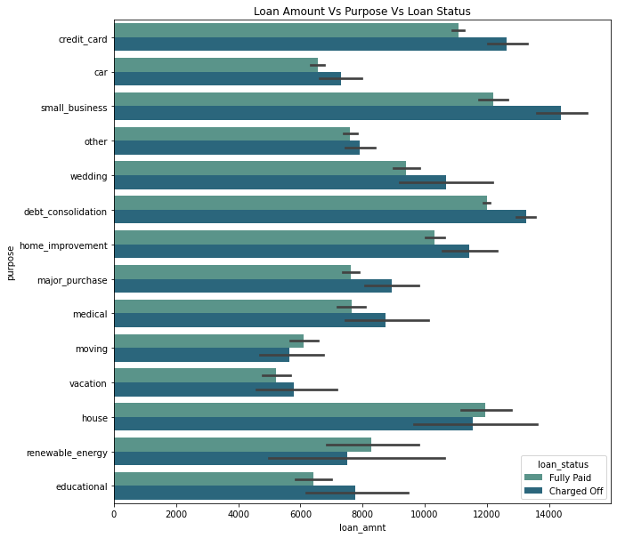
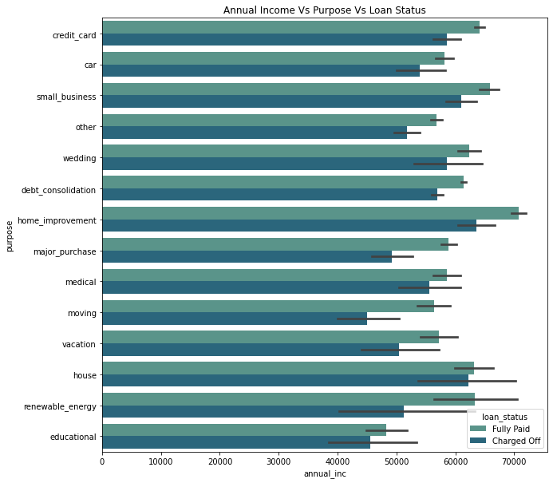
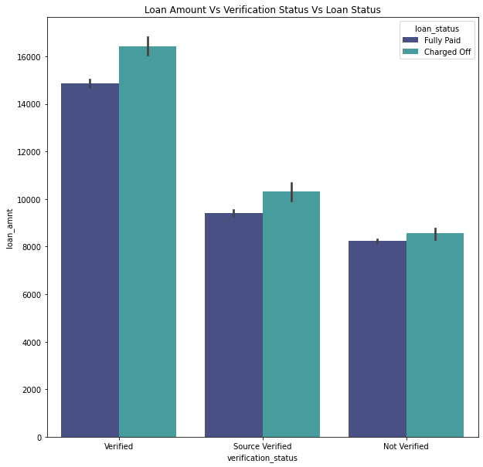
Highlights:
14.76% of the entire applicants are charged off. Maximum number of loans are approved for the loan applicants whose annual income is roughly between $50000 and $60000 47.24% of clients bought the loan for Debit Consolidation purpose. 44.4% of clients got loan approval without being verified. This is very risky. Maximum loan applications were in the slab of loan amount around $5000. Maximum number of loans were in 36 terms itself. | Maximum number of loan applications were roughly in between 150 and 275 installments Maximum number of loan applications were approved roughly in between 11.75 and 14 interest rate Maximum number of loan applications were approved for moderate risky clients with DTI roughly between 12 to 16 There are around 5.5% of loan applicants who have derogatory public records , and they are risky applicants
Analysis
Multivariate Analysis

Slide 16
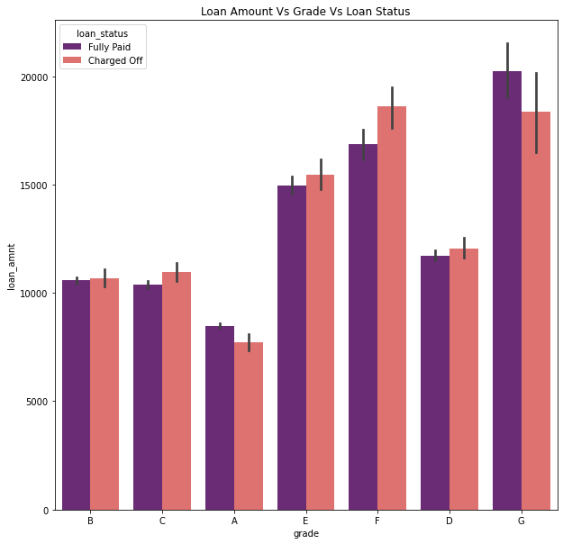
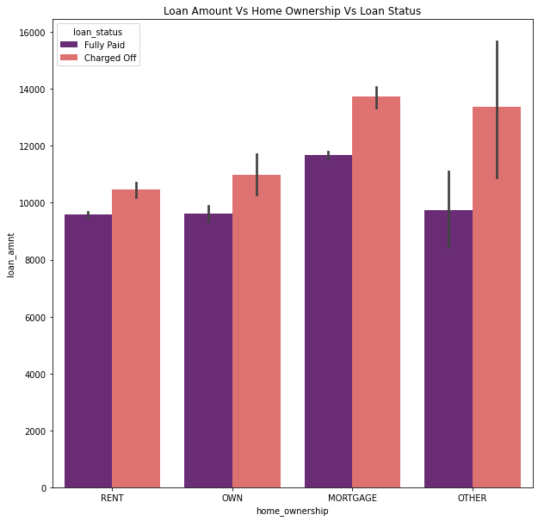
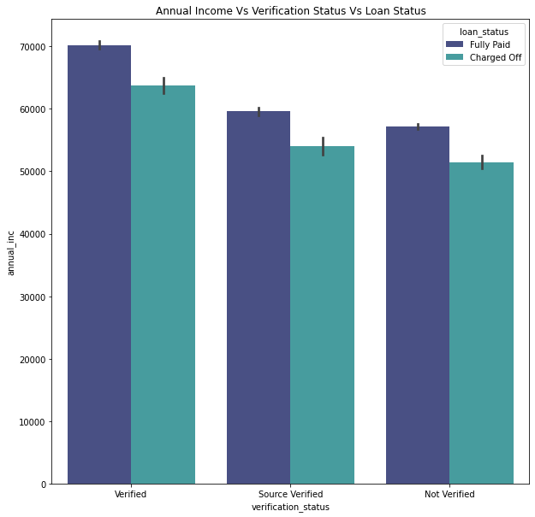
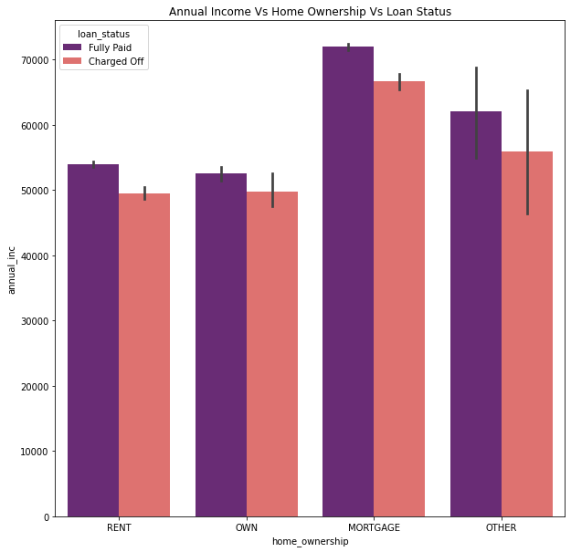
Highlights:
14.76% of the entire applicants are charged off. Maximum number of loans are approved for the loan applicants whose annual income is roughly between $50000 and $60000 47.24% of clients bought the loan for Debit Consolidation purpose. 44.4% of clients got loan approval without being verified. This is very risky. Maximum loan applications were in the slab of loan amount around $5000. Maximum number of loans were in 36 terms itself. | Maximum number of loan applications were roughly in between 150 and 275 installments Maximum number of loan applications were approved roughly in between 11.75 and 14 interest rate Maximum number of loan applications were approved for moderate risky clients with DTI roughly between 12 to 16 There are around 5.5% of loan applicants who have derogatory public records , and they are risky applicants
Analysis
Multivariate Analysis

Slide 17
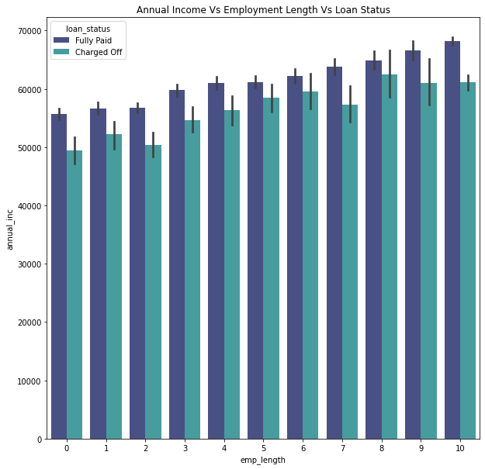
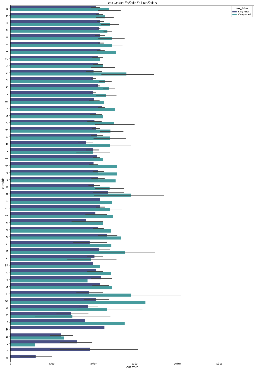


Highlights:
14.76% of the entire applicants are charged off. Maximum number of loans are approved for the loan applicants whose annual income is roughly between $50000 and $60000 47.24% of clients bought the loan for Debit Consolidation purpose. 44.4% of clients got loan approval without being verified. This is very risky. Maximum loan applications were in the slab of loan amount around $5000. Maximum number of loans were in 36 terms itself. | Maximum number of loan applications were roughly in between 150 and 275 installments Maximum number of loan applications were approved roughly in between 11.75 and 14 interest rate Maximum number of loan applications were approved for moderate risky clients with DTI roughly between 12 to 16 There are around 5.5% of loan applicants who have derogatory public records , and they are risky applicants
Analysis
Multivariate Analysis

Slide 18
Highlights:
14.76% of the entire applicants are charged off. Maximum number of loans are approved for the loan applicants whose annual income is roughly between $50000 and $60000 47.24% of clients bought the loan for Debit Consolidation purpose. 44.4% of clients got loan approval without being verified. This is very risky. Maximum loan applications were in the slab of loan amount around $5000. Maximum number of loans were in 36 terms itself. | Maximum number of loan applications were roughly in between 150 and 275 installments Maximum number of loan applications were approved roughly in between 11.75 and 14 interest rate Maximum number of loan applications were approved for moderate risky clients with DTI roughly between 12 to 16 There are around 5.5% of loan applicants who have derogatory public records , and they are risky applicants
Analysis
Multivariate Analysis
Consolidated Insights of Variable Relationships w.r.t. Loan Status
With this analysis, we can conclude that probability of defaulters could be because of below reasons: 1. Client has loan amount in the range of 28000 to 35000 with term more than 50 months 2. Client has annual income above 112k-141K with loan amount of more than 15K 3. Client with rate of interest more than 11% irrespective of annual income 4. Client with loan amount in the range of 28000 to 35000 with interest rate more than 15% 5. Client with annual income in the range of 31K to 58K with dti more than 14 6. Clients requesting small business loans with loan amount above 14000 7. Clients requesting home improvement loan with annual income of above 65000 8. Verified loan account client requesting loan amount more than 15000 or annual income of above 60000 9. Client with grade F & G and has loan amount more than 15000. This could be because of high interest rate and loan amount disposed 10. Client whose home ownership is Mortgage or Others and has loan amount more than 12000 11. Client whose home ownership is Mortgage and has annual income above 60000 12. More the employment experience, loan amount keeps increasing and defaulters are also high in all experience level. Ratio between defaulters and fully paid is not much. If lender provides loan amount around 1K-2K less across the experience level, defaulters will be less. 13. Clients in address state “WY” with loan amount more than 15000

Slide 19

Highlights:
14.76% of the entire applicants are charged off. Maximum number of loans are approved for the loan applicants whose annual income is roughly between $50000 and $60000 47.24% of clients bought the loan for Debit Consolidation purpose. 44.4% of clients got loan approval without being verified. This is very risky. Maximum loan applications were in the slab of loan amount around $5000. Maximum number of loans were in 36 terms itself. | Maximum number of loan applications were roughly in between 150 and 275 installments Maximum number of loan applications were approved roughly in between 11.75 and 14 interest rate Maximum number of loan applications were approved for moderate risky clients with DTI roughly between 12 to 16 There are around 5.5% of loan applicants who have derogatory public records , and they are risky applicants
Analysis
Heatmap

Slide 20
Conclusion
Loan Applications must be verified
Lower the Grades higher the chances of getting default , Before approving loans to lower grades it should be thoroughly investigated
small_business loans are most likely to be defaulted lending institution should reduce the no of loans issuing to this category
Higher the loan amount , interest , installment and debit to investment ratio higher the chances of getting default , Lending club should pay attention to these attributed before allocating the loans
Lending club should keep a check on high revolving credit utilisation before approving the loan
Lending club should try to try reduce the term higher the term higher the chances of getting default
Public record borrower are most likely to bankrupt lending club should investigate before approving loan that there are no public records for borrower
Lending club should reduce the no of loans to borrowers with home type Mortgage with higher loan amount as their chances of getting defaulted is more
THANK YOU

