Slide 1
IBM University Engagement Project Submission
“Exploring the Power of Agentic AI with IBM Granite and IBM Bob”

Slide 2

Project Tile – AI-Powered Course Content Simplification Agent
Domain of Project – Education
Student Name | Recent Passport Photo | Email ID | Mobile number [WhatsApp]
Sreegovind Subhash |  | Sreegovind13 @gmail.com | 8848859349

Slide 3
Problem Statement
Problem Statement : Course Content Simplification Agent
The Challenge
Many students, especially first-generation learners and those from non-English-medium backgrounds, struggle to understand complex academic course material. Textbooks, research papers, and lecture notes often contain technical jargon and dense explanations, making it difficult for students to understand core concepts independently. This comprehension gap can lead to lower academic performance, reduced confidence, and unequal learning outcomes, particularly in under-resourced and rural educational institutions. There is a need for a solution that can automatically simplify educational content into clear and digestible formats suitable for diverse learners.
The Objective
Build an AI-powered Course Content Simplification Agent that transforms complex academic content into clear, easy-to-understand explanations based on the learner's proficiency level. The solution should:
• Academic Content Simplification – Convert complex academic text into simpler and more understandable language.
• Learner-Level Adaptation – Reframe explanations according to the learner's proficiency level, such as Beginner or Advanced.
• Clear Concept Explanation – Reduce technical jargon and present important concepts in a structured and accessible manner.
• Improved Learning Accessibility – Help students from different educational backgrounds understand academic material more independently.
• AI-Powered Processing – Use IBM Granite through IBM watsonx.ai to analyze and simplify the provided academic content.
• User-Friendly Interface – Provide a simple web interface where users can enter academic content, select their learning level, and receive a simplified explanation.

Slide 4
Proposed Solution
Proposed Solution: AI-Powered Course Content Simplification Agent
The proposed solution is an AI-powered Course Content Simplification Agent built using IBM Bob, IBM watsonx.ai, and IBM Granite to help students understand complex academic content more easily. The system transforms technical and jargon-heavy educational material into clear, concise, and learner-friendly explanations.
At its core, the solution uses the IBM Granite foundation model through watsonx.ai to analyze academic content provided by the user and generate simplified explanations based on the learner's proficiency level. This allows the same academic content to be presented at different levels of complexity.
The system provides a simple and user-friendly web interface where students can:
• Enter academic content such as textbook paragraphs, lecture notes, or study material.
• Select a learner level, such as Beginner or Advanced.
• Submit the content for AI-powered simplification.
• Receive a clear and easy-to-understand explanation while preserving the important concepts.
The Flask-based backend processes the user's input and communicates with IBM watsonx.ai using the IBM Granite model. The selected learner level is included in the request so that Granite can adapt the vocabulary, explanation depth, and complexity of the generated response.
The solution is designed with a lightweight architecture consisting of a web interface, Flask backend, and IBM watsonx.ai Granite model. No database or complex external infrastructure is required, making the system simple, accessible, and easy to demonstrate.
IBM Bob is used as the AI-assisted development environment for building and organizing the application, while IBM watsonx.ai provides access to the Granite foundation model for content simplification.
Overall, the solution provides an accessible AI learning assistant that helps students overcome technical language barriers and understand academic concepts more effectively through level-based content simplification.

Slide 5
Technology Used
• IBM Bob – AI-assisted development environment used for planning and developing the application.
• IBM Granite 4 H Small – Foundation model used to analyze academic content and generate learner-level simplified explanations.
• IBM watsonx.ai – Platform used to access and run the IBM Granite model.
• IBM Cloud – Provides the cloud infrastructure and watsonx.ai Runtime for AI model access.
• Python & Flask – Used to develop the backend and connect the web application with IBM watsonx.ai.
• HTML & CSS – Used to build the user interface for entering content, selecting learner level, and displaying results.

Slide 6
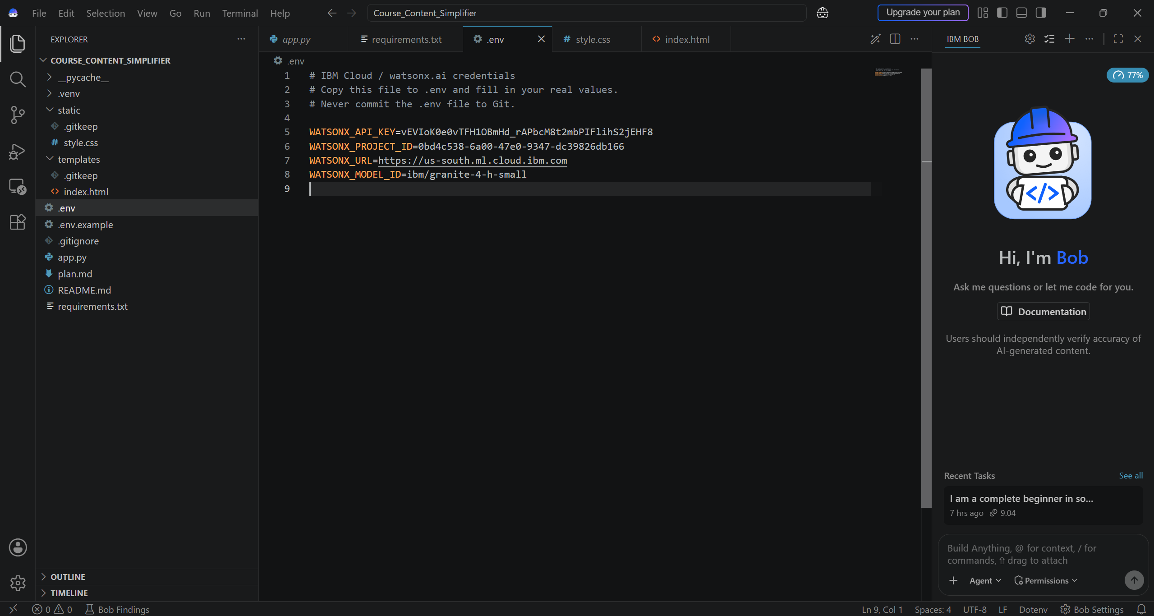
Required Files created using IBM bob -
App.py
Requirements.txt
Style.css
.env
Index.html

Slide 7
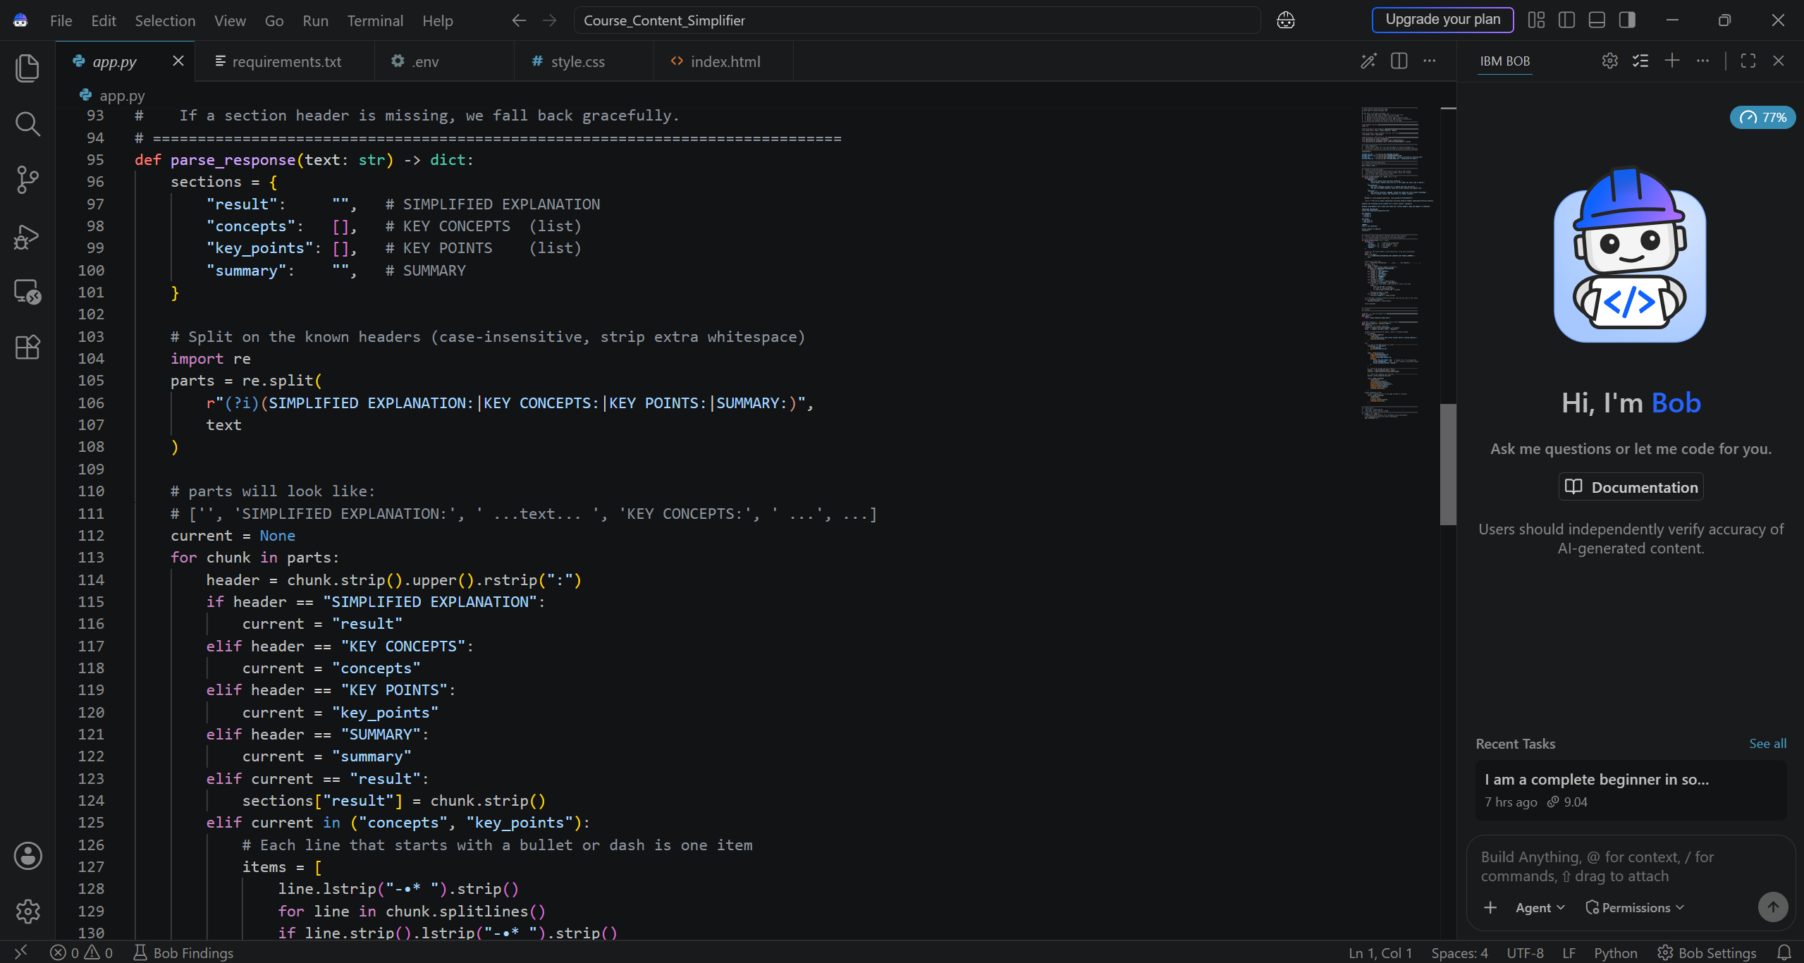
IBM Bob Screenshots:

Slide 8
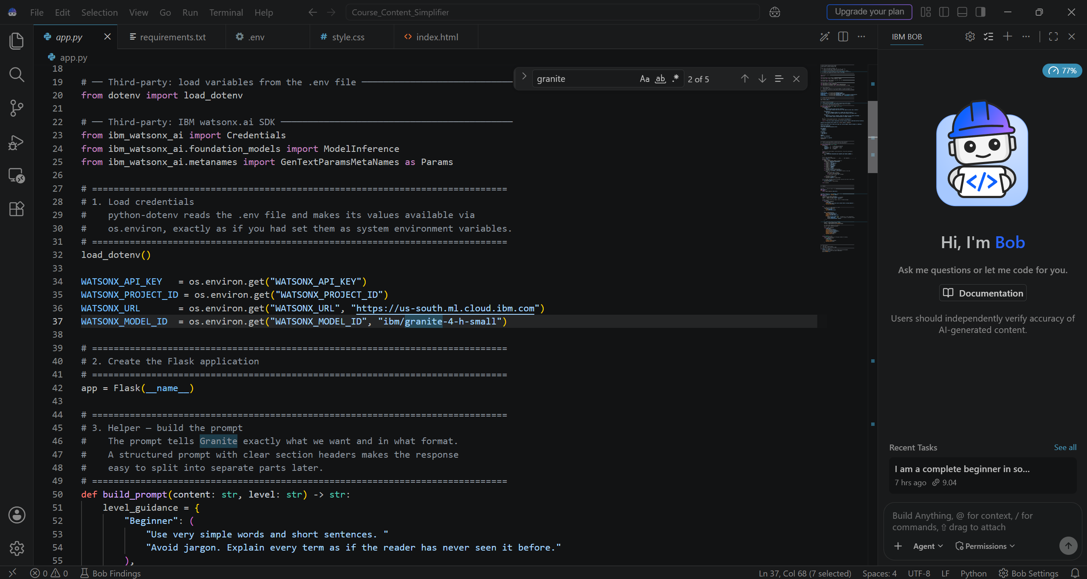

Slide 9
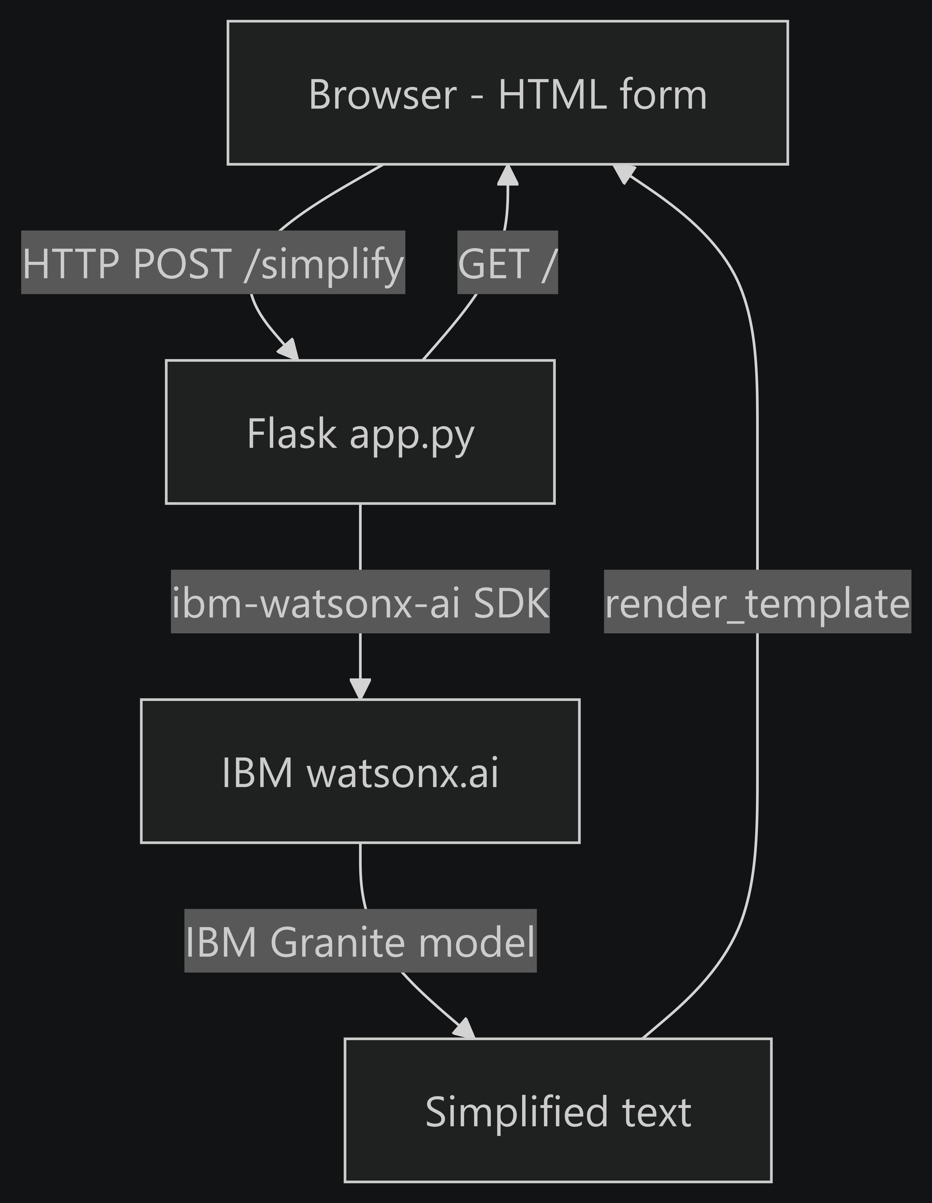
Architecture blueprint for IBM bob:

Slide 10

Role of Agentic AI in the solution
Role of Agentic AI in the Course Content Simplification Agent
Agentic AI enables the Course Content Simplification Agent to intelligently process academic content and adapt its response according to the learner's selected proficiency level. Using IBM watsonx.ai and the IBM Granite foundation model, the system transforms complex academic material into clear and learner-friendly explanations.
The agent accepts academic text from the user and analyzes its context and complexity before generating the response. Based on the selected level, such as Beginner or Advanced, it adjusts the vocabulary, explanation depth, and complexity of the generated content.
For beginner learners, the agent focuses on simple language and easy-to-understand explanations, while advanced learners receive responses that retain greater technical depth. This allows the same academic material to be personalized for different levels of prior knowledge.
The agent also presents the generated information in a structured and readable format, helping learners identify important concepts and key points while reducing unnecessary technical jargon.
Overall, Agentic AI makes the solution an intelligent and adaptive learning assistant that helps students understand complex academic content more effectively and supports personalized learning.

Slide 11
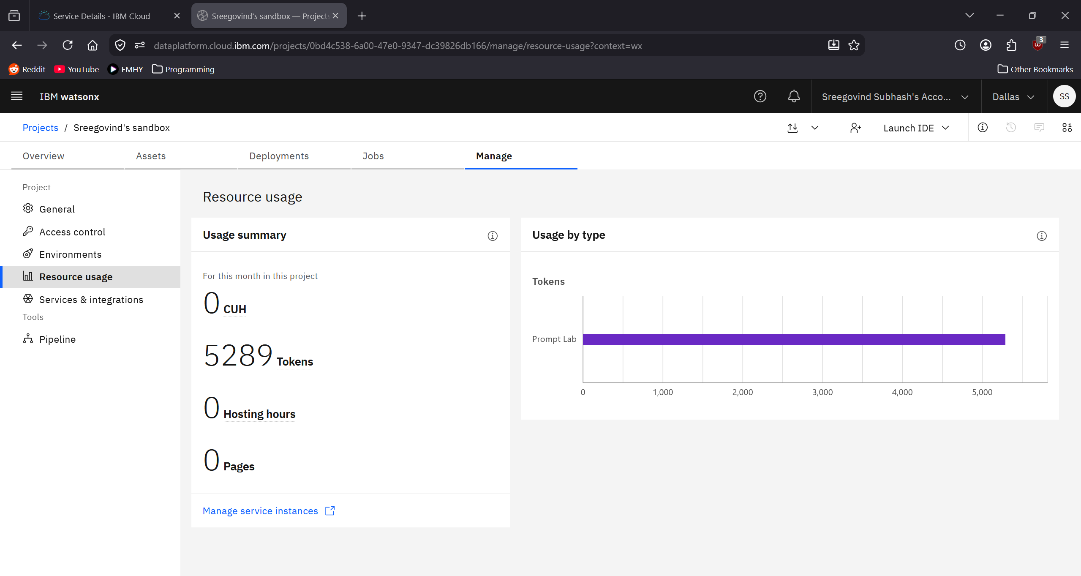

Token Usage
1519 token are used
Before Prompt
After the Prompt
·
·
·

Slide 12
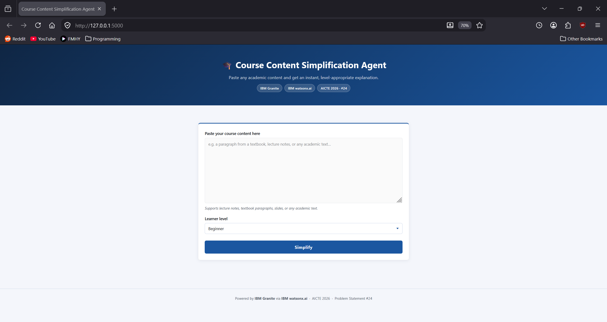
Project Output Screenshot
Please put IBM Bob output screenshots with 2-3 prompts.
You can take 2-3 more slides for each screenshot
·
·
·

Slide 13
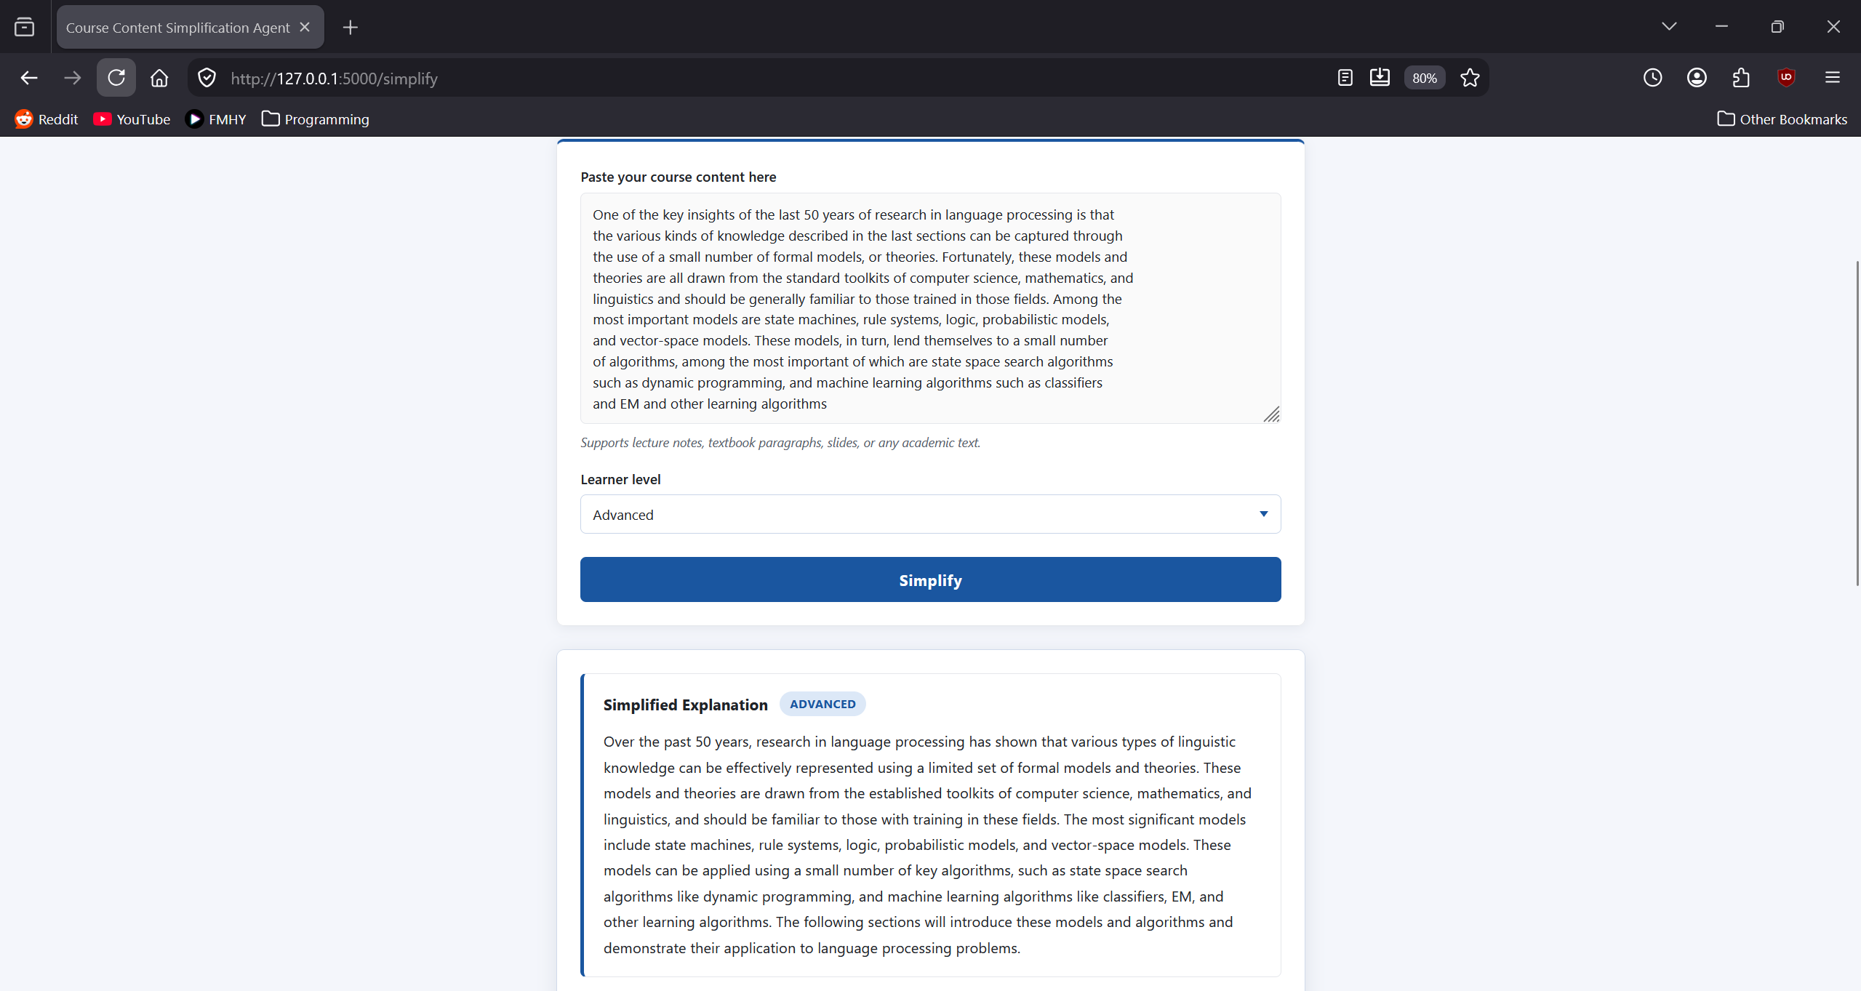
Project Output Screenshot
Please put IBM Bob output screenshots with 2-3 prompts.
You can take 2-3 more slides for each screenshot
·
·
·

Slide 14
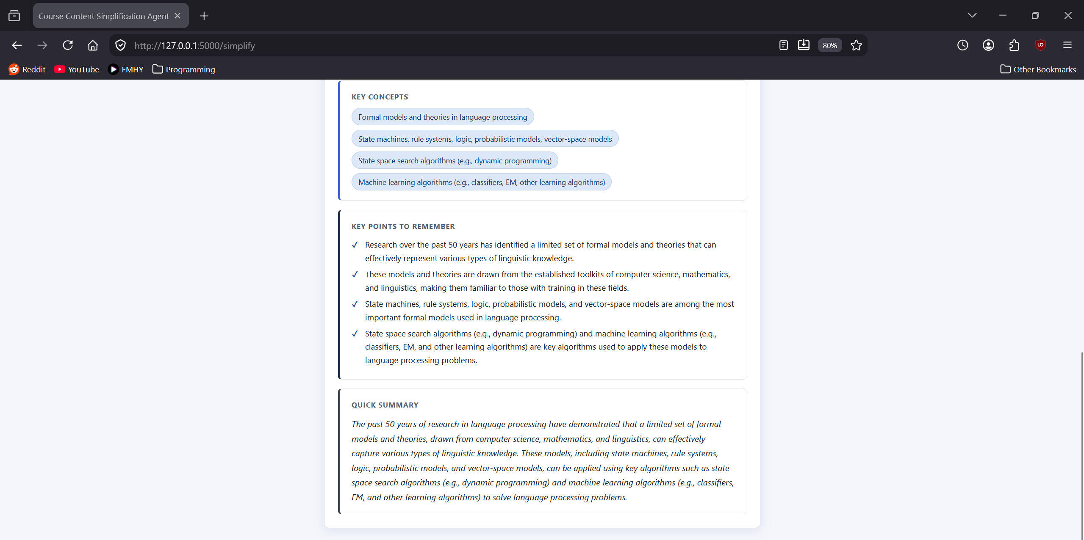
Project Output Screenshot
Please put IBM Bob output screenshots with 2-3 prompts.
You can take 2-3 more slides for each screenshot
·
·
·

Slide 15
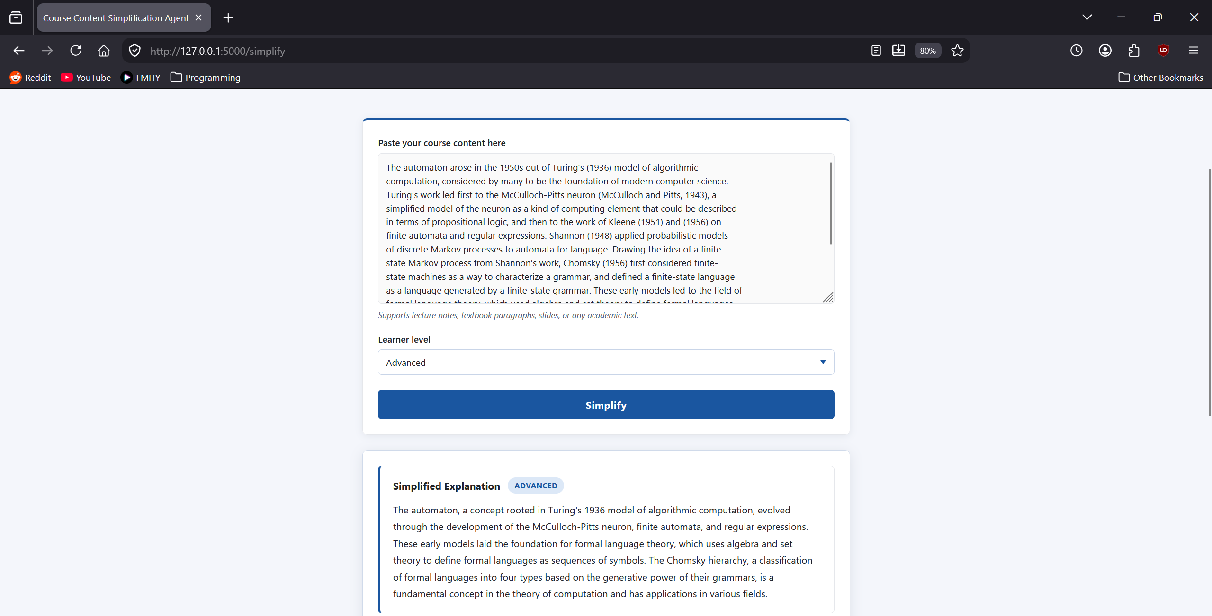
Project Output Screenshot : Prompt 2
Please put IBM Bob output screenshots with 2-3 prompts.
You can take 2-3 more slides for each screenshot
·
·
·

Slide 16
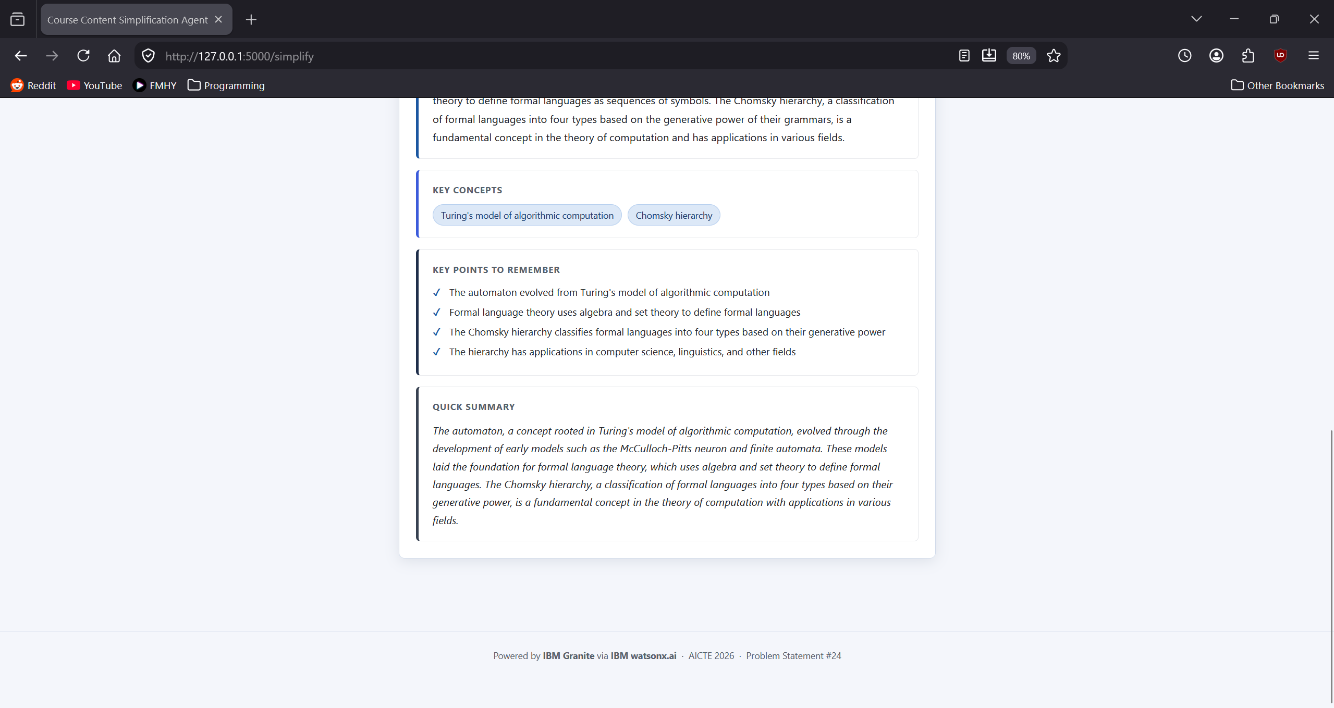
Project Output Screenshot
Please put IBM Bob output screenshots with 2-3 prompts.
You can take 2-3 more slides for each screenshot
·
·
·

Slide 17
Novelty and Uniqueness
The proposed Course Content Simplification Agent stands out by combining Agentic AI, learner-level adaptation, and IBM Granite to transform complex academic material into clear and accessible explanations.
Learner-Level Adaptation – Adjusts the language, explanation depth, and technical complexity according to the selected proficiency level, such as Beginner or Advanced.
Academic Content Simplification – Converts complex, jargon-heavy academic material into simpler and more understandable language while preserving important concepts.
Personalized Learning Experience – Presents the same academic content differently based on the learner's prior knowledge and selected learning level.
Clear Concept Extraction – Identifies and presents important concepts and key points in a structured format, making difficult topics easier to study and remember.
Digestible AI-Generated Output – Produces concise explanations and summaries that help students understand lengthy or complicated course material more efficiently.
Accessibility for Diverse Learners – Helps students, particularly first-generation and non-English-medium learners, overcome technical language barriers and understand academic content more independently.
IBM Granite Powered – Uses IBM Granite through IBM watsonx.ai to analyze academic content and generate learner-friendly explanations.
Simple & Scalable Architecture – Built with Python, Flask, HTML, CSS, IBM watsonx.ai, and IBM Granite, keeping the solution lightweight while allowing it to be demonstrated and extended easily.
This makes the solution a smart, adaptive, and accessible learning assistant, rather than just a basic text summarization tool.

Slide 18
Git Hub Link
https://github.com/sreegovindsubhash/course-content-simplification-agent
·
·
·

Slide 19
Future Scope
1. Multilingual Academic Content Support – The system can be extended to support multiple languages, allowing students to simplify academic content in their preferred language. This can improve accessibility for learners from diverse linguistic backgrounds and help reduce language barriers in education.
2. Voice-Based Learning Assistance – A voice-enabled feature can be added to allow students to provide academic content and receive explanations through voice interaction. This can make the solution more convenient and accessible for students who prefer spoken learning.
3. Personalized Learning Recommendations – The agent can be enhanced to understand a learner's previous interactions and preferred difficulty level, providing more personalized explanations and learning recommendations over time.
4. Support for Multiple Academic Formats – Future versions can support additional content formats such as PDFs, documents, presentations, and scanned study materials, allowing students to simplify larger portions of their course material.
·
·
·

Slide 20
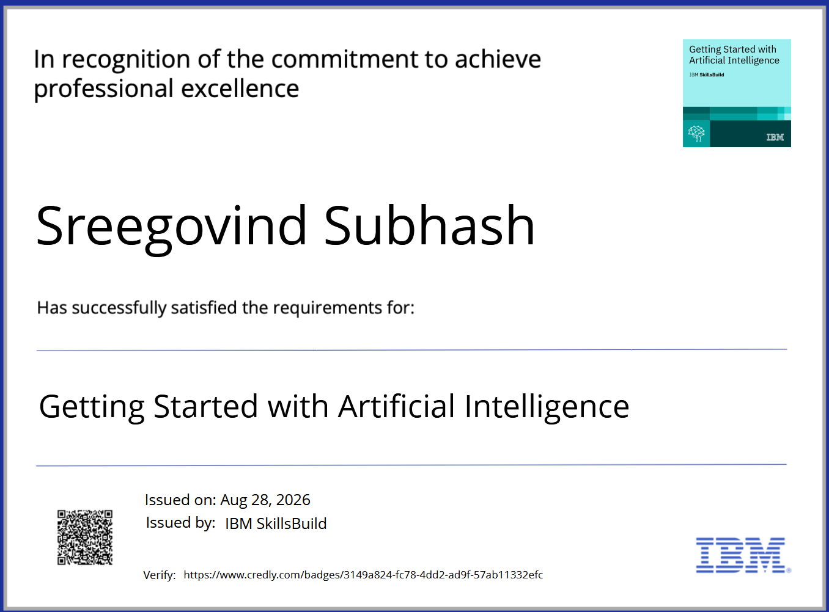
Certificates Earned:

Slide 21
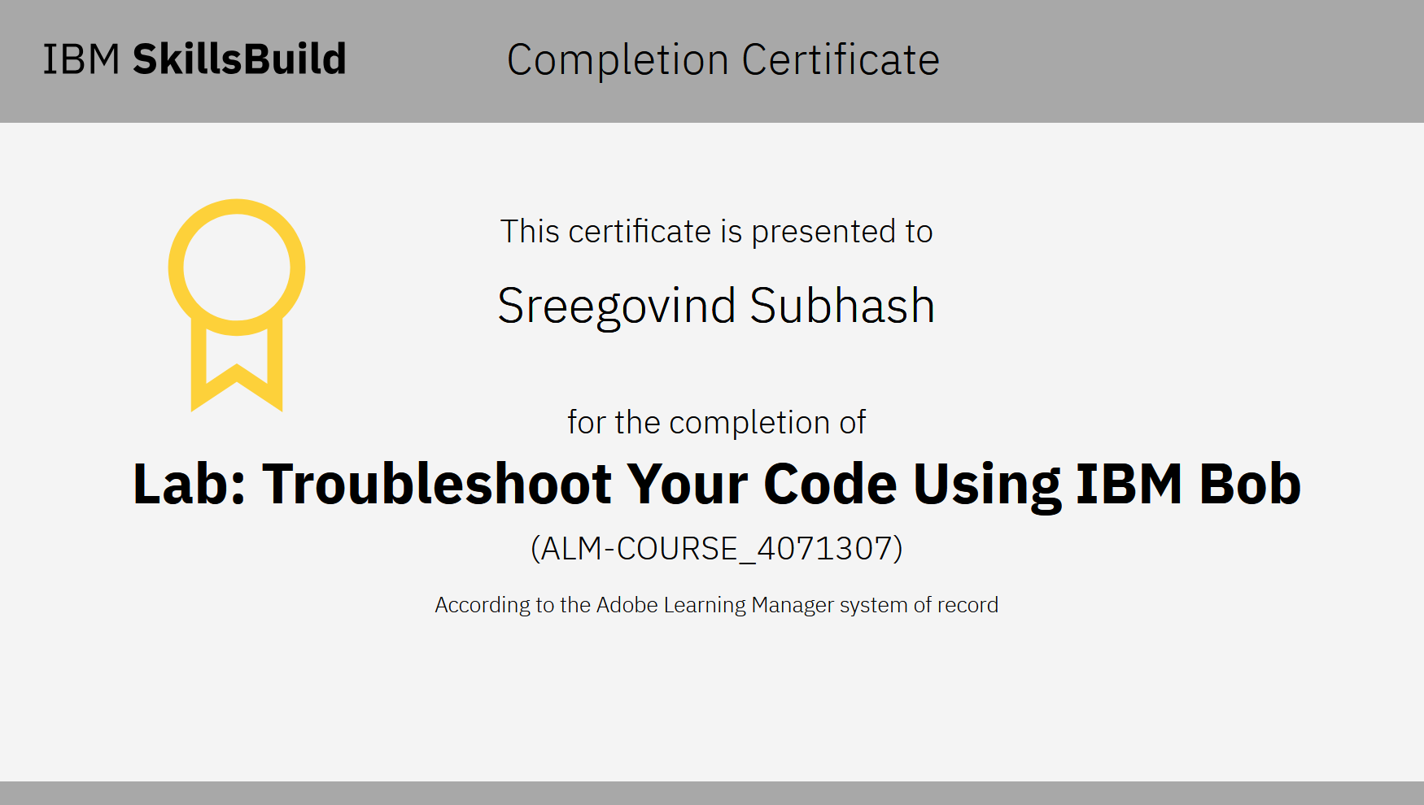
Certificates Earned:​

Slide 22


