Slide 1
Customer Churn Prediction for a Telecom Company
Team Members:
Giri M
ML Engineer
Sreehar S
Data Analyst
Venkata Susmitha
Data Engineer
Sowjanya k
Research & Documentation

Slide 2

Challenge:
Telecom companies face major challenge with customer churn, as customers switch to alternate provider due to various reasons like lower cost, multi (combo) service offerings, marketing promotions by competitors, etc.

Slide 3

The Solution
Identifying the customer's needs or problems on early basics who may voluntarily churn and providing them retention incentives in form of discounts & combo offers will help the organization to retain those customers and reduce revenue loss.
Proactive actions will prevent the loss of revenue for the company and will improve / retain the market share among the industry peers in terms of the number of active subscribers.

Slide 4
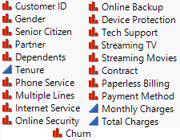
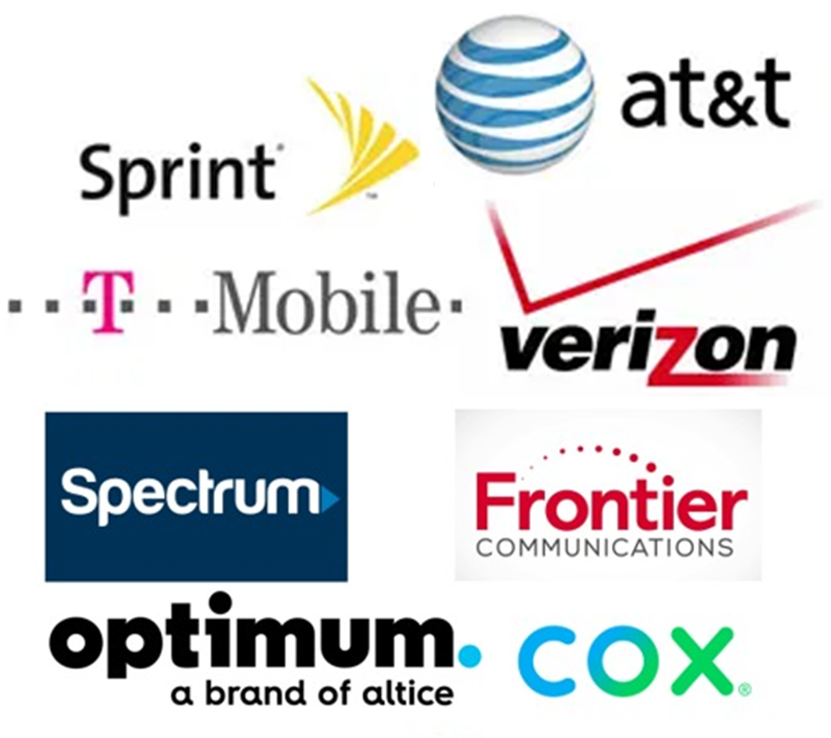
description of the data and sources
In this project, we are conducting logistic regression analysis on the provided dataset from the DSCI6002_prj2_data.db file. The objective is to explore the data's characteristics and estimate the likelihood of events, thereby facilitating better decision-making to predict whether the customer going to exit from company or not.
Source : https://www.kaggle.com/blastchar/telco-customer-churn ( IBM Sample dataset)
Here, IBM provided customer data for Telco industry to predict behavior of the customers. Main objective is that to analyze customer behaviors and develop strategies for customer retention.

Slide 5
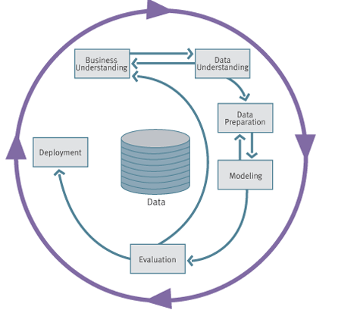
We are going to follow our process CRISP DM Methodology for tour project
Business Understanding:
In this phase, we will work closely with stakeholders to understand the business problem thoroughly. Key activities include:
Defining the business objectives: What is the problem you are trying to solve, and what are the goals?
Assessing the situation: What is the current state of the business, and how does the problem impact it?
Understanding constraints: Are there any limitations, such as budget or time constraints?
This Photo by Unknown Author is licensed under CC BY-SA

Slide 6
2. Data Understanding:
The focus is on gathering, exploring, and understanding the data that will be used in the project:
Data collection: Identifying the data sources, data availability, and data access methods.
Data description: Describing the data's characteristics, including its structure, format, and potential quality issues.
Data exploration: Exploring the data through summary statistics, visualizations, and other techniques to gain insights.

Slide 7

Our Dataset has information-
Demographic: Gender - Male / Female
Services:
Phone service - If customer has Phone service, then services related to Phone like;
Multiline Phone service
Account type:
Tenure - How long customer is with the company?
Contract type - What kind of contract they have with a company? Like
Monthly bases
On going bases - If on going bases, then One month contract or Two-year contract
Paperless billing - Customer is paperless billion option or not?
Payment method - What kind of payment method customer has?
Mailed check
Electronic check
Credit card (Automatic)
Bank transfer (Automatic)
Usage:
Monthly charges
Total charges

Slide 8
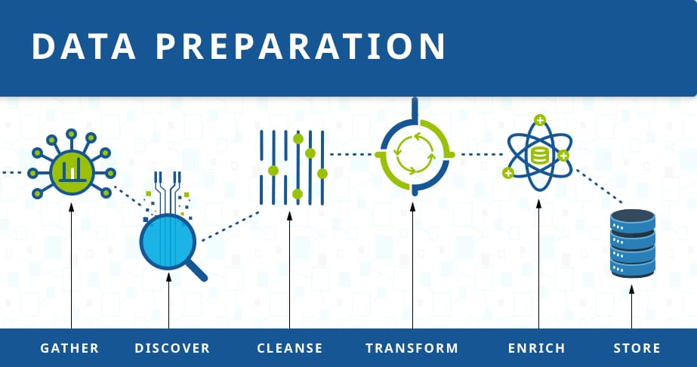
3.Data Preparation:
In the initial phase of our methodology, we focus on preparing the dataset for effective analysis. This involves essential steps such as handling missing values, removing correlated and unnecessary columns, and encoding categorical variables. The goal is to ensure the dataset's cleanliness and relevance for subsequent modeling.
To achieve this, we employ the following key procedures:
Handling Missing Values:
The dataset is carefully inspected for any missing values. In this instance, we are pleased to report that there are no missing values in the dataset, affirming its completeness.
Removing Correlated and Unnecessary Columns:
Certain columns deemed as potentially correlated or unnecessary for the predictive model are dropped. This step aids in streamlining the dataset, enhancing computational efficiency, and focusing on features with significant predictive power.
Label Encoding Binary Columns:
Binary categorical columns are label-encoded, converting them into a format suitable for machine learning models.
This Photo by Unknown Author is licensed under CC BY-SA

Slide 9
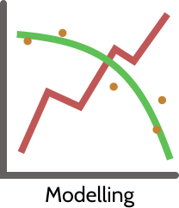
4. Modeling:
The modeling phase involves selecting and building predictive models. For churn prediction, machine learning algorithms are commonly used. The data is split into training and testing sets, and various models are trained and evaluated. The goal is to develop a model that can accurately predict customer churn based on the selected features.
Technologies/Software’s:
Machine Learning and python Libraries

Slide 10
5.MODEL EVALUATION
Model Evaluation is a critical phase in assessing the effectiveness of trained models and making informed decisions about their deployment. This phase involves quantifying the model's performance using various metrics and visualizations to understand how well it generalizes to unseen data.
During the Model Evaluation phase, we employ the following functions and visualizations to comprehensively assess the performance of the trained models.
model_report Function
The model_report function plays a central role in evaluating the model's performance. It takes a trained model and a dataset as inputs and generates a comprehensive report. The report includes key metrics such as accuracy, recall, precision, F1-score, ROC-AUC, and Cohen's Kappa. This consolidated information provides a holistic view of the model's capabilities.

Slide 11

MODEL DEPLOYMENT
Deploying the Telecom Customer Churn Prediction project on PythonAnywhere involves a systematic process to make the predictive model accessible to users. The following steps outline the deployment journey, ensuring a seamless transition from model development to a functional web application.
Deployment Steps:
To deploy the Telecom Customer Churn Prediction project on PythonAnywhere, a series of steps were meticulously followed:
Hosting Platform Selection:
PythonAnywhere was chosen as the hosting platform for its simplicity and compatibility with Python web applications.
Deployment Process:
The project was deployed to PythonAnywhere using the provided deployment tools or following PythonAnywhere-specific instructions. This may include actions like pushing code to a repository, configuring deployment settings, and initiating the deployment process.
Accessing the Deployed Project::
Once successfully deployed, users can access the Telecom Customer Churn Prediction application through the unique http://churnprediction.pythonanywhere.com/ provided during the deployment process. Simply navigate to the provided URL to interact with the deployed model seamlessly.

Slide 12
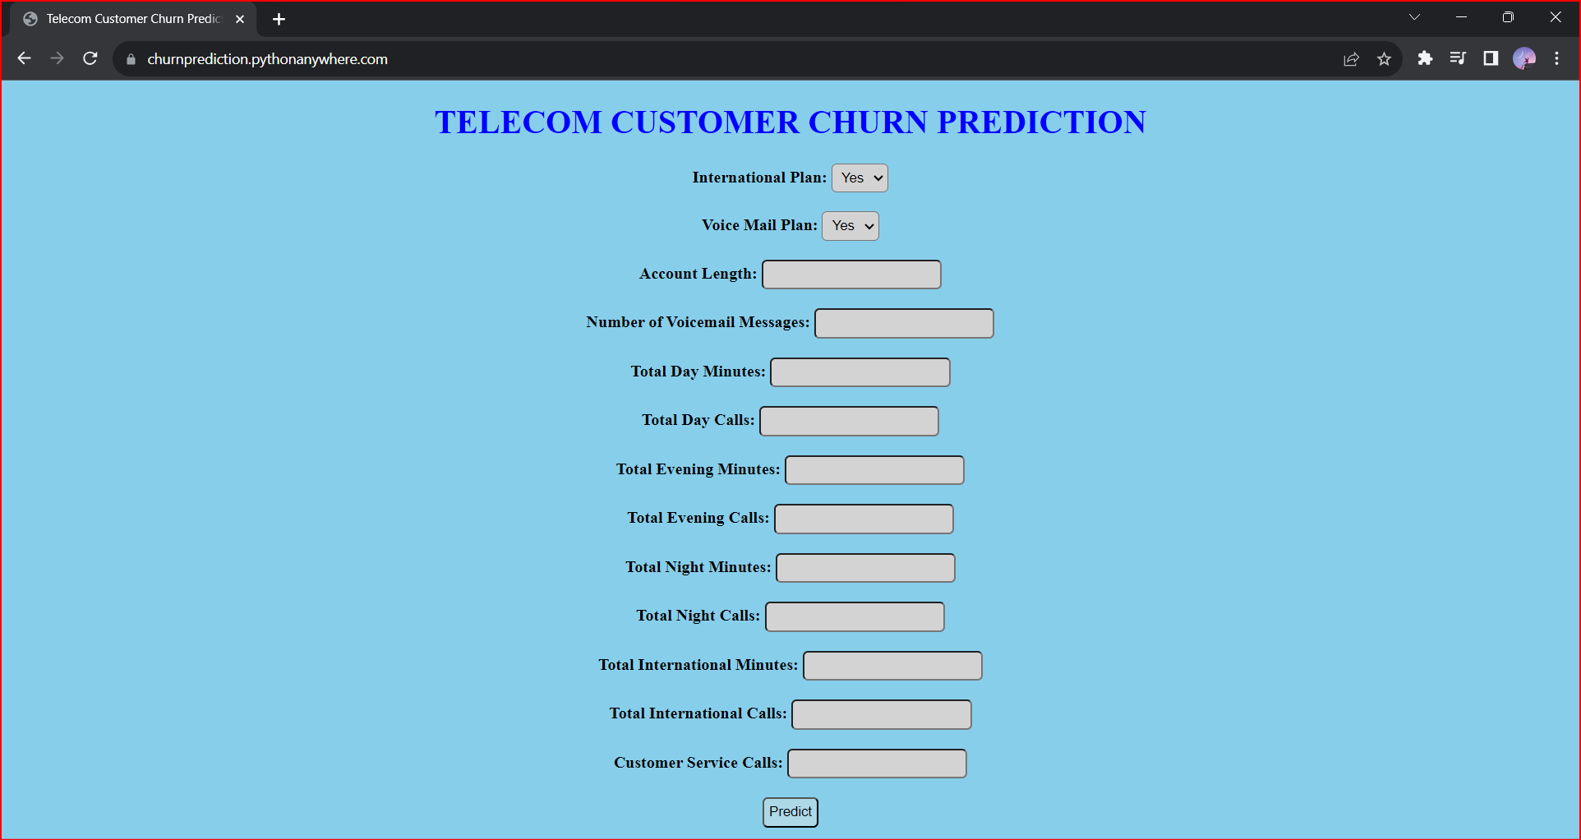
Example of Model Web Application:

Slide 13
CONCLUSION
Hence, based on this project, we can deduce that logistic regression is utilized to estimate the probabilities of events within the given dataset. It involves establishing relationships between features or attributes and the probabilities of specific outcomes in various scenarios. Multiple approaches are employed to determine the optimal fit of the model.
During our logistic regression analysis, we began by thoroughly studying the dataset and assessing its sensitivity. By altering the threshold values, we observed changes in the confusion matrix, with minimal fluctuations in specificity. Due to the dataset's bias towards the "Non-Spam" category, the model tends to classify messages as "non-spam," resulting in higher accuracy. The obtained confusion matrix provides insights into the model's performance.
GITHUB LINK : https://github.com/Mid-Term-Project-Team-5

Slide 14

Thank You

