Slide 1
BYTEFORGE 2026 | HACKATHON STAGE 2
EDUSYNC × TRIPWIRE
The Unified Smart Campus Operating System with Real-Time Behavioral Drift Intelligence
"From Paper Chits to Instant Verification; From Academic Failure to Proactive Recovery"
Institutional Deployment: TKM Institute of Technology (TKMIT) | APJ Abdul Kalam Technological University (KTU)

Slide 2
1. PROBLEM STATEMENT
The Dual Campus Crisis: Administrative Bottlenecks & The Silent Dropout Funnel
Why higher-education institutions struggle with operational gridlock and late academic intervention.
CRISIS 1: Administrative Paper Gridlock
• Manual Signature Chasing:
Students lose 3–5 days per semester physically collecting stamps across campus blocks from Faculty Advisors, HODs, Office Staff, and Principal.
• Duty Leave Friction:
Extracurricular achievers representing colleges in hackathons or sports face severe attendance penalties due to delayed or lost paper approval slips.
• Office Queue Congestion:
Bonafide certificates, fee dues clearances, and hostel out-passes require long physical lines and manual clerical verification.
• Paper Vulnerability:
Physical slips are easily misplaced, forged, or unrecorded, causing compliance chaos during semester university audits.
CRISIS 2: The Late-Detection Attrition Trap
• The 75% Statutory Cutoff:
Under university rules (KTU), <75% attendance leads to condonation fines (60–74%) or year-back debarment (<60%).
• Purely Reactive Portals:
Legacy ERPs only display passive historical numbers. Students discover debarment 48 hours before exams when hall tickets are blocked.
• The 'Silent Drift' Phenomenon:
Students disengage quietly 3 to 4 weeks before grades fall—skipping morning lectures, submitting labs 18h late, reducing LMS access.
• Blind Triage for Faculty:
In cohorts of 60–120 students, mentors cannot manually connect multi-modal behavioral signals until it is mathematically too late to recover.

Slide 3
2. TARGET USERS / STAKEHOLDERS
Whole-Campus Inclusivity: A Multi-Tiered Stakeholder Ecosystem
Empowering every persona in the academic lifecycle with specialized digital tools.
Students (UG & PG)
Friction: Paper signature chasing, sudden exam debarment shock, opaque university ordinances.
Solution: 1-click digital leave requests, QR passes, 'What-If' grade/attendance simulators, 24/7 AI Ordinance guidance.
Faculty Advisors / Mentors
Friction: Drowning in paper approvals, manual attendance math, blind to quiet student disengagement.
Solution: 1-click tiered approvals, real-time cohort batch attendance register, automated behavioral drift alerts.
Heads of Dept & Principal
Friction: Lack of departmental oversight, compliance risks, manual paper audit trails.
Solution: Executive dashboard with cohort risk heatmaps, institutional analytics, single-click leave audit compliance.
Industry Connect & Placement
Friction: Sifting through hundreds of resume PDFs manually, unstandardized candidate matching.
Solution: AI ATS Placement Studio with 100+ skill parsing, CGPA eligibility filters, automated drive shortlisting.
Admin Office & Exam Cell
Friction: Manual queues for fee clearances, bonafide certificates, spreadsheet condonation errors.
Solution: Digital clearance portal, cryptographic ZXing QR tokens, automated condonation calculation.

Slide 4
3. EXISTING GAPS & LIMITATIONS
Why Legacy College ERPs & Generic Early Warning Systems Fail
Four fundamental systemic blindspots in current higher-education software.
1. Passive Digital Ledgers, Not Workflows
Existing campus software acts merely as a database. Even when installed, a duty leave or medical certificate still requires physical paper slips hand-carried across offices. There is zero automated multi-tier routing.
2. Disconnected Duty Leaves & False Penalties
Legacy portals record hackathon and sports participation as absences first. Because leave approvals take weeks to reflect, students representing their college suffer false attendance penalties and blocked hall tickets.
3. Blunt 75% Cutoffs vs. Personal Velocity
Conventional systems evaluate absolute thresholds only. They miss an honors student whose attendance just plummeted from 96% to 76% (an acute crisis), while constantly red-flagging students whose baseline is 73%.
4. Black-Box Opacity & Failure to Close the Loop
Generic ML algorithms spit out arbitrary risk scores ('0.82 High Risk') without explainability. Worse, they provide no actionable 'what-if' recovery guidance or structured mentor intervention tracking.

Slide 5
4. PROPOSED SOLUTION
EduSync + Tripwire: The Unified Intelligent Campus Ecosystem
Bridging administrative automation with real-time predictive behavioral analytics.
EDUSYNC: Campus Governance Operating Core
✔ Multi-Tier Digital Leave Engine:
3-tier approval hierarchy (Advisor -> HOD -> Principal) with tamper-proof cryptographic ZXing QR verification.
✔ KTU Attendance & CIE Calculator:
Automated Series Exams 1 & 2, assignment weightings, and mathematical 'What-If' exam eligibility simulator.
✔ Campus AI Copilot (Hybrid RAG):
Document-grounded assistant trained on 200+ page KTU ordinances, credit rules, and curriculum regulations.
✔ AI ATS Placement Studio:
100+ technical skill matcher, CGPA filtering, and automated student-to-recruiter matching.
TRIPWIRE: Behavioral Early-Warning Brain
✔ Dynamic Velocity Index (DVI):
Unified 0–100 composite evaluating 40% Attendance, 35% Submission Latency, and 25% LMS Engagement relative to personal baseline.
✔ EWMA Temporal Noise Smoothing:
Alpha=0.35 exponential smoothing filters out 1-day illnesses/transient drops while detecting sustained 2-week behavioral decline.
✔ Approved Duty-Leave Masking:
Directly reads EduSync's sanctioned leaves, mathematically excluding hackathon and sports dates from attendance penalties!
✔ Counterfactual XAI & Closed Loop:
Generates exact mathematical recovery targets and tracks post-intervention student velocity through hysteresis recovery.

Slide 6
5. INNOVATION & UNIQUE CONTRIBUTION
Four Breakthrough Technical Innovations in Campus AI
Engineered for institutional reality, mathematical rigor, and ethical fairness.
1. Approved Duty-Leave Mathematical Masking
Traditional EWS algorithms penalize student achievers who miss lectures for national hackathons or sports. EduSync + Tripwire directly connects the digital approval pipeline to the analytical engine: verified duty and medical leave dates are mathematically excluded from attendance drift calculations. Zero false positives for campus ambassadors.
2. EWMA Noise-Dampened Behavioral Velocity
Rather than static grade cuts, Tripwire implements Exponentially Weighted Moving Average (EWMA) smoothing (alpha=0.35). An isolated 48-hour sickness will never trigger an alert, but progressive 2-week disengagement across attendance, assignment delays, and LMS access triggers early triage.
3. Document-Grounded Campus RAG AI
Generic chatbots hallucinate on institutional policies. EduSync integrates an in-memory TF-IDF semantic retrieval engine over actual KTU university ordinances, course syllabi, and circulars via Apache PDFBox, providing source-backed answers to credit and academic queries.
4. Actionable Counterfactual Explainable AI (XAI)
Instead of delivering opaque risk probability scores, Tripwire computes minimal actionable behavioral deltas: 'If Rahul attends next week's 4 lectures and submits Lab 2 on time, his DVI drops by 28 points, clearing the monitoring threshold.' Actionable pathways replace punitive condemnation.

Slide 7
6. SYSTEM / SOLUTION ARCHITECTURE
End-to-End Enterprise Multi-Tier Campus Pipeline
Seamless coordination across enterprise microservices, real-time analytics, and mobile clients.
CLIENT TIER
React 18 + Vite Web App
Android APK via Capacitor
Glassmorphism UI System
Offline ZXing QR Scanner
ENTERPRISE ERP CORE
Spring Boot 3.2.3 (Java 17)
3-Tier Leave Approval Engine
KTU CIE & Attendance Math
OpenPDF + ZXing Token Engine
Spring Mail Automated SMTP
PREDICTIVE AI ENGINE
FastAPI (Python 3.11)
DVI Velocity Engine (40/35/25)
EWMA Temporal Smoother
Approved Leave Date Masker
Counterfactual Optimizer
PERSISTENCE & DATA
MySQL 8.0 (17 Relational Tables)
HikariCP Connection Pool (200 th)
Google Drive Cloud Syllabus Sync
In-Memory TF-IDF Document Store
Historical Audit Trail Logs

Slide 8
7. TECHNOLOGY STACK
Robust Engineering Stack: High Concurrency, Fast Math & Mobile Mobility
Enterprise-grade frameworks engineered for 10,000+ student campuses.
ENTERPRISE BACKEND
Spring Boot 3.2.3 | Java 17
Spring Data JPA, Hibernate 6.4, HikariCP 200 connection pool, Spring Security 6 stateless JWT, OpenPDF 1.3, ZXing QR generation, Spring Mail SMTP.
PREDICTIVE ANALYTICS CORE
FastAPI | Python 3.11
ASGI asynchronous concurrency, vectorized NumPy numerical calculations, EWMA matrix math, Pydantic data validation, sub-10ms DVI recalculation.
DATABASE & STORAGE
MySQL 8.0 & SQLite
17 normalized relational schemas (InnoDB, UTF8mb4), indexing on student/period pairs, Google Drive API v3 bi-directional syllabus sync worker.
CLIENT & MOBILE DEPLOYMENT
React 18, Vite & Capacitor
Sub-second HMR development, modern responsive CSS system, SVG radial gauges, Recharts visualization, cross-platform Android mobile APK generation.

Slide 9
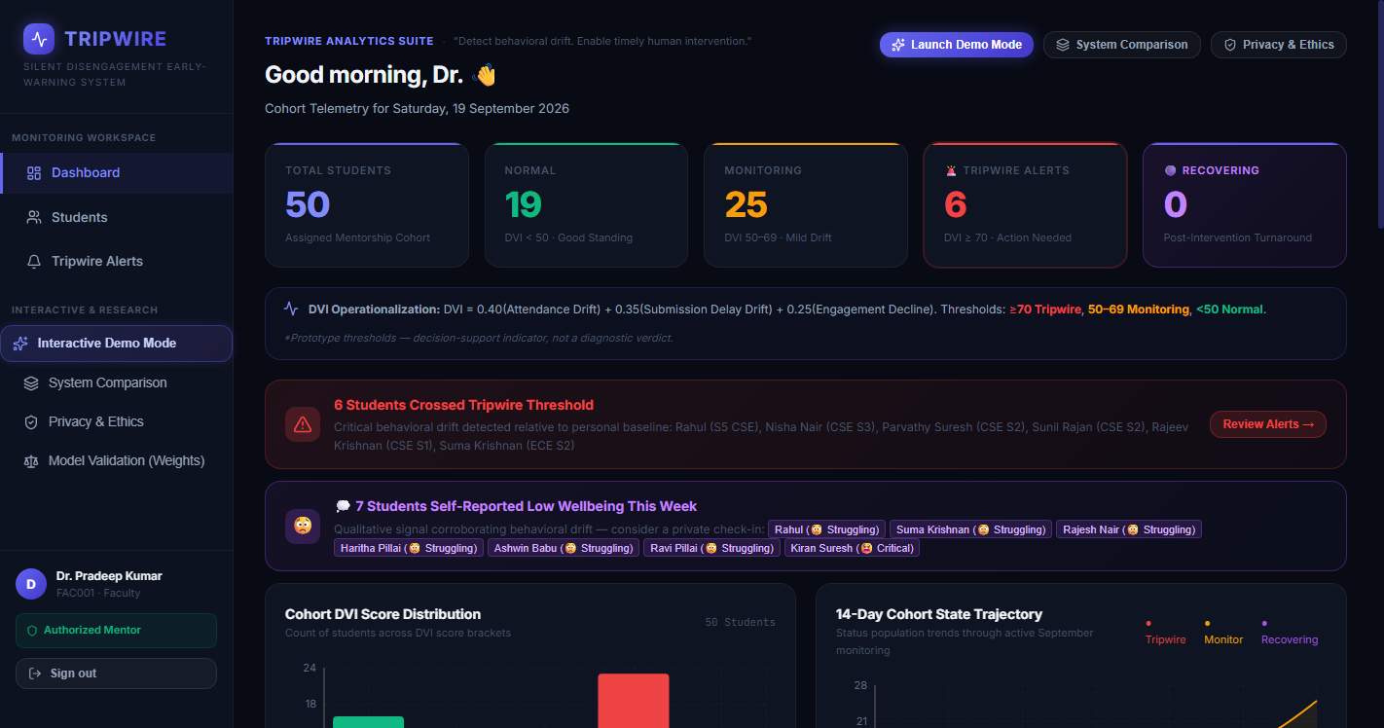
8. WORKING PROTOTYPE: FACULTY RISK RADAR & COHORT OVERVIEW
Real-Time Triaged Student Roster & Behavioral Archetype Distribution
Live screenshot from the running EduSync Tripwire application.
PROTOTYPE CAPABILITY: Risk Radar
✔ 50-Student Live Cohort: Categorized dynamically across 7 behavioral archetypes.
✔ Real-Time Velocity Ranking: Students sorted by DVI score; acute drift surfaced instantly.
✔ Categorized Risk Zones: Normal (DVI < 35), Monitoring Zone (35–69), and Tripwire Active Alert (DVI ≥ 70).
✔ Instant Triage: Mentors focus immediately on students destabilizing right now, ignoring noise.

Slide 10
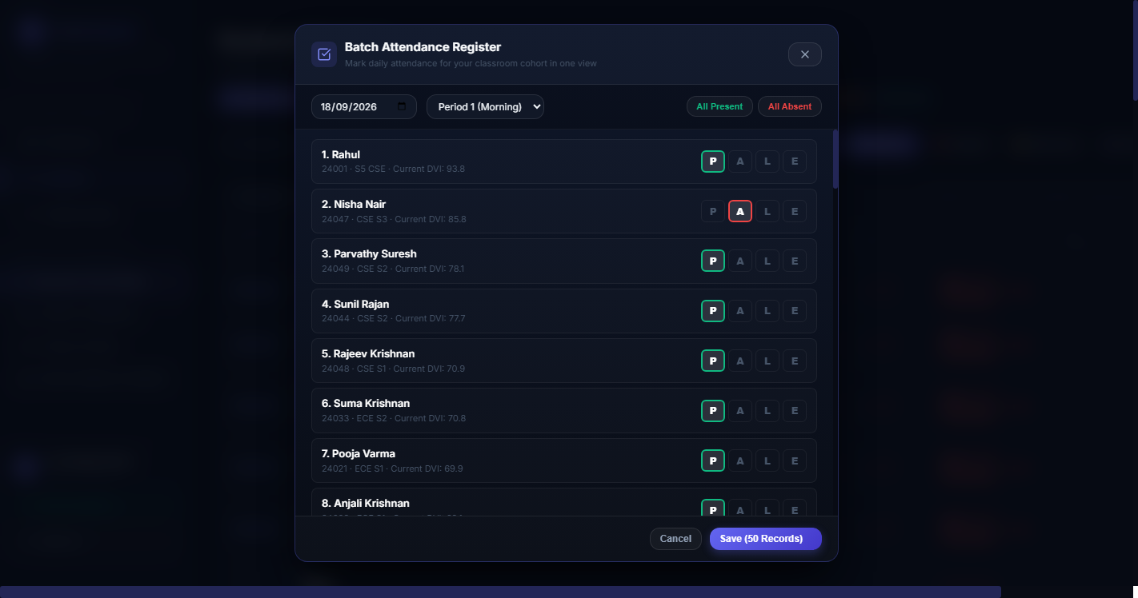
8. WORKING PROTOTYPE: BATCH ATTENDANCE REGISTER
One-Click Classroom Telemetry Recording with Reliable Database Persistence
Live screenshot of the Batch Attendance Register modal with date & period tracking.
PROTOTYPE CAPABILITY: Telemetry Modal
✔ One-Click Cohort Marking: Quick toggling across Present (P), Absent (A), Late (L), and Excused (E).
✔ Multi-Period Tracking: Periods 1 through 6 selectable with morning absence anomaly detection.
✔ Saved State Persistence: Reopening the modal immediately fetches saved marks from database—no blank or fresh resets.
✔ Live DVI Recomputation: Saving attendance updates all 50 student velocity scores in under 200ms.

Slide 11
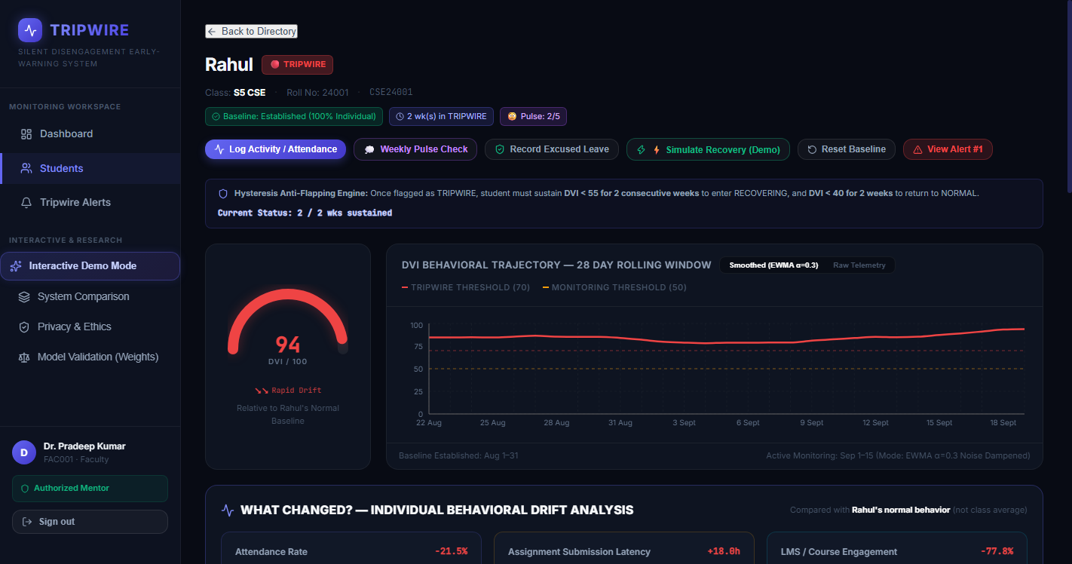
8. WORKING PROTOTYPE: STUDENT PROFILE & COUNTERFACTUAL XAI
Deep Behavioral Breakdown of Student Rahul (CSE24001) with 'What-If' Guidance
Live screenshot of Rahul's DVI Profile, gauge, component scores, and counterfactuals.
PROTOTYPE CAPABILITY: Explainable XAI
✔ DVI Radial Gauge: Displays real-time score (74 High Risk) with velocity indicator.
✔ Tri-Component Breakdown: Explicitly attributes drift: 28 pts from attendance, 30 pts from late submissions, 16 pts from LMS drop.
✔ Actionable Counterfactual: System calculates minimal change required to exit the alert zone.
✔ Non-Punitive Guidance: Gives mentors supportive talking points instead of algorithmic condemnation.

Slide 12

8. WORKING PROTOTYPE: CLOSED-LOOP INTERVENTION & RECOVERY
Logging Consultations, Outcome Classifications, and Hysteresis Tracking
Live screenshot of the Faculty Interventions Log & Recovery Monitoring pipeline.
PROTOTYPE CAPABILITY: Closed Loop
✔ Structured Outreach Logging: Records in-person meetings, phone calls, LMS messages, and referrals.
✔ Outcome Classification: Categorizes academic vs personal issues to guide institutional support.
✔ Hysteresis Recovery Monitor: Student transitions to 'Recovering' when DVI drops below 50, preventing alert oscillation.
✔ Audit-Ready Compliance: Creates a permanent, institutional record of supportive mentorship.

Slide 13
9. IMPACT & USEFULNESS
Transforming Campus Operations, Academic Retention & Student Well-Being
Quantified institutional impact backed by ethical AI and privacy-by-design.
21–28 Days Earlier
LEAD TIME ADVANTAGE
Detects micro-drift in 14-day rolling windows rather than waiting 90 days for midterm grades or exam hall ticket debarment.
< 2 Minutes
DUTY LEAVE TURNAROUND
Replaces 3–5 days of physical signature chasing across blocks with instant 3-tier digital approvals and QR passes.
15,000+ Sheets
ZERO-PAPER SUSTAINABILITY
Completely eliminates physical leave chits, medical condonation chits, and hall ticket clearance slips annually.
15–20% Reduction
AVOIDABLE DEBARMENTS
Early velocity check-ins prevent students from sliding into the condonation (<75%) or year-back (<60%) danger zone.
Zero Stigmatization
DIGNITY-PRESERVING SAFETY NET
Alerts are strictly private to mentors. Approved duty leaves are automatically masked. Zero public red flags.
85% Reduction
FACULTY TRIAGE OVERHEAD
Automated velocity scoring highlights the top 5 at-risk students out of 100 in less than 10 seconds.

Slide 14
10. FUTURE SCOPE & ROADMAP
From Institution Prototype to State-Wide Higher Education Standard
Scalable multi-phase trajectory expanding to national university ecosystems.
Phase 1 (Delivered Prototype)
Current Hackathon Release
• Full 3-Tier Digital Leave & QR Generation Engine
• Tripwire DVI Behavioral Velocity Engine (40/35/25)
• Batch Attendance Register with Persistence
• Document-Grounded RAG AI for KTU Ordinances
• AI ATS Placement Resume Screening Studio
Phase 2 (Next 3 Months)
Deep Ecosystem Integration
• Generative AI Advisor Outreach Copilot (Google Gemini API)
• Direct Canvas / Moodle LTI 1.3 Streaming Connectors
• Automated WhatsApp & SMS Gateway for Immediate Alerts
• State-Wide KTU University Portal API Synchronization
Phase 3 (Next 6–12 Months)
State-Wide Enterprise Scale
• Cross-Semester Longitudinal Retention AI Modeling
• Blockchain-Anchored Credential Verification for Leaves & Bonafides
• Predictive Departmental Resource & Faculty Workload Balancer
• Multi-Institution Federated Learning for Cross-Campus Models

Slide 15
CONCLUSION & JUDGE DEFENSE
Why EduSync × Tripwire is the Winning Higher-Ed Solution
Cheat-sheet answering the toughest judge questions.
Q: "Why combine campus ERP duty leaves with behavioral AI?"
A: Because they cannot work in silos! An early warning system that doesn't know about approved duty leaves will penalize students who are winning hackathons for the college. Integrating leave governance directly into the telemetry pipeline eliminates false positives.
Q: "How does this protect student dignity and mental health?"
A: Students are NEVER shown a public 'High Risk' label. Alerts are private advisory signals strictly inside the Faculty Advisor portal. The mentor reaches out naturally and supportively, preserving student dignity.
Q: "What if a student is sick with the flu for 2 days?"
A: Our EWMA noise-smoothing filter (alpha=0.35) mathematically dampens isolated shocks. An alert requires sustained behavioral drift across rolling 14-day windows.
Q: "Is this feasible to deploy across a 5,000-student university?"
A: Yes. Spring Boot handles ACID transactions via HikariCP connection pooling, while FastAPI executes vectorized NumPy calculations that recompute 5,000 student DVI scores in under 1.2 seconds.

