Slide 1



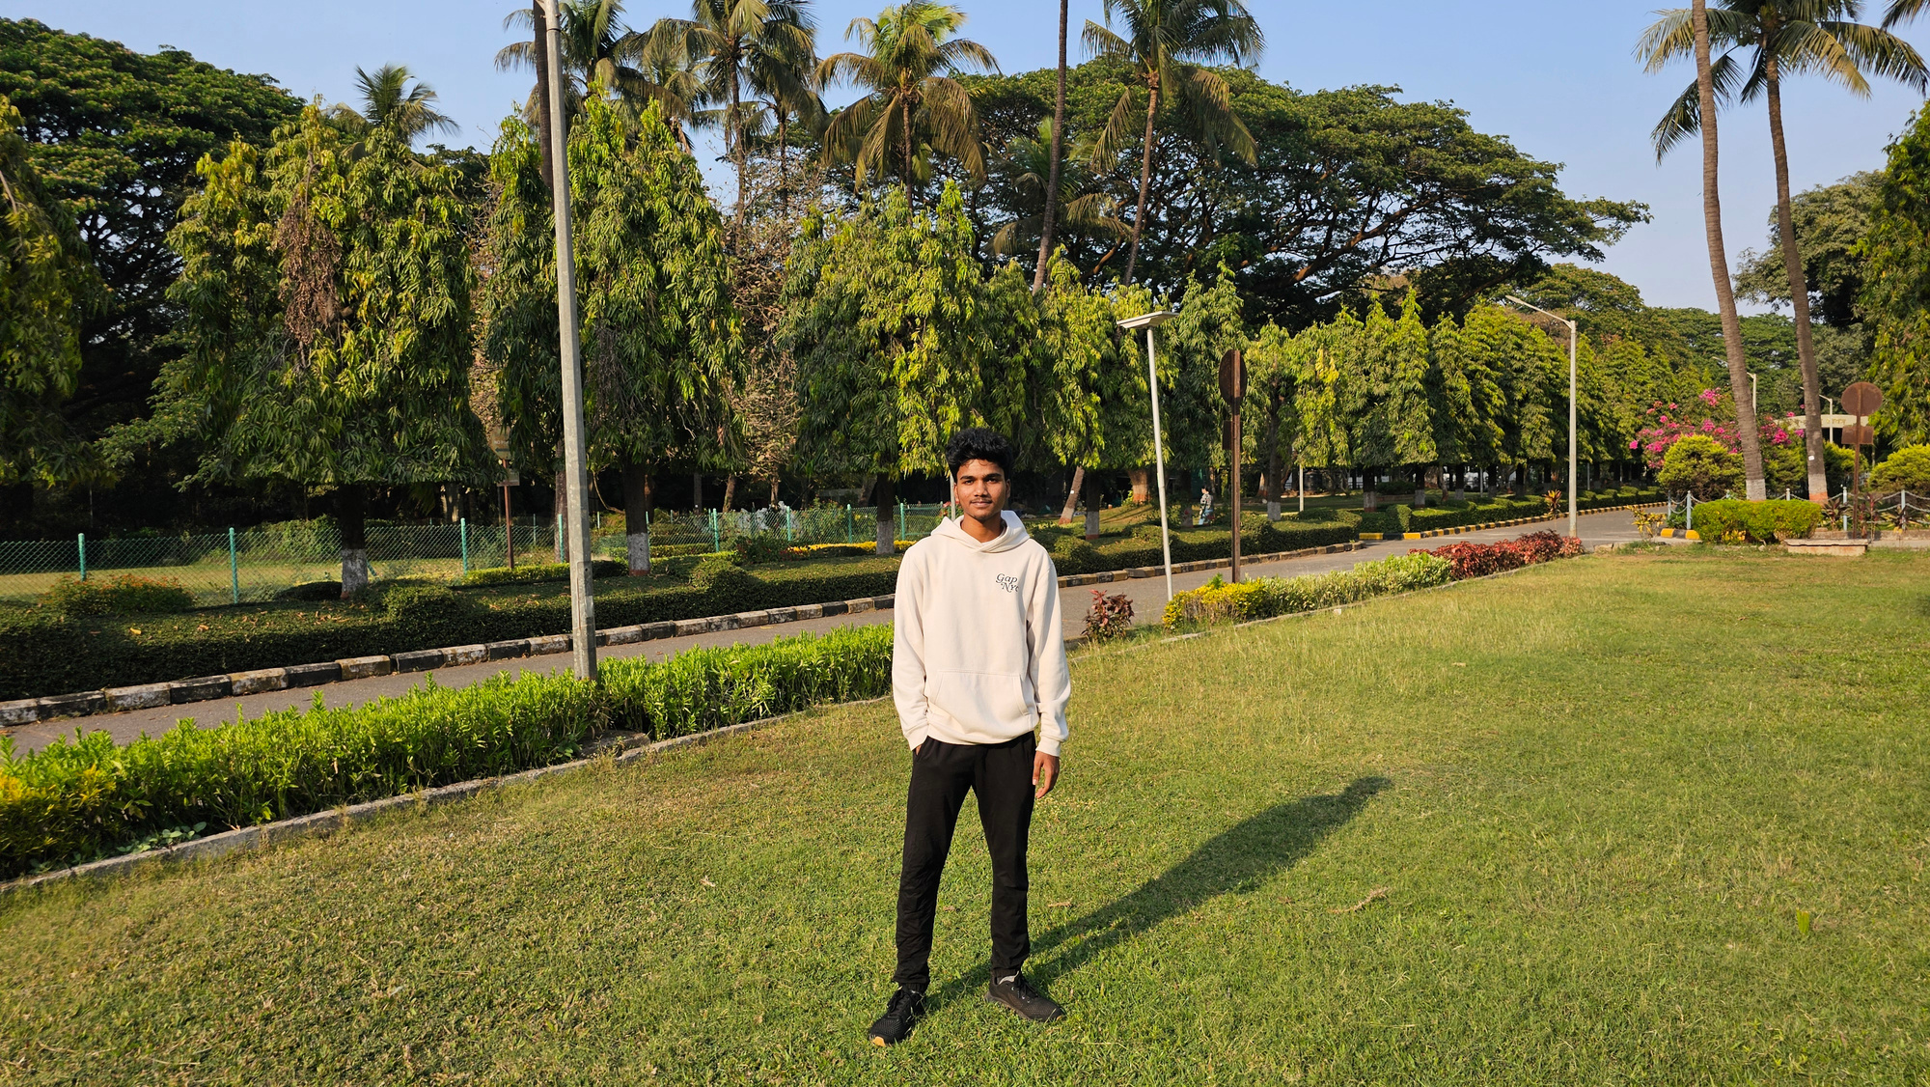
COMPUTER VISION BASED EMERGENCY VEHICLE TRAFFIC CLEARANCE
Presented by: Sreehari Nallapaneni(cyeX)

Slide 2

PROBLEM STATEMENT
Emergency vehicles often face delays in heavy traffic, especially in India, which can cost lives that can be saved with better solutions like computer vision. Current systems lack real-time, automated detection and give faster clearance for emergency vehicles, leading to inefficient emergency response times in urban areas, especially in Mumbai.

Slide 3
Proposed solution
Using computer vision we take raw videos from traffic signal and process them using yolov8 and custom model trained on emergency vehicles and change the traffic light to green dynamically reducing the waiting for emergency vehicles.
The program detects traffic light as reference point to calculate the distance to emergency vehicles for dynamic light switching of traffic signal

Slide 4

Project Implementation(How it Works)
02
03
04
01
04
Users will upload traffic videos through a simple Gradio web interface. This is a demo feature that can later be integrated with real-time video streams from traffic cameras.
The YOLOv8 and custom trained model trained on emergency vehicle dataset from roboflow detects emergency vehicles
Distance between emergency vehicle and traffic signal is calculated using traffic signal as reference point.Once the emergency vehicles is detected the traffic singal would turn to green when emergency vehicles are passed then it would turn to red
The user output is a video which demostrates how the singnal changes dynamically

Slide 5



Technologies Used
Pytorch , Yolov8, Roboflow for dataset , OpenCV,Gradio,Numpy
Future Scope
Due to time constraints I am not able to implement so many thing that i thought one of them is using meta segment anything model which would be better for accuracy .
Coversion of video to 3d simulation for better precision of detection of vehicles

Slide 6
THANK YOU

