Slide 1

Demo video : https://youtu.be/nGDS7qykMOw?si=2feFpN9XdnsPcMlx
i-Hack AWS Financial Security Hackathon
TEAM : SHA256
by sreehari

Slide 2

PROBLEM STATEMENT
Spam Call Detection and Prevention:Implement real-time call blocking or user alerts to mitigate risks.
Deepfake Detection in VKYC:Differentiate between authentic and AI-generated inputs in real time, ensuring the integrity of the VKYC process.
Enable users to report spam or fraudulent activities, improving the system's detection algorithms through feedback loops

Slide 3
Our approach
Scam call detection : We use AWS Transcribe for real-time speech-to-text transcription. Every 10 seconds, the transcribed text is processed by an LLM, which analyzes it to produce a structured output indicating whether the interaction is classified as 'FRAUD' or 'LEGITIMATE,' based on a calculated confidence score
SHA256(security): I thought how can we guarantee users that their data is safe so the approach is everytime we record a call or video and upload to the backend we create a sha256 hash so in the future if there is any data leak they can verify if the sha256 hash matches that means it is leaked from our end otherswise we guarantee user protection
Spam report : You can report a user with phone number and description we use that data to improve the spam detection model in future models
Vkyc deepfake detection: Tried using amazon faceliveness also implemented backend but currently it does not support react native it does but with native component not able to implement due to time constraints

Slide 4
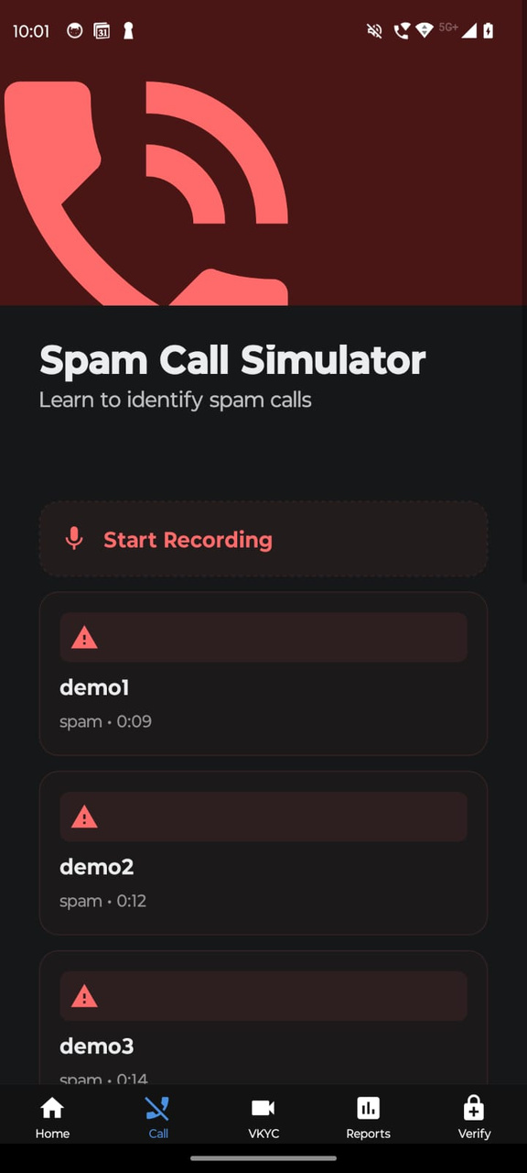
HOW SCAM DETECTION WORKS?
First we wil record the audio in mobile and send to backend because getting auto call recording permission for ios and android is hard so we then simulate the call
When call is simulated using aws transcribe realtime transcription we get the realtime transcription then every 10 seconds pass to llm and get structured output if confidence is higher
Then we will trigger a warning in the react native expo app

Slide 5
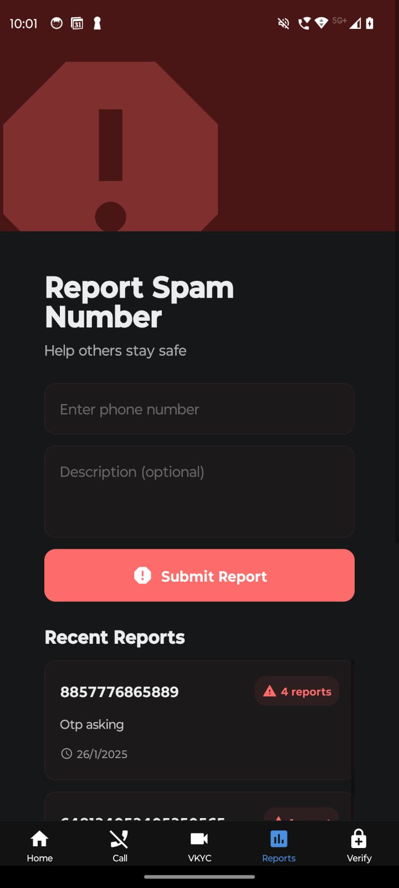
HOW REPORTING WORKS ?
Users report spam by submitting a phone number and description, which is sent to the backend API.
The backend checks if the phone number exists; if so, it increments the report count, otherwise, it creates a new report.
Users can view recent reports in the app, helping them stay informed about potential spam numbers and also we use this data to improve future modesl accuracy

Slide 6
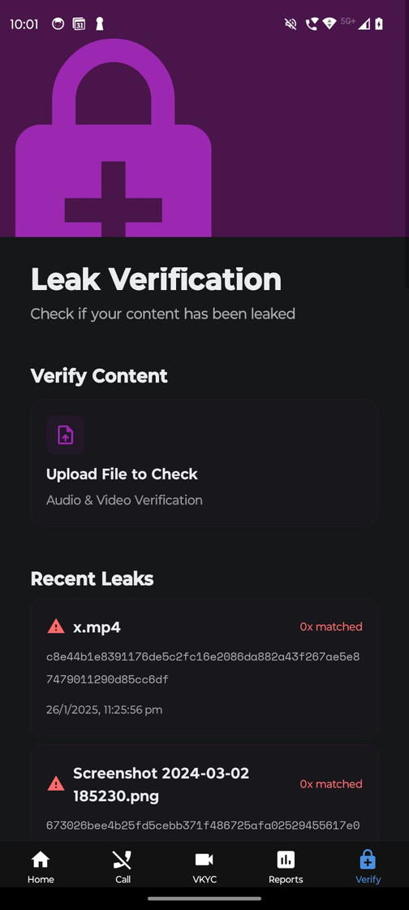
HOW SECURITY WORKS ?
Everytime we record audio and upload to backend we will send that to /audio/storehash endpoint just before deleting the audio file and get sha256 hash
This hash is unique for every input so the incase that user wants to verify in future whether his data is safe or not
He will upload that to the hash verification screen if the hash does not match then data is not leaked if so then it is issue with our application . By implementing this we give user security .

Slide 7
Future Improvements
If time would have permitted i would implement amazon faceliveness into react native app using native module approach for deepfake detection for vkyc
I would implement Transaction fraud detection using amazon fraud detector aws s3 and aws Lamda
Integrating with native mobile phone app to auto record recordings instead of simulation and showing the scam warnings

Slide 8

Thank You
TEAM SHA256 :
SREEHARI NALLAPANENI

