Slide 1
Lending Club Case Study
Group Members:
1. Saksham Gupta
2. Sreehari G Varma

Slide 2
The Problem
You work for a consumer finance company Lending Club which specializes in lending various types of loans to urban customers. This company is the largest online loan marketplace, facilitating personal loans, business loans, and financing of medical procedures. Borrowers can easily access lower interest rate loans through a fast online interface. When the company receives a loan application, the company must decide for loan approval based on the applicant’s profile. When a person applies for a loan, there are two types of decisions that could be taken by the company:
1. Loan accepted: If the company approves the loan, there are 3 possible scenarios described below:
Fully paid: Applicant has fully paid the loan (the principal and the interest rate)
Current: Applicant is in the process of paying the instalments, i.e. the tenure of the loan is not yet completed. These candidates are not labelled as 'defaulted'.
Charged-off: Applicant has not paid the instalments in due time for a long period of time, i.e. he/she has defaulted on the loan
2. Loan rejected: The company had rejected the loan (because the candidate does not meet their requirements etc.). Since the loan was rejected, there is no transactional history of those applicants with the company and so this data is not available with the company (and thus in this dataset)

Slide 3
Analysis Approach
Drop columns with null values ,all random values or single category value
Convert values to proper int, float, date representations
Analyze variables against segments of other variables
Create derived variables
Data Cleaning
Univariate analysis
Bivariate analysis
Segmented univariate analysis
Findings
Check distributions and frequencies of various numerical and categorical variables
Create derived variables
Do correlation analysis
Check how two variables affect each other or a third variable
Analyze joint distributions

Slide 4
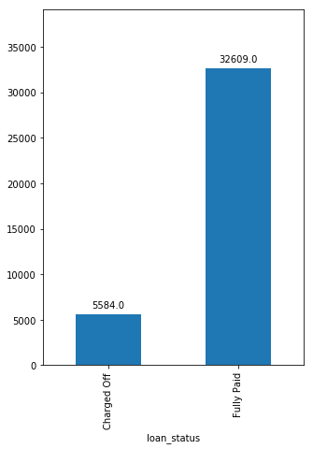
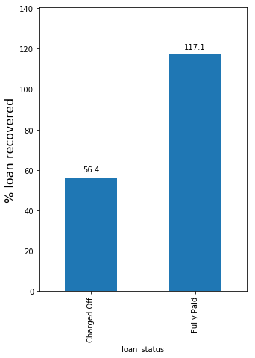
Analysis - Overall Loan Status
Total Loans
Total Money Earned
Lending Club only
recovers 57% of the
loan amount when
loans are defaulted.
Approximately
15% of loans
are defaulted

Slide 5
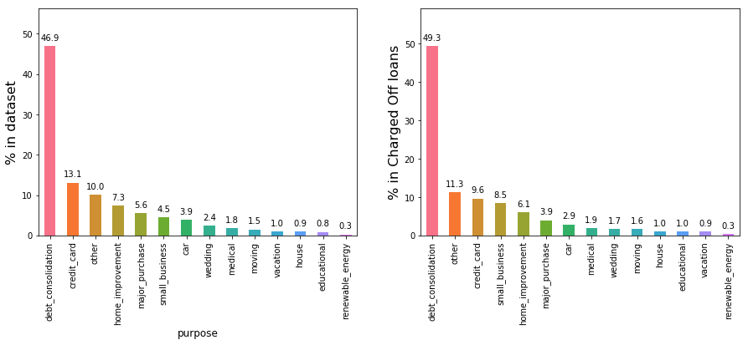
Analysis- Defaults by Loan-Purpose
Charged Off Rate - Top 3 Borrower's Purpose:
small business = 26.27%
renewable energy = 18.81%
educational = 17.03%

Slide 6
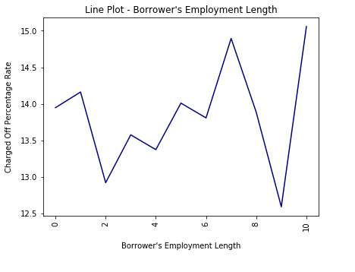
Analysis- Defaults by Employment Length
Top 4 employment length belonging to Charged Off category :
1 year
0 year (< 1 year)
7 year
10 Years (> 10 years)

Slide 7
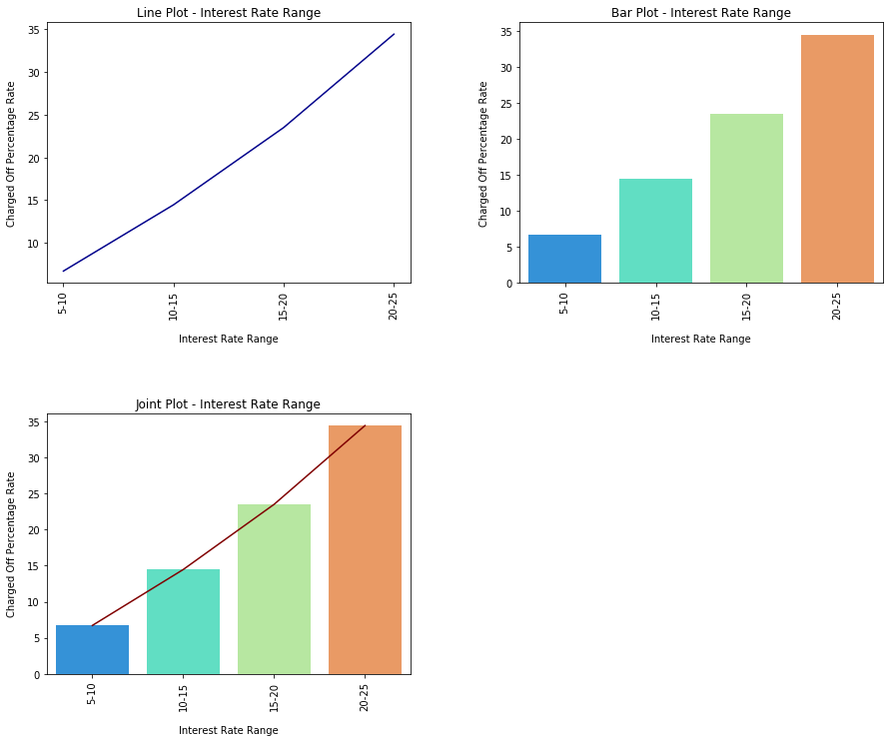
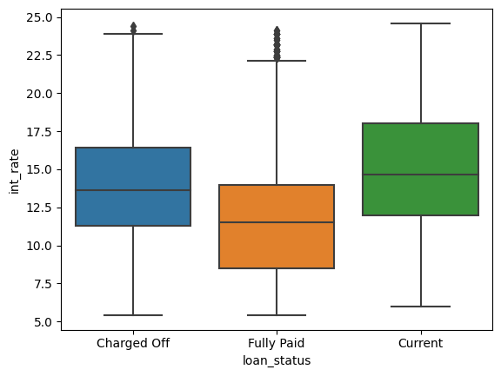
Analysis- Defaults by Interest Rate
Charged Off Rate - Top 2 Interest Rate Range:
20-25 = 34.44%
15-10 = 23.51%
10-15 = 14.46%
There is a clear indication that higher the 'interest rate’ , higher the chances to fall into charged off category
The 25% quartile of 'charged-off' is almost same to the median of 'fully paid' status. This indicates a similar composition (~25%) to fall into charged off category if they have higher interest rates.

Slide 8
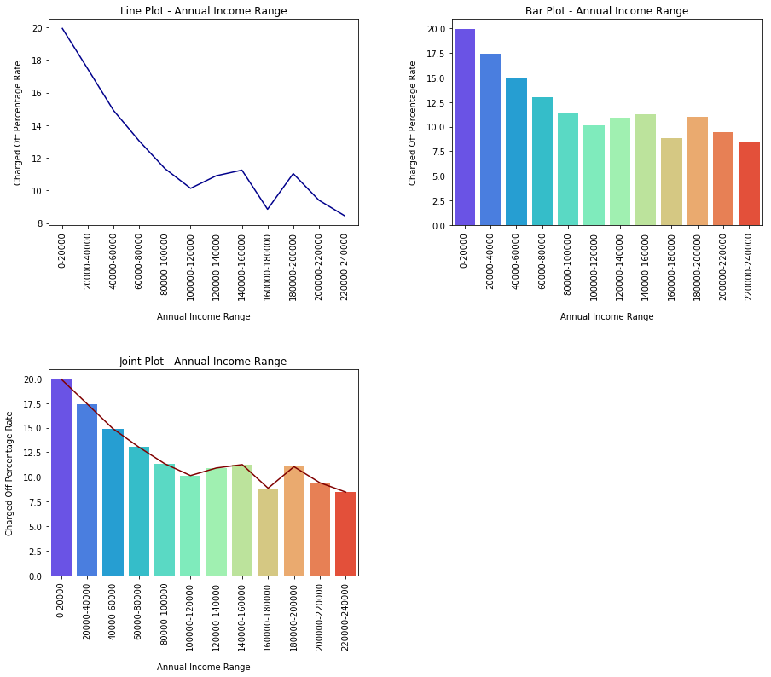
Analysis- Defaults by Annual Income
Charged Off Rate - Top 3 Annual Income Range:
0-20000 = 19.93%
20000-40000 = 17.43%
40000-60000 = 14.90%
So, as the Annual Income decreases, Charge Off Rate Increases

Slide 9
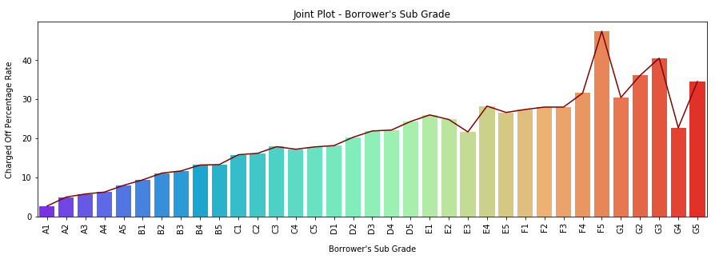
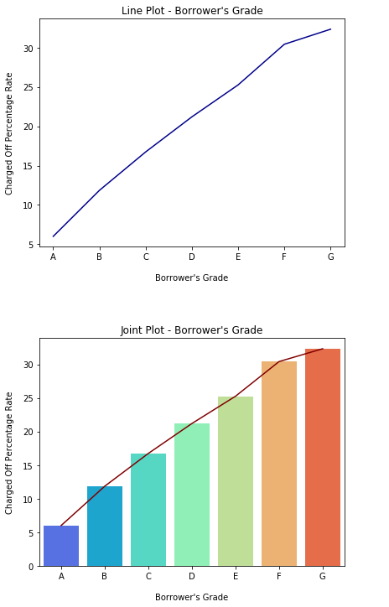
Analysis- Defaults by Grade & Sub-grade
Charged Off Rate - Grade:
As the Grade increases, Charged Off Rate increases.
Top Order:
1. G
2. F
3. E
4. D
5. C
6. B
7. A
Charged Off Rate - Sub Grade:¶
As the Grade and the Sub Grades increases, Charged Off Rate increases.

Slide 10
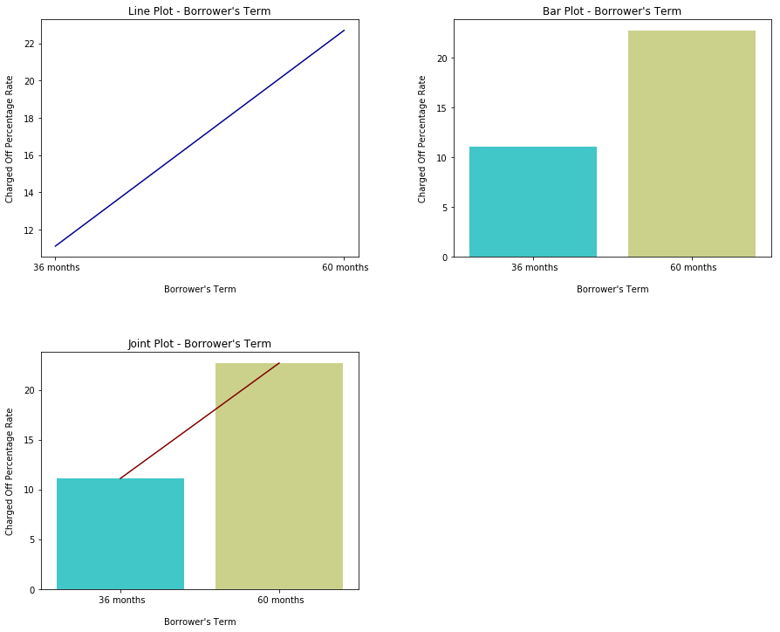
Analysis- Defaults by Term
Charged Off Rate - Borrower's Top Loan Term:
1. 60 months = 22.70%
2. 30 months = 11.10%
Which means 60 Months are more prone to defaults and there will be twice as chance of default than 36 months time period loan.

Slide 11
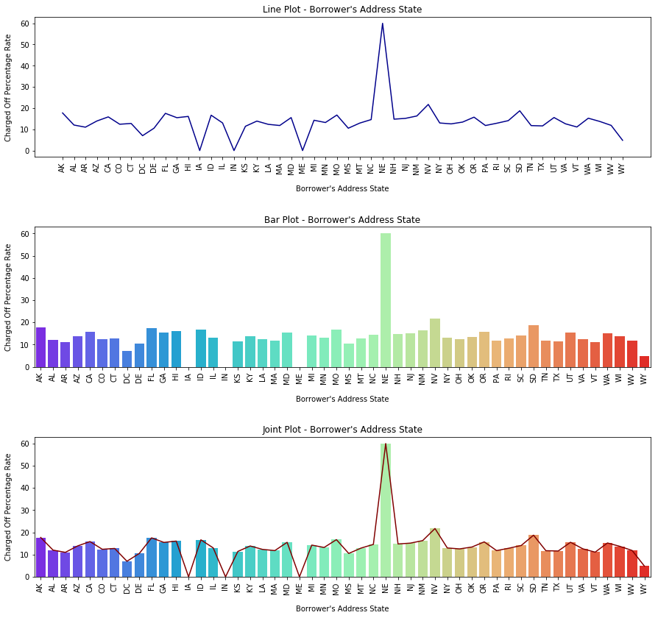
Analysis- Defaults by Address State
Charged Off Rate - Top 5 Borrower's Address State:
NE (Nebraska) = 60.00%
NV (Nevada) = 21.75%
SD (South Dakota) = 18.75%
AK (Alaska) = 17.72% 5. FL (Florida) = 17.54%
*NE (Nebraska) has a total of 5 loans out of which 3 were charged-off.

Slide 12
Conclusion:
Based on our Analysis, we produced following recommendations for Investors :
Customers with long term loans tend to default more, recommendation is to encourage shorter term loans (36 month) as the interest rates are also higher in long term loans and customers fail to repay the loans.
Higher LC Grade Loans have an impact on default rate as the interest rates also increase from grade A to grade G. Nearly 33% of all loans in Grades F and G see a default. Recommendation is to prefer Grade A, B, C over D, E, F, G. This is a Loan Attribute influencing tendency to default.
Purpose of loan is also a strong indicator; recommendation is to scrutinize more for small business and renewable energy related loans. Wedding, cars, big purchases remains safe bet. Also one can provide small business loans at lower interest rates to reduce defaults. This is a consumer Attribute influencing tendency to default.
Income source verification is not showing impact on tendency to default, recommendation is to not rely on income source verification for approving loans. But customers with lower incomes are tending to default more.
Loan amounts of 30% of annual income or higher see a high rate of default. As long as loan amount is less than 20% of annual income, defaults are low. This could be considered if other risk factors are higher to provide large loan amounts.
Loan Default tendency driving variables are Loan Purpose, Emp length, Grade, Interest rate, Annual Income, Term of Loan.
Other General Observations:
The percentage of Charged Off loans is marked higher when the borrower has a prior record of bankruptcy.
Higher the ‘dti’ higher the chances of loan being Charged Off
Charged Off rate increases for people with less employment length.

