Slide 1
Optimizers
Based on Geron Chapter 11

Slide 2
Key Optimizers to be Familiar with
Optimizer | Significance
SGD with Momentum | Fundamental and common in tutorials and simple networks
RMSProp | Sometimes effective, and used to be common
Adam | Effective and common, a go-to optimizer

Slide 3



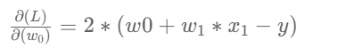

Reminder: The Gradient
The gradient is at the basis of all DL Optimizers
For the MSE loss function:
and a single linear neuron as the model:
The gradient of the loss function with respect to the model parameters is:

Slide 4
Gradient – Detailed Calculation
The functional form of the gradient is constant – it doesn’t change with a change of the input (x,y) or the value of the weights. However the value of the gradient will be different for each combination of inputs and weight values.

Slide 5
Gradient – Detailed Calculation
What will be the value of the gradient for (x=2, y=1, w_0=3, w_1=4)?

Slide 6
Gradient – Detailed Calculation
What will be the value of the gradient for (x=2, y=1, w_0=3, w_1=4)?
(20, 40)

Slide 7
Gradient – Detailed Calculation
What will be the value of the gradient for (x=2, y=1, w_0=3, w_1=4)?
(20, 40)
The gradient represents the direction in which the loss function will increase the most, for a small step taken in (w_0, w_1) around the point (x,y,w_0,w_1).
The negative of the gradient is the direction in (w_0,w_1) in which the function will decrease most in value, for a small step around the point (x,y,w_0,w_1)

Slide 8

Momentum
DreamStudio: A bowling ball rolling down a hill
Notes:
The image is an analogy for parametric optimization.
So, in the image:
What/Where is the Loss Function? It is the height of the surface
What/Where is the Gradient? It is the slope of the surface
What/Where are the trainable parameters? They are the x and y axes

Slide 9

Momentum
What will happen in real life?
What will happen with gradient descent?
DreamStudio:A bowling ball rolling down a hill with a small stone in front of it

Slide 10

Momentum
Friction and terminal (maximum) speed
DreamStudio: A bowling ball rolling down a muddy hill
Notes:
Terminal / Maximum Speed

Slide 11
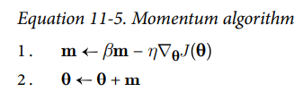
Momentum
DreamStudio: A bowling ball rolling down a hill
Geron, p.380
Notes:
Imagine a bowling ball rolling down a gentle slope: it will start out slowly, but will quickly pick up speed until it eventually reaches a terminal velocity (assuming that there is some friction or air resistance). In contrast, regular gradient descent will take small steps when the slope is gentle and big steps when the slope is steep, but it will never pick up speed. As a result, regular gradient descent is generally much slower to reach the minimum than momentum optimization.
Momentum optimization cares a great deal about what previous gradients were: at each iteration, it subtracts the local gradient from the momentum vector m (multiplied by the learning rate η), and it updates the weights by adding this momentum vector. In other words, the gradient is used as an acceleration, not as a speed. To simulate some sort of friction mechanism and prevent the momentum from growing too large, the algorithm introduces a new hyperparameter β, called the momentum, which must be set between 0 (high friction) and 1 (no friction). A typical momentum value is 0.9.
The update of the trainable parameters ‘moves’ in a direction that is a version of a weighted average of all previous gradients, each one multiplied by β multiplied by the number of steps since it was calculated
If the gradient remains constant, the terminal velocity (i.e., the maximum size of the weight updates) is equal to that gradient multiplied by the learning rate η multiplied by 1 / (1 – β) (ignoring the sign). For example, if β = 0.9, then the terminal velocity is equal to 10 times the gradient times the learning rate, so momentum optimization ends up going 10 times faster than gradient descent.
It can help roll past local minima.

Slide 12
Momentum
Momentum
Friction
Gradient
LR
Loss
Trainable Parameters
In which image would β be larger? What would be the effect on the parameters update?
DreamStudio: A bowling ball rolling down a hill
Geron, p.380
Notes:
Imagine a bowling ball rolling down a gentle slope on a smooth surface: it will start out slowly, but it will quickly pick up momentum until it eventually reaches terminal velocity (if there is some friction or air resistance). In contrast, regular gradient descent will take small steps when the slope is gentle and big steps when the slope is steep, but it will never pick up speed. As a result, regular gradient descent is generally much slower to reach the minimum than momentum optimization.
Momentum optimization cares a great deal about what previous gradients were: at each iteration, it subtracts the local gradient from the momentum vector m (multiplied by the learning rate η), and it updates the weights by adding this momentum vector. In other words, the gradient is used as an acceleration, not as a speed. To simulate some sort of friction mechanism and prevent the momentum from growing too large, the algorithm introduces a new hyperparameter β, called the momentum, which must be set between 0 (high friction) and 1 (no friction). A typical momentum value is 0.9.
The update of the trainable parameters ‘moves’ in a direction that is a version of a weighted average of all previous gradients, each one multiplied by β multiplied by the number of steps since it was calculated
If the gradient remains constant, the terminal velocity (i.e., the maximum size of the weight updates) is equal to that gradient multiplied by the learning rate η multiplied by 1 / (1 – β) (ignoring the sign). For example, if β = 0.9, then the terminal velocity is equal to 10 times the gradient times the learning rate, so momentum optimization ends up going 10 times faster than gradient descent.
It can help roll past local minima.

Slide 13
Momentum Numerical Example
Assuming:
A model with just one trainable parameter: w_1
w_1 is initialized to 0
The gradients of the loss function with respect to w_1 at three consecutive steps are: (4,6,2).
Let’s compare an SGD to a SGD with momentum:
A plain gradient descent optimizer with a learning rate of 0.1
A momentum-based optimizer with a learning rate of 0.1 and a friction of 0.9

Slide 14

Momentum Numerical Example
Initialization: w_1=0
w_1 after each update:
Optimizer | Step 1 (gradient=4) | Step 2 (gradient=6) | Step 3 (gradient=2)
Gradient Descent (LR=0.1) | ?
Momentum (LR=0.1, beta=0.9)

Slide 15
Momentum Numerical Example
Initialization: w_1=0
w_1 after each update:
Optimizer | Step 1 (gradient=4) | Step 2 (gradient=6) | Step 3 (gradient=2)
Gradient Descent (LR=0.1) | -0.4
Momentum (LR=0.1, beta=0.9)

Slide 16
Momentum Numerical Example
Initialization: w_1=0
Optimizer | Step 1 (gradient=4) | Step 2 (gradient=6) | Step 3 (gradient=2)
Gradient Descent (LR=0.1) | -0.4
Momentum (LR=0.1, beta=0.9) | ?

Slide 17
Momentum Numerical Example
Initialization: w_1=0
Optimizer | Step 1 (gradient=4) | Step 2 (gradient=6) | Step 3 (gradient=2)
Gradient Descent (LR=0.1) | -0.4
Momentum (LR=0.1, beta=0.9) | -0.4 (m = -0.4)

Slide 18
Momentum Numerical Example
Initialization: w_1=0
Optimizer | Step 1 (gradient=4) | Step 2 (gradient=6) | Step 3 (gradient=2)
Gradient Descent (LR=0.1) | -0.4 | ?
Momentum (LR=0.1, beta=0.9) | -0.4 (m = -0.4)

Slide 19
Momentum Numerical Example
Initialization: w_1=0
Optimizer | Step 1 (gradient=4) | Step 2 (gradient=6) | Step 3 (gradient=2)
Gradient Descent (LR=0.1) | -0.4 | -0.4 – 0.6 = -1.0
Momentum (LR=0.1, beta=0.9) | -0.4 (m = -0.4)

Slide 20
Momentum Numerical Example
Initialization: w_1=0
Optimizer | Step 1 (gradient=4) | Step 2 (gradient=6) | Step 3 (gradient=2)
Gradient Descent (LR=0.1) | -0.4 | -1.0
Momentum (LR=0.1, beta=0.9) | -0.4 (m = -0.4) | ?

Slide 21
Momentum Numerical Example
Initialization: w_1=0
Optimizer | Step 1 (gradient=4) | Step 2 (gradient=6) | Step 3 (gradient=2)
Gradient Descent (LR=0.1) | -0.4 | -1.0
Momentum (LR=0.1, beta=0.9) | -0.4 (m = -0.4) | m= -0.4*0.9 -0.6 = -0.96 -0.4 + (-0.96) = -1.36

Slide 22
Momentum Numerical Example
Initialization: w_1=0
Optimizer | Step 1 (gradient=4) | Step 2 (gradient=6) | Step 3 (gradient=2)
Gradient Descent (LR=0.1) | -0.4 | -1.0 | ?
Momentum (LR=0.1, beta=0.9) | -0.4 (m = -0.4) | -1.36 (m = -0.96)

Slide 23
Momentum Numerical Example
Initialization: w_1=0
Optimizer | Step 1 (gradient=4) | Step 2 (gradient=6) | Step 3 (gradient=2)
Gradient Descent (LR=0.1) | -0.4 | -1.0 | -1.0 – 0.2 = -1.2
Momentum (LR=0.1, beta=0.9) | -0.4 (m = -0.4) | -1.36 (m = -0.96)

Slide 24
Momentum Numerical Example
Initialization: w_1=0
Optimizer | Step 1 (gradient=4) | Step 2 (gradient=6) | Step 3 (gradient=2)
Gradient Descent (LR=0.1) | -0.4 | -1.0 | -1.2
Momentum (LR=0.1, beta=0.9) | -0.4 (m = -0.4) | -1.36 (m = -0.96) | ?

Slide 25
Momentum Numerical Example
Initialization: w_1=0
Optimizer | Step 1 (gradient=4) | Step 2 (gradient=6) | Step 3 (gradient=2)
Gradient Descent (LR=0.1) | -0.4 | -1.0 | -1.2
Momentum (LR=0.1, beta=0.9) | -0.4 (m = -0.4) | -1.36 (m = -0.96) | m = -0.96*0.9 - 0.2 m = -1.064 -1.36 + (-1.064) = -2.424

Slide 26
Momentum Numerical Example
Initialization: w_1=0
Optimizer | Step 1 (gradient=4) | Step 2 (gradient=6) | Step 3 (gradient=2)
Gradient Descent (LR=0.1) | -0.4 | -1.0 | -1.2
Momentum (LR=0.1, beta=0.9) | -0.4 (m = -0.4) | -1.36 (m = -0.96) | -2.424 (m = -1.064)

Slide 27
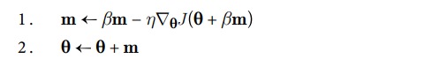
Nesterov Accelerated Gradient (NAG) Nesterov momentum optimization
Compare to the momentum algorithm:
Geron, p.380
Notes:
Nesterov Accelerated Gradient calculates the gradient at a point slightly forward from the current values of the parameters. The exact position is the current values + the momentum.
Other than that, the algorithm is the same as SGD with Momentum.
This is not a key algorithm, but because of its simplicity, it is presented here.

Slide 28
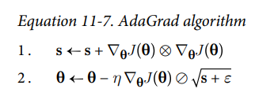


AdaGrad - Adaptive Gradient
Compare to SGD:
Notes:
scaling down the gradient vector proportionally to the accumulative gradient per trainable parameter.
this algorithm decays the learning rate, but it does so faster for steep dimensions than for dimensions with gentler slopes. This is called an adaptive learning rate.
If the cost function is steep along the i th dimension, then si will get larger and larger at each iteration.
It helps point the resulting updates more directly toward the global optimum. One additional benefit is that it requires much less tuning of the learning rate hyperparameter η.
AdaGrad frequently performs well for simple quadratic problems, but it often stops too early when training neural networks: the learning rate gets scaled down so much that the algorithm ends up stopping entirely before reaching the global optimum. So even though Keras has an Adagrad optimizer, you should not use it to train deep neural networks (it may be efficient for simpler tasks such as linear regression, though). Still, understanding AdaGrad is helpful to comprehend the other adaptive learning rate optimizers.

Slide 29
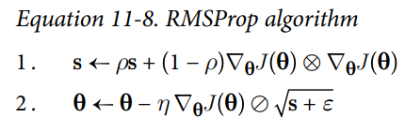
RMSProp
RMSProp:
Compare to AdaGrad:
Notes:
RMSProp Acronym stands for: Root Mean Squared Propagation
As we’ve seen, AdaGrad runs the risk of slowing down a bit too fast and never converging to the global optimum. The RMSProp algorithm fixes this by accumulating only the gradients from the most recent iterations, as opposed to all the gradients since the beginning of training. It does so by using exponential decay in the first step.
The decay rate ρ is typically set to 0.9. It is a hyperparameter, but this default value often works well, so you may not need to tune it at all.

Slide 30
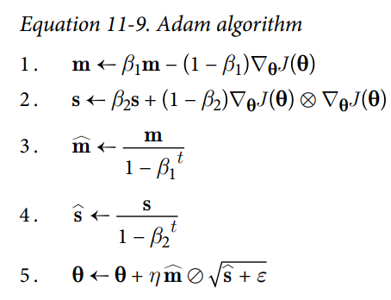
Adam – Adaptive Moment Estimation
Notes:
The momentum decay hyperparameter β1 is typically initialized to 0.9, while the scaling decay hyperparameter β2 is often initialized to 0.999.
As earlier, the smoothing term ε is usually initialized to a tiny number such as 10–7. These are the default values for the Adam class.
Since Adam is an adaptive learning rate algorithm, like AdaGrad and RMSProp, it requires less tuning of the learning rate hyperparameter η. You can often use the default value η = 0.001, making Adam even easier to use than gradient descent.
Adam, which stands for adaptive moment estimation, combines the ideas of momentum optimization and RMSProp: just like momentum optimization, it keeps track of an exponentially decaying average of past gradients; and just like RMSProp, it keeps track of an exponentially decaying average of past squared gradients. These are estimations of the mean and (uncentered) variance of the gradients. The mean is often called the first moment while the variance is often called the second moment, hence the name of the algorithm.

Slide 31
Adam – Adaptive Moment Estimation
Adam is a combination of momentum and RMSProp
momentum
Adagrad and RMSProp
Notes:
The momentum decay hyperparameter β1 is typically initialized to 0.9, while the scaling decay hyperparameter β2 is often initialized to 0.999.
As earlier, the smoothing term ε is usually initialized to a tiny number such as 10–7. These are the default values for the Adam class.
Since Adam is an adaptive learning rate algorithm, like AdaGrad and RMSProp, it requires less tuning of the learning rate hyperparameter η. You can often use the default value η = 0.001, making Adam even easier to use than gradient descent.
Adam, which stands for adaptive moment estimation, combines the ideas of momentum optimization and RMSProp: just like momentum optimization, it keeps track of an exponentially decaying average of past gradients; and just like RMSProp, it keeps track of an exponentially decaying average of past squared gradients. These are estimations of the mean and (uncentered) variance of the gradients. The mean is often called the first moment while the variance is often called the second moment, hence the name of the algorithm.

Slide 32
Adam – Adaptive Moment Estimation
technical detail: since m and s are initialized at 0, they will be biased toward 0 at the beginning of training, so these two steps will help boost m and s at the beginning of training.
Notes:
The momentum decay hyperparameter β1 is typically initialized to 0.9, while the scaling decay hyperparameter β2 is often initialized to 0.999.
As earlier, the smoothing term ε is usually initialized to a tiny number such as 10–7. These are the default values for the Adam class.
Since Adam is an adaptive learning rate algorithm, like AdaGrad and RMSProp, it requires less tuning of the learning rate hyperparameter η. You can often use the default value η = 0.001, making Adam even easier to use than gradient descent.
Adam, which stands for adaptive moment estimation, combines the ideas of momentum optimization and RMSProp: just like momentum optimization, it keeps track of an exponentially decaying average of past gradients; and just like RMSProp, it keeps track of an exponentially decaying average of past squared gradients (see Equation 11-9). These are estimations of the mean and (uncentered) variance of the gradients. The mean is often called the first moment while the variance is often called the second moment, hence the name of the algorithm.

Slide 33
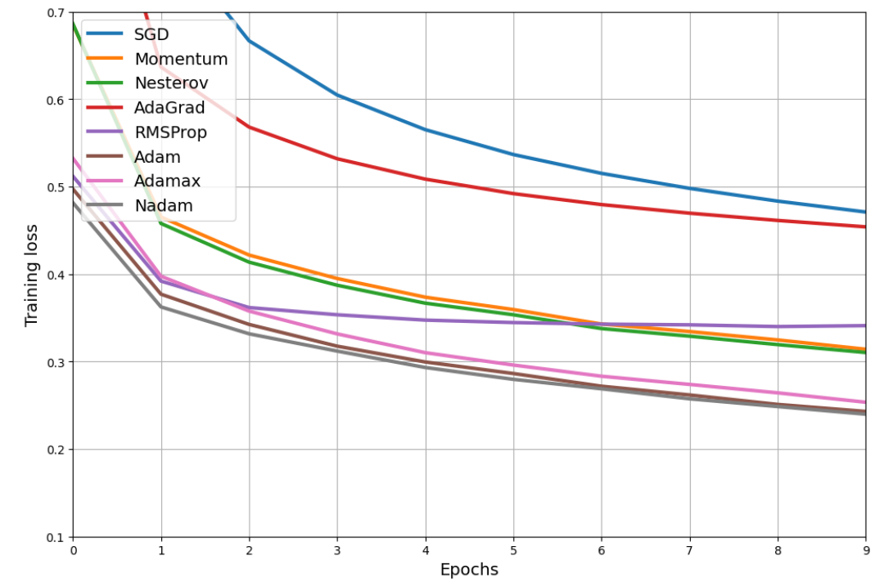
Benchmark f-MNIST with Dense NN

Slide 34
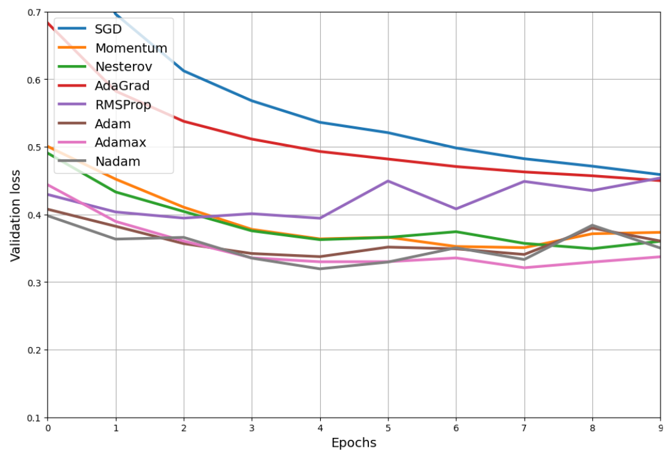
Benchmark f-MNIST with Dense NN

