Slide 1
Map Reduce - Yarn

Slide 2
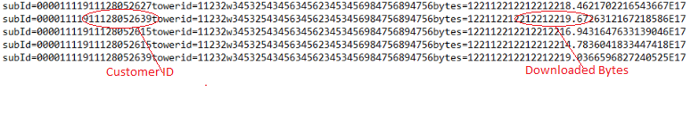
Case Study 1
To find out subscribers and their corresponding downloaded bytes from sample logs of airmobile provided. Each line has information about subscriber (substring 15,26) the bytes downloaded (substring 87,97)
Sample log files are present in above format. Data is present in line delimited format. From each line Customer ID and Downloaded Bytes have to be extracted for analysis.

Slide 3
Solution 1
Pseudo code
Map<long, double> subscribertobytesMap;
for(each line in doc)
{
parse line for subsriber id and bytes
if(subscribertobytesMap.contains(subscriber id))
subscribertobytesMap.get(subscriberid) + bytes
else
{
subscribertobytesMap.put(subscriberid, bytes)
}
}

Slide 4
When Documents Become Large
When there are multiple documents
We need to iterate through each document and calculate the map following solution 1

Slide 5
Issues
Performance All the data is processed sequentially. There are millions of records which get processed and hence it takes hours and becomes pretty slow as the number of records increases
Can run out of memory- Since we are maintaining a hashmap the heap memory can become insufficient

Slide 6
Solution 2
Use multithreading to process the records in parallel, however this approach is also limited to number of CPUs / cores

Slide 7
Issues
How to divide the data in equal parts
Combining results will take further processing
Still limited by processing power of 1 machine. Some data sets are beyond the memory of single machine

Slide 8
Solution 3: Map Reduce v2 (Yarn)

Slide 9
What is Map Reduce v2?
Split input files(e.g., by HDFS blocks)
Operate on key / value pairs
Mappers filter and transform input data
Reducers operate on mapper output
Finally, move code to data.
The new map reduce i.e. YARN was born of a need to enable a broader array of interaction for data stored in HDFS beyond MapReduce. The YARN-based architecture of Hadoop 2.0 provides a more general processing platform that is not constrained to MapReduce.
YARN :- Yet Another Resource Negotiator , allows other applications on top of it.

Slide 10
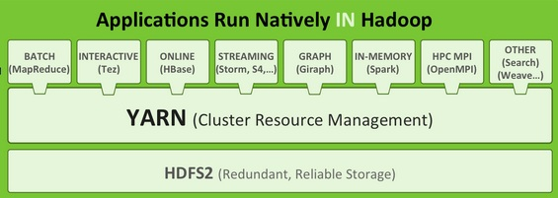
Why YARN ?
Yarn provides programming beyond java application and makes it interactive to let other applicatons like GI-Raph, Hbase to work on it.
The beauty of YARN’s design is that different YARN applications can co-exist on the same cluster—so a MapReduce application can run at the same time as an MPI application, for example—which brings great benefits for managability and cluster utilization.
Source:-http://hortonworks.com/hadoop/yarn/
Notes:
Provide
Source

Slide 11
Components of Yarn
Client :- For submitting MapReduce Jobs.
Resource manager :- For coordinating the allocation of computer resources on the cluster.
Node managers :- For launching and monitoring the computer containers on machines in the cluster.
The MapReduce application master :- Checks tasks running the MapReduce job. The application master and the MapReduce tasks run in containers that are scheduled by the resource manager, and managed by the node managers.
The distributed filesystem i.e HDFS which is used for sharing job files between the other entities.
Note:-- Previously installed hadoop had Jobtracker & Tasktracker which were responsible for handling resources and checking progress management. However, Hadoop 2.0 has Resource manager and Nodemanager to overcome the shortfall of Jobtracker & Tasktracker.
JobTracker(JT) managed the task trackers & also kept track of resource availability and task life cycle management tracking its progress, fault tolerance whereas TaskTracker just does the job submitted by JT & gives updates to them about their progress.

Slide 12
Map Reduce
Steps in Map-reduce Phase:
Map takes a data in the form of <key , value> pairs and returns a list of <key , value> pairs. The keys will not be unique in this case
Using the output of Map, sort and shuffle are applied by the hadoop architecture. This sort and shuffle acts on these list of <key , value> pairs and sends out unique keys and a list of values associated with this unique key <key , list(values)>
Output of sort and shuffle will be sent to reducer phase. Reducer will perform a defined function on list of values for unique keys and Final output will <key , value> will be stored/displayed.
 | Input | Output
Map | <k1, v1> | list(<k2, v2>)
Reduce | <k2, list(v2)> | list(<k3, v3>)

Slide 13
Sample Input File
subId=00001111911128052639towerid=11232w34532543456345623453456984756894756bytes=122112212212212219.6726312167218586E17
subId=00001111911128052615towerid=11232w34532543456345623453456984756894756bytes=122112212212212216.9431647633139046E17
subId=00001111911128052615towerid=11232w34532543456345623453456984756894756bytes=122112212212212214.7836041833447418E17
subId=00001111911128052639towerid=11232w34532543456345623453456984756894756bytes=122112212212212219.0366596827240525E17
subId=00001111911128052619towerid=11232w34532543456345623453456984756894756bytes=122112212212212218.0686280014540467E17
subId=00001111911128052658towerid=11232w34532543456345623453456984756894756bytes=122112212212212216.9860890496178944E17

Slide 14
k1, v1
(0 , subId=00001111911128052639towerid=11232w34532543456345623453456984756894756bytes=122112212212212219.6726312167218586E17)
(121 , subId=00001111911128052615towerid=11232w34532543456345623453456984756894756bytes=122112212212212216.9431647633139046E17
(242 , subId=00001111911128052615towerid=11232w34532543456345623453456984756894756bytes=122112212212212214.7836041833447418E17)
Data as input is sent through “TextInput” format ( to be discussed later) . Mapper takes input in form of (k1,v1). Using this format, one particular line is read and sent as value with key as offset from start
First line has zero offset from start, so key will be 0
Second line has offset equal to length of first line, so offset 121. Similarly each line is sent in the form of <key , value> pairs.

Slide 15
list(K2, V2)
(Output from mapper)
(28052627, 8.4621702216543)
(28052639, 9.672631216721858)
(28052627, 8.64072609693471)
In our mapper function for each <k1,v1> we have extracted Subscriber’s ID and Downloaded bytes from ‘v1’ using Substring() method. Then output is sent in the form of < ID, Downloaded bytes> as <k2,v2>.

Slide 16
(K2, list(V2))
(“28052627”, (8.4621702216543, 8.64072609693471)
(“28052639”, (9.672631216721858))
Sort and shuffle
Using the input from each mapper <k2,v2> , we collect all the values for each unique key k2. This output from shuffle phase in the form of <k2,list(v2)> is sent as input to reducer phase.
* Reducer phase cannot start unless all the mapper functions have been completed.

Slide 17
list(K3, V3)
(Output of reducer)
(“28052627”, (17.10289631858901))
(“28052639”, (9.672631216721858))
In our reducer phase, Sum is applied on list(v2) to get total downloaded bytes.
<k3,v3> = <k2,Sum(list(v2))>

Slide 18
Flow chart of data flow through MAP-REDUCE phase
Input
Map
Shuffle
Output
Reduce Output
Reduce Input

Slide 19
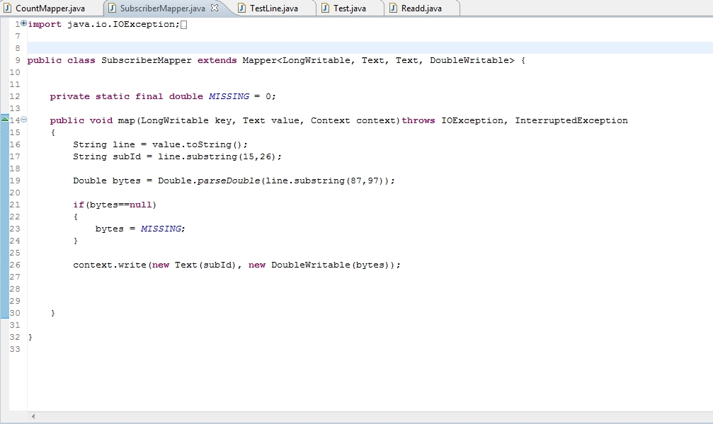
Mapper

Slide 20
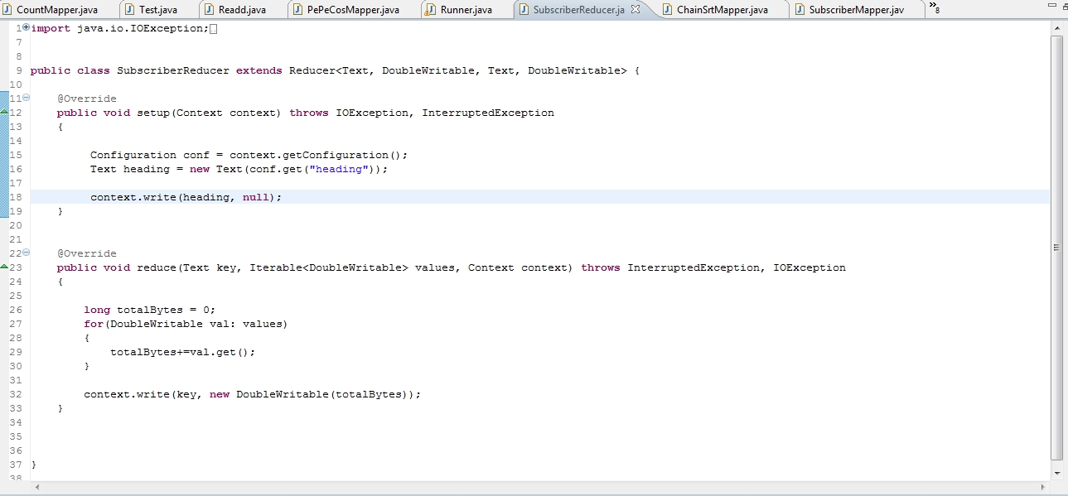
Reducer

Slide 21
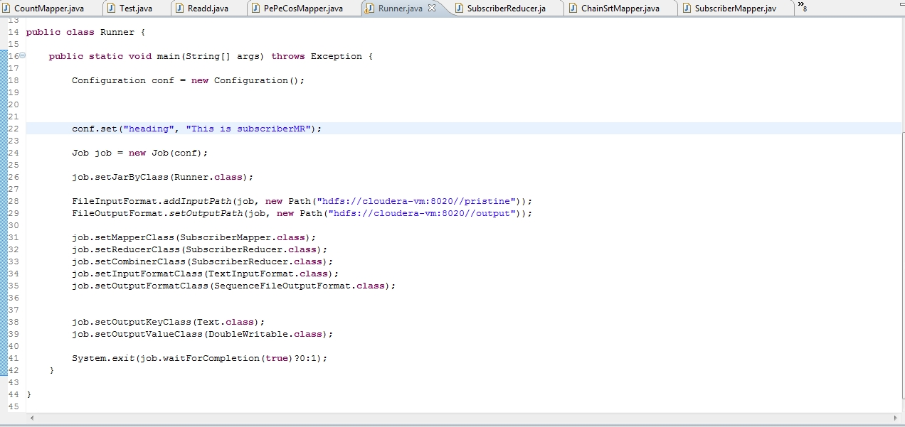
Main Class

Slide 22
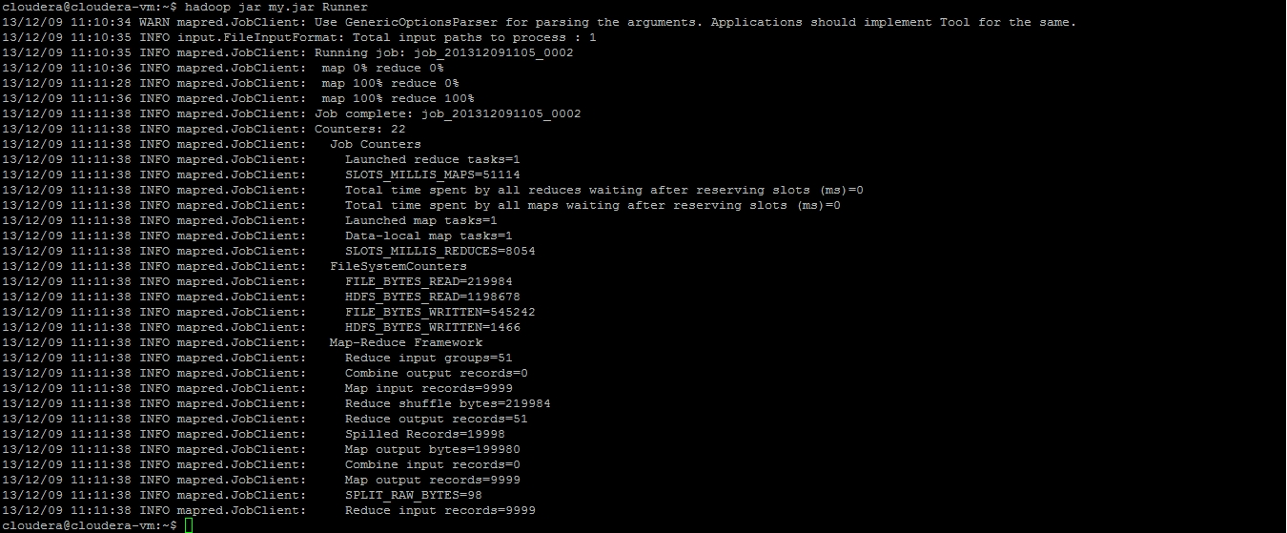
Run Job Command (Hadoop jar “MR.jar” Runner)

Slide 23
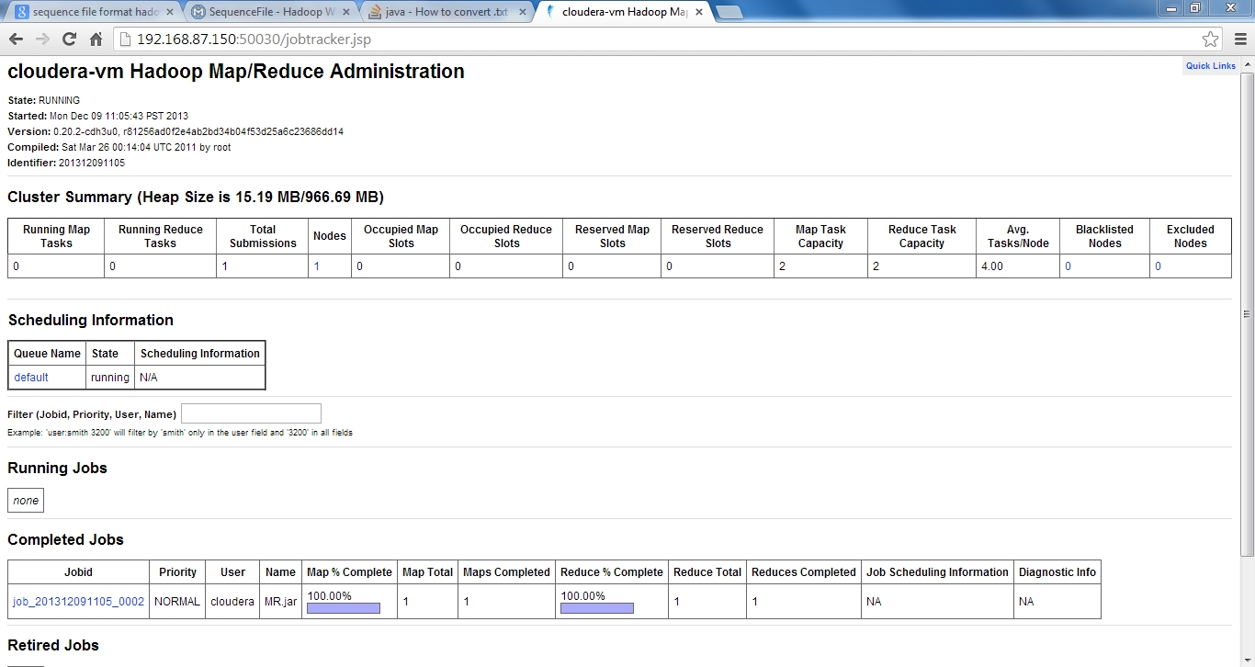
Status can be Checked with WEB GUI IP:50030(URL)

Slide 24
Code Walk Through Subscribermapper
This class extends org.apache.hadoop.mapreduce.Mapper class
The Mapper class has methods cleanup(),map(),setup() and run() that can be overridden by the child class
Framework first calls startup , map and then cleanup
In SubscriberMapper class the map() method is overridden.
Typically with TextInputFormat the input key for Mapper function is offset bytes for each line. This is not needed for further processing so we can ignore this field
Input value for Mapper function is Text which is string representation of each line.
We can extract subscriber id and their corresponding bytes using substring.
The output key value pair is subscriber id <LongWritable> and corresponding bytes <DoubleWritable>
The output is written in Mapper context which can be retrieved by Reducer

Slide 25
Subscriber Reducer
This class extends org.apache.hadoop.mapreduce.Reducer
The Reducer class also has methods setup(), cleanup() and reduce methods which can be overridden
Framework first calls startup(), reduce() and then cleanup()
In SubscriberReducer reduce() method is overridden
The input key value pair of reducer are output of SubscriberMapper. Hence, <subscriberid, bytes> LongWritable and Iterable of DoubleWritable are input for reducer
The output key is subscriber Id
The output value i.e., total bytes for each subscriber is calculated by applying aggregate function on the bytes

Slide 26
Runner Class
org.apache.hadoop.conf.Configuration -> The hadoop configuration parameters can be set by making object of Configuration
The Mapper, Reducer, Combiner, InputFormat, OutputFormat need to be set in the main class

Slide 27
Architecture
Split input data into independent chunks
MAP Phase (input/output key value pair)
Shuffling and sorting
Reduce Phase(input/output key value pair)
Compute and storage nodes are same. i.e., MR and HDFS run on same nodes.
Schedule tasks on nodes where data is already present

Slide 28
Title to come
Resource Manager-> YARN combines a central resource manager that reconciles the way applications use Hadoop system resources with node manager agents that monitor the processing operations of individual cluster nodes.
Application master – 1 application master per application(job)-> executes tasks as directed by master.

Slide 29
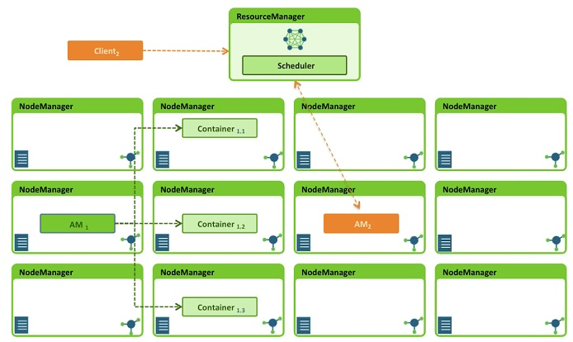
Architecture – Resource Manager
Source: Yarn webinar by Hortonworks
Notes:
Source & URL

Slide 30
Architecture - MapReduce
Client Node
2. Get new application
Resource manager Node
Client JVM
MapReduce Program
1. Run job
JobClient
Resource manager
4. Submit application
3. Copy job resources
8. Allocate resources
5.a Start container
Nodemanager node
Nodemanager
Nodemanager
Start container
9. Launch
6.Initialize
job
5.b Launch
Child JVM
Shared FileSystem (e.g., HDFS)
MRappmaster
Yarn Child
11. Run
7.Retrieve input splits
MapTask
or ReduceTask
10.Retrieve job resources

Slide 31
Status Updation
Client Node
Resource Manager Node
Client JVM
MapReduce Program
Get status
Job
ResourceManager
Node manager node
NodeManager
Nodemanager Node
Shared FileSystem (e.g., HDFS)
Nodemanager
MRappmaster
Task JVM
How status updates are propagated
Yarn Child
MapTask
or ReduceTask
[Progress or counter updated] statusUpdate

Slide 32
Shuffle and Sort in Map Reduce
Copy phase
“Sort” phase
Reduce phase
Map task
Reduce task
Partition, sort, and spill to disk
Fetch
Map
Buffer in memory
Merge
Reduce
Merge
Merge on disk
Merge
Output
Input split
Partitions
Mixture of in-memory and on-disk data
Other maps
Other reduces

Slide 33
Features
Process data in-parallel on a cluster of nodes
Fault tolerant
Commodity hardware

Slide 34
Implementation
Applications specify input/output location, MR functions, job parameters (job configuration)
Hadoop job client submits the job(jar/executable).
Resource manager now takes the responsibility of distributing software, monitoring and scheduling tasks.

Slide 35
How Many Maps?
The total number of maps required to run a job depends on the size of data to be processed. i.e., total number of blocks of input files
If the input file is of the size 1000Mbytes and typically block size is 128 Mbytes, the number of mappers will be 8

Slide 36
How Many Reduces?
The number of reduces is approximately 0.95 or 1.75*(<numofnodes>*mapred.tasktracker.reduce.tasks.maximum)
Increasing the number of reduces increases the framework overhead, but the load balancing improves
The scaling factor is not kept a whole number to reserve slots for failed tasks

Slide 37
Data Flow with Single Reducer
Input HDFS
Map
Sort
Split 0
Copy
Output HDFS
Merge
Map
Reduce
Split 1
Part 0
HDFS Replication
Map
Split 2

Slide 38
Data Flow with Multiple Reducers
Input HDFS
Map
Sort
Split 0
Copy
Output HDFS
Merge
Reduce
Part 0
HDFS Replication
Map
Split 1
Merge
Reduce
Part 1
HDFS Replication
Map
Split 2

Slide 39
Data Flow with No Reducer
Input HDFS
Output HDFS
Map
Split 0
Part 0
HDFS Replication
Map
Split 1
Part 1
HDFS Replication
Map
Split 2
Part 2
HDFS Replication

Slide 40
No Reducer
It is possible to set no reducer, if reduce phase is not required
In this case the outputs of map tasks go directly to filesystem, in the path specified by setOutputPath(Path)

Slide 41
Partitioner
Controls the partioning of the keys of intermediate map-outputs. The key is used to derive the partition, typically by hashfunction
Total number of partitions is same as number of reduce tasks for the job
Controls which intermediate key and hence record is sent to which reduce task for reduction

Slide 42
Serialization / Deserialization

Slide 43
Serialization / Deserialization
Serialization: Process of turning objects into stream of bytes for transmission across network or for writing into some storage(e.g., disk). Hadoop uses it’s own format Writables which are compact and fast
Deserialzaton: Reverse of serialization turning byte stream back into objects

Slide 44
Writable
Defines methods for writing its state to DataOutput binary stream, and for reading its state from DataInput binary stream

Slide 45
Title to come
Primitives
Others
BooleanWritable
NullWritable
ByteWritable
Text
IntWritable
BytesWritable
<<interface>> Writable org.apache.hadoop.io
<<interface>> WritableComparable
VlntWritable
MD5Hash
FloatWritable
ObjectWritable
LongWritable
GenericWritable
VLongWritable
ArrayWritable
DoubleWritable
TwoDArrayWritable
AbstractMapWritable
MapWritable
SortedMapWritable

Slide 46
Properties of Writable Wrappers for Primitives
All have a get() and a set() method for retrieving and sorting the wrapped value

Slide 47
org.apache.hadoop.mapreduce.Job
The job submitter’s view of the Job
It allows user to configure job, submit it and query the state
Parameters like job name, input/output path, Mapper, Reducer, priority etc can be set

Slide 48
Task Execution
Tasktracker executes MR task as separate child process in a separate JVM

Slide 49
Job Submission and Monitoring
Job Client is the interface by which user interacts with Job tracker
Job submission involves
Checking input/output specifications of job
Computing input split values for the job
Setting up accounting information for DistributedCache of the job
Copying the job’s jar and configuration to MR system directory on FileSystem
Submitting job to jobtracker and optionally monitoring it’s status

Slide 50
Job Control
To chain MR jobs so that output of one MR job becomes input to another DistributedCache can be used
The job can be submitted by job.submit

Slide 51
Job Input
InputFormat describes input specification for MR job
It validates input specification of the job
Split up the input file into logical InputSplit instances, each of which can be assigned to an individual Mapper
A lower bound on split size can be set mapred.min.split.size
Default InputFormat is TextInputFormat

Slide 52
FileInputFormat
Base class that uses file as it’s data source
Defines which files are included as input to a job
Implementation for generating splits for the input files

Slide 53
Methods for Setting Jobconf’s Input Paths
Public static void addInputPath(JobConf conf, Path path)
Public static void addInputPaths(JobConf conf, String commaSeparatedPaths)
Public static void setInputPaths(JobConf conf, Path... inputPaths)
Public static void setInputPaths(JobConf conf, String commaSeparatedPaths)
Note: A path represents file/directory/collectionof files/collection of directories

Slide 54
InputFormat Class Hierarchy
CombineFile InputFormat<K,V>
TextInputFormat
<interface> InputFormat<K,V> org.apache.hadoop.mapred
FileInputFormat<K,V>
KeyValueTextInputFormat
StreamInputFormat
NLineInputFormat
SequenceFile InputFormat<K,V>
SequenceFileAsBinary InputFormat
SequenceFileAsText InputFormat
<interface> Composable InputFormat<K,V>
CompositeInputFormat <K,V>
SequenceFile InputFilter<K,V>
DBInputFormat<T>
Empty InputFormat<K,V>

Slide 55
How Does FileInputFormat Split?
Splits only files larger than HDFS block size
Applications can set a minimum split size also: by setting mapred.min.split.size this value larger than block size

Slide 56
CombineFileInputFormat
MR framework optimizes mappers and reducers when files are large. However for cases where there are large number of small files the performance degrades
CombineInputFormat alleviates the above problem by packing many files into each split, so that each mapper has more to process
The best solution is always to keep small number of large files. This can be done my merging files using SequenceFile: keys file names and values file contents

Slide 57
Preventing Splitting
Can be needed when a single mapper is needed to process single file entirely
E.g., to check if records in a file are sorted
Can be done by setting minimum split size as the largest Long value, or by overriding isSplittable in FileInputFormat as false

Slide 58
TextInputFormat
Default input format
Key LongWritable, byte offset within file of the beginning of line
Value is content of line, packaged as Text Object

Slide 59
KeyValueTextInputFormat
To interpret files where each line in a file is in key value format

Slide 60
SequenceFileInputFormat
Stores sequence of binary key value pairs
If sequence file has IntWritable Keys and Text values, then Map signature will be <IntWritable, Text, K,V> where K and V are types of the map’s output keys and values

Slide 61
Output Format

Slide 62
OutputFormat Class Hierarchy
TextOutputFormat<K,V>
<interface> OutputFormat<K,V> org.apache.hadoop.mapred
FileOutputFormat<K,V>
SequenceFile OutputFormat<K,V>
SequenceFileAsBinary OutputFormat
MapFileOutputFormat
MultipleOutputFormat <K,V>
MultipleTextOutputFormat <K,V>
MultipleSequenceFile OutputFormat<K,V>
NullOutputFormat<K,V>
DBOutputFormat<K,V>
FilterOutputFormat<K,V>
LazyOutputFormat<K,V>

Slide 63
Text Output
Default output format
Writes records as lines of text

Slide 64
SequenceFileOutputFormat
Writes sequence files for its output
Can be used if the output is further input for chained job

Slide 65
Exercise
Use the output of case study 1 and sort the subscribers based on their data usage
What would be the key value pair if we want to calculate the occurrence of the words in the file (e.g., if the file has content “The brown fox jumped over the brown tree”) “The” and “brown” appears twice, others have 1 occurrence

Slide 66
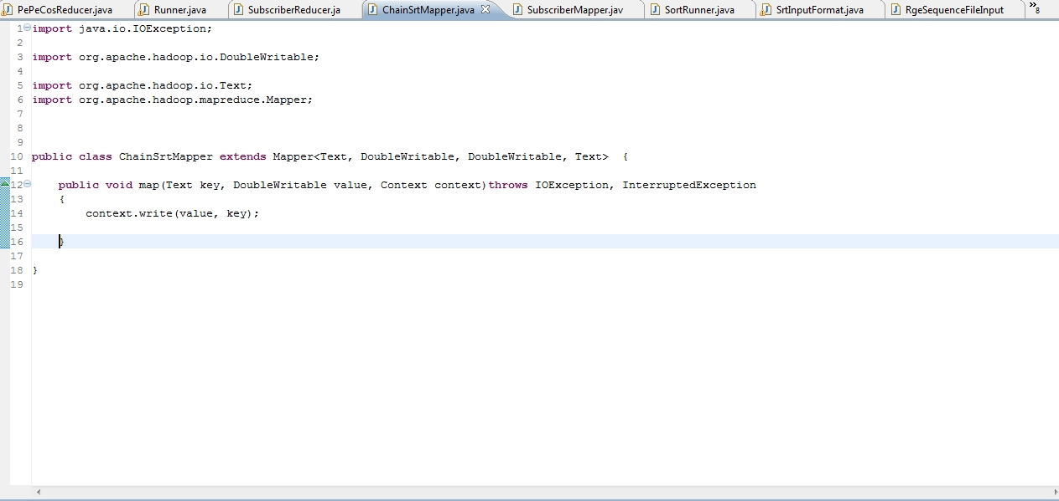
Solution 1

Slide 67
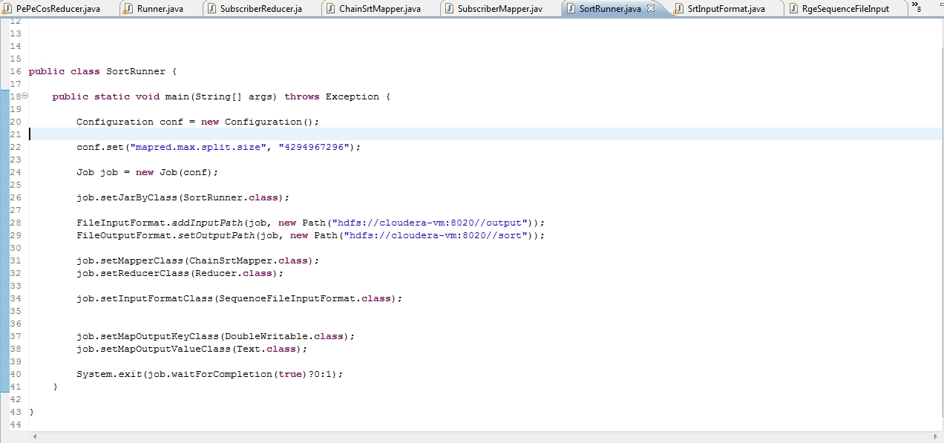
Solution 1

Slide 68
EduPristine 702, Raaj Chambers, Old Nagardas Road, Andheri (E), Mumbai-400 069. INDIA www.edupristine.com Ph. +91 22 3215 6191

