Slide 1

Kafka
Krunal Sabnis

Slide 2
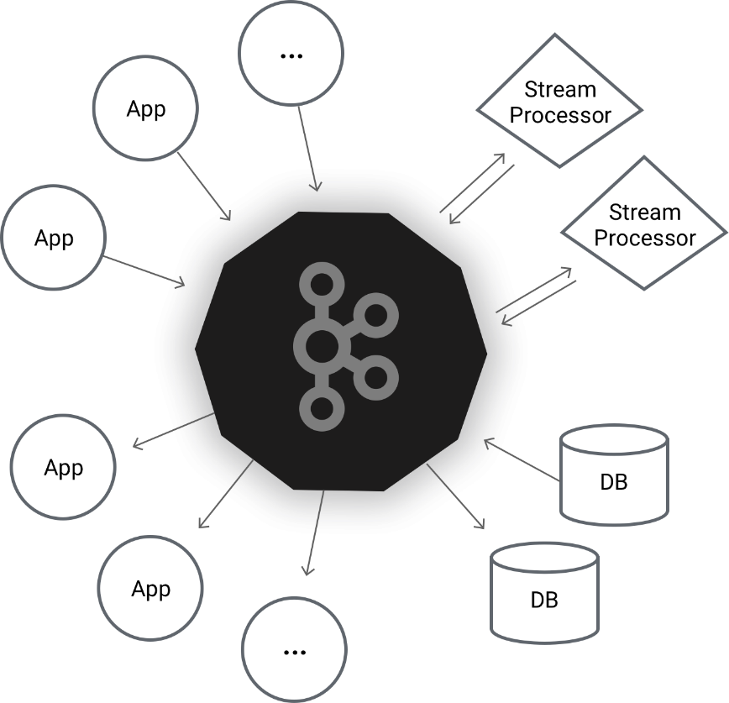
Kafka a distributed streaming platform
Introduction to Kafka
Distributed publish-subscribe messaging system
Designed to be fast, scalable, and durable.
Very simple - at a high level
- Incredible depth of technical details deep inside
Kafka is used for building real-time data pipelines and streaming apps.
It is horizontally scalable, fault-tolerant, wicked fast, and runs in production in thousands of companies.

Slide 3
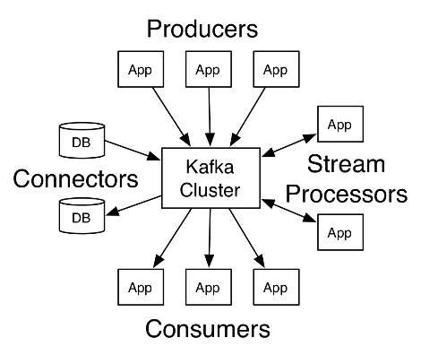
Architecture
Kafka runs as a cluster on server/s.
Streams of records in topics.
Kafka record = [key, value, timestamp]
Very simple - at a high level

Slide 4
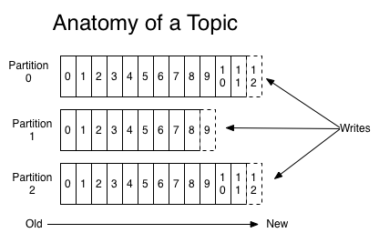
Topics and Logs
Topic
Partitions
Offsets
Retentions
Partition is replicated across a configurable number of servers for fault tolerance.
It is horizontally scalable, fault-tolerant, wicked fast, and runs in production in thousands of companies.
The partitions of the log are distributed over the servers in the Kafka cluster with each server handling data and requests for a share of the partitions.

Slide 5
Distribution
The partitions of the log are distributed over the servers in the Kafka cluster
Each server handling data and requests for a share of the partitions.
Each partition is replicated across a configurable number of servers for fault tolerance.
Each partition has one server which acts as the "leader" and zero or more servers which act as "followers".
The leader handles all read and write requests for the partition while the followers passively replicate the leader. If the leader fails, one of the followers will automatically become the new leader. Each server acts as a leader for some of its partitions and a follower for others so load is well balanced within the cluster.
Producers
Producers publish data to the topics of their choice.
The producer is responsible for choosing which record to assign to which partition within the topic.
This can be done in a round-robin fashion simply to balance load or it can be done according to some semantic partition function (say based on some key in the record). More on the use of partitioning in a second!

Slide 6
Kafka Guarantees
Messages sent by a producer to a particular topic partition will be appended in the order they are sent.
That is, if a record M1 is sent by the same producer as a record M2, and M1 is sent first, then M1 will have a lower offset than M2 and appear earlier in the log.
A consumer instance sees records in the order they are stored in the log.
For a topic with replication factor N, we will tolerate up to N-1 server failures without losing any records committed to the log.

Slide 7
Consumers
Consumers label themselves with a consumer group name, and each record published to a topic is delivered to one consumer instance within each subscribing consumer group. Consumer instances can be in separate processes or on separate machines.
Producers
Producers publish data to the topics of their choice.
The producer is responsible for choosing which record to assign to which partition within the topic.
This can be done in a round-robin fashion simply to balance load or it can be done according to some semantic partition function (say based on some key in the record). More on the use of partitioning in a second!

Slide 8
APIs
Kafka has four core APIs
Producer API
Consumer API
Streams API
Connector API
Programming languages – Java + more
Protocol - TCP
Kafka™ is used for building real-time data pipelines and streaming apps.
It is horizontally scalable, fault-tolerant, wicked fast, and runs in production in thousands of companies.

Slide 9
Kafka as a Messaging System
Kafka as a Storage System
Kafka for Stream Processing
Example : A retail application might take in input streams of sales and shipments, and output a stream of reorders and price adjustments computed off this data.

Slide 10
Lets Try Kafka !
CLI
kafka-topics --list --zookeeper localhost:2181/kafka
kafka-topics --create --zookeeper localhost:2181/kafka --replication-factor 1 --partitions 1 --topic DBS_TOPIC
kafka-console-consumer --zookeeper localhost:2181/kafka --topic DBS_TOPIC
kafka-console-producer --broker-list localhost:9092 --topic DBS_TOPIC

Slide 11
https://kafka.apache.org

