Slide 1
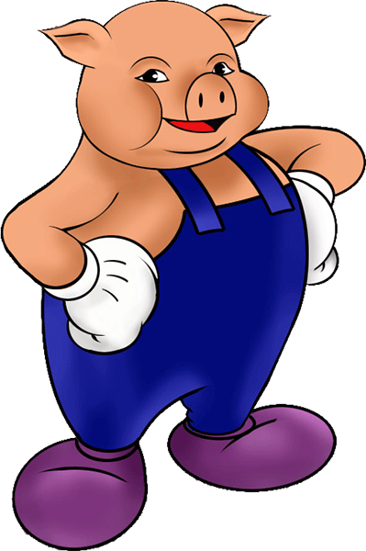
Apache Pig

Slide 2
Assignment For Practice
MOST OCCURED START LETTER:
Pig Way …

Slide 3
PIG Use Case
Load text into a bag (named ‘lines’)
Tokenize the text in the ‘lines’ bag
Retain first letter of each token
Group by letter
Count the number of occurrences in each group
Descending order the group by the count
Grab the first element => Most occurring letter
Persist result on a file system
1
2
3
4
5
6
7
8

Slide 4
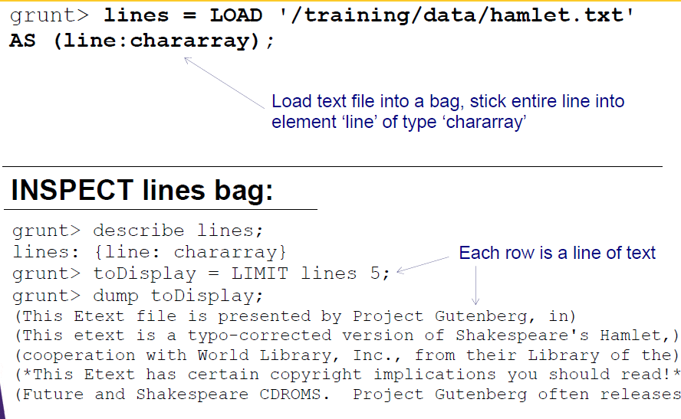
Step 1: LOAD text in to BAG

Slide 5
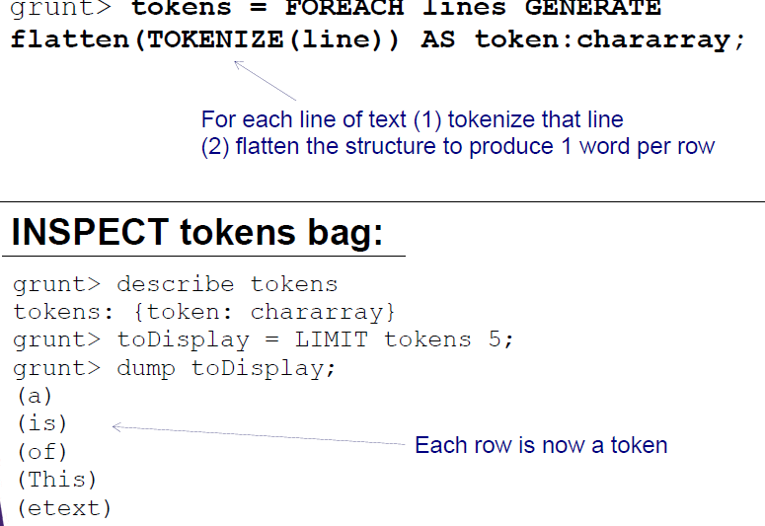
Step 2: Tokenize the text in the ‘Lines’ Bag

Slide 6
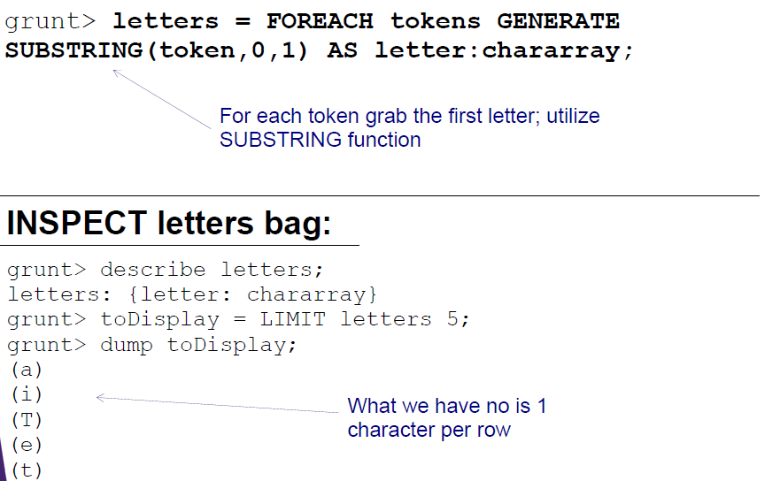
Step 3: Retain First Letter Of Each Token

Slide 7
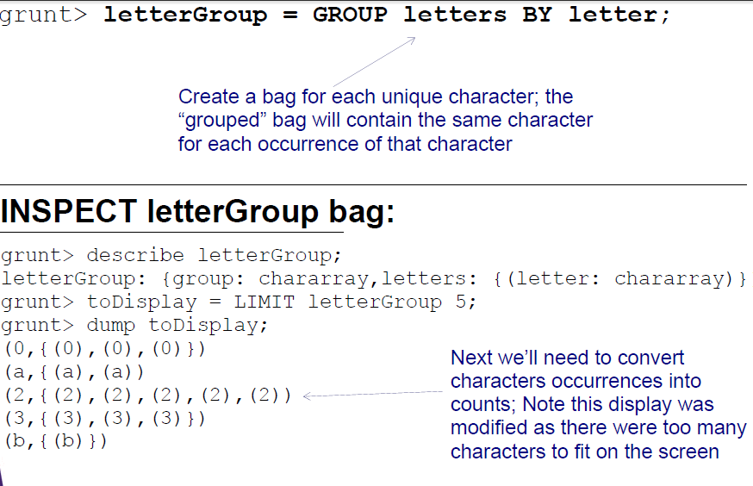
Step 4: Group up letters

Slide 8
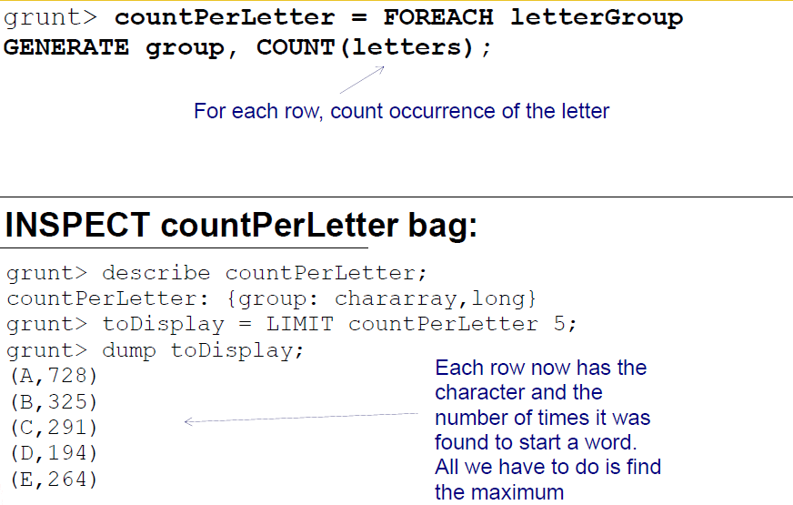
Step 5: Count The No Of Occurrence In Each Group

Slide 9
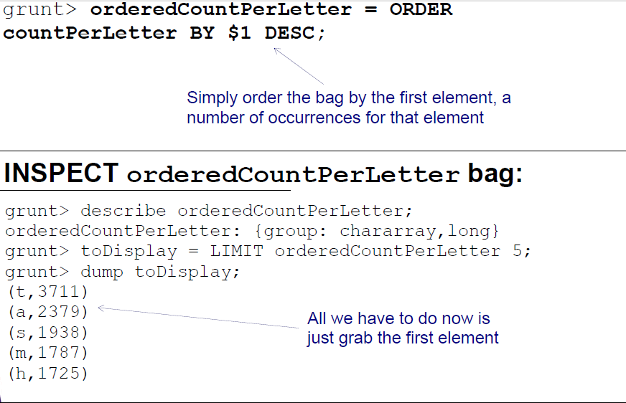
Step 6: Descending Order Of The Group By Count
♦

Slide 10
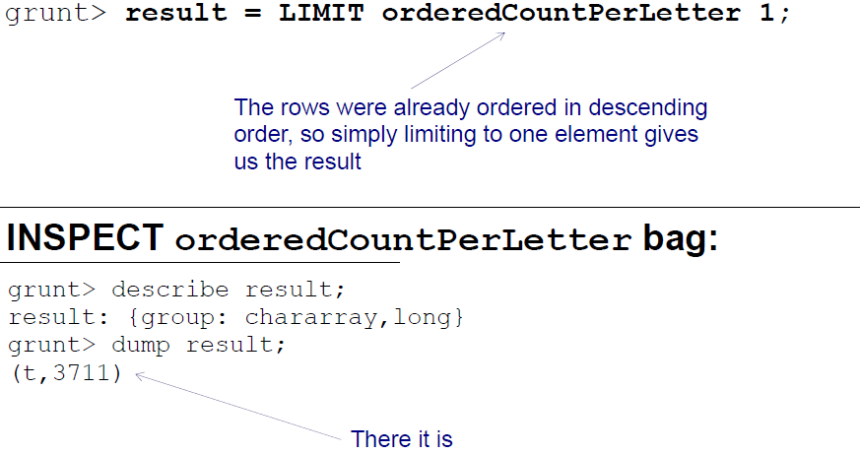
Step 7: Grab The First Element
♦

Slide 11
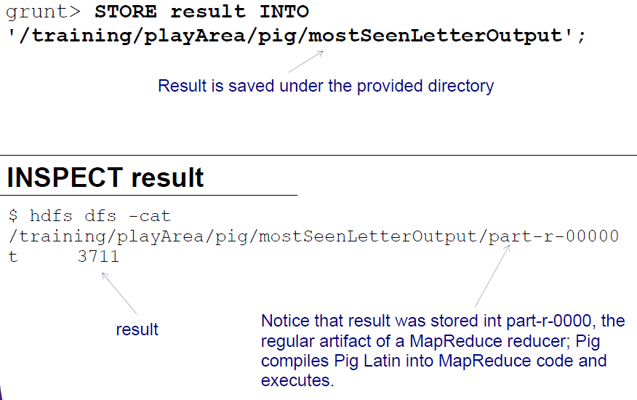
Step 8: Persist The Result
♦♦♦

