Slide 1

Sqoop
Data Imports
Data Exports
Integration with Hadoop Ecosystem

Slide 2
SQOOP…
Overview
Why Sqoop so popular
How to get it working
Work-flow
Rdbms-Hdfs-Hive

Slide 3
SQOOP…
Prerequisite
Mysql db which is available and db user has all privilege rights
The db should have at least one table with few rows in it – preferable close to 100 to be able to see the no of mappers kicking in
Internet access on system or Keep the sqoop tar downloaded from apache location
MySQL - Installation
http://dev.mysql.com/downloads/mysql/
32 Bit OR 64 bit based on Windows version can be downloaded from here
You will have an MSI file downloaded .

Slide 4
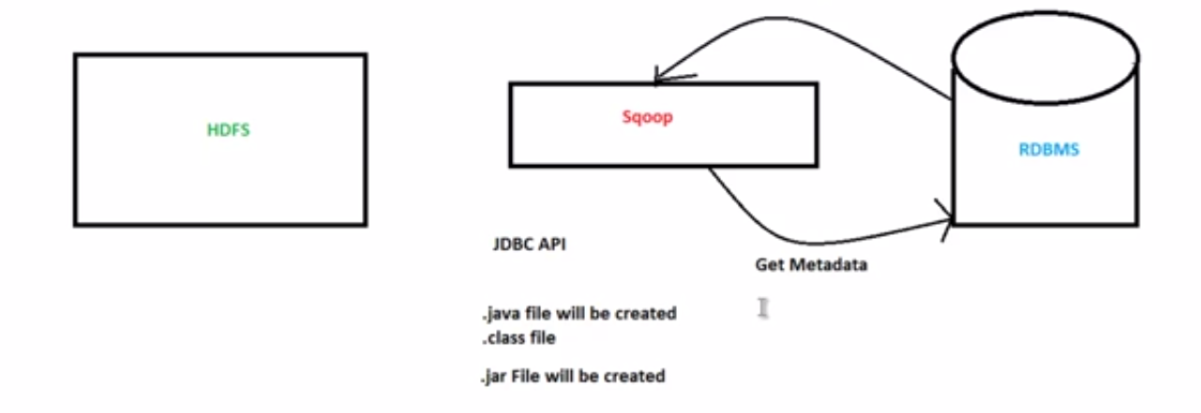
SQOOP…
Sqoop is used widely in industry as it is going to be your first apache product from the minute you have decided to move from relational DB to Hadoop ecosystem
Working

Slide 5
SQOOP…
Working in Step By Step:
Step 1:Sqoop send the request to Relational DB to send the return the meta data information about the table(Metadata here is the data about the table in relational DB)
Step 2: From the received information it will generate the java classes (Reason why you should have java configured before get it working-Sqoop internally uses jdbc API to generate data).
Step 3:Now sqoop (As its written in java –tries to package the compiled classes to be able to generate table structure) , post compiling creates jar file(Java packaging standard)

Slide 6
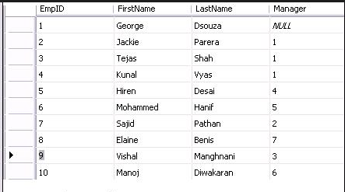
SQOOP…
Lets Dive in:
Say you had a table like
Now you have decided that you do not like relational structure any more as you expect this table to grow really-really large hence you want this to get moved to Hadoop ecosystem and get rid of licensing
PS: sqoop needs to have primary key t work best – but no worries if your table structure inherently doens’t have it , it will create that for you but without affecting your table metadata structure

Slide 7
SQOOP…
Internal Workflow:
Sqoop asks fro meta data information from Relation DB
Relational DB returns the required request
Based on meta data information sqoop generates java classes
Based on primary id partitioning happens in table as multiple mappers will importing data as the same time
Lets understand this line in more detail as this is crux of why sqoop works faster than any other importing technique and how come mapper comes in to picture

Slide 8
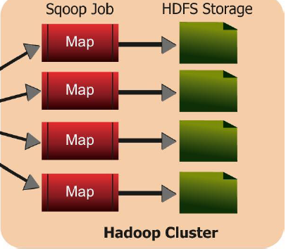
SQOOP…
1
2
3
4
This image is symbolic and of course you do not need 4 mappers to just import a row size of 10 and sqoop is intelligent enough to decide on optimum number of mappers required for the job

Slide 9
SQOOP…
Lets Understand it in terms of what would have happened technically
Sqoop fires and import request
Internally what it needs to know is what is min and max primary key value is in there
Select min(emp_id) as min_value ,max(emp_id) as max_value from employee
And then for each mapper
Select * from employee where emp_id between min_value and max_value(Scope of each mapper)

Slide 10
SQOOP…
Example: Where relation DB is present
sqoop import \
--connect jdbc:mysql://<ip address>\<database name>
--table <mysql_table name>
--username <username_for_mysql_user> --password <Password>
-m <number of mappers to run>
--target-dir <target directory where we need copied data>
If you do not want sqoop to decide on your behalf
Double “–” because its subcommand of import

Slide 11
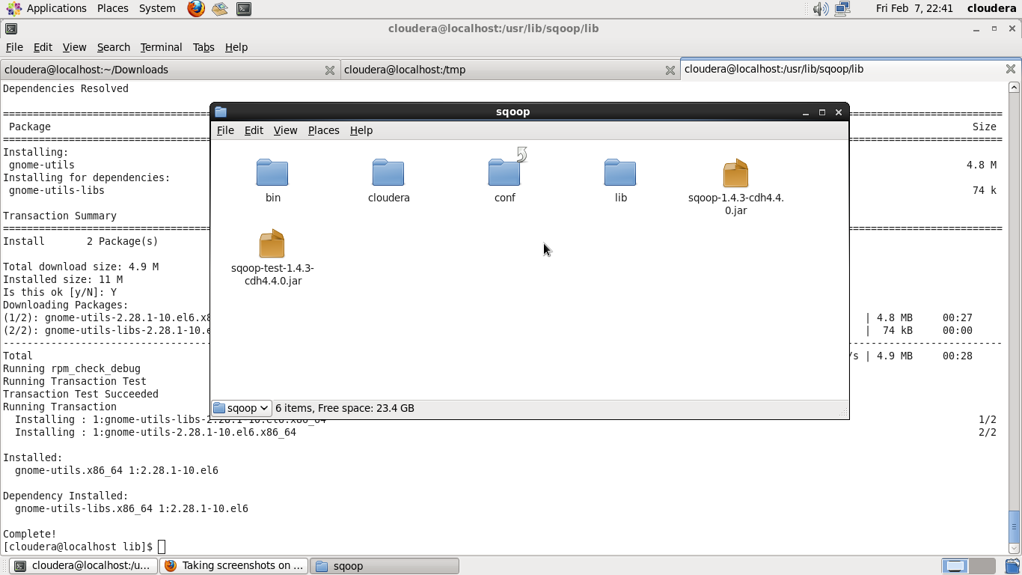
SQOOP…
Now how to setup Sqoop and see it working
Write sqoop.apache.org on google and you should be able to get it
Download and extract it at a convenient location This is how its going to look like post extraction

Slide 12
SQOOP…
Write sqoop on the terminal after adding the sqoop to PATH variable
Your system might complain for HADOOP_COMMON_HOME,HADOOP_MAPRED_HOME ,HIVE_HOME,HBASE_HOME,HCAT_HOME . You could set all of it at once in sqoop-env-template.sh
You will find this file in conf folder else search for this by firing command
Find –iname sqoop-env*.sh (On Ubuntu-lnux)
Download connector for your DB (mysql , oracle,Teradata,DB2 etc) and place it in lib folder
Also copy sqljdbcx.jar (replace x with version no) in lib as well

Slide 13
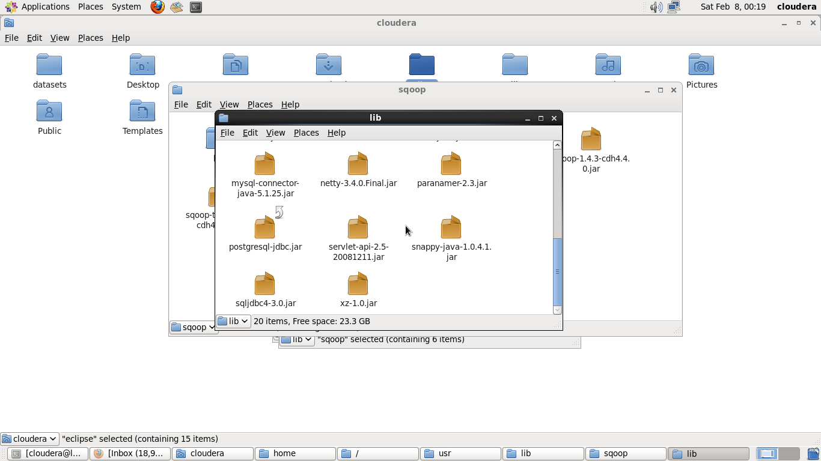
SQOOP…
Typically your sqoop lib folder will have these
Mysql Connector
Connector
Jdbc –sql link
Sql-jdbc connector

Slide 14
Sqoop
An Open Source Tool used for Data Interaction between traditional RDBMs and Hadoop Environment.
Using Sqoop, Data can be moved into HDFS/hive/hbase from MySQL/ PostgreSQL/Oracle/SQL Server/DB2 and vive versa.
This import of data takes into distributed processing power of hadoop making it faster

Slide 15
Starting Sqoop
Sqoop is a command line tool with following structure
sqoop TOOL PROPERTY_ARGS SQOOP_ARGS [-- EXTRA_ARGS]
TOOL indicates the operation eg: “import”, “export”.
PROPERTY_ARGS are Java properties in the format “-Dname=value”
SQOOP_ARGS mention various Sqoop parameters
EXTRA_ARGS are for specialized connectors, separated from the SQOOP_ARGS with a “--”
E.g.:
% sqoop import --connect jdbc:mysql://localhost/hadoopguide --table widgets -m 1

Slide 16
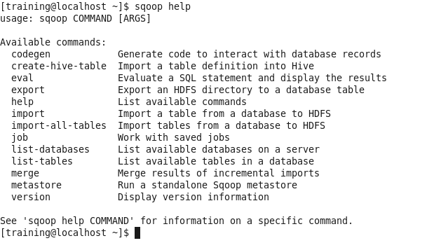
Starting Sqoop
Type “sqoop help” to get all the tools available:

Slide 17
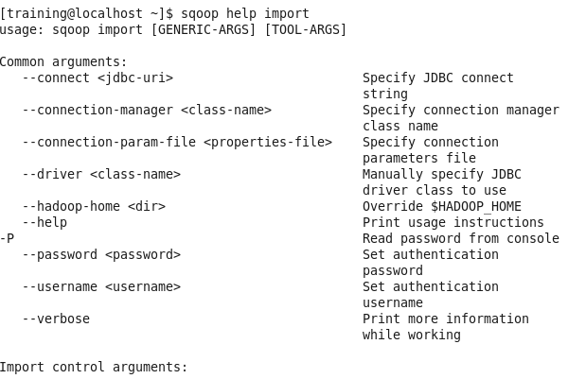
Starting Sqoop
For information on specific Sqoop tool, type “sqoop help TOOL”
Lets start by exploring import tool using SQL databases.

Slide 18
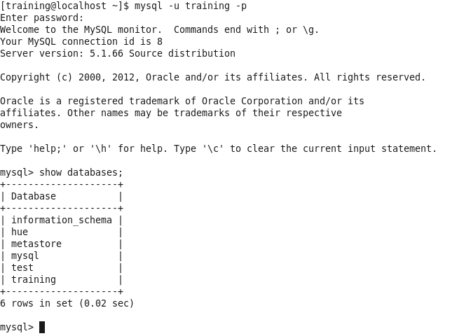
MySQL
We have MySql installed in our Vm image and certain tables already present in various databases. First we will take a look at these data sets and finally play with various data sets
Logging into MySQL
$ mysql -u training -p
mysql> show databases;

Slide 19
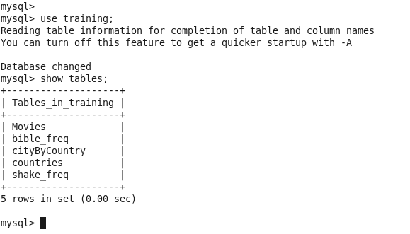
MySQL
Listing of tables
mysql> use training;
Mysql> show tables;

Slide 20
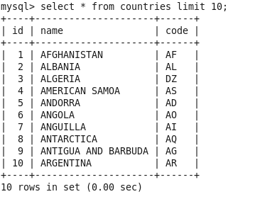
MySQL
Listing of table contents
mysql> select * from table_name limit 10
Now lets import this complete table into our HDFS and view its contents

Slide 21
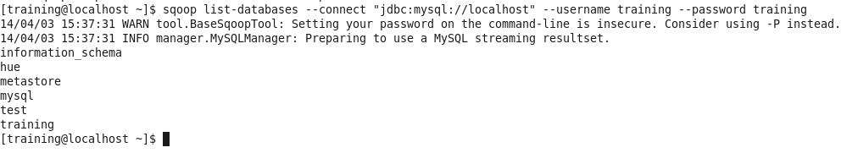
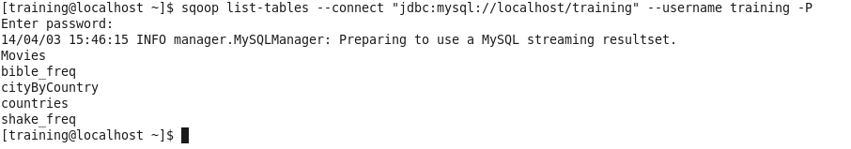
Tools
Lets list all databases present on a mysql server using a “list-databases” tool.
(Note : for more information on list-databases, type “$ sqoop help list-databases”)
$ sqoop list-databases --connect “jdbc:mysql://localhost” --username training --password training
Similarly for listing tables,
$ sqoop list-tables --connect “jdbc:mysql://localhost/training” --username training -P
( Note: Another safe method of mentioning password will be discussed later )

Slide 22
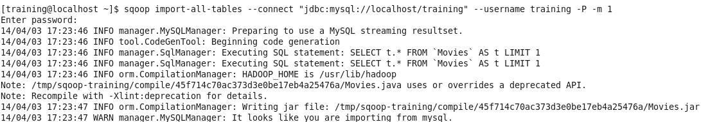
Tools
“import-all-tables” imports all the tables present in the database mentioned.
$ sqoop import-all-tables --connect "jdbc:mysql://localhost/training" --username training -P -m 1
Here -m 1 specifies one mapper for each table. All the tables are downloaded in default directory.

Slide 23
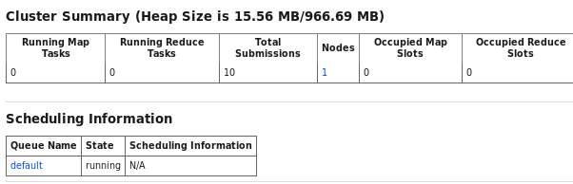
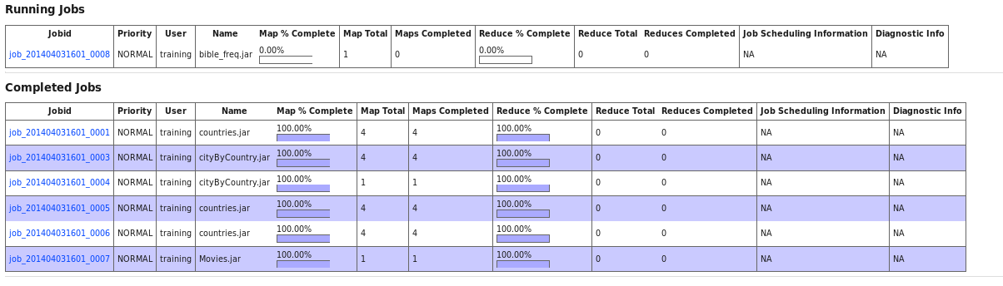
Tools
JobTracker Status

Slide 24
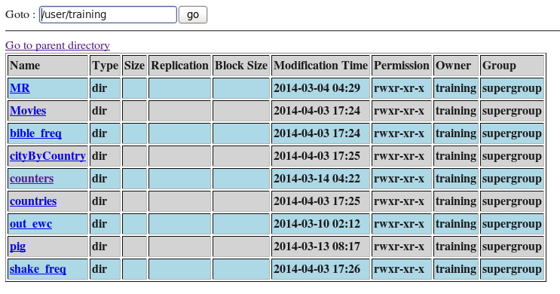
Tools
Namenode
Default location is /user/hadoop_user_name

Slide 25
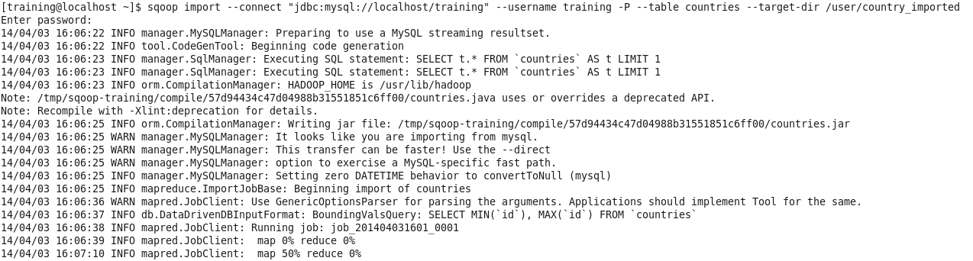
Import
Importing “countries” table into our HDFS environment
$ sqoop import --connect “jdbc:mysql://localhost/training” --username training -P --table countries –target-dir /user/country_imported
(Note: make sure the target directory does not exists already)

Slide 26
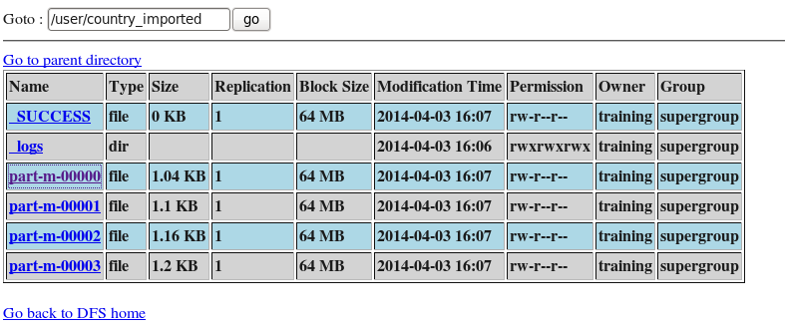
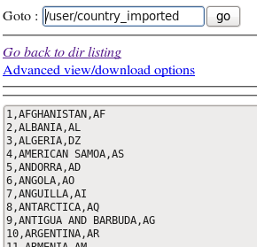
Import
The default number of mappers used is 4. you can change this by appending the command by “-m number_of_mappers”

Slide 27
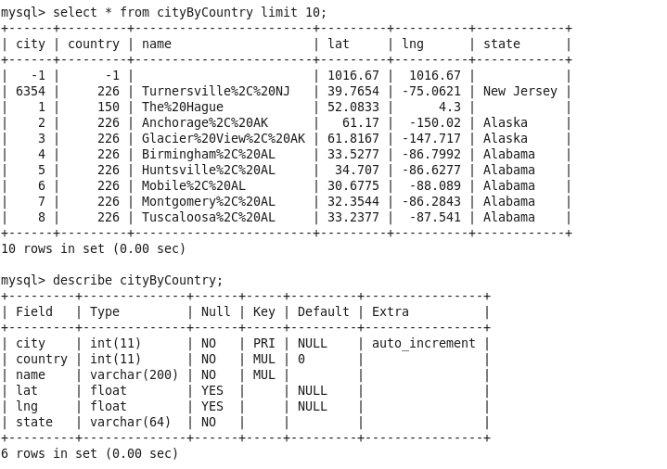
“where” clause
You can place restrictions on data imported by using “where” clause.
Exercise :
Lets import cityByCountry table where state ( 6th column is restricted to “Alaska”)
cityByCountry:

Slide 28
“where” clause
Solution:
sqoop import \
--connect “jdbc:mysql://localhost/training” \
--username training –P \
--table cityByCountry \
--target-dir /user/where_clause \
--where “state = ‘Alaska’” \
-m 1

Slide 29
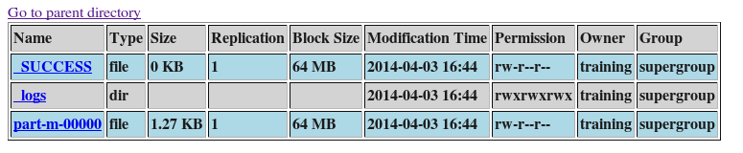
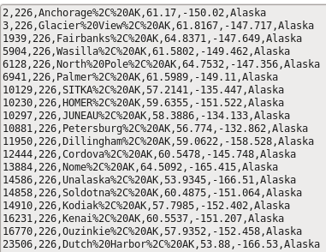
“where” clause - output

Slide 30
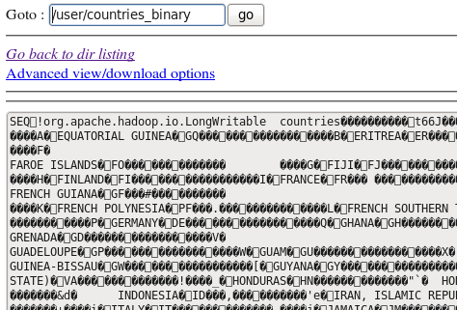
Sequence File
The default output of sqoop is a CSV file ( Notice outputs of previous two outputs ) But you can get a different output format such as binary format :
sqoop import \
--connect “jdbc:mysql://localhost/training” \
--username training –P \
--table countries \
--target-dir /user/country_binary \
--as-sequencefile
Output

Slide 31
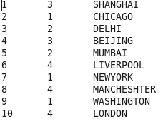
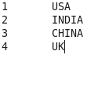
Free-Form Query
Problem: We need to import data from two tables after merging them as per certain constraints and need certain columns from it
Solution: Free form queries
Create two files t1 and t2 as follows t2
t1
Create two tables in mysql and load these tables into them
mysql> create table t1(id int, country_name varchar(20));
mysql> create table t2(number int, id int, city_name varchar(20));

Slide 32
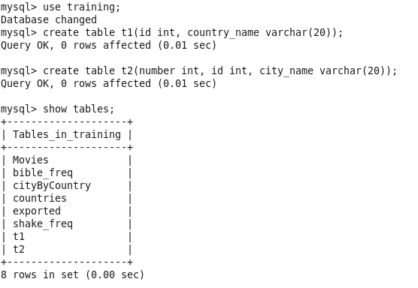
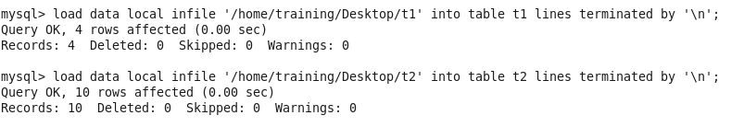
Free-Form Query
Import these data files into created mysql tables.

Slide 33
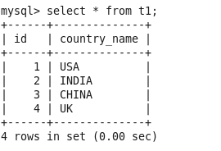
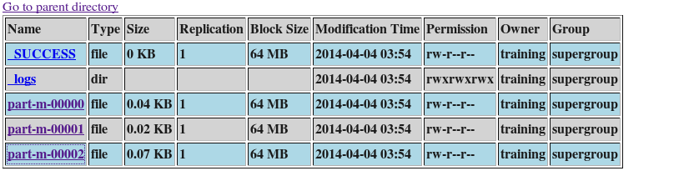
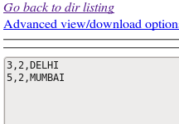
Free-Form Query
Viewing data from created tables.
mysql> select * from t1;
test sqoop query:
sqoop import \
--connect jdbc:mysql://localhost/training \
--username training -P \
--query “select * from t2 where \$CONDITIONS” \
--split-by t2.id
--target-dir /user/simple

Slide 34
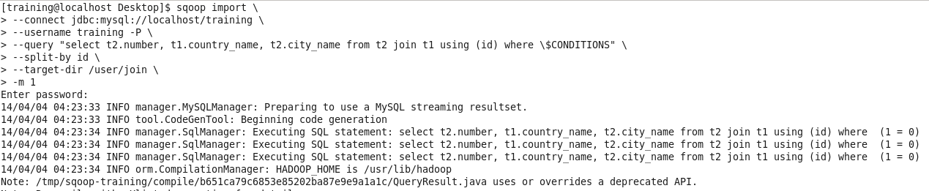
Free-Form Query
Final Code:
sqoop import \
--connect jdbc:mysql://localhost/training \
--username training -P \
--query “select t2.number, t1.country_name, t2.city_name from t2 join t1 using (id) \
Where \$CONDITIONS” \
--split-by id \
--target-dir /user/join \
-m 1

Slide 35
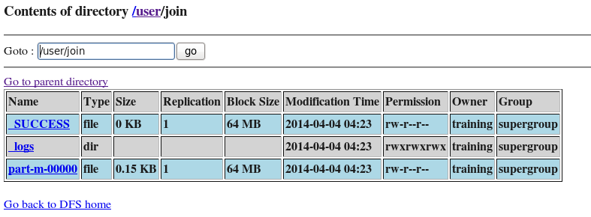
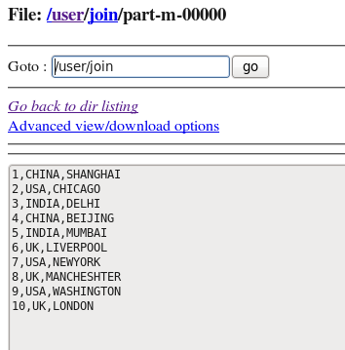
Free-Form Query
Output:

Slide 36
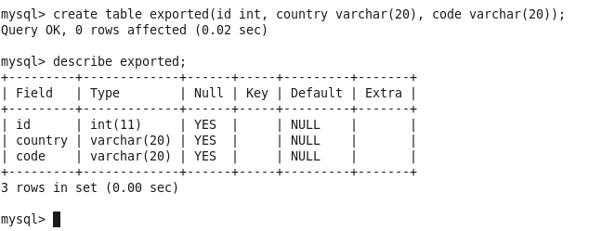
Exports
In previous cases, flow of data was from RDBMs to HDFS. Using “export” tool, we can import data from HDFS to RDBMs.
Before performing export, sqoop fetches table metadata from mysql database. Thus we first need to create a table with required metadata.
Table creation in mysql
mysql>Create table table_name( column_name column_type )

Slide 37
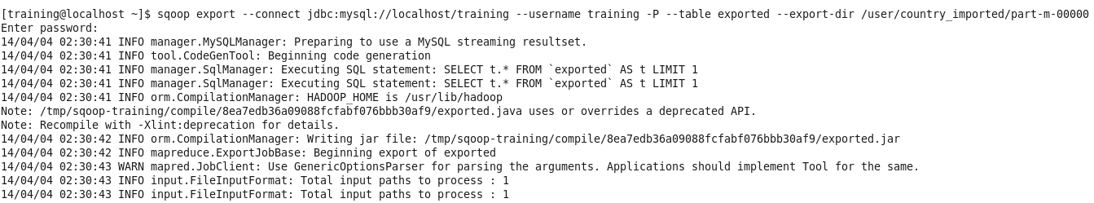
Exports
Sqoop query
sqoop export \
--connect jdbc:mysql://localhost/training \
--username training –P \
--table exported \
--export-dir /user/country_imported/part-m-00000

Slide 38
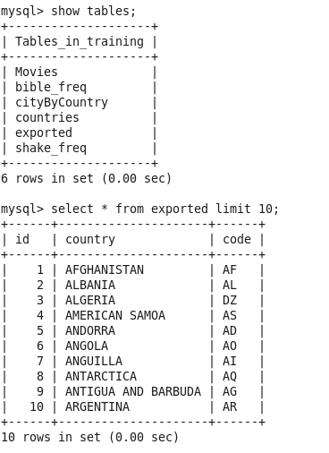
Exports
Viewing output in mysql
mysql> select * from exported

Slide 39
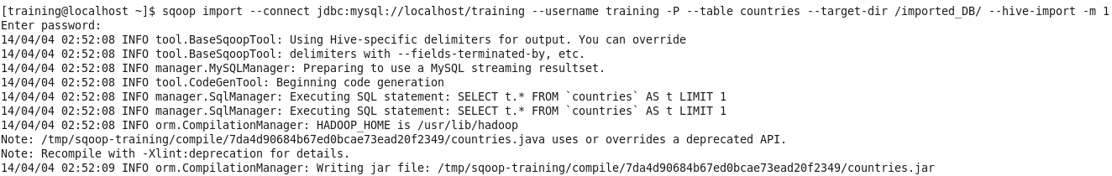
Integration with hadoop ecosystem
Till now data was moved between RDBMS to HDFS. This imported data may further be required to be analysed using hive or hbase.
Sqoop offers property to directly import data to Hive / Hbase.
Just add “--import-hive” at the end of the command.

Slide 40
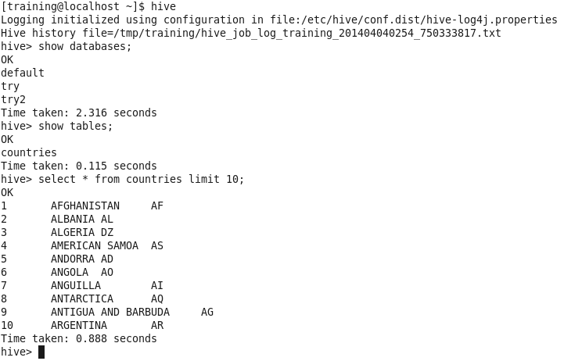
Integration with hadoop ecosystem
Viewing in Hive
table is added in default database .
Similarly sqoop also provides commands to import data into Hbase directly.

Slide 41

ZooKeeper (Because Distributed computing is a Zoo)
What are the problem You are worried about When developing a distributed
System?
Centralized configuration
Synchronization
Serialization
Partial Failures? Deadlocks??
Race conditions
Networking problems
What is Zookeeper? :
It’s a distributed Co-ordination service for distributed
application. It takes care of all the difficulties mentioned above while maintaining a distributed application

Slide 42
ZooKeeper (Because Distributed computing is a Zoo)
What ZooKeeper does?
Handles the nitty-gritty of distributed application development on Hadoop ecosystem so that the developer can focus on functionality.
Goals:
Serialization: Reliability
Atomicity: Simple API (All or nothing)
Uses:
Configuration : Message queues
Notification : Synchronization(Very important use case)

Slide 43
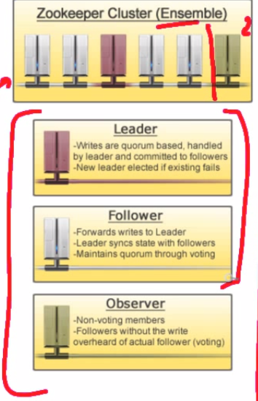
ZooKeeper (Because Distributed computing is a Zoo)
Archtecture: (Physical)
5 Cluster 1 Observer
Always odd number of nodes as the selection is via voting
Only a leader(1) can write and commit to a file (All request eventually come to leader via follower(4))
Selection of leader server among all available is totally random
If leader goes down follower will do the voting process to elect new leader
Observers are just there to observe the result of voters but never take part in voting process

Slide 44
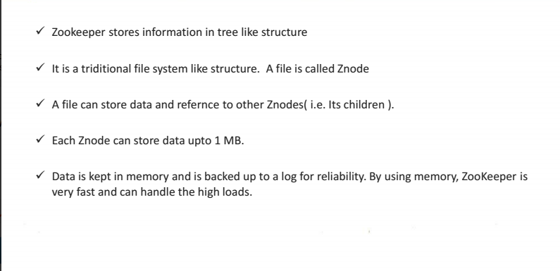
ZooKeeper (Because Distributed computing is a Zoo)
How the data is stored:

Slide 45
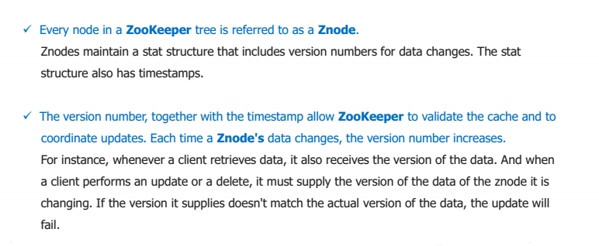
ZooKeeper (Because Distributed computing is a Zoo)
What are Z nodes:

Slide 46
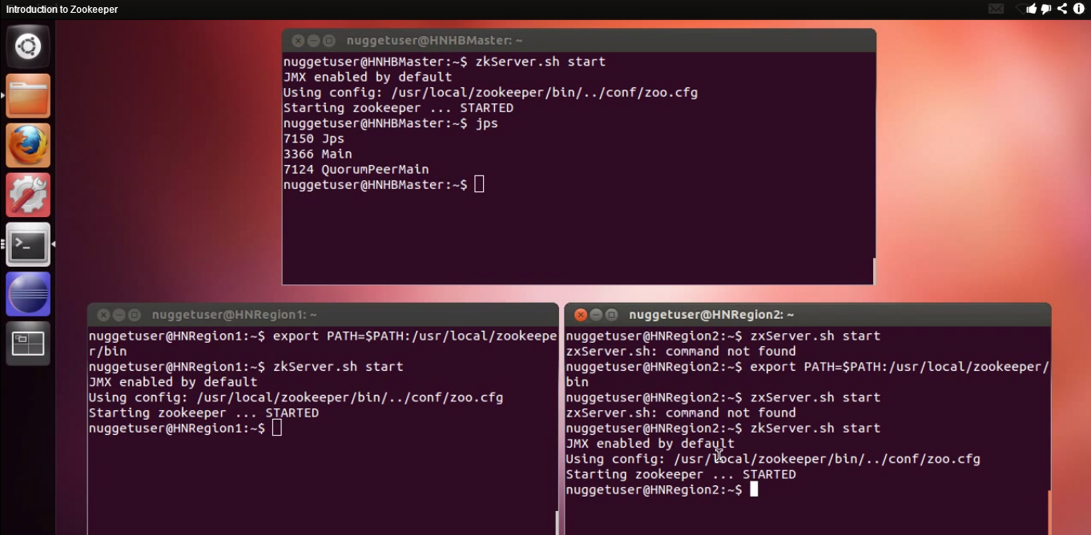
ZooKeeper (Because Distributed computing is a Zoo)
All Three nodes have zoo keeper installed

Slide 47
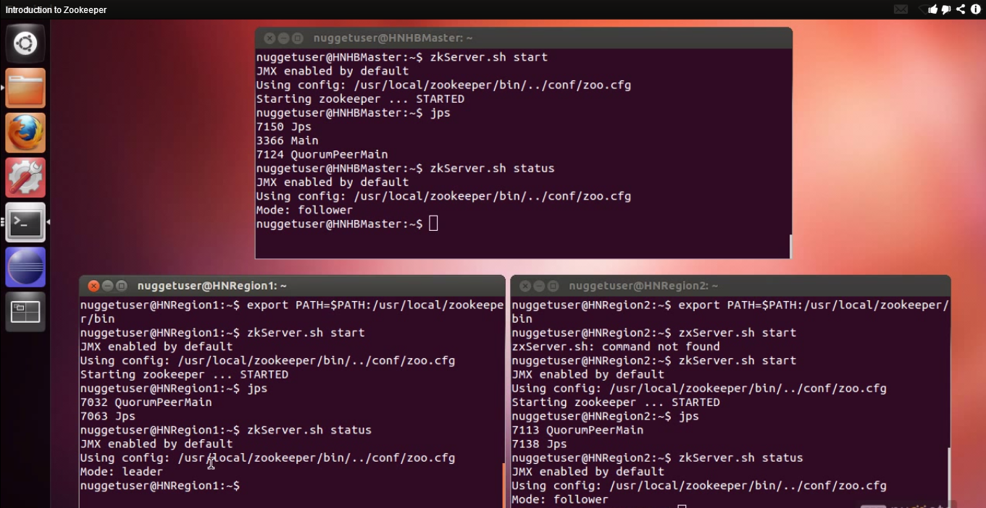
ZooKeeper (Because Distributed computing is a Zoo)
To check among three nodes who is leader and who is follower

Slide 48
ZooKeeper (Because Distributed computing is a Zoo)
If we want to connect to a zookeeper server as a client
zkCli.sh –server HNHBMaster:2181(one of the node name)
Commands we can use post getting connected
Zookeeper help
ls /
To create a new node
Create my_app /somedate (App with some data in it – Same data is accessible to all connected clients and as and when data gets updated – all the clients are informed about it)

Slide 49
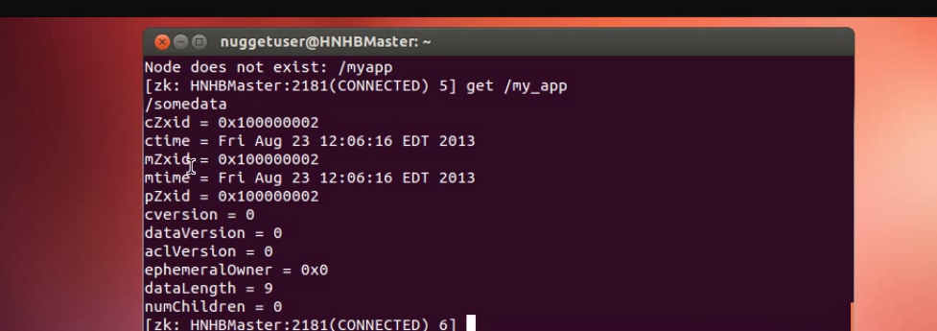
ZooKeeper (Because Distributed computing is a Zoo)
To get the information on just created app
To delete
Delete my_app/
So it’s a central repository for clients to access synchronized data
Common Data

Slide 50
EduPristine 702, Raaj Chambers, Old Nagardas Road, Andheri (E), Mumbai-400 069. INDIA www.edupristine.com Ph. +91 22 3215 6191

