Slide 1
TECHNOLOGY · PROCESS · MATHEMATICS · DIFFERENTIATION
Zero-Degree Belt Technology for TBR
Conventional vs Wavy (Undulating) Construction
Scope: Truck & Bus Radial (all-steel) · process & green-to-cure focus · patent basis 2015–2026 + foundational art
Covers: how waviness is induced · governing mathematics · influencing parameters (A/λ, winding tension, ZD layout, cure-lift) · TBR recommendations
Prepared for internal R&D review · June 2026 · Confidential — engineering working document

Slide 2
Executive Summary — the core thesis
02
Why a wavy 0° belt is a genuine lever, not a gimmick
▪ Problem. A conventional 0° steel cord is essentially inextensible (working strain to 'taut' ≈ 0.2%). It fights the green→cure crown expansion (typ. 0.5–3%), so a true rigid 0° steel belt is hard to build flat / single-stage.
▪ Mechanism. A wavy cord stores length in a wave. It straightens before going taut, giving 1–3% apparent elongation with no strain in the steel — soft during shaping, stiff in service. This is a 'step (bilinear) modulus'.
▪ Governing law. Available elongation ε ≈ π²(A/λ)². The industry's wavy A/λ = 1.5–6% window is exactly what covers TBR cure-lift and restores service rigidity — the ranges fall out of the geometry.
▪ Three constructions compared. (1) Conventional straight 0°, (2) Wavy/undulating 0°, (3) High-elongation (HE) steel cord — a material route to the same soft→stiff behaviour.
BOTTOM LINE FOR TBR
• Target A/λ ≈ 3–5% → ε ≈ 0.9–2.4%
• Apply via servo OSCILLATING head, or
• use HE steel cord (drop-in, low gauge)
• Closed-loop WINDING TENSION control
• Deploy as 0° SHOULDER/EDGE cover to
• cut belt-edge shear → protects bead
• OWN the white space: amplitude-GRADED
• 0° (more wave at shoulder, less centre)
Math verified numerically (arc-length integral); A/λ ranges & elongation specs from cited patents — see slides 4–6 and references (slide 10).

Slide 3
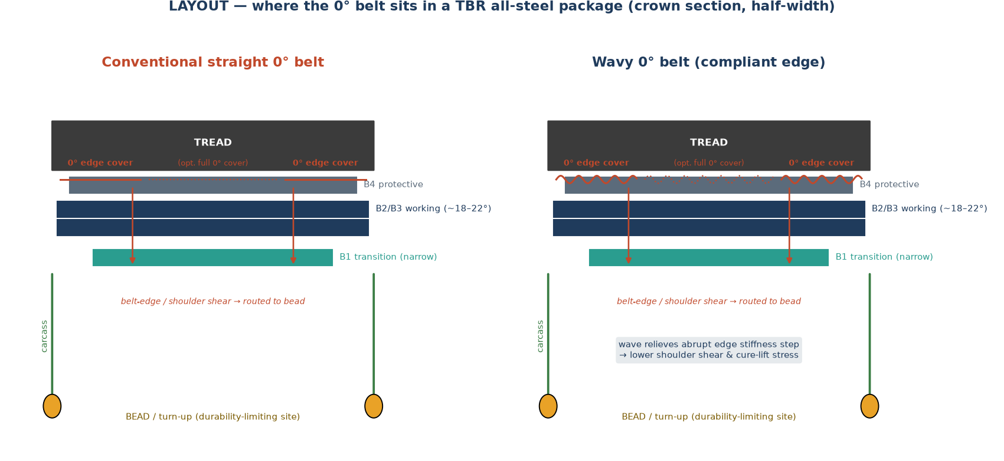
Where the 0° belt sits — and how it reaches the bead
03
TBR all-steel package; 0° as edge cover or full cover
▪ Package. B1 transition, B2/B3 working belts (~18–22°), B4 protective, plus the 0° circumferential layer.
▪ Hoop role. The 0° belt restrains crown radial growth (centrifugal + inflation), keeping the toroid stable at speed.
▪ The catch. A stiff straight 0° creates an abrupt stiffness step at its edge → belt-edge / shoulder shear, which is routed down the carcass to the turn-up end (the TBR durability-limiting site).
▪ Wavy fix. A compliant wavy edge softens that step → lower shoulder shear and lower cure-lift stress, without over-stiffening the crown centre (avoids uneven wear).
Belt-cord circumferential elongation spec 1.0–2.5% @ 100–300 N; 17–30 ends/50 mm (crown-reinforcement disclosures). Layout schematic — indicative.

Slide 4
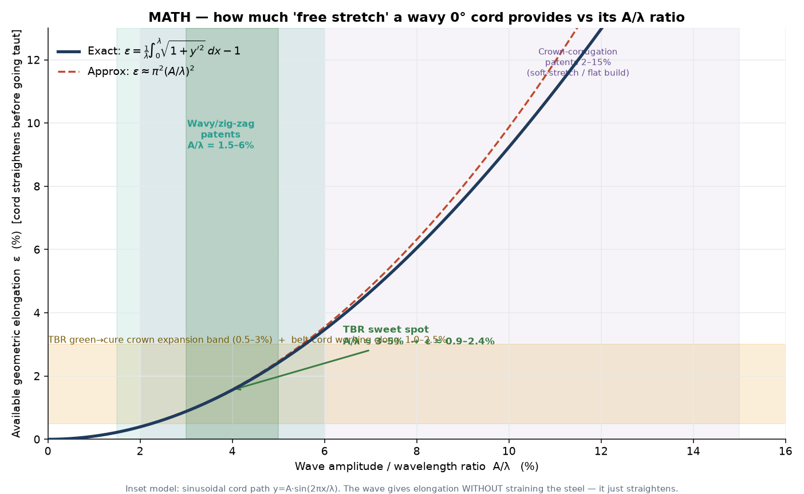
The mathematics of 'free stretch'
04
How much apparent elongation a wave provides vs its A/λ ratio
GOVERNING FORMULAS
Path: y(x) = A·sin(2πx/λ)
Exact: ε = (1/λ)∫₀^λ √(1+(y′)²)dx − 1
Small-amplitude: ε ≈ π²(A/λ)²
▪ Idea. The wave stores extra arc-length. As the tyre grows, the wave flattens and the cord 'elongates' geometrically — the steel never strains.
▪ Verified. A/λ = 1.5% → 0.22% ; 4% → 1.56% ; 6% → 3.46% (numeric).
▪ Design fit. The 1.5–6% band brackets TBR cure-lift (0.5–3%) and the 1.0–2.5% working-elongation spec.
Ranges: corrugation A/λ 2–15% [US6659147]; wavy/zig-zag A/λ 0.015–0.06 [US8079392, US5054532]. Approximation from arc-length of a sinusoid (standard result).

Slide 5
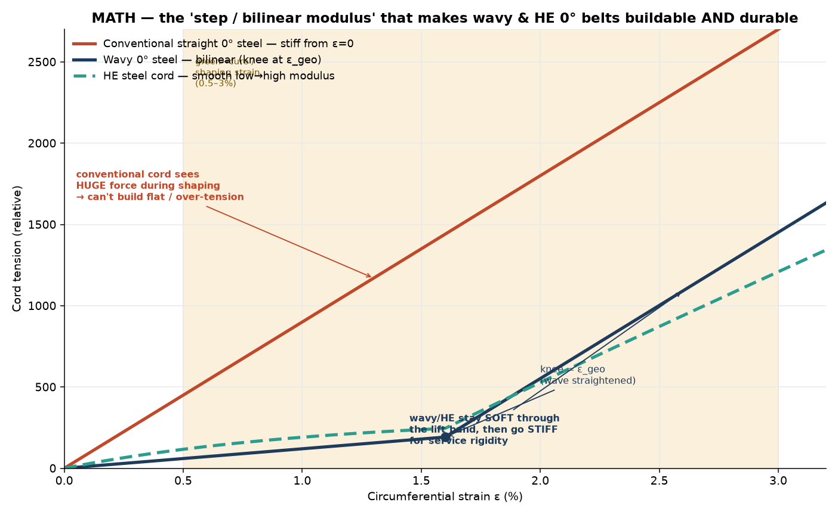
The 'step / bilinear modulus' — buildable AND durable
05
Soft through the lift band, stiff in service
▪ Conventional. Stiff and linear from ε = 0 → very high cord force during shaping; cannot be built flat without special process.
▪ Wavy. Bilinear — low modulus until the 'knee' at ε_geo (wave straightened), then full steel modulus.
▪ HE cord. Smooth concave low→high modulus from structural elongation in the cord itself.
▪ Design lever. Place the knee just past the cure-lift band → service rigidity engages early with no build penalty; lowers belt-edge reaction and controls high-speed standing waves.
Soft-stretch / single-stage flat build [US3956546, US3900062, US4050973]; HE steel cord ε_break ≥ 5% [US2016/0152082]; standing-wave cord stress vs speed [Sun et al., Shock & Vibration 2019].

Slide 6
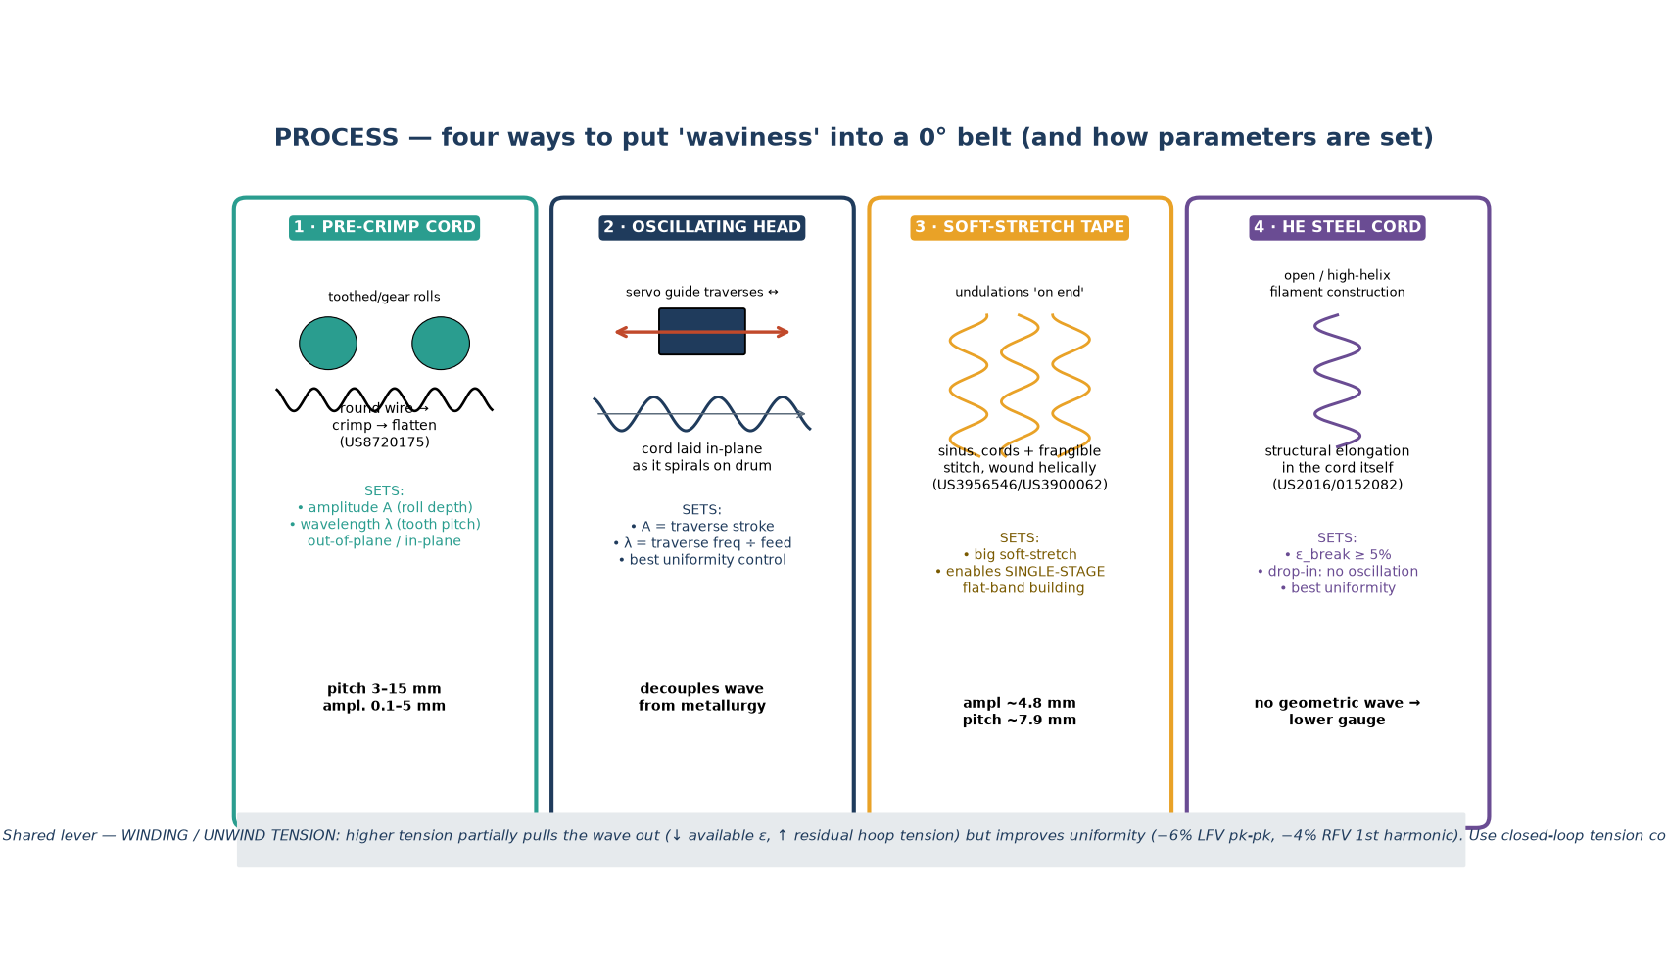
Process — four ways to induce the waviness
06
…and the parameters each route lets you set
ROUTE NOTES
• 1 Pre-crimp: A=roll depth, λ=tooth
• pitch (3–15 mm; amp 0.1–5 mm)
• 2 Oscillating head: A=stroke,
• λ=freq÷feed — best control
• 3 Soft-stretch tape: 'on-end'
• undulations → single-stage build
• 4 HE cord: structural elong.,
• drop-in, lowest gauge
•
• Shared: WINDING TENSION ↑
• → uniformity ↑ (−6% LFV pk-pk,
• −4% RFV 1st harmonic) but
• available ε ↓ & residual tension ↑
[US8720175] crimped flat-wire core · [US3956546/US3900062] undulated tape · [US2016/0152082] HE cord · winding-tension uniformity: Procedia Manufacturing (cap-ply cord tension study).

Slide 7
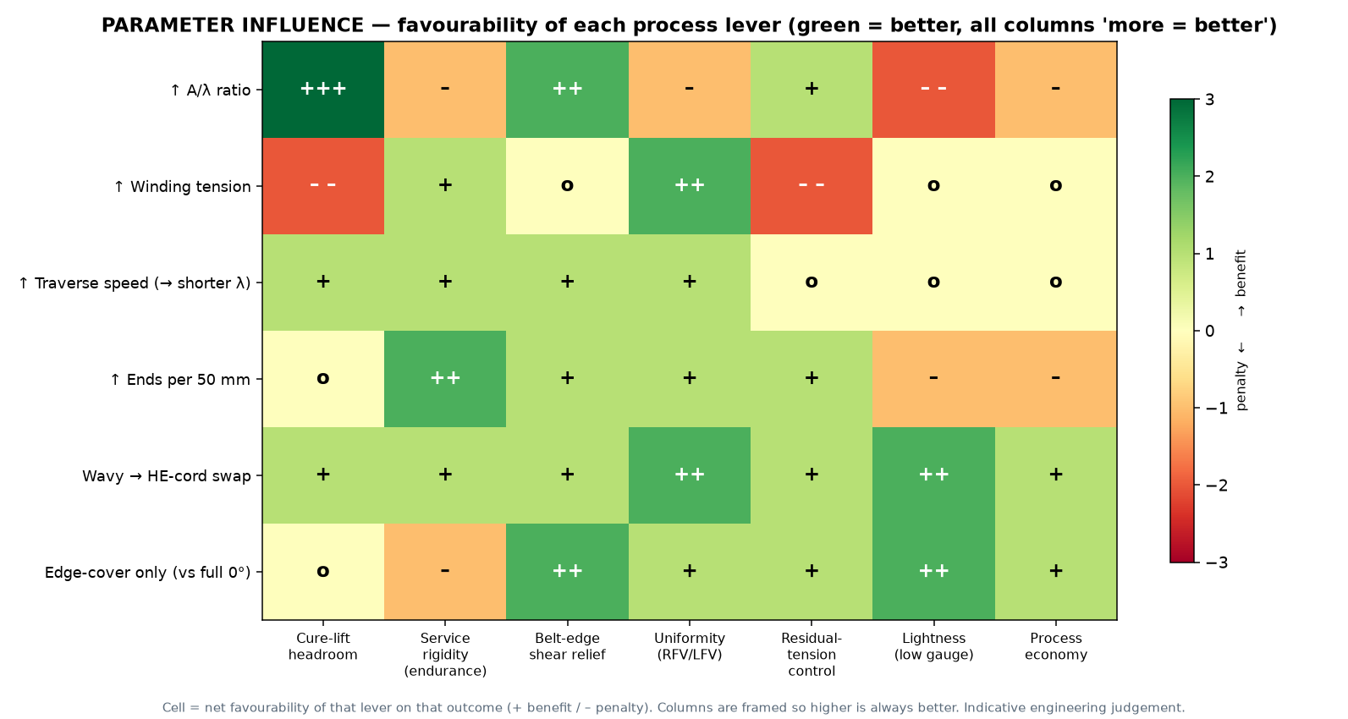
Influencing parameters — favourability map
07
Green = favourable; every column framed so 'more = better'
▪ ↑ A/λ. Big cure-lift headroom, better edge-shear relief — but gauge/weight & uniformity penalty.
▪ ↑ Winding tension. Uniformity ↑↑, but pulls the wave out (ε ↓) and raises residual hoop tension.
▪ HE-cord swap. Broadly favourable — uniformity & lightness gains, simpler line.
▪ Edge-cover only. Targets belt-edge shear with lightness; intentionally lowers centre rigidity (good for even wear).
Cells = net favourability (engineering judgement, indicative). Uniformity direction from cap-ply winding-tension study (Procedia Manufacturing).

Slide 8
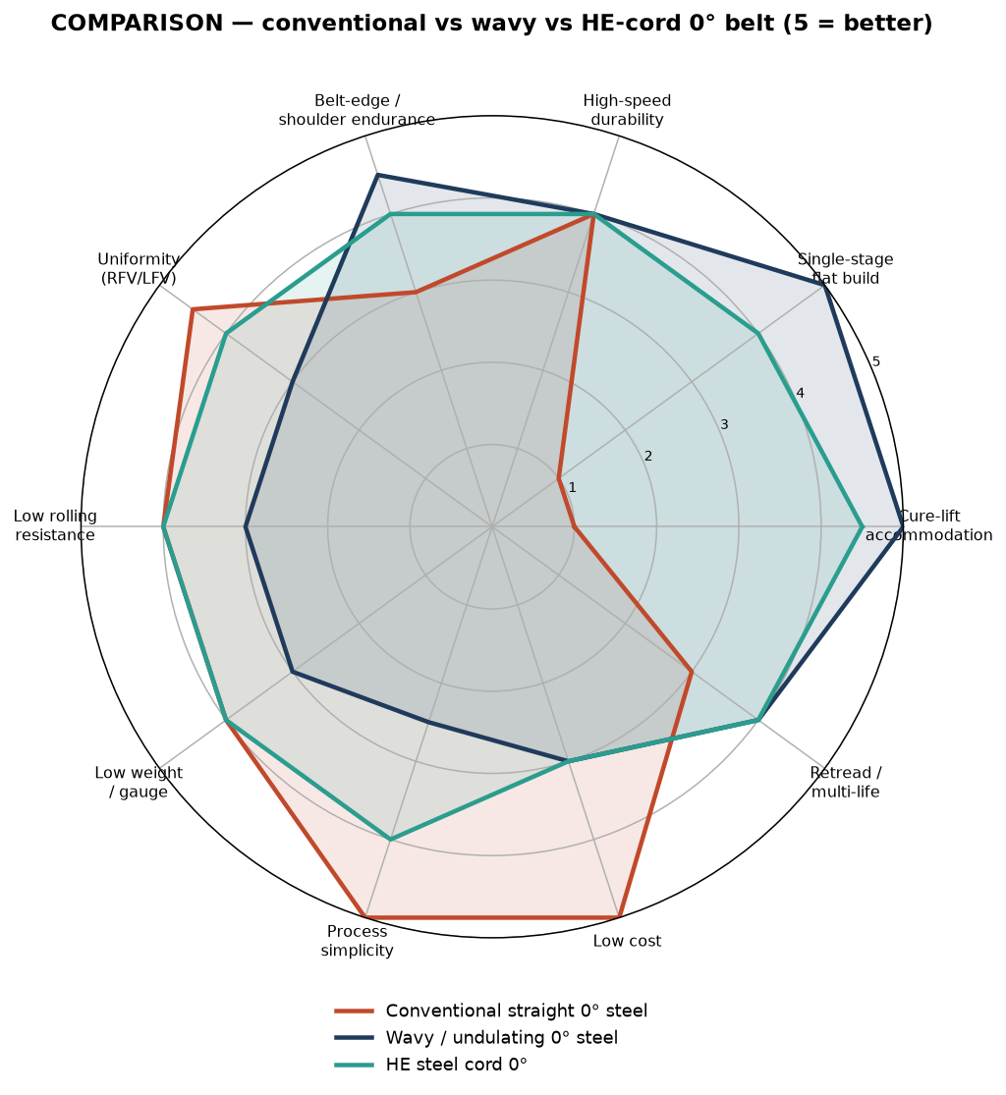
Head-to-head — conventional vs wavy vs HE cord
08
Choosing the right construction for the duty
▪ Conventional straight. Best on simplicity, cost, uniformity, rolling resistance. Weak on cure-lift accommodation and single-stage build.
▪ Wavy. Wins cure-lift, flat build, belt-edge/shoulder endurance. Costs gauge/weight, some RR & uniformity, process complexity.
▪ HE cord. The balanced middle — most of the wavy benefit with better uniformity and lower gauge, at a special-cord cost.
▪ Pick by duty. Long-haul/retread casing → wavy or HE edge cover; high-speed coach → consider full 0°; cost-driven regional → straight + process tweak.
Radar scores (1–5, higher = better) are indicative engineering judgement synthesised from the cited art — not measured data.

Slide 9
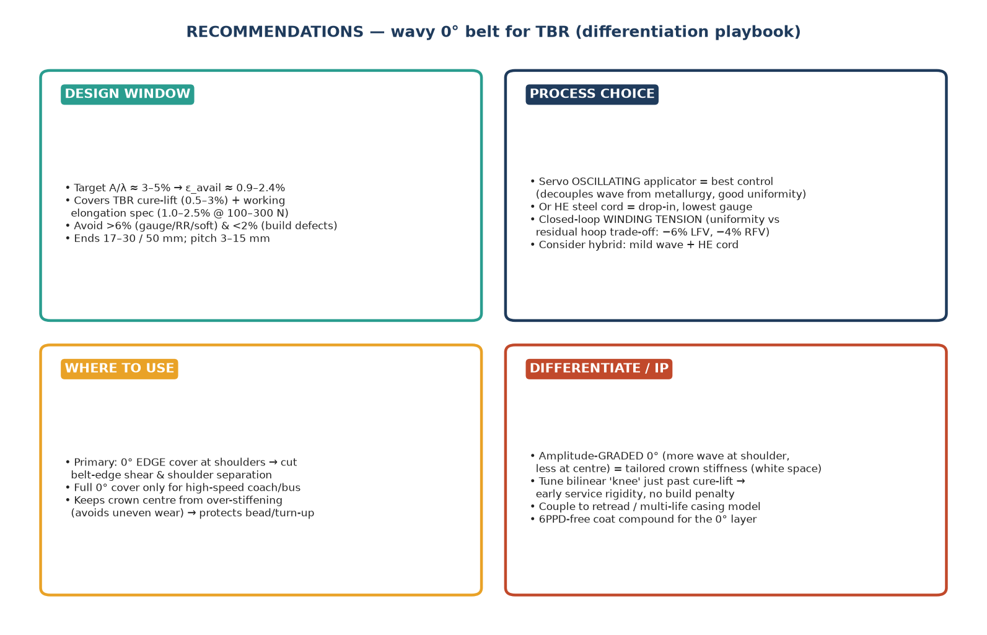
Recommendations & IP white space — TBR
09
A differentiation playbook
▪ Window. A/λ ≈ 3–5%; ends 17–30/50 mm; knee just past cure-lift.
▪ Process. Servo-oscillated application or HE cord; closed-loop tension; consider hybrid (mild wave + HE).
▪ Placement. 0° shoulder/edge cover first; full cover only for high-speed.
▪ Differentiate. Amplitude-graded 0°; tie to retread / multi-life casing; 6PPD-free coat compound.
NEXT STEPS
• FEA + DoE on a real TBR crown (sweep A/λ, winding tension, edge-cover width) to convert indicative ratings into measured claims · Targeted patentability scan on amplitude-graded / position-varying 0° belts before investment.
Design window reconciles cited A/λ ranges with TBR cure-lift & working-elongation specs; white-space claim to be confirmed by formal FTO/patentability search.

Slide 10
References & methodology
10
Primary patents, papers, and basis of estimates
PATENTS (process & structure)
US3956546 / US3900062 / US4050973 / US3979536 — 'high soft-stretch' undulated belt tape; single-stage flat-band 0° building (Goodyear).
US6659147 — corrugated crown reinforcement; A/λ 2–15% to avoid interfering with shaping during vulcanisation while giving crown rigidity.
US8079392 — alternating straight/wavy reinforcement; A/λ 0.015–0.06.
US5054532 — wavy / zig-zag cord ply (belt–carcass).
US8720175 — crimped flat-wire cord core; pitch 3–15 mm, amplitude 0.1–5 mm.
US2016/0152082 A1 — high-elongation steel cord (ε_break ≥ 5%) for 0° / protective layers.
US7337817 / US5591284 — circumferential spirally-wound & triangulated steel-cord belts (context).
PAPERS
Influence of textile cord tension in cap-ply production — Procedia Manufacturing (ScienceDirect): +unwind tension → −6% lateral-force pk-pk, −4% 1st-harmonic radial force.
Sun et al. (2019) — Experiment & Analysis of Cord Stress on High-Speed Radial Tire Standing Waves, Shock and Vibration: wavelength & cord stress rise with speed.
METHODOLOGY & LIMITS
• ε(A/λ) curve: exact sinusoid arc-length, numerically verified; small-amplitude form ε ≈ π²(A/λ)².
• A/λ ranges, pitch/amplitude, elongation specs: taken from the cited patents.
• Bilinear curve shape is schematic but physically grounded (geometry + steel modulus).
• Radar scores and the parameter favourability map are indicative engineering judgement, not measured data — for direction-setting, not spec-fixing.
• Patent numbers are representative anchors surfaced via Google Patents / Justia / USPTO; verify status & jurisdiction before any FTO use.
Working document for internal R&D · figures generated from first-principles models + cited ranges · confirm all citations against primary sources before external use.

