Slide 1
Hybrid Cord Patents — Wear Analysis
Zero-degree belt cords in PCR tires · General hybrid vs. Nylon-Aramid · 1080 PCR patents (audited, motorcycle-excluded)

Slide 2
Scope & Method
• PatSeer zero-degree landscape, screened to 1080 passenger-car-radial (PCR) patents — primary motorcycle tires excluded.
• Two hybrid-cord cohorts, defined by EXPLICIT hybrid-cord construction (not mere material co-occurrence):
– General hybrid cords: 157 patents
– Nylon-Aramid cords (focus): 100 patents
– PET-Nylon cords (comparison): 13 patents
• Wear detection over title/abstract/claims/description + PatSeer AI summaries; 'mileage' is rarely named — this is predominantly a treadwear analysis.
• Theme tagging: BENEFIT (wear resistance/mileage) vs. DEFENSIVE (fixing uneven wear). See Limitations slide for caveats.

Slide 3
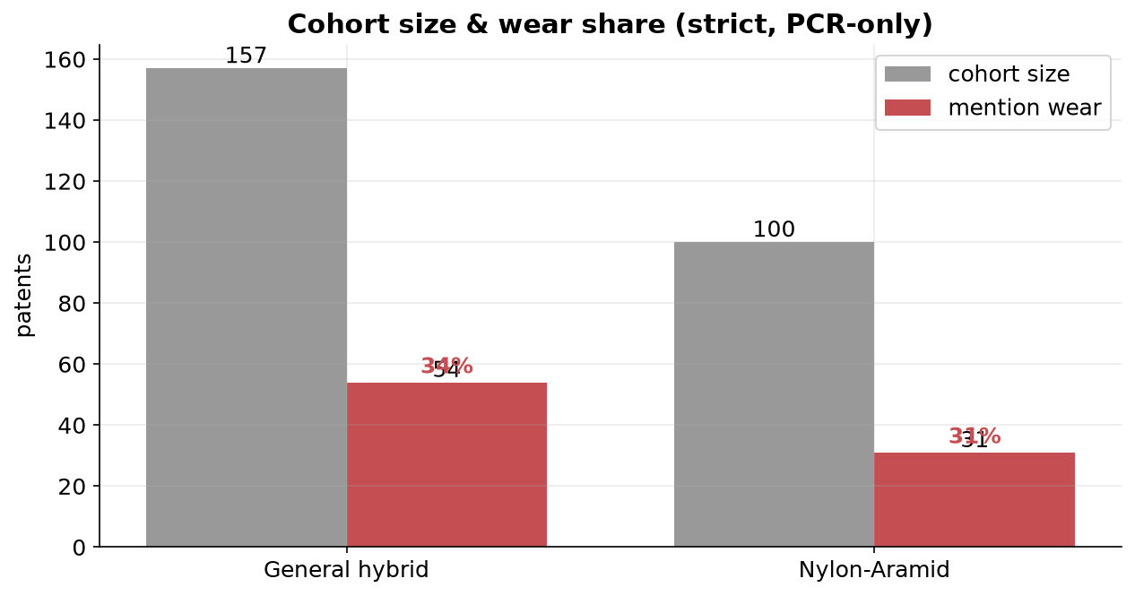
Headline Finding
• General hybrid: 54 of 157 (34%) make a wear claim.
• Nylon-Aramid: 31 of 100 (31%) make a wear claim.
• Wear is a SECONDARY, indirect benefit — driven by crown stiffness & footprint uniformity, not abrasion chemistry.
• Nylon-Aramid-specific wear evidence is thin (31 patents) — interpret with care.

Slide 4
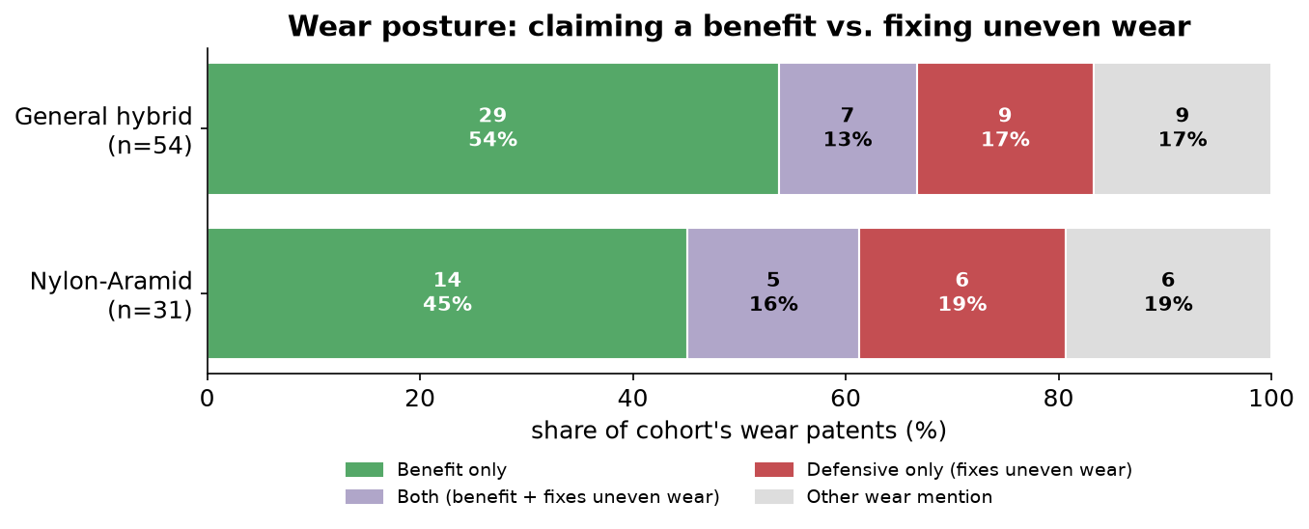
Wear Posture — Benefit vs. Fixing Uneven Wear
• Each bar = 100% of that cohort's wear patents.
• Nylon-Aramid: 6 defensive-only vs 5 'both'.
• General hybrid: 29 benefit-only leads.
• Stiff aramid helps footprint uniformity but its stiffness step can trigger uneven wear that must be engineered out.

Slide 5
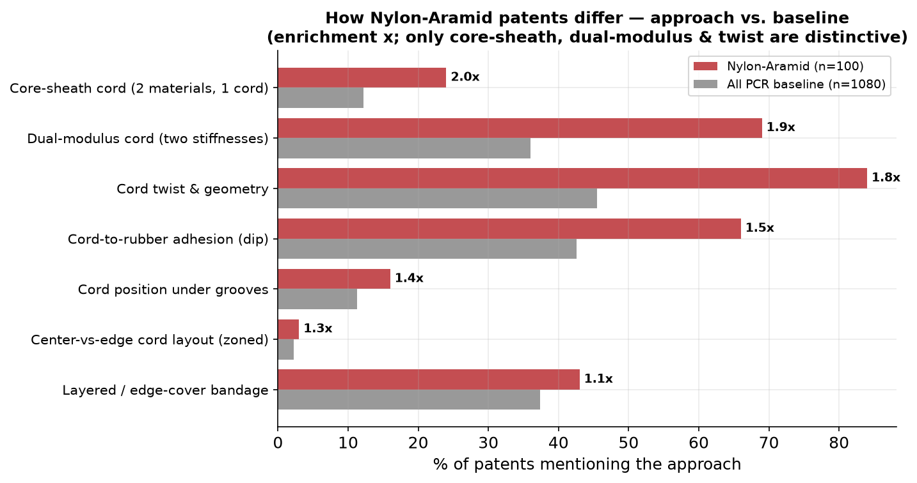
How Nylon-Aramid Tackles Wear (vs. baseline)
• Compared to all PCR patents, Nylon-Aramid is distinctive in the CORD itself:
– Core-sheath cord — 2 materials in 1 cord (2.0x)
– Dual-modulus cord — two stiffnesses (1.9x)
– Cord twist & geometry tuning (1.8x)
• Adhesion/dip, layered bandage and center-vs-edge layout are NOT distinctive to Nylon-Aramid (~1x) — zoned layout is a PET/PA story (next slide).

Slide 6
Representative Nylon-Aramid Patents
• WO2018230265A1 — BRIDGESTONE CORP (2017, DEAD)
– The present invention addresses the problem of suppressing the occurrence, in a tire having a spiral cord layer formed by winding a reinforcement cord in a spiral shape, of uneven wear due to the spiral cord layer.
• US20040108037A1 — BOOZER MATTHEW (2002, DEAD)
– The use of high modulus at high stress cords in the second reinforcement plies allows the tire to flatten the transverse curvature at low and moderate speeds, improving wear performance.
• JP2001163005A — BRIDGESTONE CORP (1999, DEAD)
– The spiral-wound structure of the fiber cord enhances circumferential rigidity and vibration suppression, leading to improved tire contact properties and wear resistance.
• WO2019116766A1 — BRIDGESTONE CORP (2017, DEAD)
– METHOD USED The invention proposes a hybrid reinforcing member that uses a carbon fiber core and a non-metallic fiber sheath.
• WO2015137901A1 — KORDSA GLOBAL ENDUSTRIYEL (2014, DEAD)
– METHOD USED The hybrid cap ply reinforcement layer is constructed by twisting polyethylene terephthalate (PET) and nylon 6.6 multifilament yarns in a specific Z or S direction.
• EP2806057A2 — THE GOODYEAR TIRE & RUBBER (2013, ALIVE)
– A hybrid cord having a Nylon core yarn (32) and an Aramid wrap yarn (34) wrapped around the Nylon core yarn (32) is disclosed.

Slide 7
Related Lever: Zoned Density is PET/PA — not Nylon-Aramid
• Zoned-density bandages (different cord/density centre vs. shoulder) are a real uneven-wear fix — but in PET/PA hybrids, not Nylon-Aramid.
– Continental EP3912833A1 (ALIVE): centre PET 120 EPDM + PA4.6 side sections 130 EPDM.
– Continental DE102016223304B4 (ALIVE): 3-section bandage, centre PA6.6 (470x2) for 'more uniform abrasion'.
• In the Nylon-Aramid cohort zoned density appears in only ~3% (1.3x) — it is NOT the Nylon-Aramid wear lever.
• Takeaway: do not attribute the zoned-density wear story to Nylon-Aramid cords.

Slide 8
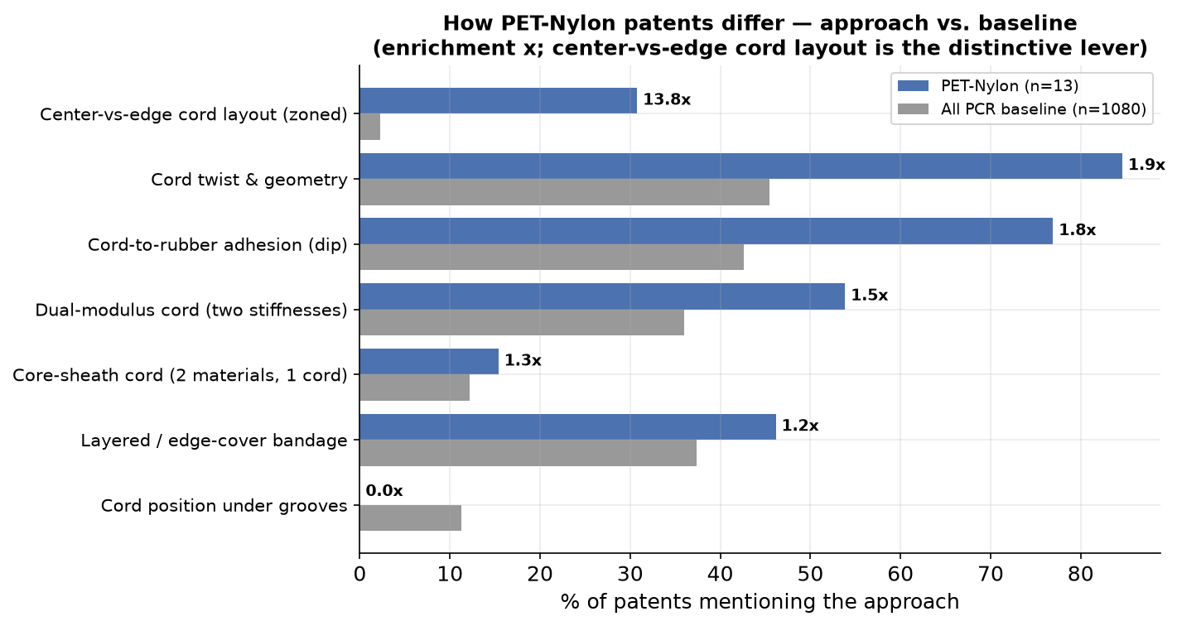
How PET-Nylon Tackles Wear (vs. baseline)
• PET-Nylon (polyester+polyamide) hybrid cohort: 13 PCR patents, 6 make a wear claim (46%).
• Same taxonomy and baseline as the Nylon-Aramid study, so the two are directly comparable.
• PET-Nylon's distinctive wear lever is SPATIAL, not the cord:
– Center-vs-edge cord layout (zoned) — by far the most enriched approach (14x baseline)
– Layered / edge-cover bandage is also above baseline
• The blended cord itself (core-sheath) is NOT enriched — PET-Nylon zones different cords by position rather than co-twisting one composite filament.
• Dual-modulus & twist tuning are shared hybrid-cord vocabulary.

Slide 9
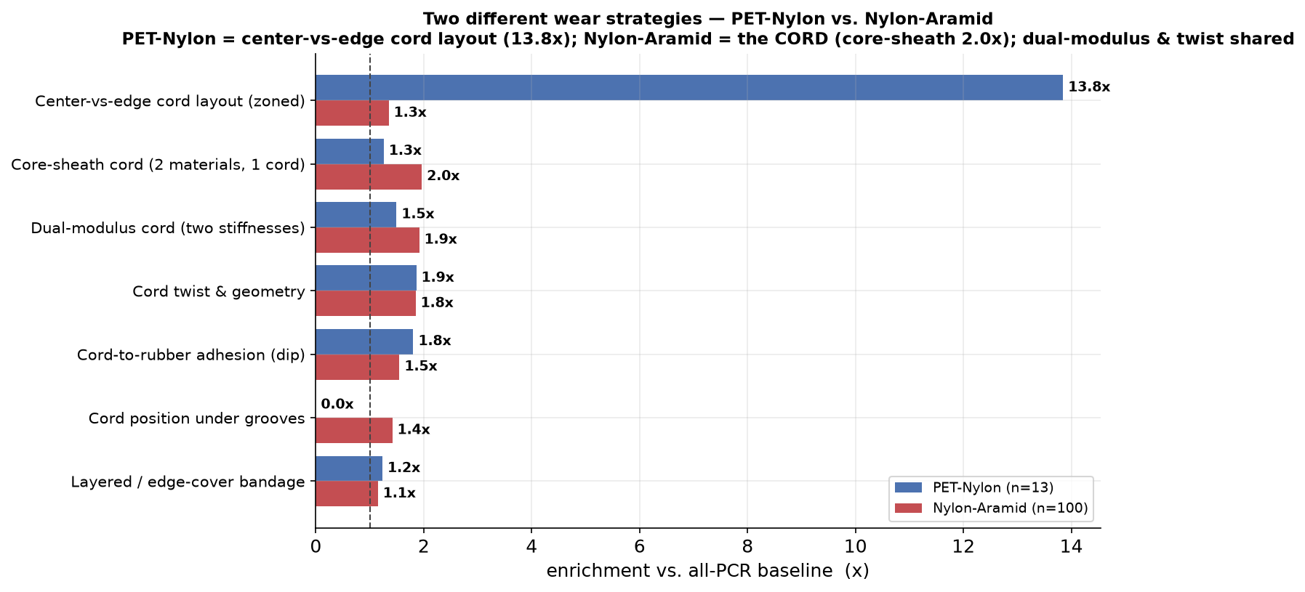
PET-Nylon vs. Nylon-Aramid — Two Different Wear Strategies
• Both raise mileage/treadwear indirectly via crown stiffness & footprint control — but by different means:
– Nylon-Aramid -> engineers the CORD: core-sheath cord, 2 materials in 1 (2x).
– PET-Nylon -> engineers the LAYOUT: center-vs-edge cord placement (14x).
• Shared levers: dual-modulus stiffness step, twist tuning, cord-to-rubber adhesion.
• Evidence base is thin for both wear angles — PET-Nylon 6 wear patents, Nylon-Aramid 31; 5 patents use both constructions. Interpret enrichment as direction, not magnitude.
• This quantifies the earlier point: zoned density is the PET/PA story, the cord is the Nylon-Aramid story.

Slide 10
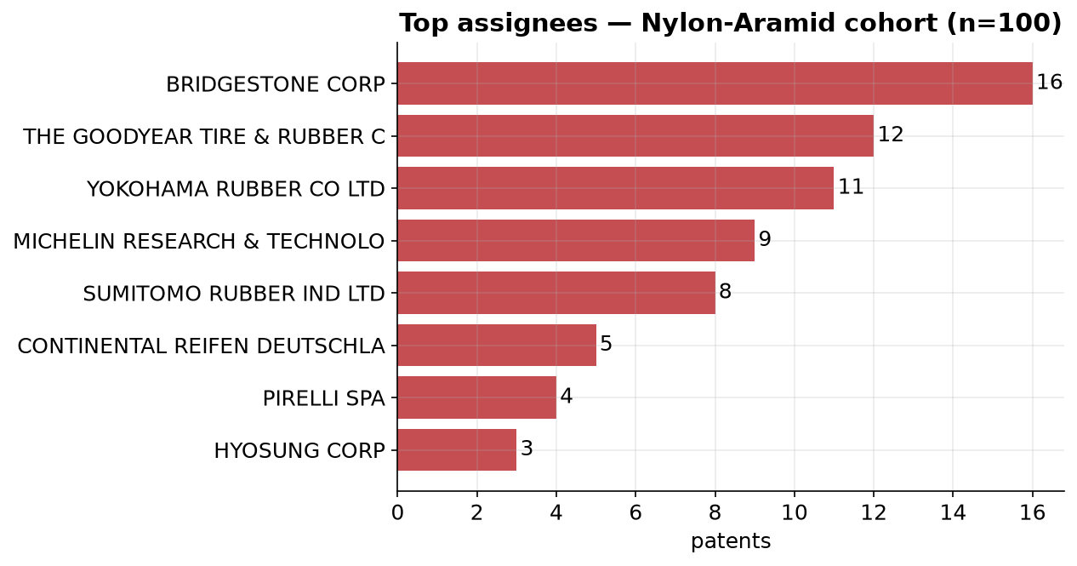
Who Owns the Nylon-Aramid IP
• Japanese OEMs (Bridgestone, Sumitomo, Yokohama) plus Goodyear, Michelin, Continental.
• Cord makers (Kordsa, Hyosung) appear in the construction patents.
• Most Nylon-Aramid wear patents are legally DEAD — limited live art on the wear angle specifically.

Slide 11
Limitations & Methodology (read before citing)
• Cohorts are text-mined (PatSeer fields + AI summaries) with high recall; spot-check before quoting individual patents.
• 'Nylon-Aramid' = explicit aramid+nylon hybrid-cord construction. A looser co-occurrence rule inflated this ~3x (318 -> 100); the strict figure is used here.
• 'PET-Nylon' = explicit polyester+polyamide pairing, core-sheath, or zoned PET-vs-PA bandage (13 patents). Polyester+nylon are commodity fibres, so loose co-occurrence was rejected; 5 overlap with Nylon-Aramid (multi-material bandages).
• 92 primary motorcycle tires were removed; some patents still mention motorcycle as a secondary application.
• Solution percentages are multi-label and shown as ENRICHMENT vs. baseline to avoid overstating common vocabulary.
• Wear is predominantly treadwear, not 'mileage' (named in only ~12 patents).
• Corpus skews pre-2015; legal status reflects the export date.

Slide 12
Takeaways & Recommendations
• Wear/mileage is a secondary, indirect benefit of Nylon-Aramid zero-degree cords — via stiffness and footprint control.
• The Nylon-Aramid wear lever is the CORD: core-sheath, dual-modulus, twist tuning — not zoned density (that is PET/PA).
• PET-Nylon attacks the same wear problem differently — center-vs-edge cord layout (zoned) — confirmed in its own enrichment study.
• Manage the uneven-wear risk created by the aramid stiffness step (defensive IP is a real share).
• White space: Nylon-Aramid wear evidence is thin and mostly dead — opportunity, but validate FTO against live PET/PA zoned-density art.
• Next: pull full claims for the strict Nylon-Aramid set; add rolling-resistance and high-speed-durability axes.

