Slide 1

Topics
Introduction to Pig
Pig vs MapReduce
Pig Architecture
Pig Components
Pig Data Model
Pig Latin Basics
User Defined Functions (UDF)

Slide 2
Need of Pig
As we know, the MapReduce code can easily take more lines of complicated code. Writing mappers and reducers, compiling and packing the code, submitting the job and retrieving the result is a time consuming work and needs expertise.
This challenge give birth to Pig @ Yahoo!.
The idea behind Pig was to provide a simpler alternative to MapReduce.

Slide 3
Need of Pig
No Java is required
Development time also got reduced to approx 1/16th
10 lines of Pig script = Approx. 200 lines of MapReduce code

Slide 4
Apache Pig vs MapReduce
Apache Pig
Apache pig is a high level data flow language
No need to write complex programs
Apache pig uses multi-query approach, there by reducing the number of line of code.
Built-in support for data operations like joins, filters, grouping and ordering etc.
Provides built-in data structures like tuple, bag and map
MapReduce
MapReduce is a low level data processing paradigm.
Exposure in Java/python is must to work with MapReduce
MapReduce will require almost 20 times more the number of lines to perform the same task.
You should write your own logic to perform all these in MapReduce.
No such data structures in MapReduce.

Slide 5
Apache Pig
Apache Pig is an abstraction over MapReduce.
It is a tool which is used to analyze larger sets of data representing them as data flows.
To Analyze data using pig, programmers need to write scripts using PigLatin language.
All these scripts are internally converts into Map and Reduce tasks.

Slide 6
Apache Pig
Disadvantages
  Pig is definitely slow compared to MapReduce.
  If you need high optimization

Slide 7
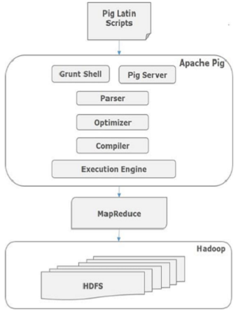
Pig Architecture

Slide 8
Pig Components
Pig is made up of two components
Pig Latin
  A pig Latin is made up of a series of operations, or transformations, that are applied to the input data to produce output.
Execution Environment
  Grunt Shell
    Interactive shell for running Pig commands
  Script
    Batch mode execution using .pig file
  Embedded
    You can define udf in Java and use them in Pig scripts.

Slide 9

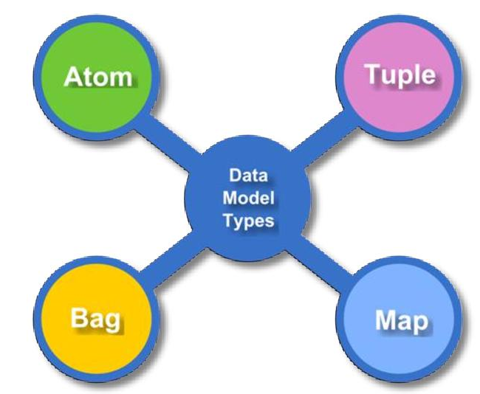
Pig Data Model

Slide 10
Pig Data Model
Atom
  A piece of data or a simple atomic value.
  int, long, float, double, chararray and bytearray are the atomic values of Pig.
Tuple
  A record that is formed by an ordered set of field/atom is known as tuple.
  A field can be of any type
  Represented as (100, Rahul, 40000.0)

Slide 11
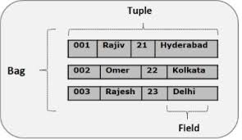
Pig Data Model
Bag
  A Bag is a collection of tuple.
  It is unordered and non-unique
  A tuple can have any number of fields.
  A Bag is represented by { }
  it is not necessary that every tuple contain the same number of fields or that the fields in the same position have the same type.

Slide 12
Pig Data Model
Map
  Is a set of key-value pairs
  Key should be of type chararray and should be unique.
  Value might be of any type.
  It is represented by [ ]
  Eg: [name#Raja, age#30]

Slide 13
Grunt Shell Commands
clear
  Clears the grunt console
exec
  runs pig script in grunt shell
help
  Shows available commands and help
history
  List the last executed query statements.
run
  run a script in the existing grunt shell
sh
  Run linux shell commands from within grunt shell

Slide 14
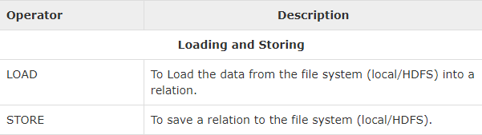
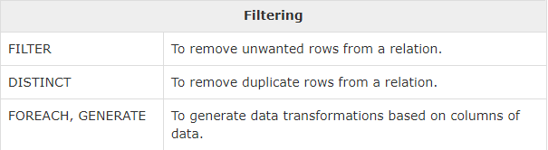
Pig Operators

Slide 15
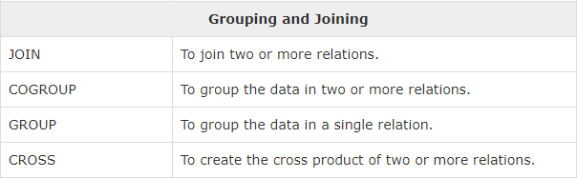
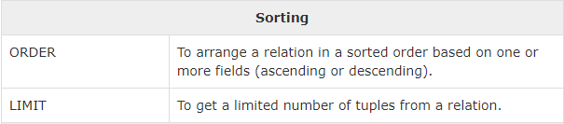
Pig Operators

Slide 16
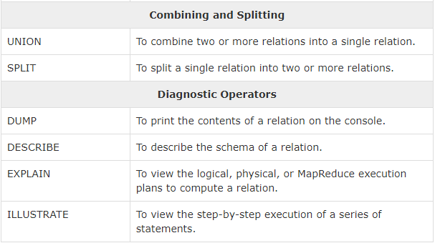
Pig Operators

