Slide 1
Topics
Introduction
Distributed File System (DFS)
Hadoop Components
Hadoop Daemons/Hadoop Processes
Hadoop architecture
HDFS Architecture
HDFS Configuration Files
Rack Awareness Policy
Namenode High Availability
HDFS Commands

Slide 2
Introduction
Due to the issues raised by its volume, velocity and variety, big data analytics are done by special tools and applications. Currently leading the field is an open-source project called Hadoop.
What Hadoop does is to distribute the storage and processing of large datasets across clusters of server computers using a simple programming model.
The number of nodes in the cluster can also be scaled easily as requirements dictate, from may be 50 machines to perhaps 4000 or more
Since both data and processes are distributed, data has grown scalable larger and computing power also scalable larger. This is a technological shift from the traditional systems where a single computer process huge amount of data.

Slide 3
History of Hadoop
The genesis of Hadoop came from the GFS(Google File System) and MapReduce white paper published by Google. Because they first faced the storage and processing needs as part of handling billions of searches and indexing millions of web pages.
Doug Cutting was inspired by Google's white papers and decided to create an open source project called Hadoop, named it after his son's toy elephant.
Yahoo! Further contributed to this project and played a key role in developing Hadoop for Enterprise applications.
Since then many companies such as Facebook, Linkedin, ebay, Hortonworks, Cloudera etc. have contributed to the Hadoop project.
Today Hadoop's framework and ecosystem of technologies are managed by Apache Software Foundation. (http://hadoop.apache.org/)

Slide 4

Advantages of Hadoop

Slide 5

Distributed File System
Data Storage and Analysis
Although the storage capacities of hard drives have increased massively over the years, access speeds—the rate at which data can be read from drives— have not kept up
A 1TB Hard disk with 4 IO channles, it takes 43+ Minutes to read the entire data.
Imagine if we have 10 machines and each have 1/10 of the data. Working in parallel, we could read the data in 4-5 minutes.
…..........
1Machine
4 I/O Channel
100MB/s
40+ Minutes
10 Machines
4 I/O Channel
100MB/s
4-5 Minutes

Slide 6


Hadoop Components
Two main components
Storage
Processing

Slide 7
HDFS Overview
HDFS is a file system designed for storing very large files with streaming data access patterns, running on clusters of commodity hardware.
Large Files : Files that are hundreds of gigabytes or terabytes or peta bytes in size.
Streaming Data Access: Write once, read-many- times pattern. A dataset is copied to HDFS once and various analysis are performed on that dataset over time.
Commodity Hardware: Hadoop doesn't require expensive and highly reliable hardware. It is designed to run on commonly available hardware for which chances of failure are high. HDFS is designed to carry on working in case of such failure.

Slide 8
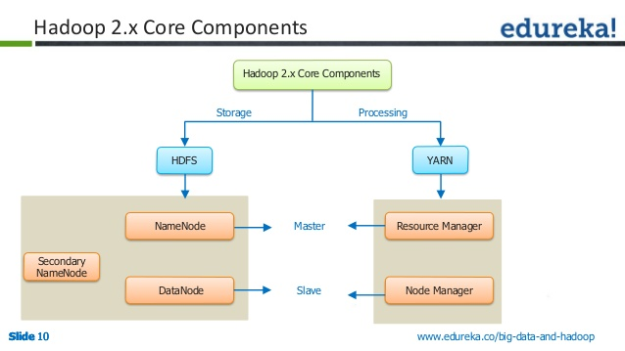
Hadoop 2.x Daemons

Slide 9
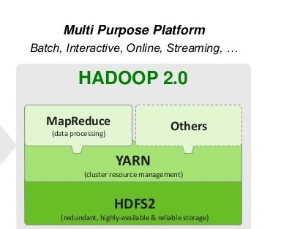
Hadoop components

Slide 10
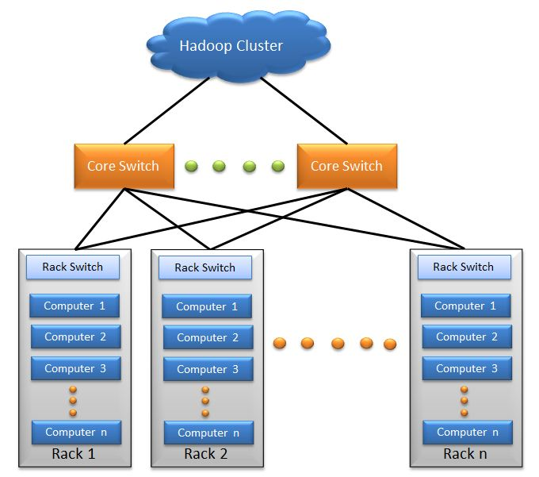
Hadoop Cluster High Level view

Slide 11




HDFS Architecture
Client
Shared
Edit logs
All namespace edits logged to shared storage
Read edit logs and applies to its own namespace
NameNode High availability
Secondary
NameNode
Active
NameNode
StandBy
NameNode
DataNode
DataNode
DataNode

Slide 12
Namenode
NameNode is the centerpiece of HDFS known as the Master.
NameNode only stores the metadata of HDFS – the directory tree of all files in the file system, and tracks the files across the cluster.
NameNode does not store the actual data or the dataset. The data itself is actually stored in the DataNodes.
NameNode knows the list of the blocks and its location for any given file in HDFS. With this information NameNode knows how to construct the file from blocks.
NameNode is so critical to HDFS and when the NameNode is down, HDFS/Hadoop cluster is inaccessible and considered down.
NameNode is a single point of failure in Hadoop cluster.

Slide 13
DataNode
DataNode is responsible for storing the actual data in HDFS.
DataNode is also known as the Slave
NameNode and DataNode are in constant communication.
When a DataNode starts up it announce itself to the NameNode along with the list of blocks it is responsible for.
When a DataNode is down, it does not affect the availability of data or the cluster. NameNode will arrange for replication for the blocks managed by the DataNode that is not available.

Slide 14
Name Node Configuration
Processors: 2 Quad Core CPUs running @ 2 GHz
RAM: 64 GB -- 512GB
Disk: 6 --12 x 1TB SATA
Network: 10 Gigabit Ethernet
Data Node Configuration
Processors: 2 Quad Core CPUs running @ 2 GHz
RAM: 16 GB -- 64GB
Disk: 4 -- 24 x 1TB SATA
Network: 10 Gigabit Ethernet

Slide 15

Blocks
HDFS stores each file as a sequence of blocks. All blocks except the last block are same size. The default size of each block is 128 MB.
The blocks of a file are replicated to insure against machine failure, data corruption. The default replication factor is 3.
Block-1
Size : 128 MB
Consumed: 128MB
Freespace: 0MB
Block-3
Size : 128 MB
Consumed: 50MB
Freespace: 78MB
File-B(50MB)
File-A (200 MB)
Block-2
Size : 128 MB
Consumed: 72MB
Freespace: 56MB
A file in HDFS smaller than the block size does not occupy full blocks storage. One block can store only one file data.

Slide 16
HDFS Read/Write
NameNode
Input-file (300 mb)
fsImage
Edit Log
b1
b2
b3
In-memory FS metadata
heartbeat message
and blockreports
DataNode (DN1)
DataNode(DN2)
DataNode(DN3)
DataNode(DN4)
b3
b3
b3
b1
b2
b2
b1
b1
b2

Slide 17
To store files client contact NameNode first. Internally file is split into one or more blocks. Namenode then responds to the client request with the identity of the Datanodes that can accommodate these blocks. Mapping of blocks to Datanode is determined by the Namenode.
Once the Datanodes are identified, client flushes the first block (b1) to the specified Datanode(DN2). Since the default replication factor is 3, the datanode upon completion of data storage in the local repository, copies the same block (b1) to second datanode(DN3) specified by the namenode and so on. Thus data blocks is pipelined from one datanode to the next.
This cycle repeats for other blocks (b2, b3).
Hadoop uses Rack Awareness Policy to determine the racks and datanodes to store data blocks.

Slide 18
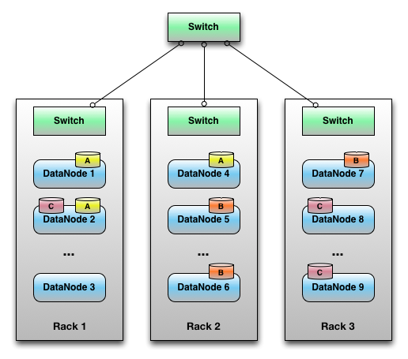
Rack Awareness Policy
According to Rack Awareness Algorithm:
  The first replica of the block will store on a local rack.
  The next replica will store on another datanode within the same rack.
  The third replica stored on the different rack.
In Hadoop, we need Rack Awareness for below reason: It improves
  Data high availability and reliability.
  The performance of the cluster.
  Network bandwidth.

Slide 19
Filesystem Namespace
The Namenode maintains the HDFS namespace. This information is stored persistently on Namenode's local disk in two files: FSImage and Edit Logs.
FSImage
It contains the entire file system namespace, including the mapping of blocks to files and file system properties.
Edit Logs
Edit log records every change that occurs to file system metadata. For example, creating a new file or removing a file inserts record in the edit log. Changing the replication factor of files causes new records to be inserted in edit log.
Namenode also keeps and in-memory representation of fsimage. When the namenode start-ups, its reads fsimage and edit logs from local disk and applied all transactions from edit logs to in-memory representation of fsimage. It then writes the new hdfs state to the fsImage representation in the local disk. Finally truncate the old edit logs, because its transactions have been merged with fsimage in the disk. This process is called checkpoint process. It happens only when we start the name node.

Slide 20
Heartbeats & Blockreports
Each DataNode sends a Heartbeat message and a blockreport to the NameNode periodically. The NameNode marks DataNodes without recent Heartbeats as dead and does not forward any new IO requests to them.
Blockreport contains list of blocks on a datanode. Any data that was registered to a dead DataNode will not be available to HDFS any more. DataNode death may cause the replication factor of some blocks to fall below their specified value.
The NameNode constantly tracks which blocks need to be replicated and initiates replication whenever necessary.

Slide 21
Secondary Namenode
If the machine running namenode fails, all the files on the file system would be lost since there would be no way of knowing how to reconstruct the files from the blocks on the datanodes. Hadoop provides two mechanism for this.
1. Backup the files that make up the persistent state of the file system metadata.
2. Configure a secondary name node.
The secondary NameNode merges the fsimage and the edits log files periodically and keeps edit log size within a limit. It is usually run on a different machine than the primary NameNode since its memory requirements are on the same order as the primary NameNode.
This happens every 1 hour or for 1 million transactions in edit log whichever is earlier.

Slide 22

Hadoop 2.x new feature
HDFS Federation. (Namenode Scalability)
Since namenode stores in-memory representation of fsImage, memory becomes the limiting factor for scaling. HDFS Federation allows a cluster to scale by adding namenodes, each of which manages a separate namespace. For example, one namenode might manage all the files rooted under /user, say, and a second namenode might handle files under /projects.
NameNode-1
NameNode-2
NameNode-N
Namespace-1
Namespace-2
Namespace-N
Block Pool-1
Block Pool-2
Block Pool-3
Common Storage
DataNode-1
DataNode-2
DataNode-3

Slide 23
NameNode High Availability
Prior to Hadoop 2.0.0, the NameNode was a single point of failure (SPOF) in an HDFS cluster. Each cluster had a single NameNode, and if that machine or process became unavailable, the cluster as a whole would be unavailable until the NameNode was either restarted or brought up on a separate machine.
In a typical HA cluster, two separate machines are configured as NameNodes. At any point in time, exactly one of the NameNodes is in an Active state, and the other is in a Standby state.
When any namespace modification is performed by the Active node, it durably logs a record of the modification to an edit log file stored in the shared directory. The Standby node is constantly watching this directory for edits, and as it sees the edits, it applies them to its own namespace. This ensures that the namespace state is fully synchronized before a failover occurs
It is also necessary that the Standby node have up-to-date information regarding the location of blocks in the cluster. To achieve this, the DataNodes are configured with the location of both NameNodes, and send blockreports and heartbeats to both namenodes

Slide 24
HDFS Configuration Files
To set hdfs daemon properties we use following two configuration files.
core-site.xml
hdfs-site.xml

Slide 25
HDFS – FS Shell Commands
The File system shell includes various shell-like commands that directly interacts with the HDFS as well as other file system that Hadoop supports like S3, web hdfs, local file system, etc
The FS shell is invoked by the following command
All FS shell commands take path URI as arguments. The URI format is scheme://hostname/path. For HDFS the scheme is hdfs, and for the local file the scheme is file. An hdfs file or directory can be specified as follows..
$ hadoop fs <args>
FS refers to any hadoop supported filesystem
$ hdfs dfs <args>
dfs is more specific to hdfs
hdfs://<hostname:port>/<dirname> (or) /dirname
hdfs://<hostname:port>/<dirname>/<filename> (or) /dirname/filename

Slide 26
HDFS – FS Shell Commands
mkdir - To create directories in the hdfs file system.
put - To copy single file or multiple files from local file system to hdfs. Also reads from stdin and write to destination file
ls – To list files in HDFS
$ hadoop fs -mkdir /user/data (or)
$ hadoop fs -mkdir hdfs://localhost:port/user/data
$ hadoop fs -put march.log /user/data (or)
$ hadoop fs -put march.log hdfs://localhost:port/user/data
$ hadoop fs -put feb.log march.log /user/data
$ hadoop fs -ls /user/data

Slide 27
HDFS – FS Shell Commands
cat: - Copy file contents to stdout
get: To get the file from HDFS to the local file system
To display the usage information of one of the commands.
$ hadoop fs -cat /user/data/march.log (or)
$ hadoop fs -cat hdfs://localhost:port/user/data/march.log
$ hadoop fs -get /user/data/march.log /user
$ hadoop fs -get hdfs://localhost:port/user/data/march.log /user
$ hadoop fs -help <cmd-name>

Slide 28
HDFS- FS Shell Commands
Command | Description
-chown | Sets the owning user and/or group for files or directories identified by <path> in the hdfs $ hadoop fs -chown -R owner:group <path>
-chmod | Change the file permissions associated with files identified by path in the hdfs $ hadoop fs -chmod -R mode <path>
-cp | Copy file or directory identified by <src> to <dest>, within HDFS $ hadoop fs -cp <srcpath> <destpath>
-mv | Moves file or directory indicated by <src> to <dest>, with in hdfs $ hadoop fs -mv <srcpath> <destpath>
-rm | Removes file or empty directory identified by path $ hadoop fs -rm <path>
-rmr | Removes file or directory identified by path. Recursively deleted child entries. $ hadoop fs -rmr <path>

Slide 29
HDFS- FS Shell Commands
Command | Description
-copyFromLocal | Similar to put cmd, except that source is restricted to local file $ hadoop fs -copyFromLocal <localsrc> <uri>
-copyToLocal | Similar to get command, except that destination is restrict to local $ hadoop fs -copyToLocal <hdfsuri> <localdest>
-moveFromLocal | Similar to put command, except that source is deleted after its's copied $ hadoop fs -moveFromLocal <localsrc> <hdfsuri>
-du | Displayes the size of files and directories contained in the given directory. $ hadoop fs -du -h <directory-uri> [-h] : will format the file size to mb, gb,etc
-find | Finds all files that matches the specified expression in given <path> $ hadoop fs -find <path> -name test

Slide 30
Hadoop- Command Reference
All these commands are executed from the hadoop shell comamnd. They have been broken up into user commands and admin commands.
distcp: Copy file or directories recursively.
It is a tool for large inter/intra-cluster copying
jar: Runs a jar file
$ hadoop distcp hdfs://host1/dir/file hdfs://host2/dir/file
$ hadoop jar <jarfile> mainclass <args>

