Slide 1
FSWD-I
Full stack web development -I

Slide 2
What is Full Stack Web Development?
Full Stack Web Development involves building web applications encompassing both front-end (client-side) and back-end (server-side) aspects.
Key Components of Full Stack Web Development
- Front-End Development: HTML, CSS , JavaScript
- Back-End Development : Server-side logic, Node.js, Django, APIs.
- Database Management : MySQL, MongoDB, data retrieval and storage.

Slide 4
HTML
HTML Introduction :
HTML is the standard markup language for creating Web pages.
HTML stands for Hyper Text Markup Language
HTML describes the structure of a Web page
HTML elements tell the browser how to display the content
HTML elements are represented by tags
Latest Version(HTML5)

Slide 5
HTML Editors :
Notepad(Windows)
Eclipse
Text Editor/GEdit(Ubuntu)
Sublime Text Editor

Slide 6
How to Save HTML File?
We can create the html file in any of the mentioned editors(previous slide).
To save an html file, we need to use filename.html extension. Or
.htm

Slide 7
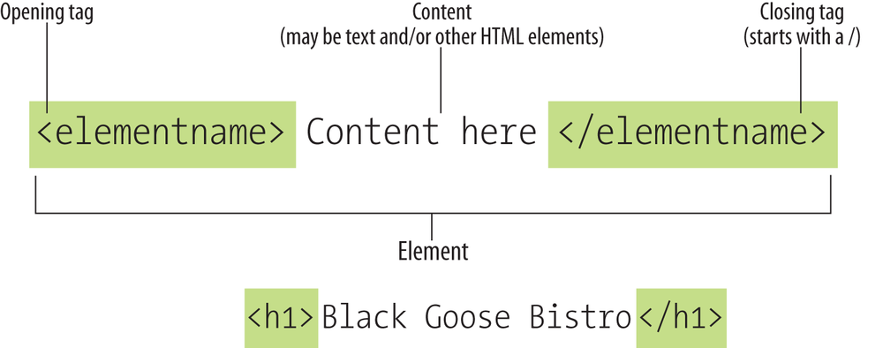
Tags
Open Tag--->
Example : <html>
Close Tag :---->Closing tag is having forward slash before name of tag.
Example :</html>

Slide 8
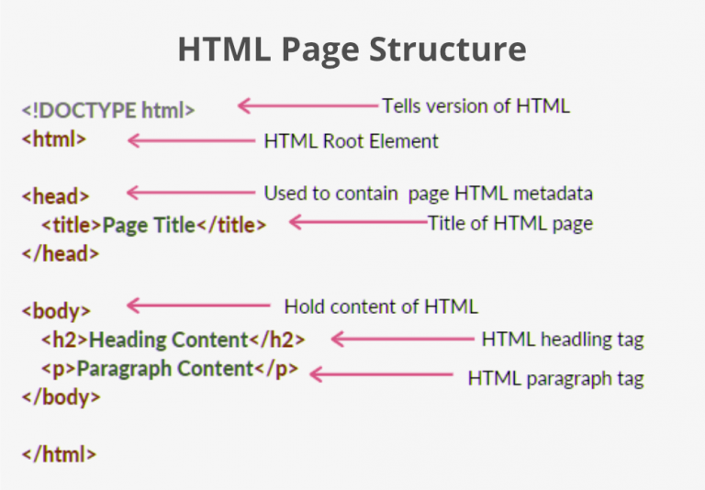

Slide 9
Basic Body Tags :
Header Tags
Heading tags are designated with the letter h. Each h tag also has a number after the h. They range from
<h1> to
<h6> .
->The
font size of text decreases from <h1> tag to <h6> tag .
 | <h1></h1>
 | <h2></h2>
 | <h3></h3>
 | <h4></h4>
 | <h5></h5>
 | <h6></h6>

Slide 10
Example html file :
<!DOCTYPE html>
<html>
<head>
<title>My First Web Page</title>
</head>
<body>
<h1>My First Heading</h1>
<p>My first paragraph.</p>
</body>
</html>

Slide 11
Paragraph tag :
-> you can use paragraphs to separate your content into blocks. You can create a paragraph by
surrounding your content with the
Line Break :
<p>
tags.
-> Now, if you want to separate your content onto multiple lines, but you don’t want that space that
comes with a paragraph, you can use a line break, or a
<br>
tag.

Slide 12
Html Formatting Elements :
Tags to format your text . Formatting elements were designed to display special types of text:
<b> - Bold text
<strong> - Important text
<i> - Italic text
<em> - Emphasized text
<mark> - Marked text
•
<del> - Deleted text
•
<small> - Small text
<ins> - Inserted text

Slide 13
•
<sup> - Superscript text
•
<sub> - Subscript text
<u>-Underline text

Slide 14
Horizontal Rule :
-> The horizontal rule tag will create a horizontal line on your web page that goes all the way
across.
Syntax : <hr>
Note : There are some unpaired tags in html like <br>,<img>,<hr>.(no
closing tags)

Slide 15
Anchor Link :
-> The <a> tag defines a hyperlink, which is used to link from one page to another.
-> The most important attribute of the <a> element is the href attribute, which indicates the link's destination.
<a href="https://www.google.com/" >Visit this Link</a>

Slide 16
Inserting Image Into Webpage :
To put an image on your web page, you can use the image tag as <img> Syntax :
<img src="img1.jpg" alt=”Not Found”>
src attribute describes the location of image
alt attribute describes alternate text will be displayed if image location is not found

Slide 17
Types of Lists in HTML :
Ordered List
To create numbered list with alphabets(uppercase,lowercase),numerics,Roman numbers(uppercase,lowercase)
Unordered List
To create bulleted List with(square,circle,disc type bullets)
Description List
displays elements in definition form like in dictionary
The 3 HTML description list tags are given below:
<dl> tag defines the description list.
<dt> tag defines data term.
<dd> tag defines data definition (description).

Slide 18
1. Ordered lists
Ex:
<ol type="1">
<li>A</li>
<li>B</li>
<li>C</li>
</ol>
Note :In the type attribute we can assign(a,A,i,I)

Slide 19
2.Unordered lists
Example :
<ul>
<li>A</li>
<li>B</li>
<li>C</li>
</ul>

Slide 20
3.Description List
Example:
<dl>
<dt>Example :</dt>
<dd>Hello welcome</dd>
</dl>
Note :
term
<dt>
tag defines the term (name), and the
<dd>
tag describes each

Slide 21
Table in Html :
We first need a
<table>
tag. Everything else in the table will be inside this tag.Inside the table
we’ll have table rows, table cells(table data), and table headers for the column headers.
<th> - table heading
<td> - table data
<tr> - table row

Slide 22
Example :
<table border="1 px" cellspacing="0" cellpadding="10">
<tr >
<th>Roll No.</th>
<th>Student Name</th>
<th>Subject Name</th>
</tr>
<tr>

Slide 23
<td>1</td>
<td>Ram</td>
<td>Physics</td>
</tr>
<tr>
<td>2</td>
<td>Shyam</td>

Slide 24
<td>Math</td>
</tr>
<tr>
<td>3</td>
<td>Murli</td>
<td>Chemistry</td>
</tr>
</table>

Slide 25
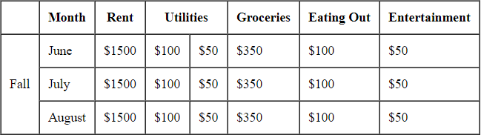
Question :
Colspan attribute : To merge two or more columns into one column it is used.
Rowspan attribute : To merge two or more rows into one row it is used.

Slide 26
Textarea tag :
The <textarea> tag defines a multi-line text input control.
A text area can hold an unlimited number of characters, and the text renders in a fixed-width font (usually Courier).
The size of a text area can be specified by the cols and rows attributes, or even
better; through CSS' height and width properties.

Slide 27
Example :
<textarea name="message" rows="10" cols="30">
The cat was playing in the garden.
</textarea>
<textarea name="message" style="width:200px; height:600px;">
The cat was playing in the garden.
</textarea>

Slide 28
Html Button :
<button type="submit" value="Submit">Submit</button>
The <form> Element :
The HTML
input:
<form>
element defines a form that is used to collect user
Form Elements in Html :
<input name="firstname" type="text">(Input element)
<select name="cars">
<option value="volvo">Volvo</option>
<option value="saab">Saab</option>
<option value="fiat">Fiat</option>
<option value="audi">Audi</option>
</select>(For creating dropdown list)

Slide 29
<textarea> element
<button> element
HTML Input Types :Here are the different input types you can use in HTML:
•
•
•
•
•
•
•
•
•
•
•
•
•
<input type="button">
<input type="checkbox">
<input type="color">
<input type="date">
<input type="datetime-local">
<input type="email">
<input type="file">
<input type="hidden">
<input type="image">
<input type="month">
<input type="number">
<input type="password">
<input type="radio">

Slide 30
•
•
•
•
•
•
•
•
•
<input type="range">
<input type="reset">
<input type="search">
<input type="submit">
<input type="tel">
<input type="text">
<input type="time">
<input type="url">
<input type="week">

Slide 31
Example :
<form>
First name:<br>
<input type="text" name="firstname"><br> Last name:<br>
<input type="text" name="lastname">
</form>

Slide 32
Input attributes :
disabled max maxlength min pattern readonly required size
step value
Specifies that an input field should be disabled
Specifies the maximum value for an input field
Specifies the maximum number of character for an input field Specifies the minimum value for an input field
Specifies a regular expression to check the input value against Specifies that an input field is read only (cannot be changed) Specifies that an input field is required (must be filled out) Specifies the width (in characters) of an input field
Specifies the legal number intervals for an input field Specifies the default value for an input field

Slide 33
CSS Introduction :
CSS stands for Cascading Style Sheets.
CSS describes how HTML elements are to be displayed on screen, paper, or in other media.
CSS saves a lot of work. It can control the layout of multiple web pages all at
once.(Using External Style Sheets).
Latest Version(CSS3).

Slide 34
Including CSS in HTML Documents
You can include CSS in an HTML document in three ways:
Inline styles — Using the style attribute in the HTML start tag.
Internal styles — Using the <style> element in the head section of a document.
External style sheets — Using the <link> element, pointing to an external CSS file.
Note : In external style sheet styles are written using selectors in a file (saved with filename.css)

Slide 35
CSS selectors are used to select the content you want to style. Selectors are the part of CSS rule set. CSS selectors select HTML elements according to its id, class, type, attribute etc.
There are several different types of selectors in CSS.
Element Selector
Id Selector
Class Selector
Universal Selector
Grouping Selector

Slide 36
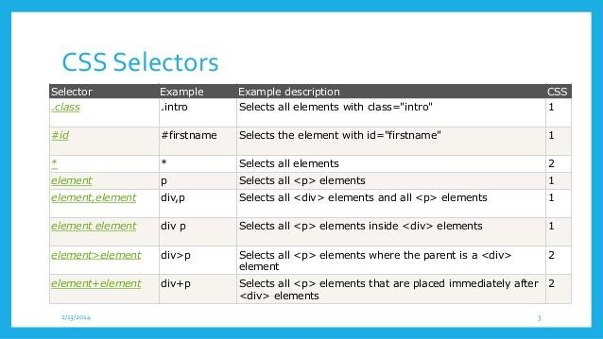

Slide 37
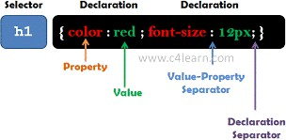
Element Selector Syntax :

Slide 38
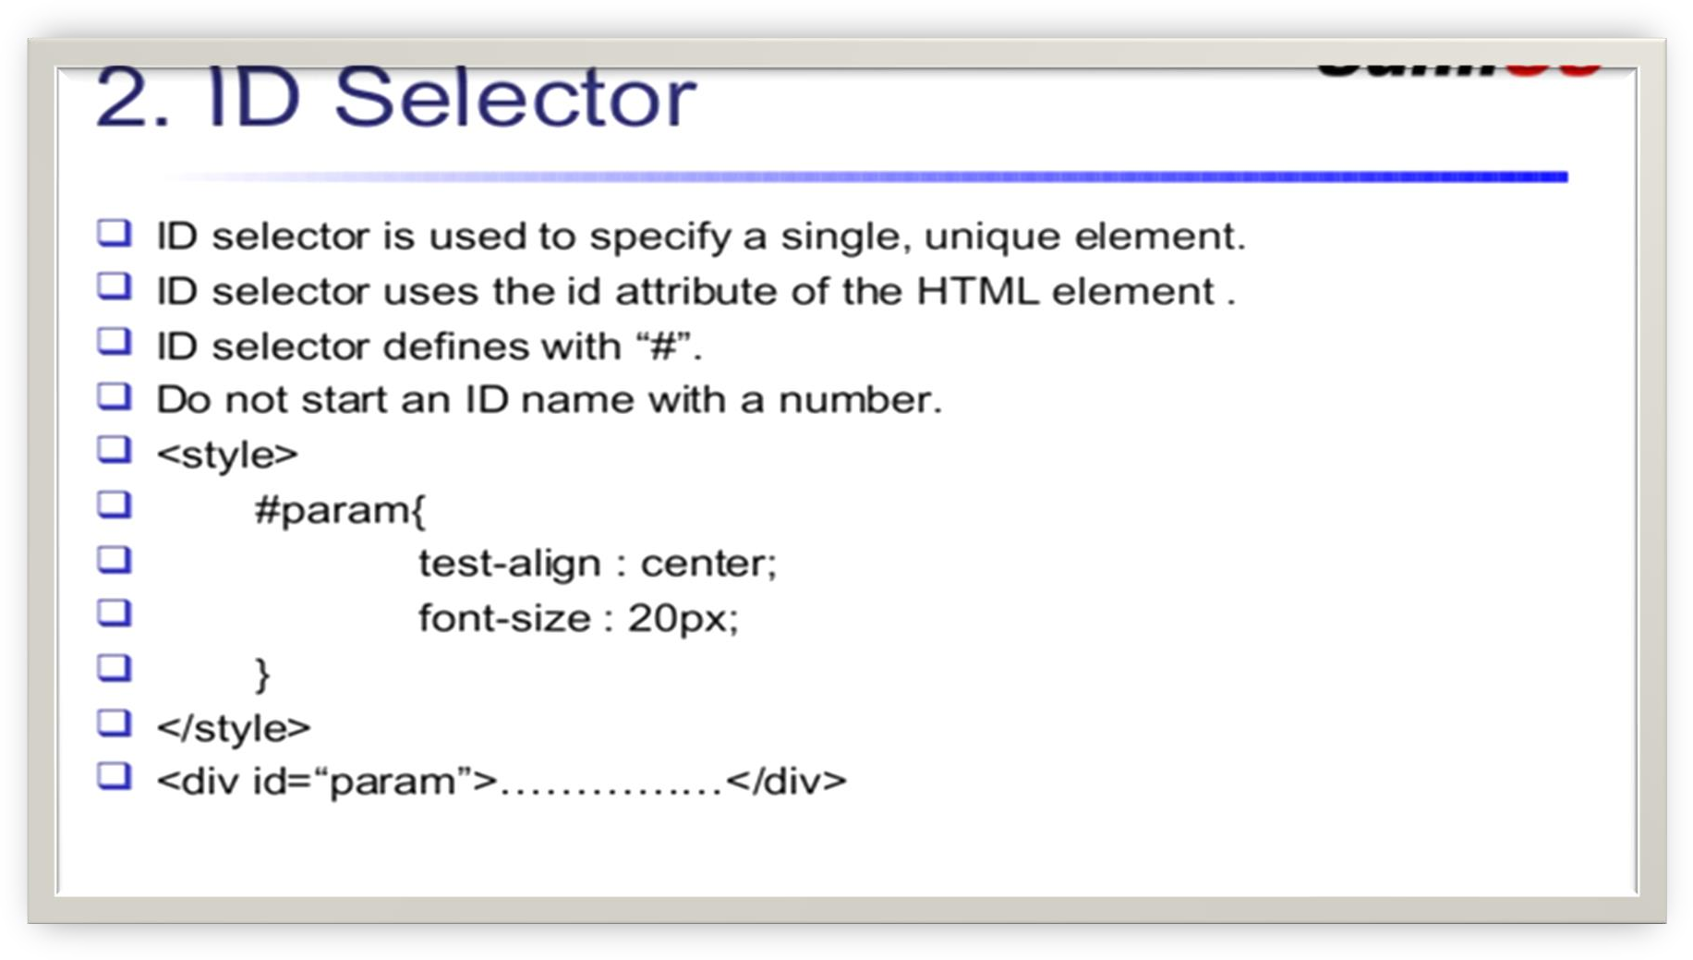

Slide 39
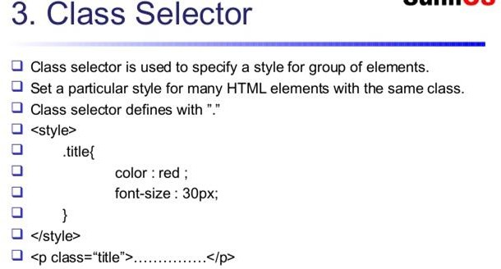

Slide 40
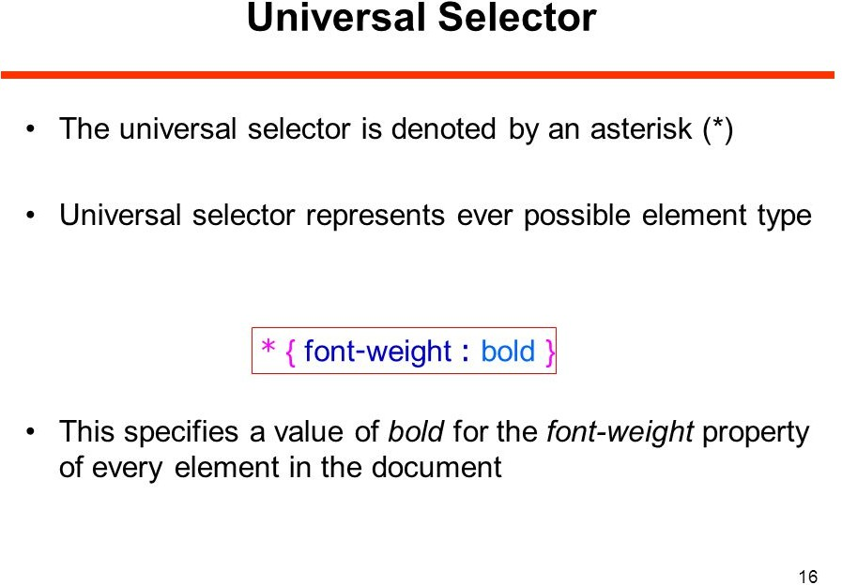

Slide 41
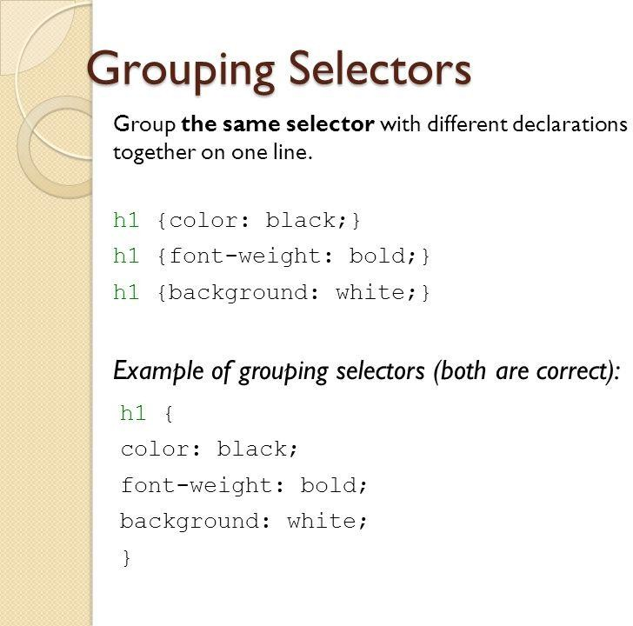

Slide 42
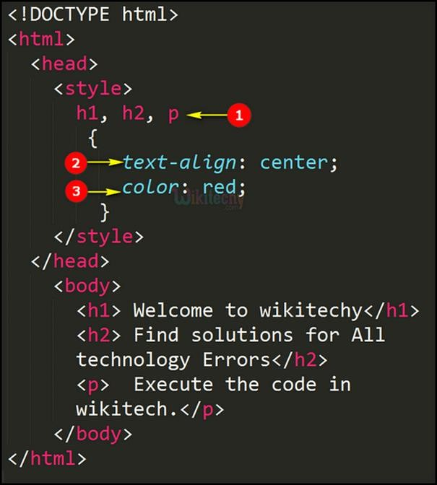

Slide 43
Inline Styles :
Inline styles are used to apply the unique style rules to an element by putting the CSS rules directly into the
start tag. It can be attached to an element using the attribute.
style
The attribute includes a series of CSS property and value pairs. Each "property: value"pair is
style
separated by a semicolon (;), just as you would write into an internal or external style sheets. But it needs to be all in one line i.e. no line break after the semicolon, as shown here:

Slide 44
Example :
<h1 style="color:red; font-size:30px;">This is a heading</h1>
<p style="color:green; font-size:22px;">This is a paragraph.</p>
<div style="color:blue; font-size:14px;">This is some text content.</div>

Slide 45
Embedded Style Sheets
Embedded or internal style sheets only affect the document they are embedded in.
Embedded style sheets are defined in the <head> section of an HTML document using the
<style> element. You can define any number of <style> elements in a HTML document but
they must appear between the
<head>
and tags.
</head>

Slide 46
<!DOCTYPE html>
<html>
<head>
<title>My HTML Document</title>
<style type="text/css">
body { background-color: Yellow; }
p { color: red; }
</style>
</head>
<body>
<h1>This is a heading</h1>
<p>This is a paragraph of text.</p>
</body>
</html>

Slide 47
External Style Sheets
An external style sheet is ideal when the style is applied to many pages of the website.
An external style sheet holds all the style rules in a separate document that you can link from any HTML file on your site. External style sheets are the most flexible because with an external style sheet, you can change the look of an entire website by changing just one file.
Linking External Style Sheets
Before linking, we need to create a style sheet first. Let's open your favorite code editor and create a new file. Now type the
following CSS code inside this file and save it as "style.css".
body {
background: yellow;
font: 18px Arial, sans-serif;
}
h1 {
color: orange;
}

Slide 48
An external style sheet can be linked to an HTML document using the <link> tag. The <link> tag goes inside the <head>
section, as shown in this example:
<!DOCTYPE html>
<html lang="en">
<head>
<title>My HTML Document</title>
<link rel="stylesheet" href="style.css">
</head>
<body>
<h1>This is a heading</h1>
<p>This is a paragraph of text.</p>
</body>
</html>

