Slide 1
A Static Code Analysis Tool for Control System Software
Sreeja S Nair, Raoul Jetley, Anil Nair, Stefan Hauck-Stattelmann, ABB Corporate Research
22nd IEEE International Conference on Software Analysis, Evolution, and Reengineering
3rd March, 2015

Slide 2
A Static Code Analysis Tool for Control System Software
Outline
Introduction to control systems and languages
Challenges and problems to be addressed
Static Code Analysis for Structured Text and Function Block Diagrams
Summary

Slide 3

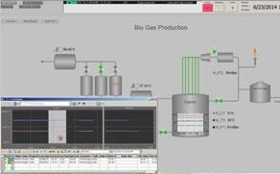
A Static Code Analysis Tool for Control System Software
Introduction
Control Systems
Typically used in industrial settings, manufacturing, power systems, oil & gas refineries, marine operations
Objects in automation engineering system
Topology Data
Geometry
Kinematics
Human Machine Interface
Control Logic
Control logic comprises sequencing, behavior and control
Specified using (proprietary) domain-specific languages.
Consist of a mix of textual and graphical (fourth generation) languages
Notes:
Objects / artifacts stored in different tools, repositories
Can be accessed through APIs

Slide 4
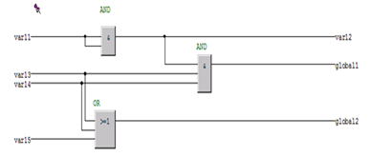

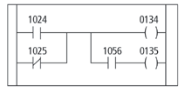
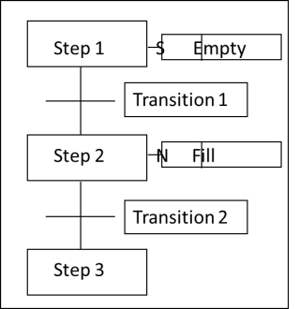
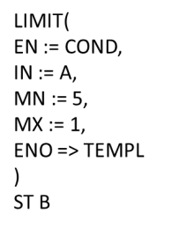
A Static Code Analysis Tool for Control System Software
Control System Languages
Languages used – include textual and graphical languages
Traditionally, defined using LL; over time more abstraction and additional constructs added
Five languages most popular – LL, IL, ST, FBD and SFC
Standards defined – IEC 61131-3, IEC 61499
PLCOpen, AutomationML efforts to standardize languages
FBD
ST
LL
SFC
IL
Notes:
IEC 61499 is an open standard for distributed control and automation.
The base IEC 61131-3 comprises of multiple (five) languages, including both graphical and textual languages
To complicate things further, each platform (by individual vendors) support their own proprietary languages and notations
Need to build a static analysis framework that supports the base languages and is extensible to work with other (3rd party) platforms
In the future, should be able to extend it to other analysis tools as well (e.g., program slicer, impact analysis, code mining, etc.)

Slide 5
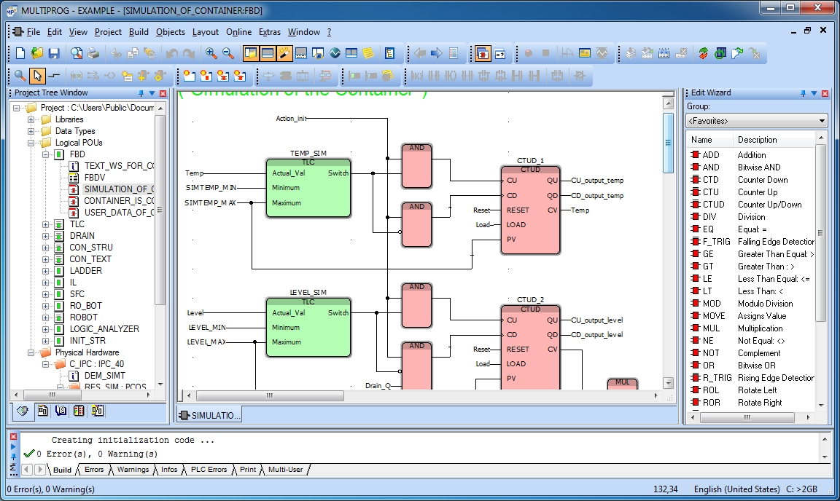
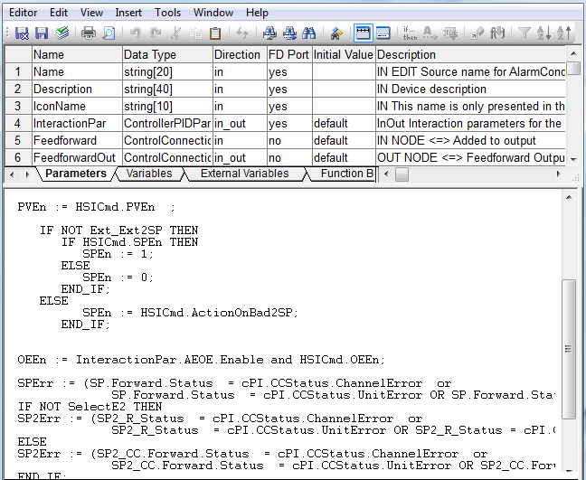
A Static Code Analysis Tool for Control System Software
Domain Specific Challenges
Programs defined using combination of text and diagrams
Interdependencies between different types of Program Organization Units (POUs)
Differing semantics – e.g., Multiple I/O ports as opposed to only one output
Tasks configured to execute applications
Can be run in parallel, synchronously or asynchronously
Nesting of POUs
Rules defined for accessing parent, child POU elements
Execution based on data flow rather than explicit control flow
Determined by data connections, positions of function blocks
Notes:
POU – Program organization Unit – basic executable block for a control system application
Diagrams can be represented in textual format when storing and for compilation/analysis
A POU is executed when the inputs are available
Inside a POU, execution is as per the control flow
Tasks are given importance
The inputs are scanned during each predetermined interval
Access rules defined for accessing variables, functions in parent, child POUs

Slide 6
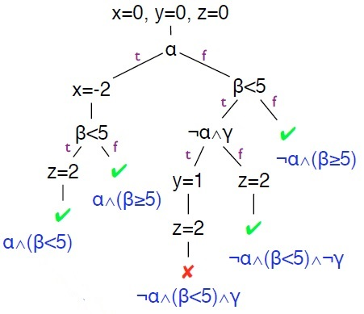
A Static Code Analysis Tool for Control System Software
Static Analysis Tool
Overview
Automated tool to detect potential error conditions and coding compliance violations in Control system applications
Current focus on Structured Text & Function Block Diagrams; other languages to be targeted in future
Benefits
Early detection of errors; Reduction of effort in testing, V&V activities
Conformance to guidelines, coding standards
Analysis Method
Reason about all possible executions of a program
Use symbolic execution to determine if certain formulas are satisfiable
Notes:
Generalize testing by using unknown symbolic variables in evaluation where we track symbolic states.
If execution path depends on unknown, we fork symbolic executor. During symbolic execution, we try to determine if certain formulas are satisfiable (e.g., is a particular program point reachable, is array access A[i] out of bounds?)
Use abstract interpretation to deal with state space explosion problem

Slide 7
A Static Code Analysis Tool for Control System Software
Static Analysis Tool – Checks
Types of checks – DFA-based, semantic checks, syntactic checks
Can be pre-defined or user-defined
Consulted application engineers to collect list of rules
Compliance rules/coding guidelines
All local variables should have a prefix “LV_”
All local variables should have the attribute cold_reset
Runtime error checking
Divide by zero errors
Buffer overflow / underflow (Out of bounds)
Best practices
Nesting level for loops should not be more than 3
Variables used for iteration counting should not be modified in the body of the loop
Notes:
Some of the rules may not be pertinent to static analysis. Others will need to be prioritized and included as part of the rule engine.
HMI-related rules: text boxes should be used rather than vertical lines
Compliance rules
All unused IO channels should be turned off to reduce loading time
Multiple writes to an output variable not allowed
Code blocks should not exceed 100 lines of code (not more than 10 operands)
Best practices
Floating point numbers should not be used as loop counters
The right hand side of a AND or OR operator shall not contain side-effects
Runtime Error Rules
Code Loops
Type checking / Illegal casts
Operations on integers should not result in an overflow
Buffer overflow / underflow (Out of bounds)

Slide 8
A Static Code Analysis Tool for Control System Software
Static Analysis Tools – Analysis Types
Syntax Analysis
AST specifies the structure of the program
AST used with variable specifications
Perform compliance checks
Naming convention
Variable attributes
Variable direction
Semantic Analysis
Performed on AST
Data type compliance checking
Data-flow Analysis
Performed on CFG
Based on
Reaching Definitions
Live Variable Analysis
Interval Analysis
Used to detect possible run-time errors

Slide 9
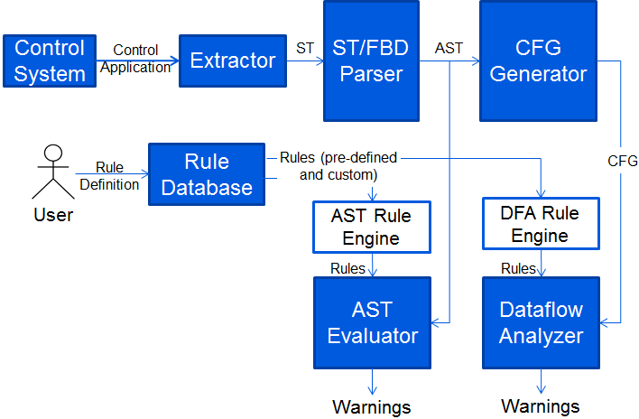
A Static Code Analysis Tool for Control System Software
Static Analysis Tool – Tool overview
Notes:
FBD stored internally (and exported) in ST format
Need to map results back to FBD from ST
Irony used for parsing ST - Parser uses LALR(1) algorithm
LVA – Used to detect unused variables
Reaching Definitions – Used to detect uninitialized variables
Interval analysis – Used to detect invariant if conditions, divide by zero, unreachable code, infinite loops

Slide 10
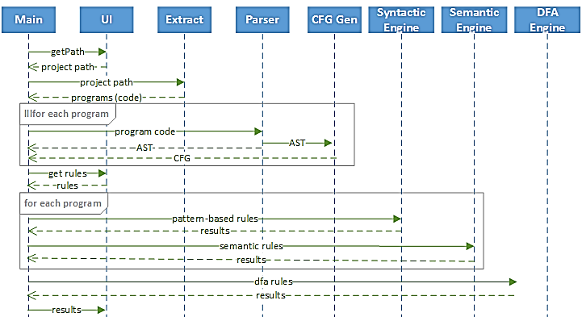
A Static Code Analysis Tool for Control System Software
Static Analysis Tool – Implementation

Slide 11
A Static Code Analysis Tool for Control System Software
Summary
Tool combines data-flow analysis and pattern-matching based analysis for industrial control code
Challenges include addressing problems specific to the domain
Need to improve analysis results by reducing false positives and to encourage usage during control system development

Slide 13
A Static Code Analysis Tool for Control System Software
Algorithm for Basic Block Construction
Starter Statements
First statement of program
First child statement after conditional or unconditional jumps
Statement pointed by the jumps
End of Syntax Tree?
Y
Output List of Basic Blocks
N
Is starter?
Y
Create new block
N
Add statement to current block
Take next statement

Slide 14
A Static Code Analysis Tool for Control System Software
Algorithm for Edge Construction
Basic Block List
Last Statement | Action needed
IF or ELSIF | Make two edges for TRUE and FALSE
FOR or WHILE | Make exit edge to next block
 | Make back edge from last block of loop body to current block
REPEAT | Make back edge from the last block of loop body to current block
 | Make exit edge from last block of loop body to next block
CASE | Make multiple edges for each case line
EXIT | Make edge to next block after the loop body
RETURN | Make edge to the exit block of the program
Make ENTRY, EXIT blocks
Make edge(ENTRY, First Block)
Make edge(current block, next block) using table
End of basic block list?
N
Y
Make edge(last block, EXIT)
List of edges

Slide 15
A Static Code Analysis Tool for Control System Software
Data Flow Analysis
Flow of relevant data in a program
Safe approximation to achieve a level of abstraction
Components
Direction, D
Meet Operator, ^
Domain, V
Transfer Function, F
Boundary Conditions
Initial Conditions
Notes:
Direction – forward or backward
Meet operator – handling joins for conditional statements
Domain – domain of values for variables to be checked
Transfer function – Provides mapping from abstract domain to real domain (includes boundary conditions and initial conditions)

Slide 16
A Static Code Analysis Tool for Control System Software
Forward Data Flow Analysis
Require: Control flow graph
Ensure: IN and OUT of each basic block
1: OUT[ENTRY] = φ
2: for each basic block B do
3: OUT[B] = φ
4: end for
5: while any OUT changes do
6: for each basic block B other than ENTRY do
7: IN[B] = Ʌ_{P a predecessor of B} OUT[P]
8: OUT[B] = f_{B}(IN[B])
9: end for
10: end while
Notes:
Direction – forward or backward
Meet operator – handling joins for conditional statements
Domain – domain of values for variables to be checked
Transfer function – Provides mapping from abstract domain to real domain (includes boundary conditions and initial conditions)

Slide 17
A Static Code Analysis Tool for Control System Software
Backward Data Flow Analysis
Require: Control flow graph
Ensure: IN and OUT of each basic block
1: IN[EXIT] = φ
2: for all basic block B do
3: IN[B] = φ
4: end for
5: while any IN changes do
6: for all basic block B other than EXIT do
7: OUT[B] = Ʌ_{S a successor of B} IN[S]
8: IN[B] = f_{B}(OUT[B])
9: end for
10: end while
Notes:
Direction – forward or backward
Meet operator – handling joins for conditional statements
Domain – domain of values for variables to be checked
Transfer function – Provides mapping from abstract domain to real domain (includes boundary conditions and initial conditions)

Slide 18
A Static Code Analysis Tool for Control System Software
Algorithms
Reaching Definitions
Definitions reaching each program point
Uninitialized Variable
Definition for a particular variable used in a basic block is absent in the incoming definitions to the block
Live Variable Analysis
Variables used in any possible execution path after the program point
Unused Variables
Variable generated in a basic block is not present in the outgoing definitions from the block
Notes:
Direction – forward or backward
Meet operator – handling joins for conditional statements
Domain – domain of values for variables to be checked
Transfer function – Provides mapping from abstract domain to real domain (includes boundary conditions and initial conditions)

Slide 19
A Static Code Analysis Tool for Control System Software
Algorithms
Interval Analysis
Range of values each variable can take at each program point
Division by zero
If the denominator interval contains zero
Array access out of bounds
If the index interval contains values out of the array range
Invariant IF condition
If the range of expression is such that the condition never changes
Infinite loop
If the range of expression is such that the condition is always true
Unreachable code
Condition statements - If the range of expression is such that the condition never changes, so one particular block will be left out
Loop statements – If the range of the expression is such that the expression always evaluates to false
Notes:
Direction – forward or backward
Meet operator – handling joins for conditional statements
Domain – domain of values for variables to be checked
Transfer function – Provides mapping from abstract domain to real domain (includes boundary conditions and initial conditions)

Slide 20
A Static Code Analysis Tool for Control System Software
Reaching Definitions
D - FORWARDS
V - Sets of definitions
^ - ∪
F - gen_{B} ∪ (x - kill_{B})
Boundary condition - OUT[ENTRY] = {}
Initial condition - OUT[B] = {}
Notes:
Direction – forward or backward
Meet operator – handling joins for conditional statements
Domain – domain of values for variables to be checked
Transfer function – Provides mapping from abstract domain to real domain (includes boundary conditions and initial conditions)

Slide 21
A Static Code Analysis Tool for Control System Software
Live Variable Analysis
D - BACKWARDS
V - Sets of variables
^ - ∪
F - use_{B} ∪ (x - def_{B})
Boundary condition - IN[EXIT] = {}
Initial condition - IN[B] = {}
Notes:
Direction – forward or backward
Meet operator – handling joins for conditional statements
Domain – domain of values for variables to be checked
Transfer function – Provides mapping from abstract domain to real domain (includes boundary conditions and initial conditions)

Slide 22
A Static Code Analysis Tool for Control System Software
Interval Analysis
D - FORWARDS
V - Sets of intervals
^ - widening operator, Ѡ
F - evaluate each basic block
Boundary condition - OUT[ENTRY] = maximum possible interval for each variable, Ш
Initial condition - OUT[B] = Ш
Notes:
Direction – forward or backward
Meet operator – handling joins for conditional statements
Domain – domain of values for variables to be checked
Transfer function – Provides mapping from abstract domain to real domain (includes boundary conditions and initial conditions)

Slide 23
A Static Code Analysis Tool for Control System Software
Inter-procedural Analysis
Function calls and Function block calls
Internal State to be preserved for Function Block calls
Calls without code
Assume worst case for return variables
Calls with code
Pass values to parameters
Analyze the function block
Map result from function parameters to variables
Notes:
Direction – forward or backward
Meet operator – handling joins for conditional statements
Domain – domain of values for variables to be checked
Transfer function – Provides mapping from abstract domain to real domain (includes boundary conditions and initial conditions)

Slide 24
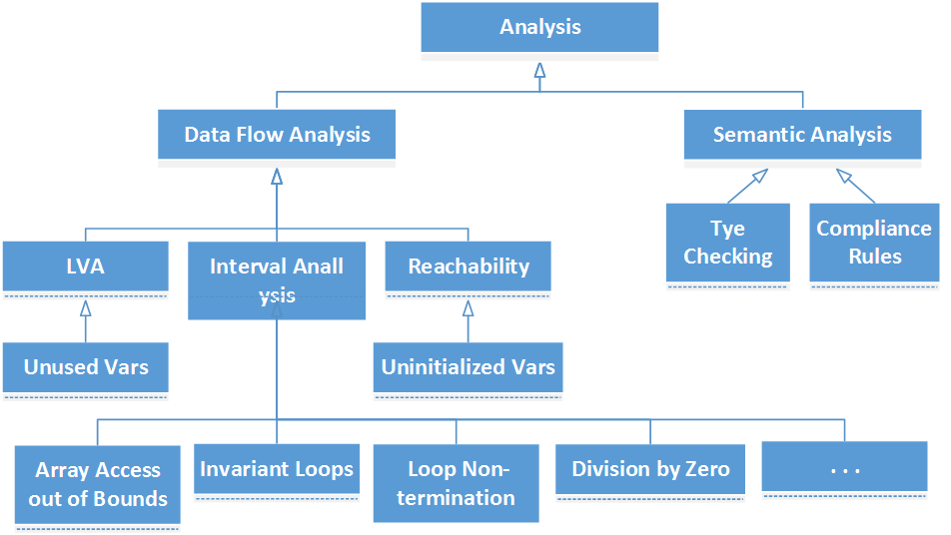
A Static Code Analysis Tool for Control System Software
Class implementation

