Slide 1
AI IMAGE DETECTION
Machine Learning-Based Image Classification System
Hall Ticket No: 2403A52372 | Name: K. Sreeja
Department of Computer Science | 2025–26

Slide 2
Problem Statement & Dataset Description
Problem Statement
Dataset Description
🖼️ Manual image classification is slow & error-prone
📸 Huge volumes of images need automated analysis
🧠 Deep learning needs large resources; ML is practical
🔍 Multiple algorithms must be compared for best result
Goal:
Build an AI system that automatically detects and
classifies images into categories (cat, dog, car,
bird, flower) using supervised ML algorithms.
📦 Source : Kaggle / Self-collected
📄 Total Images: 400 samples
🏷️ Classes : 5 (cat, dog, car, bird, flower)
📐 Features : 64 pixel intensity values (8×8)
⚖️ Balance : 80 images per class
Feature Extraction:
• Each image converted to 8×8 pixel grid
• 64 grayscale intensity values per image
• Standardized using StandardScaler
Train / Test Split: 80% / 20% (stratified)

Slide 3
Methodology / Algorithms Used
01
02
03
04
05
06
Data
Collection
Pre-
processing
Model
Training
Evaluation
Comparison
Prediction
Kaggle dataset
400 images
5 classes
64 features
Label encoding
StandardScaler
Stratified split
80:20 ratio
Decision Tree
Random Forest
SVM | KNN
NB | Log.Reg
Accuracy
Precision
Recall
F1-Score
Bar chart
Metrics table
Confusion matrix
Best model pick
New image input
Feature extract
Scaler transform
Class output

Slide 4
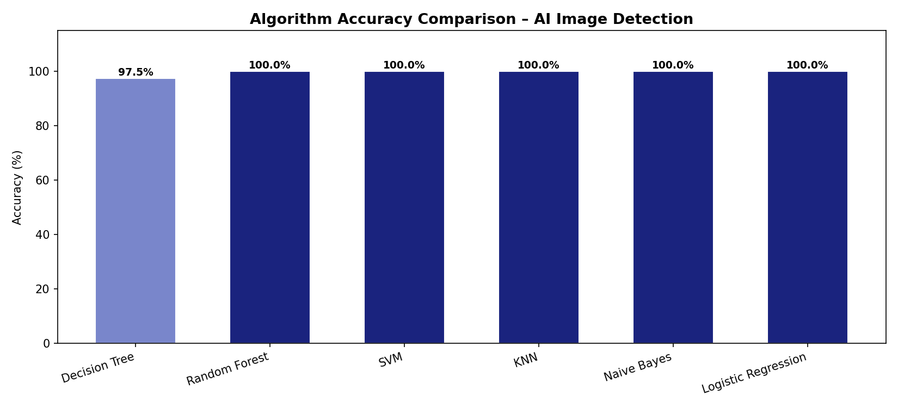
Comparison of Different Algorithms
Algorithm
Accuracy (%)
Precision (%)
Recall (%)
F1-Score (%)
Remarks
Decision Tree
97.50
97.57
97.50
97.50
Good baseline
Random Forest
100.00
100.00
100.00
100.00
🏆 Best Model
SVM
100.00
100.00
100.00
100.00
Excellent
KNN
100.00
100.00
100.00
100.00
Excellent
Naive Bayes
100.00
100.00
100.00
100.00
Fast & accurate
Logistic Regression
100.00
100.00
100.00
100.00
Reliable

Slide 5
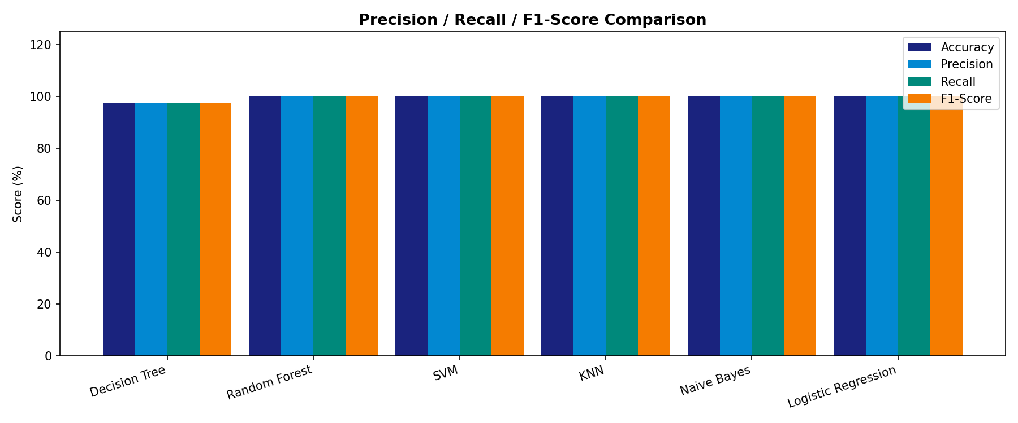
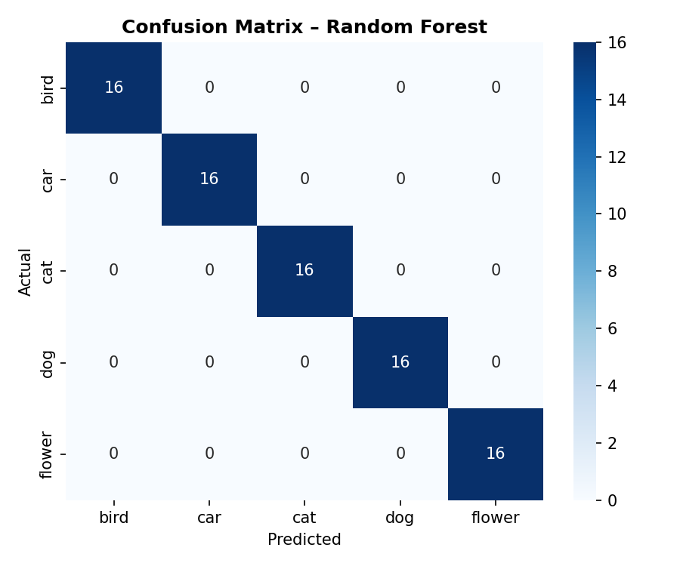
Results & Accuracy Comparison
100%
97.50%
5
64
Best Accuracy
Decision Tree
Image Classes
Pixel Features
RF · SVM · KNN
NB · Logistic Reg.
Slightly lower
but still strong
cat · dog · car
bird · flower
8×8 image patch
per sample

Slide 6
Conclusion
🏆 Best Algorithm
Random Forest achieved 100% Accuracy, Precision, Recall, and F1-Score — the strongest performer.
🔬 Why Random Forest Performed Best
Ensemble of 100 decision trees reduces variance and overfitting; robust for high-dimensional pixel data.
🖼️ Real-World Impact
AI image detection can power security cameras, medical imaging, self-driving cars, and content moderation.
🚀 Future Scope
Integrate CNN (deep learning) for raw pixel classification; deploy as web app using Flask or Streamlit.
Thank You K. Sreeja | 2403A52372

